Slide 1
2
Conceptual Framework for Financial Reporting
LEARNING OBJECTIVES
After studying this chapter, you should be able to:
Describe the usefulness of a conceptual framework.
Describe the FASB’s efforts to construct a conceptual framework.
Understand the objective of financial reporting.
Identify the qualitative characteristics of accounting information.
Define the basic elements of financial statements.
Describe the basic assumptions of accounting.
Explain the application of the basic principles of accounting.
Describe the impact that the cost constraint has on reporting accounting information.

Slide 2
Conceptual Framework
The Need for a Conceptual Framework
To develop a coherent set of standards and rules.
To solve new and emerging practical problems.
LO 1 Describe the usefulness of a conceptual framework.

Slide 3
Conceptual Framework
Question (true or false):
A conceptual framework underlying financial accounting is important because it can lead to consistent standards and it prescribes the nature, function, and limits of financial accounting and financial statements.
True
LO 1 Describe the usefulness of a conceptual framework.

Slide 4
Conceptual Framework
Question (true or false):
A conceptual framework underlying financial accounting is necessary because future accounting practice problems can be solved by reference to the conceptual framework and a formal standard-setting body will not be necessary.
False
LO 1 Describe the usefulness of a conceptual framework.

Slide 5
2
Conceptual Framework for Financial Reporting
LEARNING OBJECTIVES
After studying this chapter, you should be able to:
Describe the usefulness of a conceptual framework.
Describe the FASB’s efforts to construct a conceptual framework.
Understand the objective of financial reporting.
Identify the qualitative characteristics of accounting information.
Define the basic elements of financial statements.
Describe the basic assumptions of accounting.
Explain the application of the basic principles of accounting.
Describe the impact that the cost constraint has on reporting accounting information.

Slide 6
Development of Conceptual Framework
The FASB has issued seven Statements of Financial Accounting Concepts (SFAC) for business enterprises.
SFAC No.1 - Objectives of Financial Reporting (superseded by SFAC No. 8)
SFAC No.2 - Qualitative Characteristics of Accounting Information. (superseded by SFAC No. 8)
SFAC No.3 - Elements of Financial Statements. (superseded by SFAC No. 6)
SFAC No.5 - Recognition and Measurement in Financial Statements.
SFAC No.6 - Elements of Financial Statements (replaces SFAC No. 3).
SFAC No.7 - Using Cash Flow Information and Present Value in Accounting Measurements.
SFAC No.8 - The Objective of General Purpose Financial Reporting and Qualitative Characteristics of Useful Financial Information (replaces SFAC No. 1 and No. 2)
LO 2

Slide 7
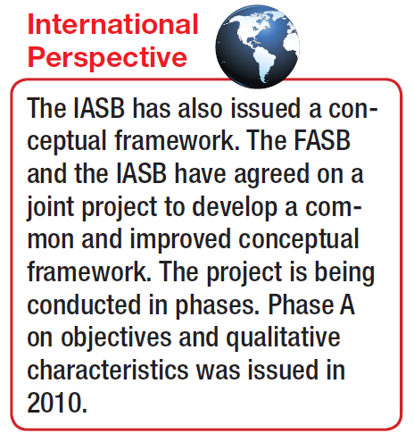
Conceptual Framework
Overview of the Conceptual Framework
First Level = Basic Objectives
Second Level = Qualitative Characteristics and Elements
Third Level = Recognition, Measurement, and Disclosure Concepts.
LO 2 Describe the FASB’s efforts to construct a conceptual framework.

Slide 8
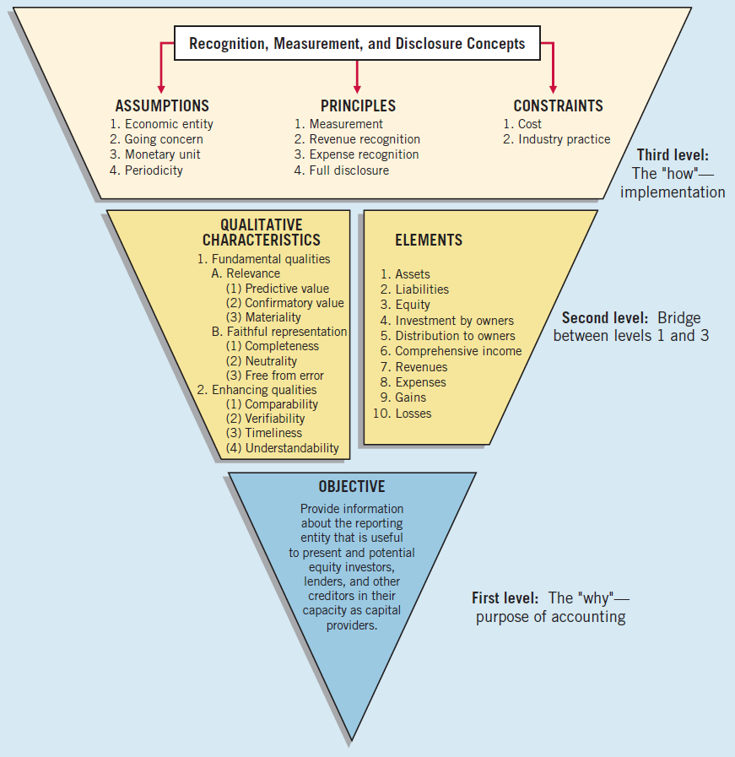
Illustration 2-7
Conceptual Framework for Financial Reporting
LO 4

Slide 9
Conceptual Framework
Question
What are the Statements of Financial Accounting Concepts intended to establish?
Generally accepted accounting principles in financial reporting by business enterprises.
The meaning of “Present fairly in accordance with generally accepted accounting principles.”
The objectives and concepts for use in developing standards of financial accounting and reporting.
The hierarchy of sources of generally accepted accounting principles.
LO 2 Describe the FASB’s efforts to construct a conceptual framework.

Slide 10
2
Conceptual Framework for Financial Reporting
LEARNING OBJECTIVES
After studying this chapter, you should be able to:
Describe the usefulness of a conceptual framework.
Describe the FASB’s efforts to construct a conceptual framework.
Understand the objective of financial reporting.
Identify the qualitative characteristics of accounting information.
Define the basic elements of financial statements.
Describe the basic assumptions of accounting.
Explain the application of the basic principles of accounting.
Describe the impact that the cost constraint has on reporting accounting information.

Slide 11
First Level: Basic Objectives
Objective of financial reporting:
To provide financial information about the reporting entity that is useful to present and potential equity investors, lenders, and other creditors in making decisions about providing resources to the entity.
LO 3 Understand the objectives of financial reporting.

Slide 12
First Level: Basic Objectives
Question
According to the FASB conceptual framework, the objectives of financial reporting for business enterprises are based on?
Generally accepted accounting principles
Reporting on management’s stewardship.
The need for conservatism.
The needs of the users of the information.
LO 3 Understand the objectives of financial reporting.

Slide 13
2
Conceptual Framework for Financial Reporting
LEARNING OBJECTIVES
After studying this chapter, you should be able to:
Describe the usefulness of a conceptual framework.
Describe the FASB’s efforts to construct a conceptual framework.
Understand the objective of financial reporting.
Identify the qualitative characteristics of accounting information.
Define the basic elements of financial statements.
Describe the basic assumptions of accounting.
Explain the application of the basic principles of accounting.
Describe the impact that the cost constraint has on reporting accounting information.

Slide 14
Second Level: Fundamental Concepts
Qualitative Characteristics of Accounting Information
“The FASB identified the qualitative characteristics of accounting information that distinguish better (more useful) information from inferior (less useful) information for decision-making purposes.”
LO 4 Identify the qualitative characteristics of accounting information.

Slide 15
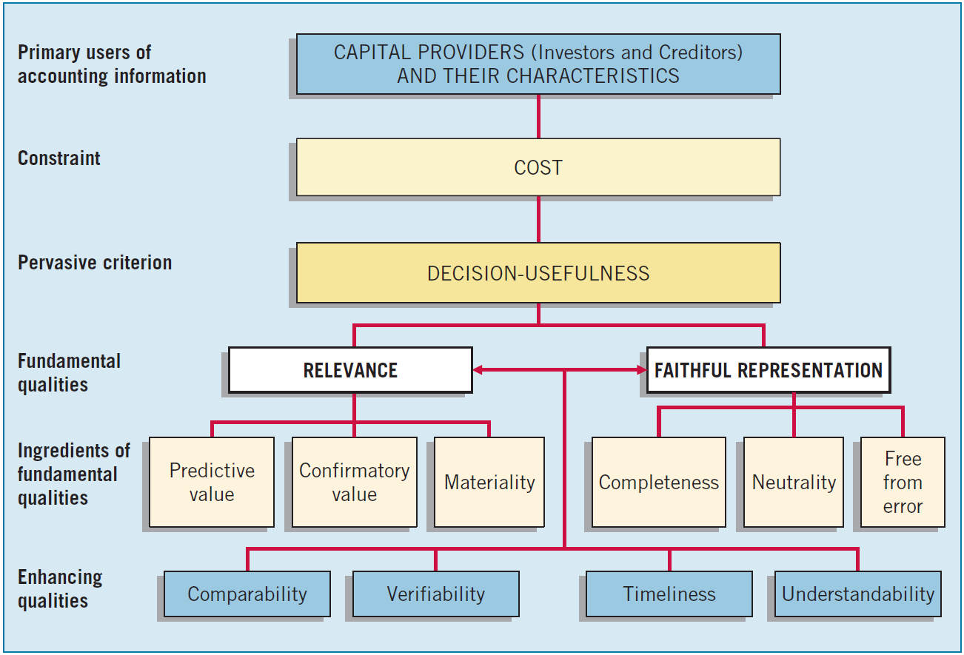
Second Level: Fundamental Concepts
Illustration 2-2
Hierarchy of Accounting Qualities
LO 4 Identify the qualitative characteristics of accounting information.

Slide 16
Relevance
Illustration 2-7
Conceptual Framework for Financial Reporting
LO 4

Slide 17
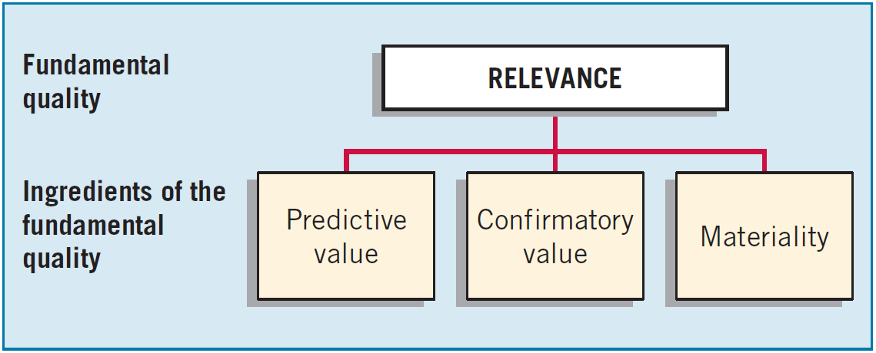
Second Level: Fundamental Concepts
Fundamental Quality—Relevance
To be relevant, accounting information must be capable of making a difference in a decision.
LO 4 Identify the qualitative characteristics of accounting information.

Slide 18
Second Level: Fundamental Concepts
Fundamental Quality—Relevance
Financial information has predictive value if it has value as an input to predictive processes used by investors to form their own expectations about the future.
LO 4 Identify the qualitative characteristics of accounting information.

Slide 19
Second Level: Fundamental Concepts
Fundamental Quality—Relevance
Relevant information also helps users confirm or correct prior expectations.
LO 4 Identify the qualitative characteristics of accounting information.

Slide 20
Second Level: Fundamental Concepts
Fundamental Quality—Relevance
Information is material if omitting it or misstating it could influence decisions that users make on the basis of the reported financial information.
LO 4 Identify the qualitative characteristics of accounting information.

Slide 21
Faithful Representation
Illustration 2-7
Conceptual Framework for Financial Reporting
LO 4

Slide 22
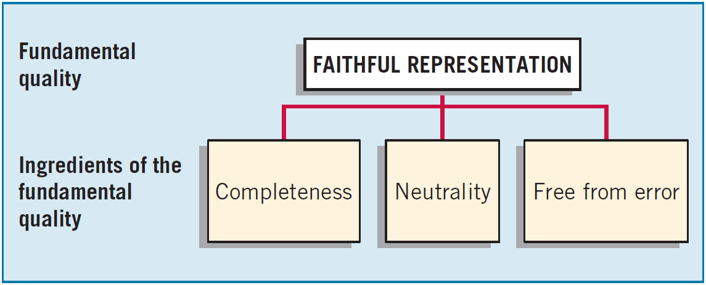
Second Level: Fundamental Concepts
Fundamental Quality—Faithful Representation
Faithful representation means that the numbers and descriptions match what really existed or happened.
LO 4 Identify the qualitative characteristics of accounting information.

Slide 23
Second Level: Fundamental Concepts
Fundamental Quality—Faithful Representation
Completeness means that all the information that is necessary for faithful representation is provided.
LO 4 Identify the qualitative characteristics of accounting information.

Slide 24
Second Level: Fundamental Concepts
Fundamental Quality—Faithful Representation
Neutrality means that a company cannot select information to favor one set of interested parties over another.
LO 4 Identify the qualitative characteristics of accounting information.

Slide 25
Second Level: Fundamental Concepts
Fundamental Quality—Faithful Representation
An information item that is free from error will be a more accurate (faithful) representation of a financial item.
LO 4 Identify the qualitative characteristics of accounting information.

Slide 26
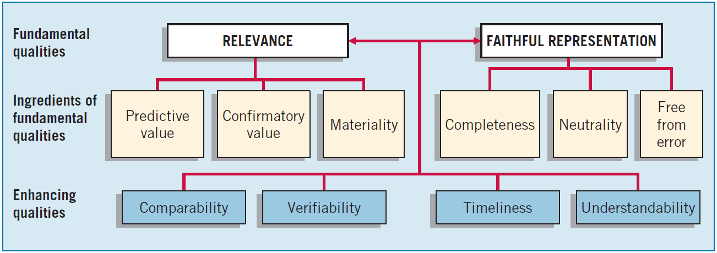
Second Level: Fundamental Concepts
Enhancing Qualities
Information that is measured and reported in a similar manner for different companies is considered comparable.
LO 4 Identify the qualitative characteristics of accounting information.

Slide 27
Second Level: Fundamental Concepts
Enhancing Qualities
Verifiability occurs when independent measurers, using the same methods, obtain similar results.
LO 4 Identify the qualitative characteristics of accounting information.

Slide 28
Second Level: Fundamental Concepts
Enhancing Qualities
Timeliness means having information available to decision-makers before it loses its capacity to influence decisions.
LO 4 Identify the qualitative characteristics of accounting information.

Slide 29
Second Level: Fundamental Concepts
Enhancing Qualities
Understandability is the quality of information that lets reasonably informed users see its significance.
LO 4 Identify the qualitative characteristics of accounting information.

Slide 30
2
Conceptual Framework for Financial Reporting
LEARNING OBJECTIVES
After studying this chapter, you should be able to:
Describe the usefulness of a conceptual framework.
Describe the FASB’s efforts to construct a conceptual framework.
Understand the objective of financial reporting.
Identify the qualitative characteristics of accounting information.
Define the basic elements of financial statements.
Describe the basic assumptions of accounting.
Explain the application of the basic principles of accounting.
Describe the impact that the cost constraint has on reporting accounting information.

Slide 31
Basic Elements
Illustration 2-7
Conceptual Framework for Financial Reporting
LO 5

Slide 32
Second Level: Basic Elements
Concepts Statement No. 6 defines ten interrelated elements that relate to measuring the performance and financial status of a business enterprise.
“Moment in Time”
“Period of Time”
Assets
Liabilities
Equity
Investment by owners
Distribution to owners
Comprehensive income
Revenue
Expenses
Gains
Losses
LO 5 Define the basic elements of financial statements.

Slide 33
Second Level: Basic Elements
Question
According to the FASB conceptual framework, an entity’s revenue may result from
A decrease in an asset from primary operations.
An increase in an asset from incidental transactions.
An increase in a liability from incidental transactions.
A decrease in a liability from primary operations.
LO 5 Define the basic elements of financial statements.

Slide 34
2
Conceptual Framework for Financial Reporting
LEARNING OBJECTIVES
After studying this chapter, you should be able to:
Describe the usefulness of a conceptual framework.
Describe the FASB’s efforts to construct a conceptual framework.
Understand the objective of financial reporting.
Identify the qualitative characteristics of accounting information.
Define the basic elements of financial statements.
Describe the basic assumptions of accounting.
Explain the application of the basic principles of accounting.
Describe the impact that the cost constraint has on reporting accounting information.

Slide 35
Third Level: Recognition and Measurement
The FASB sets forth most of these concepts in its Statement of Financial Accounting Concepts No. 5, “Recognition and Measurement in Financial Statements of Business Enterprises.”
Illustration 2-7
Conceptual Framework for Financial Reporting
LO 6

Slide 36
Third Level: Basic Assumptions
Economic Entity – company keeps its activity separate from its owners and other businesses.
Going Concern - company to last long enough to fulfill objectives and commitments.
Monetary Unit - money is the common denominator.
Periodicity - company can divide its economic activities into time periods.
LO 6 Describe the basic assumptions of accounting.

Slide 37
Third Level: Basic Assumptions
Illustration: Identify which basic assumption of accounting is best described in each item below.
The economic activities of KC Corporation are divided into 12-month periods for the purpose of issuing annual reports.
(b) Solectron Corporation, Inc. does not adjust amounts in its financial statements for the effects of inflation.
(c) Walgreen Co. reports current and noncurrent classifications in its balance sheet.
(d) The economic activities of General Electric and its subsidiaries are merged for accounting and reporting purposes.
Periodicity
Monetary
Unit
Going Concern
Economic
Entity
LO 6 Describe the basic assumptions of accounting.

Slide 38
2
Conceptual Framework for Financial Reporting
LEARNING OBJECTIVES
After studying this chapter, you should be able to:
Describe the usefulness of a conceptual framework.
Describe the FASB’s efforts to construct a conceptual framework.
Understand the objective of financial reporting.
Identify the qualitative characteristics of accounting information.
Define the basic elements of financial statements.
Describe the basic assumptions of accounting.
Explain the application of the basic principles of accounting.
Describe the impact that the cost constraint has on reporting accounting information.

Slide 39
Third Level: Basic Principles
Measurement Principle – The most commonly used measurements are based on historical cost and fair value.
Issues:
Historical cost provides a reliable benchmark for measuring historical trends.
Fair value information may be more useful.
Recently the FASB has taken the step of giving companies the option to use fair value as the basis for measurement of financial assets and financial liabilities.
Reporting of fair value information is increasing.
LO 7 Explain the application of the basic principles of accounting.

Slide 40
Third Level: Basic Principles
Revenue Recognition - requires that companies recognize revenue in the accounting period in which the performance obligation is satisfied.
Expense Recognition - “Let the expense follow the revenues.”
Illustration 2-6 Expense Recognition
LO 7 Explain the application of the basic principles of accounting.

Slide 41
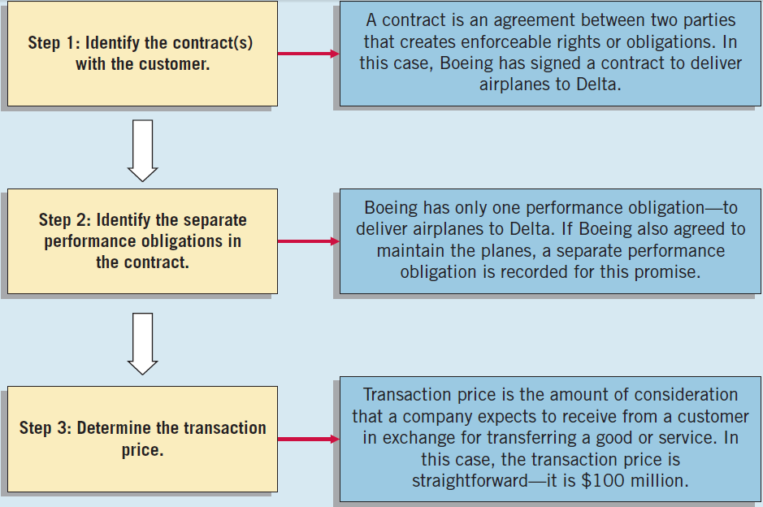
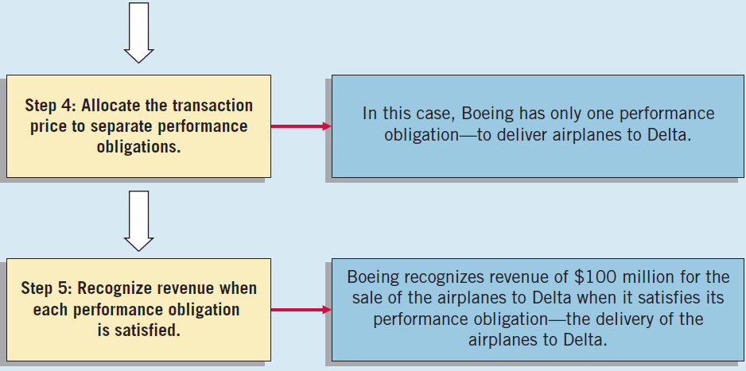
Third Level: Basic Principles
Illustration: Assume the Boeing Corporation signs a contract to sell airplanes to Delta Air Lines for $100 million. To determine when to recognize revenue, use the five steps for revenue recognition shown at right.
Illustration 2-5

Slide 42
Third Level: Basic Principles
Full Disclosure – providing information that is of sufficient importance to influence the judgment and decisions of an informed user.
Provided through:
Financial Statements
Notes to the Financial Statements
Supplementary information
LO 7 Explain the application of the basic principles of accounting.

Slide 43
Third Level: Basic Principles
Illustration: Identify which basic principle of accounting is best described in each item below.
(a) KC Corporation reports revenue in its income statement when it is earned instead of when the cash is collected.
(b) Yahoo, Inc. recognizes depreciation expense for a machine over the 2-year period during which that machine helps the company earn revenue.
(c) Oracle Corporation reports information about pending lawsuits in the notes to its financial statements.
(d) Eastman Kodak Company reports land on its balance sheet at the amount paid to acquire it, even though the estimated fair market value is greater.
Revenue
Recognition
Expense
Recognition
Full
Disclosure
Measurement
LO 7 Explain the application of the basic principles of accounting.

Slide 44
2
Conceptual Framework for Financial Reporting
LEARNING OBJECTIVES
After studying this chapter, you should be able to:
Describe the usefulness of a conceptual framework.
Describe the FASB’s efforts to construct a conceptual framework.
Understand the objective of financial reporting.
Identify the qualitative characteristics of accounting information.
Define the basic elements of financial statements.
Describe the basic assumptions of accounting.
Explain the application of the basic principles of accounting.
Describe the impact that the cost constraint has on reporting accounting information.

Slide 45
Third Level: Constraints
Cost Constraint – cost of providing information must be weighed against the benefits that can be derived from using it.
Illustration: The following two situations represent applications of the cost constraint.
Rafael Corporation discloses fair value information on its loans because it already gathers this information internally.
Willis Company does not disclose any information in the notes to the financial statements unless the value of the information to users exceeds the expense of gathering it.
LO 8 Describe the impact that the cost constraint has on reporting accounting information.

Slide 46
Summary of the Structure
Illustration 2-7
Conceptual Framework for Financial Reporting

Slide 47
RELEVANT FACTS
Similarities
In 2010, the IASB and FASB completed the first phase of a jointly created conceptual framework. In this first phase, they agreed on the objective of financial reporting and a common set of desired qualitative characteristics.
The existing conceptual frameworks underlying GAAP and IFRS are very similar.
The converged framework should be a single document, unlike the two conceptual frameworks that presently exist; it is unlikely that the basic structure related to the concepts will change.
LO 9 Compare the conceptual frameworks underlying GAAP and IFRS.

Slide 48
RELEVANT FACTS
Both the IASB and FASB have similar measurement principles, based on historical cost and fair value. In 2011, the Boards issued a converged standard fair value measurement so that the definition of fair value, measurement techniques, and disclosures are the same between GAAP and IFRS when fair value is used in financial statements.
Differences
Although both GAAP and IFRS are increasing the use of fair value to report assets, at this point IFRS has adopted it more broadly. As examples, under IFRS companies can apply fair value to property, plant, and equipment; natural resources; and in some cases intangible assets.
LO 9 Compare the conceptual frameworks underlying GAAP and IFRS.

Slide 49
RELEVANT FACTS
GAAP has a concept statement to guide estimation of fair values when market-related data is not available (Statement of Financial Accounting Concepts No. 7, “Using Cash Flow Information and Present Value in Accounting”). The IASB is considering a proposal to provide expanded guidance on estimating fair values.
The monetary unit assumption is part of each framework. However, the unit of measure will vary depending on the currency used in the country in which the company is incorporated.
The economic entity assumption is also part of each framework although some cultural differences result in differences in its application. For example, in Japan many companies have formed alliances that are so strong that they act similar to related corporate divisions although they are not actually part of the same company.
LO 9

Slide 50
ABOUT THE NUMBERS
Financial Statement Elements
While the conceptual framework that underlies IFRS is very similar to that used to develop GAAP, the elements identified and their definitions under IFRS are different. The IASB elements and their definitions are as follows.
Assets. A resource controlled by the entity as a result of past events and from which future economic benefits are expected to flow to the entity.
Liabilities. A present obligation of the entity arising from past events, the settlement of which is expected to result in an outflow from the entity of resources embodying economic benefits. Liabilities may be legally enforceable via a contract or law, but need not be, i.e., they can arise due to normal business practice or customs.
LO 9 Compare the conceptual frameworks underlying GAAP and IFRS.

Slide 51
ABOUT THE NUMBERS
Financial Statement Elements
While the conceptual framework that underlies IFRS is very similar to that used to develop GAAP, the elements identified and their definitions under IFRS are different. The IASB elements and their definitions are as follows.
Equity. A residual interest in the assets of the entity after deducting all its liabilities.
Income. Increases in economic benefits that result in increases in equity (other than those related to contributions from shareholders). Income includes both revenues (resulting from ordinary activities) and gains.
Expenses. Decreases in economic benefits that result in decreases in equity (other than those related to distributions to shareholders). Expenses includes losses that are not the result of ordinary activities.
LO 9

Slide 52
ON THE HORIZON
The IASB and the FASB face a difficult task in attempting to update, modify, and complete a converged conceptual framework. There are many difficult issues. For example: How do we trade off characteristics such as highly relevant information that is difficult to verify? How do we define control when we are developing a definition of an asset? Is a liability the future sacrifice itself or the obligation to make the sacrifice? Should a single measurement method, such as historical cost or fair value, be used, or does it depend on whether it is an asset or liability that is being measured? We are optimistic that the new document will be a significant improvement over its predecessors and will lead to principles-based standards that help users of the financial statements make better decisions.
LO 9 Compare the conceptual frameworks underlying GAAP and IFRS.

Slide 53
IFRS SELF-TEST QUESTION
Which of the following statements about the IASB and FASB conceptual frameworks is not correct?
The IASB conceptual framework does not identify the element comprehensive income.
The existing IASB and FASB conceptual frameworks are organized in similar ways.
The FASB and IASB agree that the objective of financial reporting is to provide useful information to investors and creditors.
IFRS does not allow use of fair value as a measurement basis.
LO 9

Slide 54
IFRS SELF-TEST QUESTION
Which of the following statements is false?
The monetary unit assumption is used under IFRS.
Under IFRS, companies may use fair value for property, plant, and equipment.
The FASB and IASB are working on a joint conceptual framework project.
Under IFRS, there are the same number of financial statement elements as in GAAP.
LO 9 Compare the conceptual frameworks underlying GAAP and IFRS.

Slide 55
IFRS SELF-TEST QUESTION
The issues that the FASB and IASB must address in developing a common conceptual framework include all of the following except:
Should the characteristic of relevance be traded-off in favor of information that is verifiable?
Should a single measurement method be used?
Should the common framework lead to standards that are principles-based or rules-based?
Should the role of financial reporting focus on stewardship as well as providing information to assist users in decision-making?
LO 9

