Slide 1
3
The Accounting
Information System
Intermediate Accounting
Kieso, Weygandt, and Warfield

Slide 2
Learning Objectives
Understand basic accounting terminology.
Explain double-entry rules.
Identify steps in the accounting cycle.
Record transactions in journals, post to ledger accounts, and prepare a trial balance.
Explain the reasons for preparing adjusting entries.
Prepare financial statement from the adjusted trial balance.
Prepare closing entries.

Slide 3
Accounting Information System
Accounting Information System (AIS)
Collects and processes transaction data.
Disseminates the information to interested parties.

Slide 4
Accounting Information System
Helps management answer such questions as:
How much and what kind of debt is outstanding?
Were sales higher this period than last?
What assets do we have?
What were our cash inflows and outflows?
Did we make a profit last period?
Are any of our product lines or divisions operating at a loss?
Can we safely increase our dividends to stockholders?
Is our rate of return on net assets increasing?

Slide 5
Accounting Information System
Basic Terminology
Event
Transaction
Account
Real Account
Nominal Account
Ledger
Journal
Posting
Trial Balance
Adjusting Entries
Financial Statements
Closing Entries
LO 1 Understand basic accounting terminology.

Slide 6
Accounting Information System
Debits and Credits
An Account shows the effect of transactions on a given asset, liability, equity, revenue, or expense account.
Double-entry accounting system (two-sided effect).
Recording done by debiting at least one account and crediting another.
DEBITS must equal CREDITS.
LO 2 Explain double-entry rules.

Slide 7
Debits and Credits
An arrangement that shows the effect of transactions on an account.
Debit = “Left”
Credit = “Right”
Account
An Account can be illustrated in a T-Account form.
LO 2 Explain double-entry rules.

Slide 8
Debits and Credits
If Debit entries are greater than Credit entries, the account will have a debit balance.
Transaction #1
$10,000
$3,000
Transaction #2
Transaction #3
8,000
Balance
$15,000
LO 2 Explain double-entry rules.

Slide 9
Debits and Credits
If Credit entries are greater than Debit entries, the account will have a credit balance.
Transaction #1
$10,000
$3,000
Transaction #2
8,000
Transaction #3
Balance
$1,000
LO 2 Explain double-entry rules.

Slide 10
Debits and Credits Summary
Normal Balance Debit
Normal Balance Credit
LO 2 Explain double-entry rules.

Slide 11
Debits and Credits Summary
Balance Sheet Income Statement
Asset
Liability
+
-
=
Equity
Revenue
Expense
=
Debit
Credit
LO 2 Explain double-entry rules.

Slide 12
The Accounting Equation
Relationship among the assets, liabilities and stockholders’ equity of a business:
Illustration 3-3
The equation must be in balance after every transaction. For every Debit there must be a Credit.
LO 2 Explain double-entry rules.

Slide 13
Double-Entry System Illustration
Owners invest $40,000 in exchange for common stock.
Assets
Liabilities
Stockholders’ Equity
=
+
+ 40,000
+ 40,000
LO 2 Explain double-entry rules.

Slide 14
Double-Entry System Illustration
2. Disburse $600 cash for secretarial wages.
Assets
Liabilities
Stockholders’ Equity
=
+
- 600
- 600 (expense)
LO 2 Explain double-entry rules.

Slide 15
Double-Entry System Illustration
3. Purchase office equipment priced at $5,200, giving a 10 percent promissory note in exchange.
Assets
Liabilities
Stockholders’ Equity
=
+
+ 5,200
+ 5,200
LO 2 Explain double-entry rules.

Slide 16
Double-Entry System Illustration
4. Received $4,000 cash for services rendered.
Assets
Liabilities
Stockholders’ Equity
=
+
+ 4,000
+ 4,000 (revenue)
LO 2 Explain double-entry rules.

Slide 17
Double-Entry System Illustration
5. Pay off a short-term liability of $7,000.
Assets
Liabilities
Stockholders’ Equity
=
+
- 7,000
- 7,000
LO 2 Explain double-entry rules.

Slide 18
Double-Entry System Illustration
6. Declared a cash dividend of $5,000.
Assets
Liabilities
Stockholders’ Equity
=
+
+ 5,000
- 5,000
LO 2 Explain double-entry rules.

Slide 19
Double-Entry System Illustration
7. Convert a long-term liability of $80,000 into common stock.
Assets
Liabilities
Stockholders’ Equity
=
+
- 80,000
+ 80,000
LO 2 Explain double-entry rules.

Slide 20
Double-Entry System Illustration
8. Pay cash of $16,000 for a delivery van.
Assets
Liabilities
Stockholders’ Equity
=
+
- 16,000
+ 16,000
Note that the accounting equation equality is maintained after recording each transaction.
LO 2 Explain double-entry rules.

Slide 21
Financial Statements and Ownership Structure
Ownership structure dictates the types of accounts that are part of the equity section.
Proprietorship or Partnership
Corporation
Capital Account
Drawing Account
Common Stock
Additional Paid-in Capital
Dividends Declared
Retained Earnings
LO 2 Explain double-entry rules.

Slide 22
Financial Statements and Ownership Structure
Balance Sheet
Illustration 3-4
Stockholders’ Equity
Common Stock
(Investment by stockholders)
Retained Earnings
(Net income retained in business)
Dividends
Net income or Net loss (Revenues less expenses)
Income Statement
Statement of Retained Earnings
LO 2 Explain double-entry rules.

Slide 23
The Accounting Cycle
Illustration 3-6
Transactions
9. Reversing entries
1. Journalization
8. Post-closing trail balance
2. Posting
7. Closing entries
3. Trial balance
6. Financial Statements
Work Sheet
4. Adjustments
5. Adjusted trial balance
LO 3 Identify steps in the accounting cycle.

Slide 24
Identify and Recording Transactions
What to Record?
FASB states, “transactions and other events and circumstances that affect a business enterprise.”
Types of Events:
External – between a business and its environment.
Internal – event occurring entirely within a business.
LO 3 Identify steps in the accounting cycle.

Slide 25
1. Journalizing
General Journal – a chronological record of transactions. Journal Entries are recorded in the journal.
September 1: Stockholders invested $15,000 cash in the corporation in exchange for shares of stock.
Illustration 3-7
LO 4 Record transactions in journals, post to ledger accounts, and prepare a trial balance.

Slide 26
2. Posting
Posting – the process of transferring amounts from the journal to the ledger accounts.
Illustration 3-7
Illustration 3-8
LO 4 Record transactions in journals, post to ledger accounts, and prepare a trial balance.

Slide 27
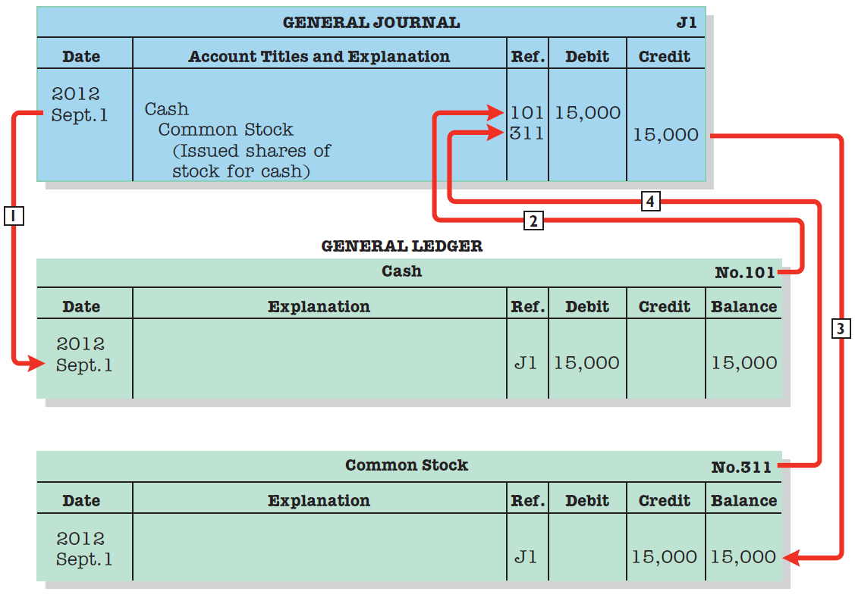
2. Posting
Posting – Transferring amounts from journal to ledger.
Illustration 3-8
LO 4

Slide 28
2. Posting
Expanded Example
The purpose of transaction analysis is
to identify the type of account involved, and
to determine whether a debit or a credit is required.
Keep in mind that every journal entry affects one or more of the following items: assets, liabilities, stockholders’ equity, revenues, or expense.
LO 4 Record transactions in journals, post to ledger accounts, and prepare a trial balance.

Slide 29
2. Posting
1. October 1: Stockholders invest $100,000 cash in an advertising venture to be known as Pioneer Advertising Agency Inc.
Oct. 1
Cash
100,000
Common stock
100,000
Cash
Common Stock
Debit
Credit
Debit
Credit
100,000
100,000
LO 4 Record transactions in journals, post to ledger accounts, and prepare a trial balance.

Slide 30
2. Posting
2. October 1: Pioneer Advertising purchases office equipment costing $50,000 by signing a 3-month, 12%, $50,000 note payable.
Oct. 1
Equipment
50,000
Notes payable
50,000
Equipment
Notes Payable
Debit
Credit
Debit
Credit
50,000
50,000
LO 4 Record transactions in journals, post to ledger accounts, and prepare a trial balance.

Slide 31
2. Posting
3. October 2: Pioneer Advertising receives a $12,000 cash advance from KC, a client, for advertising services that are expected to be completed by December 31.
Oct. 2
Cash
12,000
Unearned service revenue
12,000
Cash
Unearned Service Revenue
Debit
Credit
Debit
Credit
100,000
12,000
12,000
LO 4 Record transactions in journals, post to ledger accounts, and prepare a trial balance.

Slide 32
2. Posting
4. October 3: Pioneer Advertising pays $9,000 office rent, in cash, for October.
Oct. 3
Rent expense
9,000
Cash
9,000
Cash
Rent Expense
Debit
Credit
Debit
Credit
100,000
9,000
9,000
12,000
LO 4 Record transactions in journals, post to ledger accounts, and prepare a trial balance.

Slide 33
2. Posting
5. October 4: Pioneer Advertising pays $6,000 for a one-year insurance policy that will expire next year on September 30.
Oct. 4
Prepaid insurance
6,000
Cash
6,000
Cash
Prepaid Insurance
Debit
Credit
Debit
Credit
100,000
9,000
6,000
12,000
6,000
LO 4 Record transactions in journals, post to ledger accounts, and prepare a trial balance.

Slide 34
2. Posting
6. October 5: Pioneer Advertising purchases, for $25,000 on account, an estimated 3-month supply of advertising materials from Aero Supply.
Oct. 5
Supplies
25,000
Accounts payable
25,000
Supplies
Accounts Payable
Debit
Credit
Debit
Credit
25,000
25,000
LO 4 Record transactions in journals, post to ledger accounts, and prepare a trial balance.

Slide 35
2. Posting
7. October 9: Pioneer Advertising signs a contract with a local newspaper for advertising inserts (flyers) to be distributed starting the last Sunday in November. Pioneer will start work on the content of the flyers in November. Payment of $7,000 is due following delivery of the Sunday papers containing the flyers.
LO 4 Record transactions in journals, post to ledger accounts, and prepare a trial balance.

Slide 36
2. Posting
8. October 20: Pioneer Advertising’s board of directors declares and pays a $5,000 cash dividend to stockholders.
Oct. 20
Dividends
5,000
Cash
5,000
Cash
Dividends
Debit
Credit
Debit
Credit
100,000
9,000
5,000
12,000
6,000
5,000
LO 4 Record transactions in journals, post to ledger accounts, and prepare a trial balance.

Slide 37
2. Posting
9. October 26: Employees are paid every four weeks. The total payroll is $2,000 per day. The pay period ended on Friday, October 26, with salaries of $40,000 being paid.
Oct. 26
Salaries expense
40,000
Cash
40,000
Cash
Salaries Expense
Debit
Credit
Debit
Credit
100,000
9,000
40,000
12,000
6,000
5,000
40,000
LO 4 Record transactions in journals, post to ledger accounts, and prepare a trial balance.

Slide 38
2. Posting
10. October 31: Pioneer Advertising receives $28,000 in cash and bills Copa Company $72,000 for advertising services of $100,000 provided in October.
Oct. 31
Cash
28,000
Accounts receivable
72,000
Service revenue
100,000
Cash
Accounts Receivable
Service Revenue
Debit
Credit
Debit
Credit
Debit
Credit
100,000
9,000
72,000
100,000
12,000
6,000
28,000
5,000
40,000
80,000

Slide 39
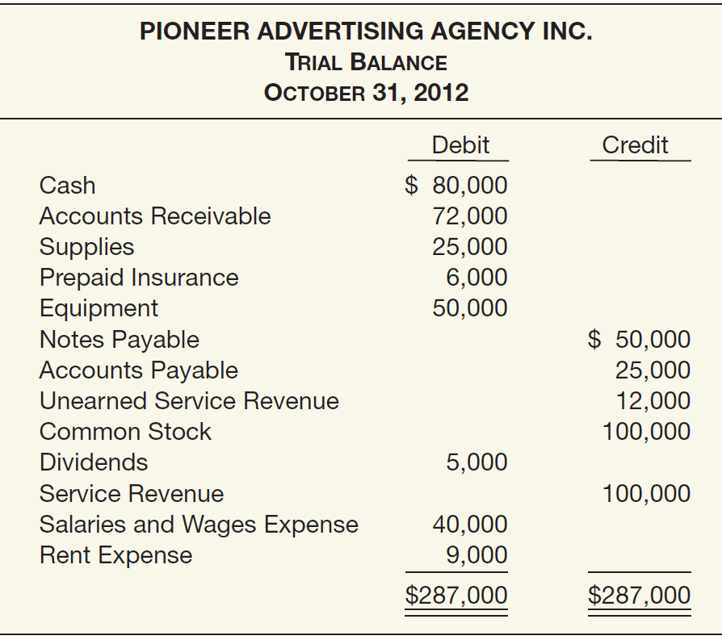
3. Trial Balance
Illustration 3-19
Trial Balance – A list of each account and its balance; used to prove equality of debit and credit balances.
LO 4

Slide 40
4. Adjusting Entries
Makes it possible to:
Report on the statement of financial position the appropriate assets, liabilities, and equity at the statement date.
Report on the income statement the proper revenues and expenses for the period.
Revenues are recorded in the period in which they are earned.
Expenses are recognized in the period in which they are incurred.
LO 5 Explain the reasons for preparing adjusting entries.

Slide 41
Types of Adjusting Entries
Illustration 3-20
Prepayments
Accruals
1. Prepaid Expenses. Expenses paid in cash and recorded as assets before they are used or consumed.
3. Accrued Revenues. Revenues earned but not yet received in cash or recorded.
2. Unearned Revenues. Revenues received in cash and recorded as liabilities before they are earned.
4. Accrued Expenses. Expenses incurred but not yet paid in cash or recorded.
LO 5 Explain the reasons for preparing adjusting entries.

Slide 42
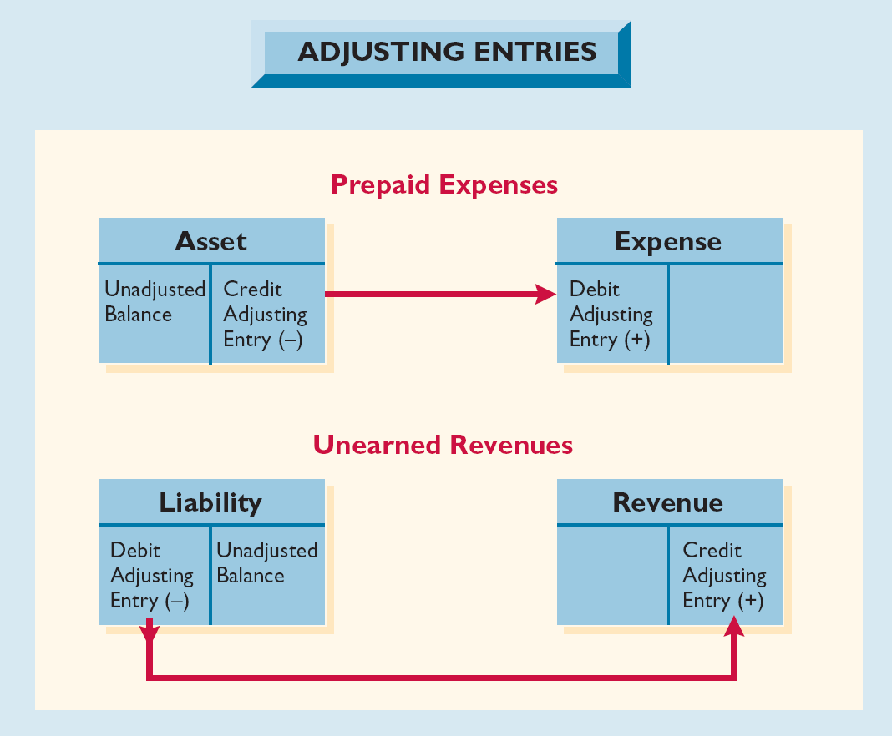
Adjusting Entries for Deferrals
Deferrals are either
prepaid expenses or
unearned revenues.
Illustration 3-21
LO 5 Explain the reasons for preparing adjusting entries.

Slide 43
Adjusting Entries for “Prepaid Expenses”
Payment of cash that is recorded as an asset because service or benefit will be received in the future.
Cash Payment
BEFORE
Expense Recorded
Prepayments often occur in regard to:
insurance
supplies
advertising
rent
buildings and equipment
LO 5 Explain the reasons for preparing adjusting entries.

Slide 44
Adjusting Entries for “Prepaid Expenses”
Supplies. Pioneer purchased advertising supplies costing
$25,000 on October 5. Prepare the journal entry to record the purchase of the supplies.
Oct. 5
Supplies
25,000
Cash
25,000
Supplies
Cash
Debit
Credit
Debit
Credit
25,000
25,000
LO 5 Explain the reasons for preparing adjusting entries.

Slide 45
Adjusting Entries for “Prepaid Expenses”
Supplies. An inventory count at the close of business on October 31 reveals that $10,000 of the advertising supplies are still on hand.
Oct. 31
Supplies expense
15,000
Supplies
15,000
Supplies
Supplies Expense
Debit
Credit
Debit
Credit
25,000
15,000
15,000
10,000
LO 5 Explain the reasons for preparing adjusting entries.

Slide 46
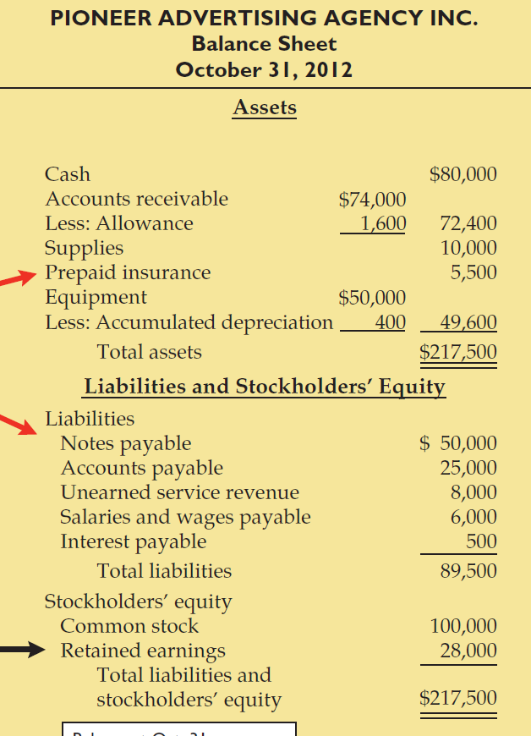
Adjusting Entries for “Prepaid Expenses”
Illustration 3-35
Statement Presentation:
Supplies identifies that portion of the asset’s cost that will provide future economic benefit.
Illustration 3-35

Slide 47
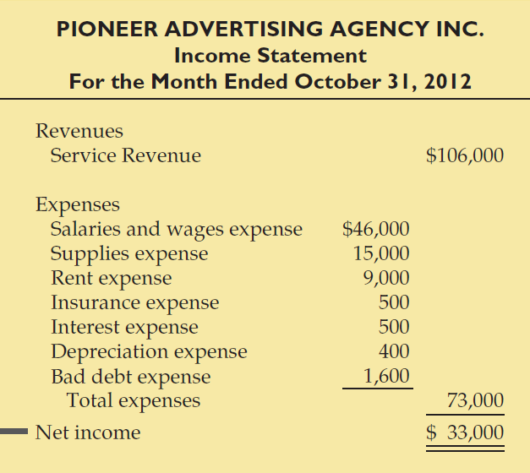
Adjusting Entries for “Prepaid Expenses”
Statement Presentation:
Supplies expense identifies that portion of the asset’s cost that expired in October.
Illustration 3-35
LO 5 Explain the reasons for preparing adjusting entries.

Slide 48
Adjusting Entries for “Prepaid Expenses”
Insurance. On Oct. 4th, Pioneer paid $6,000 for a one-year fire insurance policy, beginning October 1. Show the entry to record the purchase of the insurance.
Oct. 4
Prepaid insurance
6,000
Cash
6,000
Prepaid Insurance
Cash
Debit
Credit
Debit
Credit
6,000
6,000
LO 5 Explain the reasons for preparing adjusting entries.

Slide 49
Adjusting Entries for “Prepaid Expenses”
Insurance. An analysis of the policy reveals that $500 ($6,000 / 12) of insurance expires each month. Thus, Pioneer makes the following adjusting entry.
Oct. 31
Insurance expense
500
Prepaid insurance
500
Prepaid Insurance
Insurance Expense
Debit
Credit
Debit
Credit
6,000
500
500
5,500
LO 5 Explain the reasons for preparing adjusting entries.

Slide 50
Adjusting Entries for “Prepaid Expenses”
Illustration 3-35
Statement Presentation:
Prepaid insurance identifies that portion of the asset’s cost that will provide future economic benefit.
Illustration 3-35

Slide 51
Adjusting Entries for “Prepaid Expenses”
Statement Presentation:
Insurance expense identifies that portion of the asset’s cost that expired in October.
Illustration 3-35
LO 5 Explain the reasons for preparing adjusting entries.

Slide 52
Adjusting Entries for “Prepaid Expenses”
Depreciation. Pioneer Advertising estimates depreciation on its office equipment to be $400 per month. Accordingly, Pioneer recognizes depreciation for October by the following adjusting entry.
Oct. 31
Depreciation expense
400
Accumulated depreciation
400
Depreciation Expense
Accumulated Depreciation
Debit
Credit
Debit
Credit
400
400
LO 5 Explain the reasons for preparing adjusting entries.

Slide 53
Adjusting Entries for “Prepaid Expenses”
Illustration 3-35
Statement Presentation:
Accumulated Depreciation—is a contra asset account.
Illustration 3-35

Slide 54
Adjusting Entries for “Prepaid Expenses”
Statement Presentation:
Depreciation expense identifies that portion of the asset’s cost that expired in October.
Illustration 3-35
LO 5 Explain the reasons for preparing adjusting entries.

Slide 55
Adjusting Entries for “Unearned Revenues”
Receipt of cash that is recorded as a liability because the revenue has not been earned.
Cash Receipt
BEFORE
Revenue Recorded
Unearned revenues often occur in regard to:
rent
airline tickets
school tuition
magazine subscriptions
customer deposits
LO 5 Explain the reasons for preparing adjusting entries.

Slide 56
Adjusting Entries for “Unearned Revenues”
Unearned Revenue. Pioneer Advertising received $12,000 on October 2 from KC for advertising services expected to be completed by December 31. Show the journal entry to record the receipt on Oct. 2nd.
Oct. 2
Cash
12,000
Unearned advertising revenue
12,000
Cash
Unearned Rent Revenue
Debit
Credit
Debit
Credit
12,000
12,000
LO 5 Explain the reasons for preparing adjusting entries.

Slide 57
Adjusting Entries for “Unearned Revenues”
Unearned Revenues. Analysis reveals that Pioneer earned $4,000 of the advertising services in October. Thus, Pioneer makes the following adjusting entry.
Oct. 31
Unearned service revenue
4,000
Service revenue
4,000
Service Revenue
Unearned Service Revenue
Debit
Credit
Debit
Credit
100,000
4,000
12,000
4,000
8,000
LO 5 Explain the reasons for preparing adjusting entries.

Slide 58
Adjusting Entries for “Unearned Revenues”
Illustration 3-35
Statement Presentation:
Unearned service revenue identifies that portion of the liability that has not been earned.
Illustration 3-35

Slide 59
Adjusting Entries for “Unearned Revenues”
Statement Presentation:
Service Revenue includes the portion of unearned service revenue earned in October.
Illustration 3-35
LO 5 Explain the reasons for preparing adjusting entries.

Slide 60
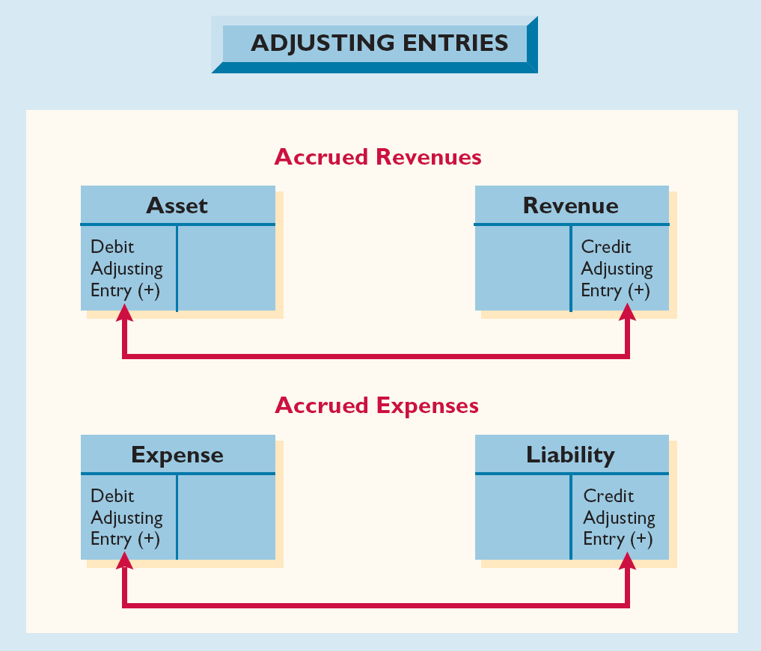
Adjusting Entries for Accruals
Accruals are either
accrued revenues or
accrued expenses.
Illustration 3-27
LO 5 Explain the reasons for preparing adjusting entries.

Slide 61
Adjusting Entries for “Accrued Revenues”
Revenues earned but not yet received in cash or recorded.
Adjusting entry results in:
Revenue Recorded
BEFORE
Cash Receipt
Accrued revenues often occur in regard to:
rent
interest
services performed
LO 5 Explain the reasons for preparing adjusting entries.

Slide 62
Adjusting Entries for “Accrued Revenues”
Accrued Revenues. In October Pioneer earned $2,000 for advertising services that it did not bill to clients before October 31. Thus, Pioneer makes the following adjusting entry.
Oct. 31
Accounts receivable
2,000
Service revenue
2,000
Accounts Receivable
Service Revenue
Debit
Credit
Debit
Credit
72,000
100,000
2,000
4,000
2,000
74,000
106,000
LO 5

Slide 63
Adjusting Entries for “Accrued Revenues”
Illustration 3-35
Illustration 3-35
LO 5

Slide 64
Adjusting Entries for “Accrued Expenses”
Expenses incurred but not yet paid in cash or recorded.
Adjusting entry results in:
Expense Recorded
BEFORE
Cash Payment, if any*
Accrued expenses often occur in regard to:
rent
interest
taxes
salaries
bad debts*
LO 5 Explain the reasons for preparing adjusting entries.

Slide 65
Adjusting Entries for “Accrued Expenses”
Accrued Interest. Pioneer signed a three-month, 12%, note payable in the amount of $50,000 on October 1. The note requires interest at an annual rate of 12 percent. Three factors determine the amount of the interest accumulation:
1
2
3
Illustration 3-29
LO 5 Explain the reasons for preparing adjusting entries.

Slide 66
Adjusting Entries for “Accrued Expenses”
Accrued Interest. Pioneer signed a three-month, 12%, note payable in the amount of $50,000 on October 1. Prepare the adjusting entry on Oct. 31 to record the accrual of interest.
Oct. 31
Interest expense
500
Interest payable
500
Interest Expense
Interest Payable
Debit
Credit
Debit
Credit
500
500
LO 5 Explain the reasons for preparing adjusting entries.

Slide 67
Adjusting Entries for “Accrued Expenses”
Illustration 3-35
Illustration 3-35
LO 5

Slide 68
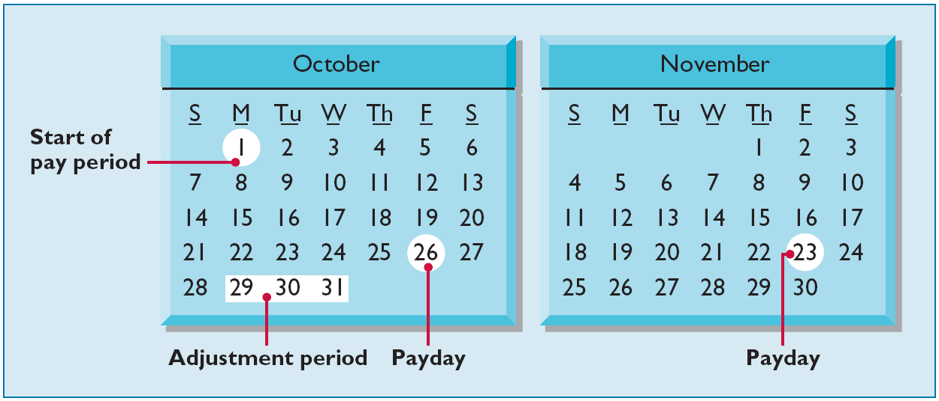
Adjusting Entries for “Accrued Expenses”
Accrued Salaries. At October 31, the salaries for these days represent an accrued expense and a related liability to Pioneer. The employees receive total salaries of $10,000 for a five-day work week, or $2,000 per day.
LO 5 Explain the reasons for preparing adjusting entries.

Slide 69
Adjusting Entries for “Accrued Expenses”
Accrued Salaries. Employees receive total salaries of $10,000 for a five-day work week, or $2,000 per day. Prepare the adjusting entry on Oct. 31 to record accrual for salaries.
Oct. 31
Salaries expense
6,000
Salaries payable
6,000
Salaries Expense
Salaries Payable
Debit
Credit
Debit
Credit
40,000
6,000
6,000
46,000
LO 5 Explain the reasons for preparing adjusting entries.

Slide 70
Adjusting Entries for “Accrued Expenses”
Accrued Salaries. On November 23, Pioneer will again pay total salaries of $40,000. Prepare the entry to record the payment of salaries on November 23.
Nov. 23
Salaries payable
6,000
Salaries expense
34,000
Cash
40,000
Salaries Expense
Salaries Payable
Debit
Credit
Debit
Credit
34,000
6,000
6,000
LO 5 Explain the reasons for preparing adjusting entries.

Slide 71
Adjusting Entries for “Accrued Expenses”
Illustration 3-35
Illustration 3-35
LO 5

Slide 72
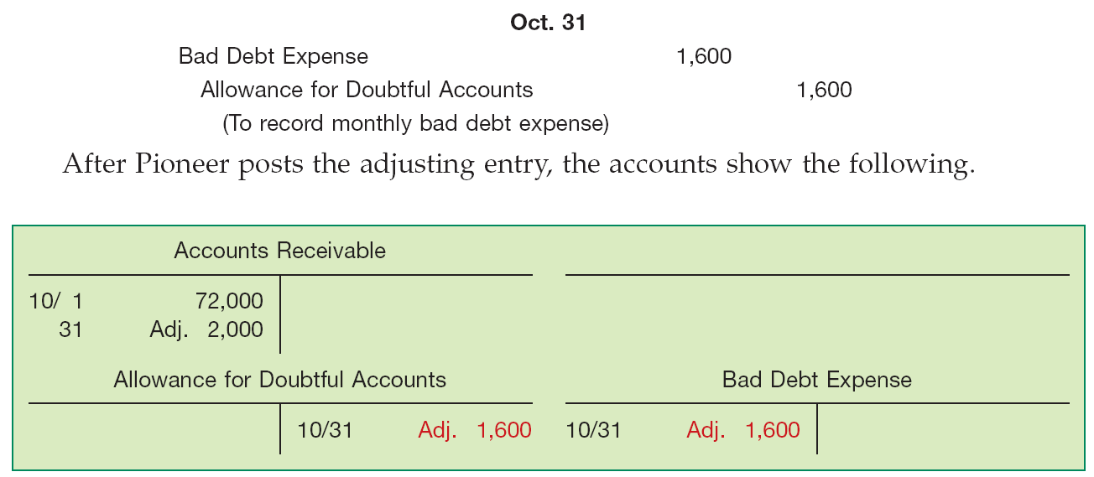
Adjusting Entries for “Accrued Expenses”
Bad Debts. Assume Pioneer reasonably estimates a bad debt expense for the month of $1,600. It makes the adjusting entry for bad debts as follows.
Illustration 3-32
LO 5 Explain the reasons for preparing adjusting entries.

Slide 73
Adjusting Entries for “Accrued Expenses”
Illustration 3-35
Illustration 3-35
LO 5

Slide 74
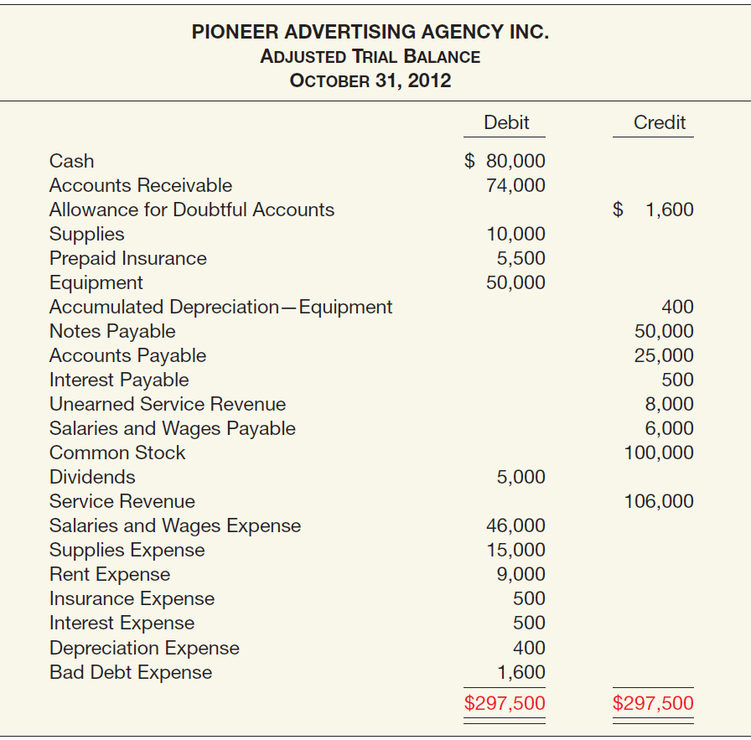
5. Adjusted Trial Balance
Shows the balance of all accounts, after adjusting entries, at the end of the accounting period.
Illustration 3-33

Slide 75
6. Preparing Financial Statements
Financial Statements are prepared directly from the Adjusted Trial Balance.
Income Statement
Retained Earnings Statement
Balance Sheet
LO 6 Prepare financial statement from the adjusted trial balance.

Slide 76
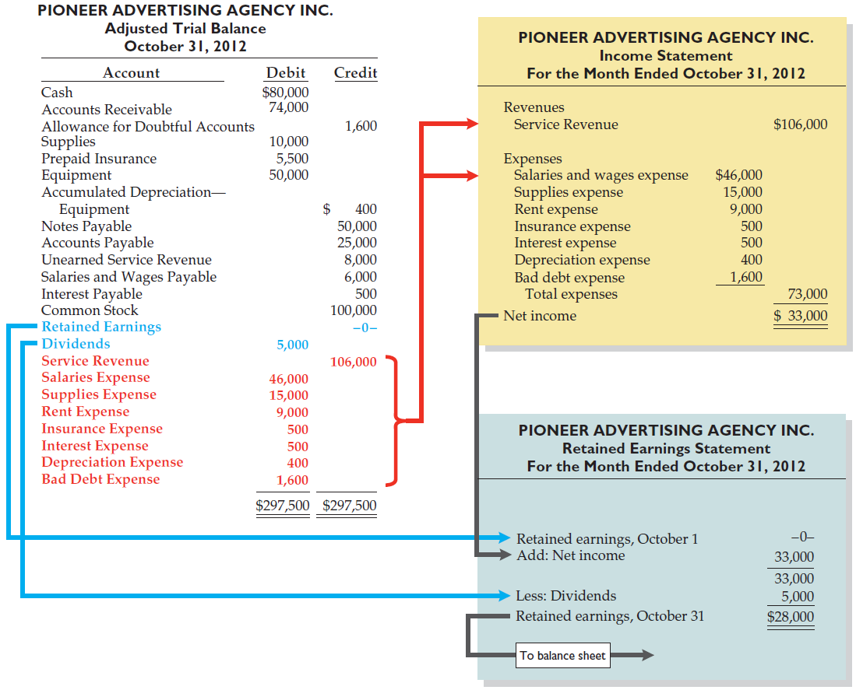
6. Preparing Financial Statements
Illustration 3-34
LO 6

Slide 77
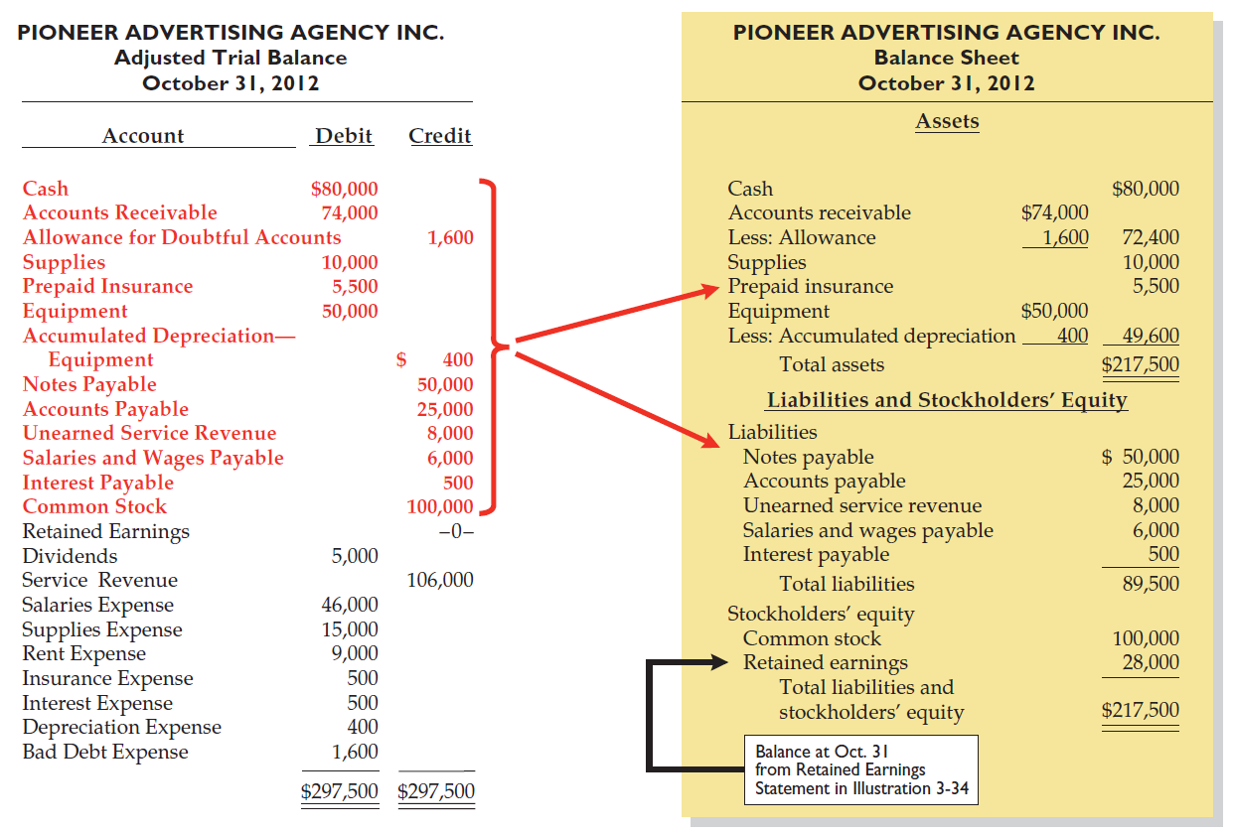
6. Preparing Financial Statements
Illustration 3-35
LO 6

Slide 78
7. Closing Entries
To reduce the balance of the income statement (revenue and expense) accounts to zero.
To transfer net income or net loss to owner’s equity.
Balance sheet (asset, liability, and equity) accounts are not closed.
Dividends are closed directly to the Retained Earnings account.
LO 7 Prepare closing entries.

Slide 79
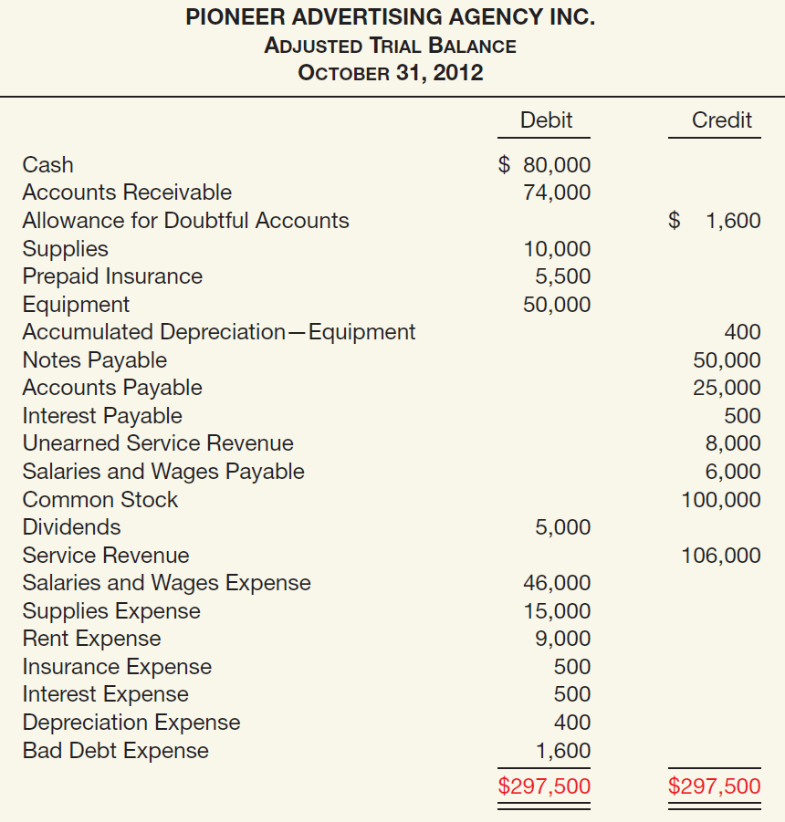
7. Closing Entries
Illustration 3-33
Closing Journal Entries:
Retained earnings 5,000
Dividends 5,000
Service revenue 106,000
Salaries & wages expense 46,000
Supplies expense 15,000
Rent expense 9,000
Insurance expense 500
Interest expense 500
Depreciation expense 400
Bad debt expense 1,600
Retained earnings 33,000
LO 7 Prepare closing entries.

Slide 80
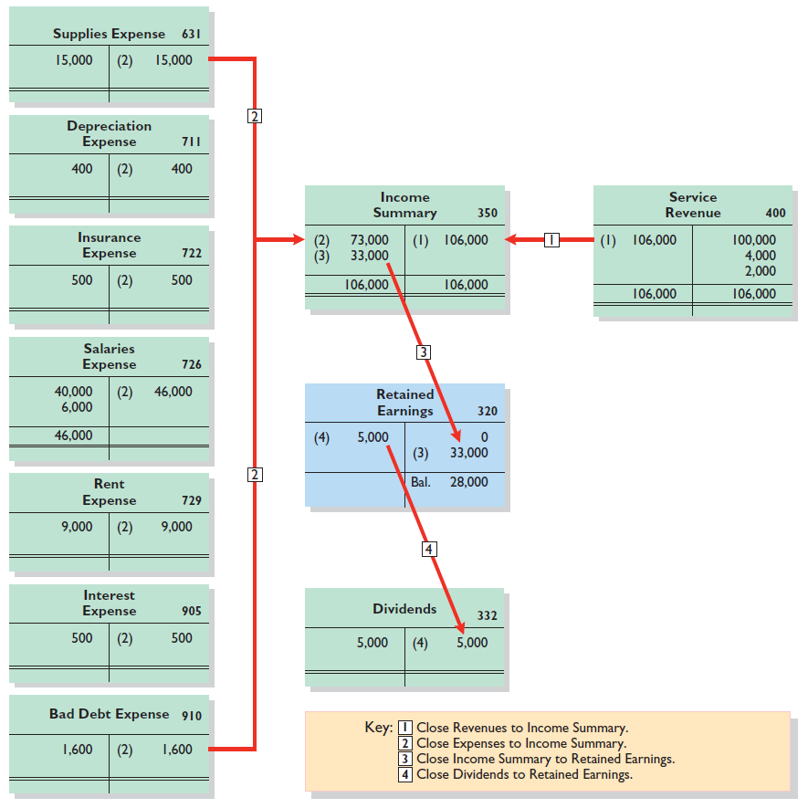
7. Closing Entries
Illustration 3-37
Illustration 3-37

Slide 81
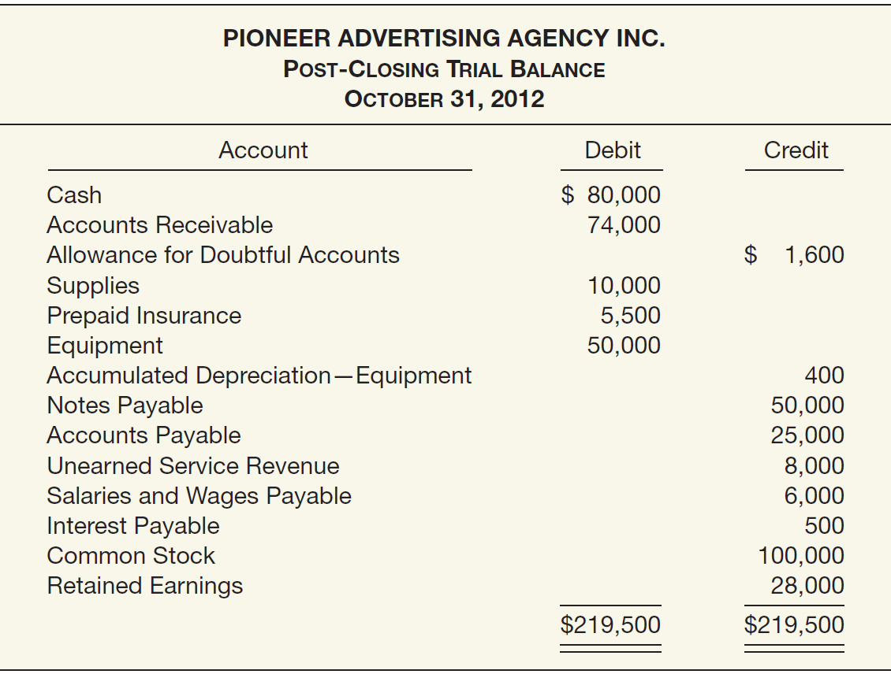
8. Post-Closing Trial Balance
Illustration 3-38
LO 7

Slide 82
9. Reversing Entries
After preparing the financial statements and closing the books, a company may reverse some of the adjusting entries before recording the regular transactions of the next period.
LO 7 Prepare closing entries.

Slide 83
Accounting Cycle Summarized
Enter the transactions of the period in appropriate journals.
Post from the journals to the ledger (or ledgers).
Take an unadjusted trial balance (trial balance).
Prepare adjusting journal entries and post to the ledger(s).
Take a trial balance after adjusting (adjusted trial balance).
Prepare the financial statements from the second trial balance.
Prepare closing journal entries and post to the ledger(s).
Take a trial balance after closing (post-closing trial balance).
Prepare reversing entries (optional) and post to the ledger(s).
LO 7 Prepare closing entries.

Slide 84
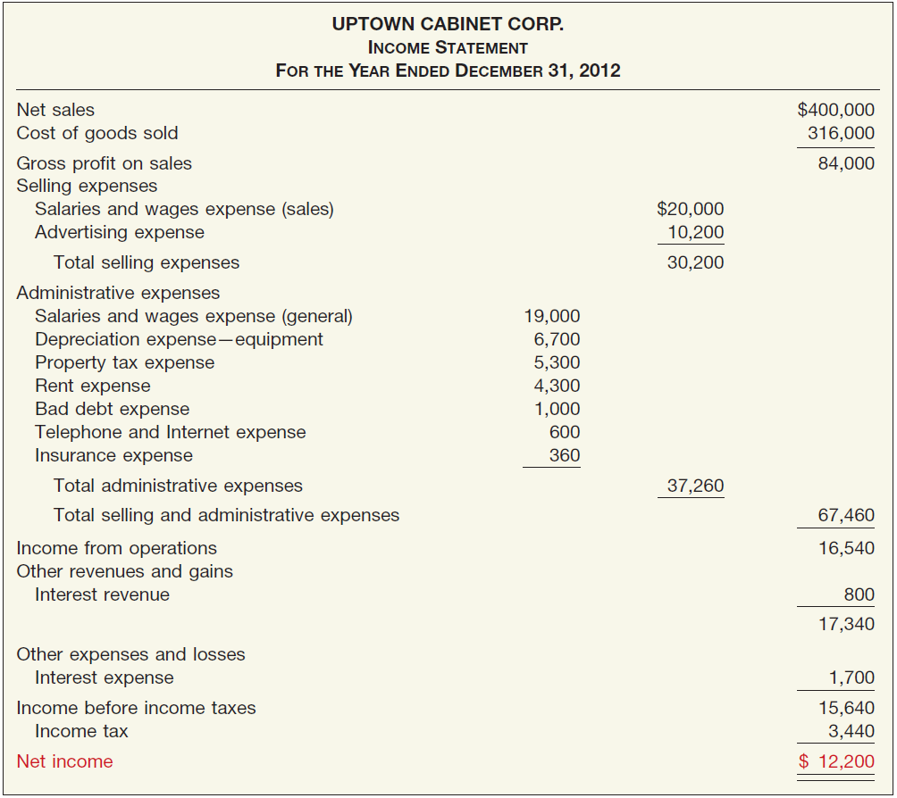
Financial Statements of a Merchandising Company
Illustration 3-39
LO 7

Slide 85
Financial Statements of a Merchandising Company
Illustration 3-40
LO 7

Slide 86
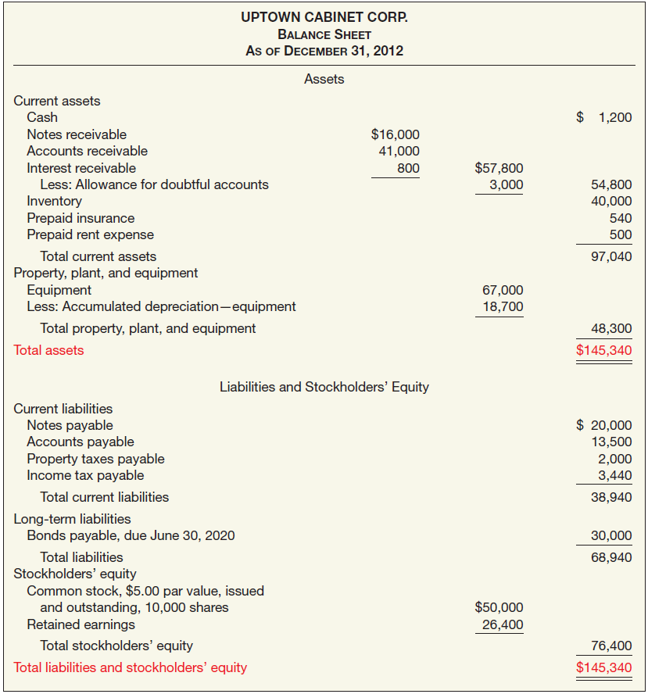
Financial Statements of a Merchandising Company
Illustration 3-41
LO 7

Slide 87
RELEVANT FACTS
International companies use the same set of procedures and records to keep track of transaction data. Thus, the material in Chapter 3 is the same under both GAAP and IFRS.
Transaction analysis is the same under IFRS and GAAP but, as you will see in later chapters, different standards sometimes impact how transactions are recorded.
Rules for accounting for specific events sometimes differ across countries. For example, European companies rely less on historical cost and more on fair value than U.S. companies. Despite the differences, the double-entry accounting system is the basis of accounting systems worldwide.

Slide 88
RELEVANT FACTS
Both the IASB and FASB go beyond the basic definitions provided in this textbook for the key elements of financial statements, that is, assets, liabilities, equity, revenues, and expenses.
A trial balance under IFRS follows the same format as shown in the textbook.
Internal controls are a system of checks and balances designed to prevent and detect fraud and errors. While most companies have these systems in place, many have never completely documented them nor had an independent auditor attest to their effectiveness. Both of these actions are required under SOX. Enhanced internal control standards apply only to large public companies listed on U.S. exchanges.

Slide 89
IFRS SELF-TEST QUESTION
Information in a company’s first IFRS statements must:
have a cost that does not exceed the benefits.
be transparent.
provide a suitable starting point.
All the above.

Slide 90
IFRS SELF-TEST QUESTION
The transition date is the date:
when a company no longer reports under its national standards.
when the company issues its most recent financial statement under IFRS.
three years prior to the reporting date.
None of the above.

Slide 91
IFRS SELF-TEST QUESTION
When converting to IFRS, a company must:
recast previously issued financial statements in accordance with IFRS.
use GAAP in the reporting period but subsequently use IFRS.
prepare at least three years of comparative statements.
use GAAP in the transition year but IFRS in the reporting year.

