Slide 1


7
Cash and Receivables
LEARNING OBJECTIVES
After studying this chapter, you should be able to:
Identify items considered cash.
Indicate how to report cash and related items.
Define receivables and identify the different types of receivables.
Explain accounting issues related to recognition of accounts receivable.
Explain accounting issues related to valuation of accounts receivable.
Explain accounting issues related to recognition and valuation of notes receivable.
Explain the fair value option.
Explain accounting issues related to disposition of accounts and notes receivable.
Describe how to report and analyze receivables.

Slide 2
Cash
What is Cash?
Most liquid asset.
Standard medium of exchange.
Basis for measuring and accounting for all items.
Current asset.
Examples: coin, currency, available funds on deposit at the bank, money orders, certified checks, cashier’s checks, personal checks, bank drafts and savings accounts.
LO 1 Identify items considered cash.

Slide 3
7
Cash and Receivables
LEARNING OBJECTIVES
After studying this chapter, you should be able to:
Identify items considered cash.
Indicate how to report cash and related items.
Define receivables and identify the different types of receivables.
Explain accounting issues related to recognition of accounts receivable.
Explain accounting issues related to valuation of accounts receivable.
Explain accounting issues related to recognition and valuation of notes receivable.
Explain the fair value option.
Explain accounting issues related to disposition of accounts and notes receivable.
Describe how to report and analyze receivables.

Slide 4
Cash
Reporting Cash
Cash Equivalents
Short-term, highly liquid investments that are both
readily convertible to cash, and
so near their maturity that they present insignificant risk of changes in value.
Examples: Treasury bills, Commercial paper, and Money market funds.
LO 2 Indicate how to report cash and related items.

Slide 5
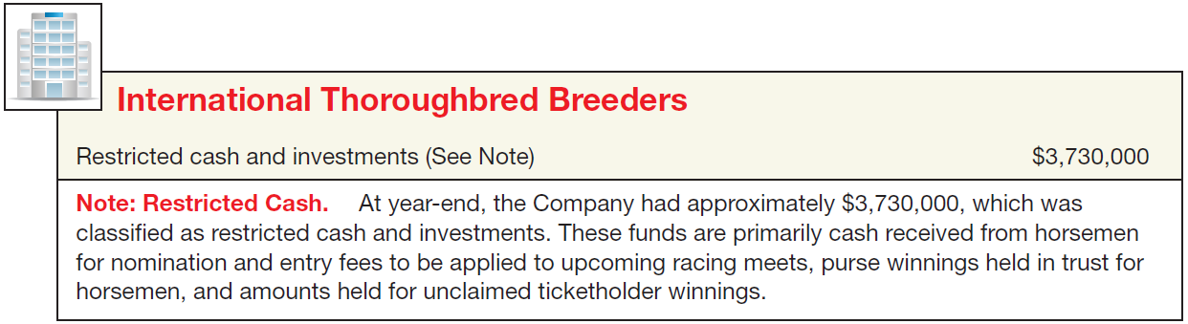
Reporting Cash
Restricted Cash
Companies segregate restricted cash from “regular” cash.
Examples, restricted for:
(1) plant expansion, (2) retirement of long-term debt, and (3) compensating balances.
Illustration 7-1
LO 2

Slide 6
Reporting Cash
Bank Overdrafts
Company writes a check for more than the amount in its cash account.
Generally reported as a current liability.
Offset against other cash accounts only when accounts are with the same bank.
LO 2 Indicate how to report cash and related items.

Slide 7
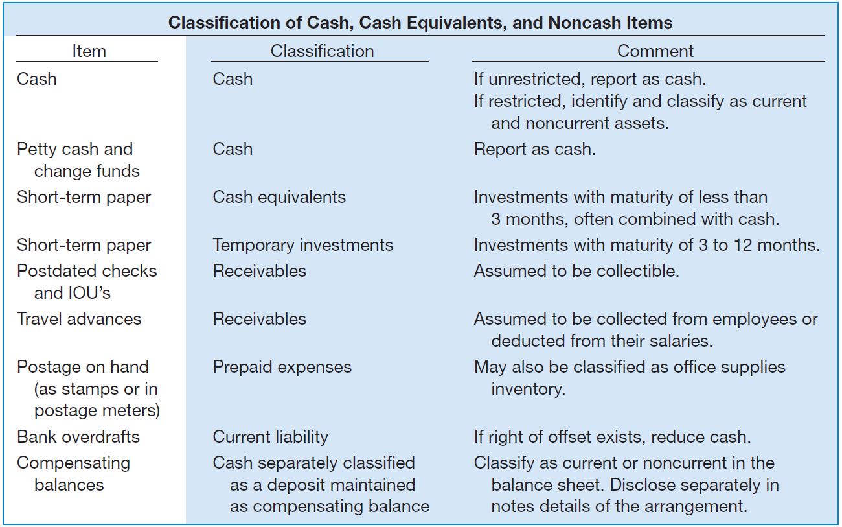
Cash-Related Items
Illustration 7-2
LO 2

Slide 8
7
Cash and Receivables
LEARNING OBJECTIVES
After studying this chapter, you should be able to:
Identify items considered cash.
Indicate how to report cash and related items.
Define receivables and identify the different types of receivables.
Explain accounting issues related to recognition of accounts receivable.
Explain accounting issues related to valuation of accounts receivable.
Explain accounting issues related to recognition and valuation of notes receivable.
Explain the fair value option.
Explain accounting issues related to disposition of accounts and notes receivable.
Describe how to report and analyze receivables.

Slide 9
Accounts Receivable
Receivables - Claims held against customers and others for money, goods, or services.
Oral promises of the purchaser to pay for goods and services sold.
Written promises to pay a sum of money on a specified future date.
Accounts Receivable
Notes Receivable
LO 3 Define receivables and identify the different types of receivables.

Slide 10
Accounts Receivable
Nontrade Receivables
Advances to officers and employees.
Advances to subsidiaries.
Deposits paid to cover potential damages or losses.
Deposits paid as a guarantee of performance or payment.
Dividends and interest receivable.
Claims against: Insurance companies for casualties sustained; defendants under suit; governmental bodies for tax refunds; common carriers for damaged or lost goods; creditors for returned, damaged, or lost goods; customers for returnable items (crates, containers, etc.).
LO 3 Define receivables and identify the different types of receivables.

Slide 11
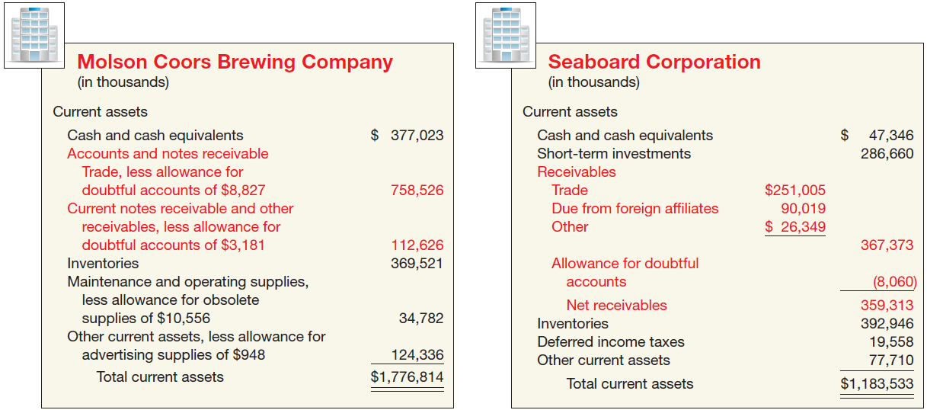
Accounts Receivable
Nontrade Receivables
Illustration 7-3
Receivables Balance
Sheet Presentations
LO 3 Define receivables and identify the different types of receivables.

Slide 12
7
Cash and Receivables
LEARNING OBJECTIVES
After studying this chapter, you should be able to:
Identify items considered cash.
Indicate how to report cash and related items.
Define receivables and identify the different types of receivables.
Explain accounting issues related to recognition of accounts receivable.
Explain accounting issues related to valuation of accounts receivable.
Explain accounting issues related to recognition and valuation of notes receivable.
Explain the fair value option.
Explain accounting issues related to disposition of accounts and notes receivable.
Describe how to report and analyze receivables.

Slide 13
Recognition of Accounts Receivables
Trade Discounts
Reductions from the list price.
Not recognized in the accounting records.
Customers are billed net of discounts.
10 % Discount for new Retail Store Customers
LO 4 Explain accounting issues related to recognition of accounts receivable.

Slide 14
Recognition of Accounts Receivables
Cash Discounts (Sales Discounts)
Offered to induce prompt payment.
Gross Method vs. Net Method.
Payment terms are 2/10, n/30
LO 4 Explain accounting issues related to recognition of accounts receivable.

Slide 15
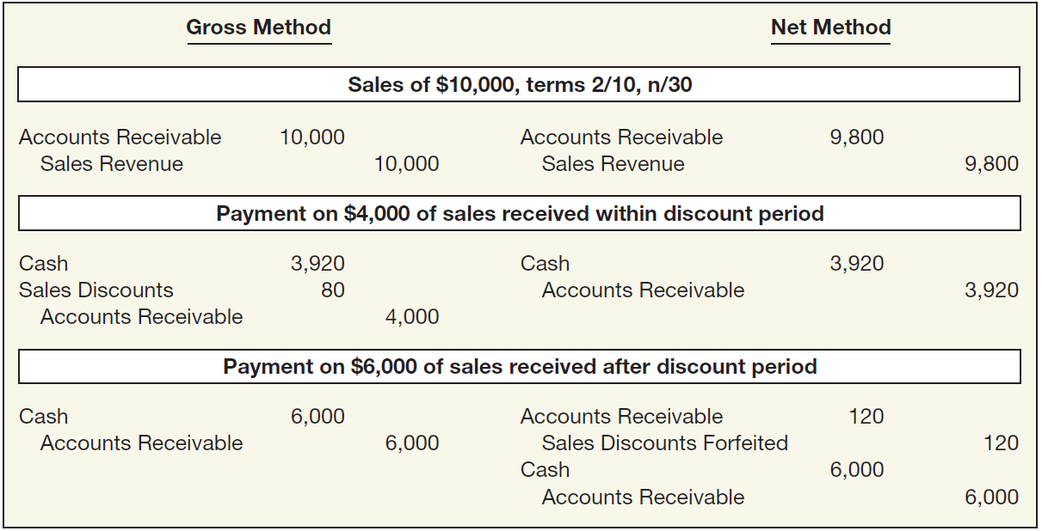
Recognition of Accounts Receivables
Cash Discounts (Sales Discounts)
Illustration 7-4
LO 4 Explain accounting issues related to recognition of accounts receivable.

Slide 16
Recognition of Accounts Receivables
Illustration: On June 3, Bolton Company sold to Arquette Company merchandise having a sale price of $2,000 with terms of 2/10, n/60, f.o.b. shipping point. On June 12, the company received a check for the balance due from Arquette Company. Prepare the journal entries on Bolton Company books to record the sale assuming Bolton records sales using the gross method.
June 3
Accounts Receivable 2,000
Sales 2,000
June 12
Cash ($2,000 x 98%) 1,960
Sales Discounts 40
Accounts Receivable 2,000
LO 4 Explain accounting issues related to recognition of accounts receivable.

Slide 17
Recognition of Accounts Receivables
Illustration: On June 3, Bolton Company sold to Arquette Company merchandise having a sale price of $2,000 with terms of 2/10, n/60, f.o.b. shipping point. On June 12, the company received a check for the balance due from Arquette Company. Prepare the journal entries on Bolton Company books to record the sale assuming Bolton records sales using the net method.
June 3
Accounts Receivable 1,960
Sales 1,960
June 12
Cash ($2,000 x 98%) 1,960
Accounts Receivable 1,960
LO 4 Explain accounting issues related to recognition of accounts receivable.

Slide 18
Recognition of Accounts Receivables
Illustration: On June 3, Bolton Company sold to Arquette Company merchandise having a sale price of $2,000 with terms of 2/10, n/60, f.o.b. shipping point. Prepare the journal entries on Bolton Company books to record the sale assuming Bolton records sales using the net method, and Arquette did not remit payment until July 29.
June 3
Accounts Receivable 1,960
Sales 1,960
June 12
Cash 2,000
Accounts Receivable 1,960
Sales Discounts Forfeited 40
LO 4 Explain accounting issues related to recognition of accounts receivable.

Slide 19
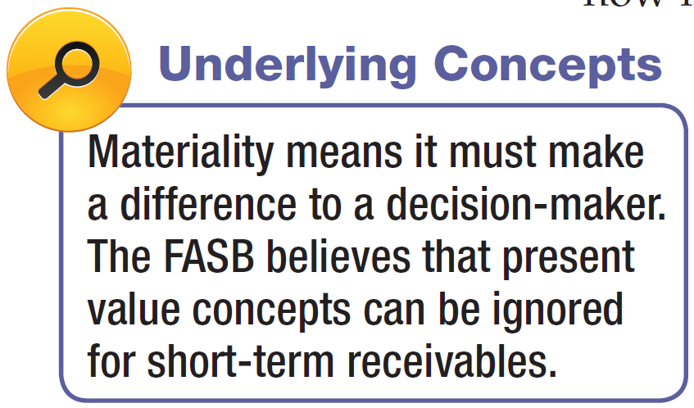
Recognition of Accounts Receivables
Non-Recognition of Interest Element
A company should measure receivables in terms of their present value.
In practice, companies ignore interest revenue related to accounts receivable because the discount is not usually material in relation to the net income for the period.
LO 4 Explain accounting issues related to recognition of accounts receivable.

Slide 20
Accounts Receivables
How are these accounts presented on the Balance Sheet?
Allowance for Doubtful Accounts
Accounts Receivable
Beg. 500
25 Beg.
End. 500
25 End.
LO 4 Explain accounting issues related to recognition of accounts receivable.

Slide 21
Accounts Receivables
LO 4 Explain accounting issues related to recognition of accounts receivable.

Slide 22
Accounts Receivables
Alternate Presentation
LO 4 Explain accounting issues related to recognition of accounts receivable.

Slide 23
Accounts Receivables
Journal entry for credit sale of $100?
Accounts Receivable 100
Sales 100
Allowance for Doubtful Accounts
Accounts Receivable
Beg. 500
25 Beg.
End. 500
25 End.
LO 4 Explain accounting issues related to recognition of accounts receivable.

Slide 24
Accounts Receivables
Journal entry for credit sale of $100?
Accounts Receivable 100
Sales 100
Allowance for Doubtful Accounts
Accounts Receivable
Beg. 500
25 Beg.
Sale 100
End. 600
25 End.
LO 4 Explain accounting issues related to recognition of accounts receivable.

Slide 25
Accounts Receivables
Collected $333 on account?
Cash 333
Accounts Receivable 333
Allowance for Doubtful Accounts
Accounts Receivable
Beg. 500
25 Beg.
Sale 100
End. 600
25 End.
LO 4 Explain accounting issues related to recognition of accounts receivable.

Slide 26
Accounts Receivables
Collected $333 on account?
Cash 333
Accounts Receivable 333
Allowance for Doubtful Accounts
Accounts Receivable
Beg. 500
25 Beg.
Sale 100
333 Coll.
End. 267
25 End.
LO 4 Explain accounting issues related to recognition of accounts receivable.

Slide 27
Accounts Receivables
Adjustment of $15 for estimated bad debts?
Bad Debt Expense 15
Allowance for Doubtful Accounts 15
Allowance for Doubtful Accounts
Accounts Receivable
Beg. 500
25 Beg.
Sale 100
333 Coll.
End. 267
25 End.
LO 4 Explain accounting issues related to recognition of accounts receivable.

Slide 28
Accounts Receivables
Adjustment of $15 for estimated bad debts?
Bad Debt Expense 15
Allowance for Doubtful Accounts 15
Allowance for Doubtful Accounts
Accounts Receivable
Beg. 500
25 Beg.
Sale 100
333 Coll.
15 Est.
End. 267
40 End.
LO 4 Explain accounting issues related to recognition of accounts receivable.

Slide 29
Accounts Receivables
Write-off of uncollectible accounts for $10?
Allowance for Doubtful accounts 10
Accounts Receivable 10
Allowance for Doubtful Accounts
Accounts Receivable
Beg. 500
25 Beg.
Sale 100
333 Coll.
15 Est.
End. 267
40 End.
LO 4 Explain accounting issues related to recognition of accounts receivable.

Slide 30
Accounts Receivables
Write-off of uncollectible accounts for $10?
Allowance for Doubtful accounts 10
Accounts Receivable 10
Allowance for Doubtful Accounts
Accounts Receivable
Beg. 500
25 Beg.
Sale 100
333 Coll.
15 Est.
10 W/O
W/O 10
End. 257
30 End.
LO 4 Explain accounting issues related to recognition of accounts receivable.

Slide 31
Accounts Receivables
LO 4 Explain accounting issues related to recognition of accounts receivable.

Slide 32
7
Cash and Receivables
LEARNING OBJECTIVES
After studying this chapter, you should be able to:
Identify items considered cash.
Indicate how to report cash and related items.
Define receivables and identify the different types of receivables.
Explain accounting issues related to recognition of accounts receivable.
Explain accounting issues related to valuation of accounts receivable.
Explain accounting issues related to recognition and valuation of notes receivable.
Explain the fair value option.
Explain accounting issues related to disposition of accounts and notes receivable.
Describe how to report and analyze receivables.

Slide 33
Accounts Receivable
Valuation of Accounts Receivable
Reporting of receivables involves
classification and
valuation on the balance sheet.
Classification involves determining the length of time each receivable will be outstanding.
Value and report short-term receivables at net realizable value.
LO 5 Explain accounting issues related to valuation of accounts receivable.

Slide 34
Valuation of Accounts Receivable
Uncollectible Accounts Receivable
Record credit losses as debits to Bad Debt Expense (or Uncollectible Accounts Expense).
Normal and necessary risk of doing business on credit.
Two methods to account for uncollectible accounts:
the direct write-off method and
the allowance method.
LO 5 Explain accounting issues related to valuation of accounts receivable.

Slide 35
Valuation of Accounts Receivable
Methods of Accounting for Uncollectible Accounts
Direct Write-Off
Theoretically deficient:
  No matching.
  Receivable not stated at cash realizable value.
  Not GAAP when material in amount.
Allowance Method
Losses are estimated:
  Percentage-of-sales.
  Percentage-of-receivables.
  GAAP requires when material in amount.
LO 5 Explain accounting issues related to valuation of accounts receivable.

Slide 36
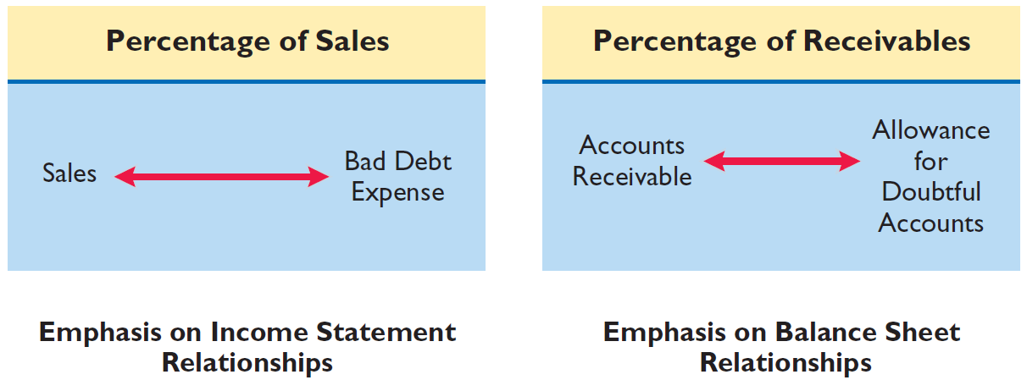
Valuation of Accounts Receivable
Illustration 7-6
The percentage-of-sales basis results in a better matching of expenses with revenues
The percentage-of-receivables
basis produces the better estimate of net realizable value
LO 5 Explain accounting issues related to valuation of accounts receivable.

Slide 37
Valuation of Accounts Receivable
Percentage-of-Sales Approach
  Percentage based upon past experience and anticipate credit policy.
  Achieves better matching of expenses with revenues.
  Any balance in Allowance for Doubtful Accounts is ignored.
LO 5 Explain accounting issues related to valuation of accounts receivable.

Slide 38
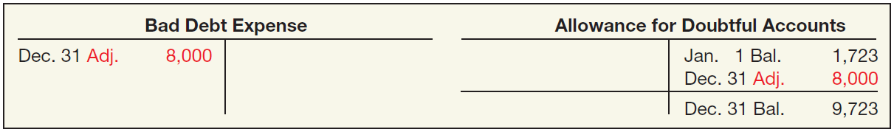
Valuation of Accounts Receivable
Illustration: Gonzalez Company estimates that about 1% of net credit sales become uncollectible. If net credit sales for are $800,000 for the year, it records bad debt expense as follows.
Bad Debt Expense 8,000
Allowance for Doubtful Accounts 8,000
Illustration 7-7
LO 5

Slide 39
Valuation of Accounts Receivable
Percentage-of-Receivables Approach
  Not matching.
  Reports estimate of receivables at realizable value.
Companies may apply this method using
  one composite rate, or
  an aging schedule using different rates.
LO 5 Explain accounting issues related to valuation of accounts receivable.

Slide 40
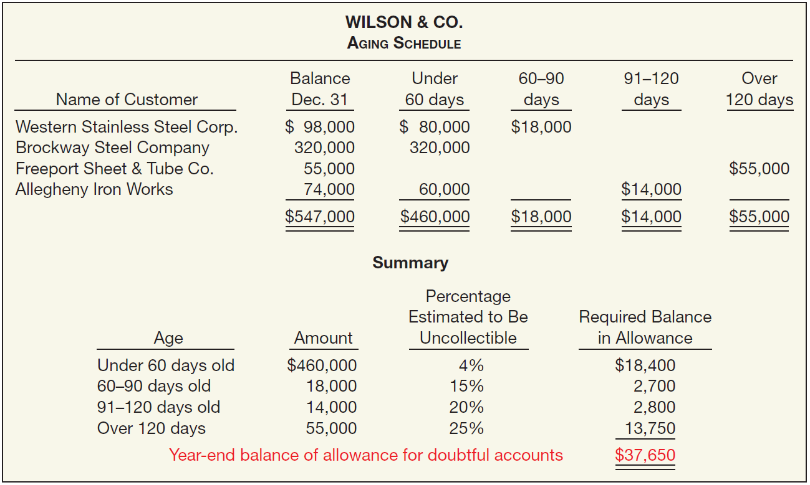
Valuation of Accounts Receivable
Illustration 7-8
Accounts Receivable Aging Schedule
What entry would Wilson make assuming that the allowance account had a zero balance?
Bad Debt Expense 37,650
Allowance for Doubtful Accounts 37,650
LO 5 Explain accounting issues related to valuation of accounts receivable.

Slide 41
Valuation of Accounts Receivable
Illustration 7-8
Accounts Receivable Aging Schedule
What entry would Wilson make assuming the allowance account had a credit balance of $800 before adjustment?
Bad Debt Expense ($37,650 – $800) 36,850
Allowance for Doubtful Accounts 36,850
LO 5 Explain accounting issues related to valuation of accounts receivable.

Slide 42
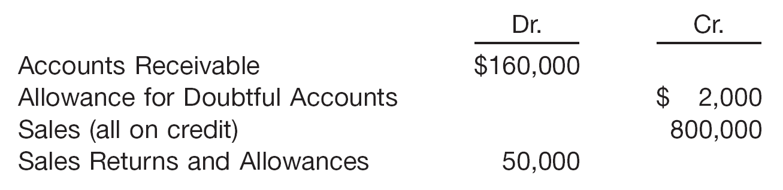
Valuation of Accounts Receivable
Illustration: Sandel Company reports the following financial information before adjustments.
Instructions: Prepare the journal entry to record bad debt expense assuming Sandel Company estimates bad debts at (a) 1% of net sales and (b) 5% of accounts receivable.
LO 5 Explain accounting issues related to valuation of accounts receivable.

Slide 43
Valuation of Accounts Receivable
Illustration: Sandel Company reports the following financial information before adjustments.
Instructions: Prepare the journal entry assuming Sandel estimates bad debts at (b) 1% of net sales.
Bad Debt Expense 7,500
Allowance for Doubtful Accounts 7,500
($800,000 – $50,000) x 1% = $7,500
LO 5
LO 5

Slide 44
Valuation of Accounts Receivable
Illustration: Sandel Company reports the following financial information before adjustments.
Instructions: Prepare the journal entry assuming Sandel estimates bad debts at (b) 5% of accounts receivable.
Bad Debt Expense 6,000
Allowance for Doubtful Accounts 6,000
($160,000 x 5%) – $2,000) = $6,000
LO 5
LO 5

Slide 45
Write-Off of Uncollectible Accounts
Illustration: The financial vice president of Brown Furniture authorizes a write-off of the $1,000 balance owed by Randall Co. on March 1. The entry to record the write-off is:
Allowance for Doubtful Accounts 1,000
Accounts Receivable 1,000
Assume that on July 1, Randall Co. pays the $1,000 amount that Brown had written off on March 1. These are the entries:
Accounts Receivable 1,000
Allowance for Doubtful Accounts 1,000
Cash 1,000
Accounts Receivable 1,000
LO 5

Slide 46
7
Cash and Receivables
LEARNING OBJECTIVES
After studying this chapter, you should be able to:
Identify items considered cash.
Indicate how to report cash and related items.
Define receivables and identify the different types of receivables.
Explain accounting issues related to recognition of accounts receivable.
Explain accounting issues related to valuation of accounts receivable.
Explain accounting issues related to recognition and valuation of notes receivable.
Explain the fair value option.
Explain accounting issues related to disposition of accounts and notes receivable.
Describe how to report and analyze receivables.

Slide 47
Notes Receivable
Supported by a formal promissory note.
Written promise to pay a certain sum of money at a specific future date.
A negotiable instrument.
Maker signs in favor of a Payee.
Interest-bearing (has a stated rate of interest) OR
Zero-interest-bearing (interest included in face amount).
LO 6 Explain accounting issues related to recognition and valuation of notes receivable.

Slide 48
Notes Receivable
  Generally originate from:
  Customers who need to extend payment period of an outstanding receivable.
  High-risk or new customers.
  Loans to employees and subsidiaries.
  Sales of property, plant, and equipment.
  Lending transactions (majority of notes).
LO 6 Explain accounting issues related to recognition and valuation of notes receivable.

Slide 49
Recognition of Notes Receivable
Short-Term
Long-Term
Record at
Face Value,
less allowance
Record at
Present Value
of cash expected to be collected
Interest Rates
Stated rate = Market rate
Stated rate > Market rate
Stated rate < Market rate
Note Issued at
Face Value
Premium
Discount
LO 6

Slide 50
Note Issued at Face Value
Illustration: Bigelow Corp. lends Scandinavian Imports $10,000 in exchange for a $10,000, three-year note bearing interest at 10 percent annually. The market rate of interest for a note of similar risk is also 10 percent. How does Bigelow record the receipt of the note?
i = 10%
$10,000 Principal
$1,000
1,000
1,000 Interest
0
1
2
3
4
n = 3
LO 6 Explain accounting issues related to recognition and valuation of notes receivable.

Slide 51
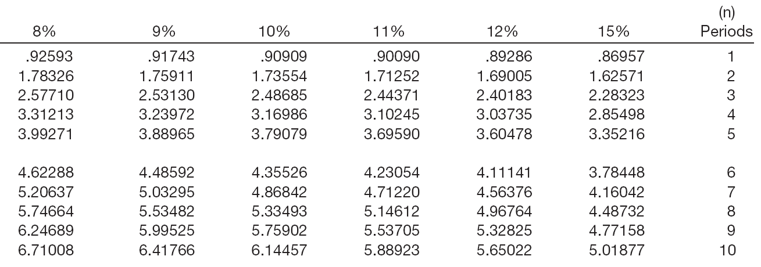
Note Issued at Face Value
PV of Interest
$1,000 x 2.48685 = $2,487
Interest Received
Factor
Present Value
LO 6 Explain accounting issues related to recognition and valuation of notes receivable.

Slide 52
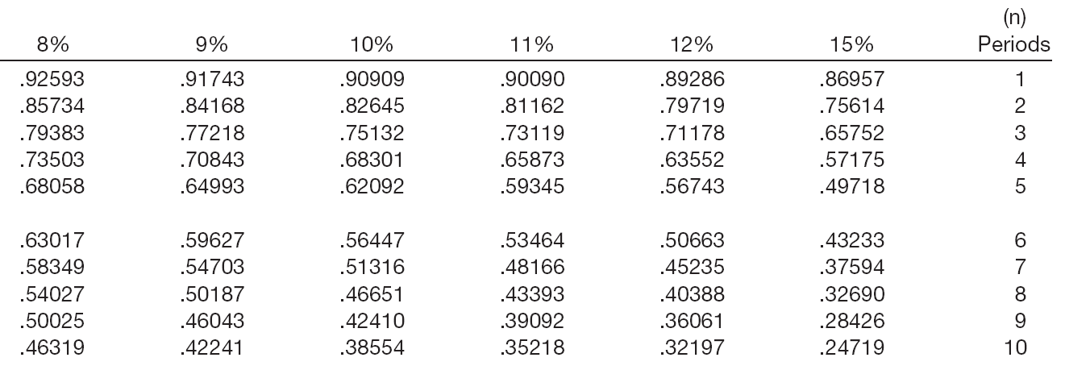
Note Issued at Face Value
PV of Principal
$10,000 x .75132 = $7,513
Principal
Factor
Present Value
LO 6 Explain accounting issues related to recognition and valuation of notes receivable.

Slide 53
Note Issued at Face Value
Summary
Present value of interest $ 2,487
Present value of principal 7,513
Note current market value $10,000
Journal Entries
Jan. yr. 1
Notes Receivable 10,000
Cash 10,000
Dec. yr. 1
Cash 1,000
Interest Revenue 1,000
LO 6 Explain accounting issues related to recognition and valuation of notes receivable.

Slide 54
Zero-Interest-Bearing Note
Illustration: Jeremiah Company receives a three-year, $10,000 zero-interest-bearing note. The market rate of interest for a note of similar risk is 9 percent. How does Jeremiah record the receipt of the note?
i = 9%
$10,000 Principal
$0
$0
$0 Interest
0
1
2
3
4
n = 3
LO 6 Explain accounting issues related to recognition and valuation of notes receivable.

Slide 55
Zero-Interest-Bearing Note
PV of Principal
$10,000 x .77218 = $7,721.80
Principal
Factor
Present Value
LO 6 Explain accounting issues related to recognition and valuation of notes receivable.

Slide 56
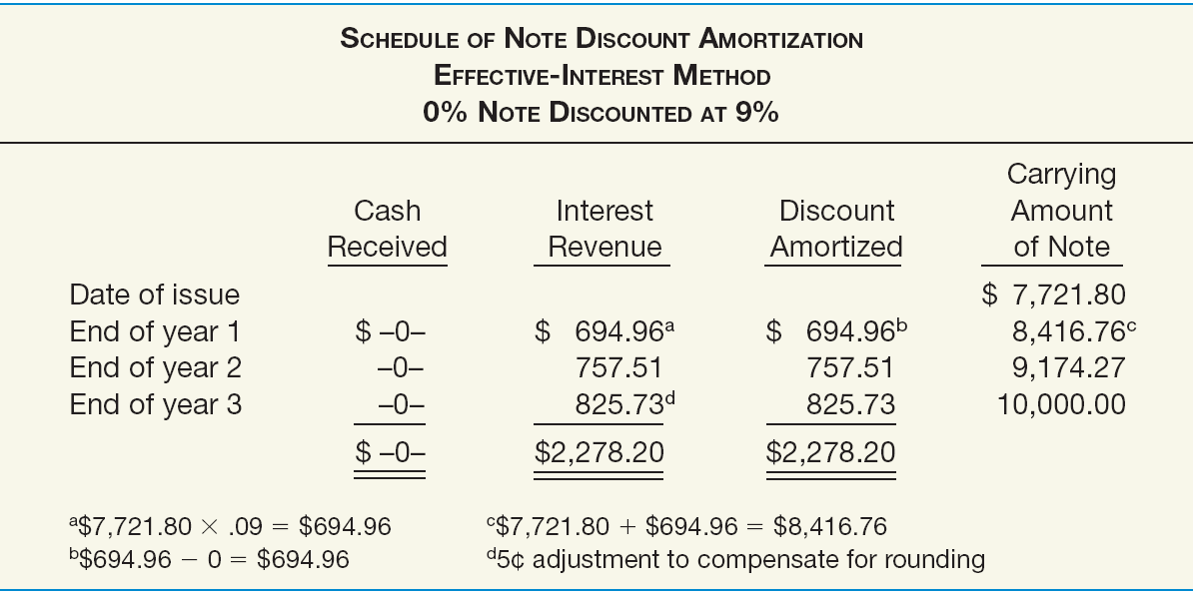
Zero-Interest-Bearing Note
Illustration 7-12
LO 6 Explain accounting issues related to recognition and valuation of notes receivable.

Slide 57
Zero-Interest-Bearing Note
Illustration 7-12
Prepare the journal entry to record the receipt of the note.
Notes Receivable 10,000.00
Discount on Notes Receivable 2,278.20
Cash 7,721.80
LO 6 Explain accounting issues related to recognition and valuation of notes receivable.

Slide 58
Zero-Interest-Bearing Note
Illustration 7-12
Prepare the journal entry to record interest revenue at the end of the first year.
Discount on Notes Receivable 694.96
Interest Revenue 694.96
LO 6 Explain accounting issues related to recognition and valuation of notes receivable.

Slide 59
Interest-Bearing Note
Illustration: Morgan Corp. makes a loan to Marie Co. and receives in exchange a three-year, $10,000 note bearing interest at 10 percent annually. The market rate of interest for a note of similar risk is 12 percent. Prepare the journal entry to record the receipt of the note?
i = 12%
$10,000 Principal
$1,000
1,000
1,000 Interest
0
1
2
3
4
n = 3
LO 6 Explain accounting issues related to recognition and valuation of notes receivable.

Slide 60
Interest-Bearing Note
PV of Interest
$1,000 x 2.40183 = $2,402
Interest Received
Factor
Present Value
LO 6 Explain accounting issues related to recognition and valuation of notes receivable.

Slide 61
Interest-Bearing Note
PV of Principal
$10,000 x .71178 = $7,118
Principal
Factor
Present Value
LO 6 Explain accounting issues related to recognition and valuation of notes receivable.

Slide 62
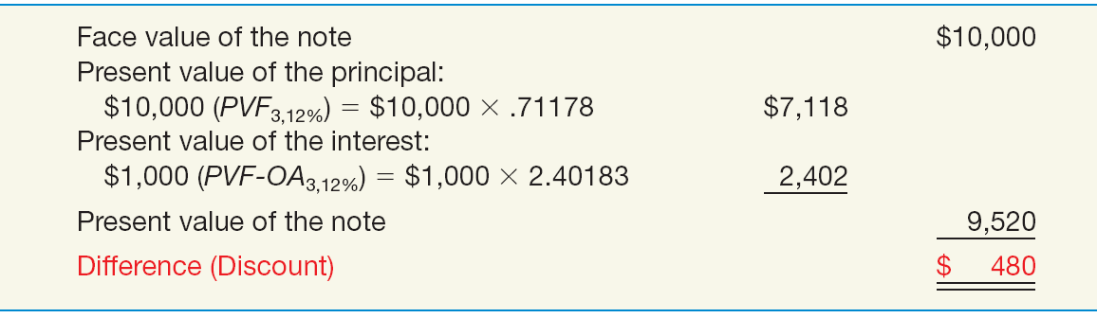
Interest-Bearing Note
Illustration: Record the receipt of the note?
Illustration 7-14
Notes Receivable 10,000
Discount on Notes Receivable 480
Cash 9,520
LO 6 Explain accounting issues related to recognition and valuation of notes receivable.

Slide 63
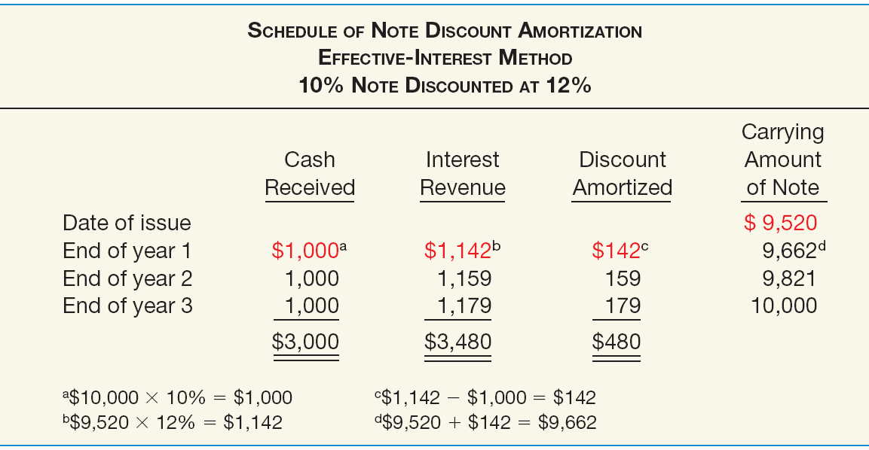
Interest-Bearing Note
Illustration 7-15
LO 6 Explain accounting issues related to recognition and valuation of notes receivable.

Slide 64
Interest-Bearing Note
Illustration 7-15
Prepare the journal entry to record interest revenue at the end of the first year.
Cash 1,000
Discount on Notes Receivable 142
Interest Revenue 1,142
LO 6 Explain accounting issues related to recognition and valuation of notes receivable.

Slide 65
Recognition of Notes Receivable
Notes Received for Property, Goods, or Services
In a bargained transaction entered into at arm’s length, the stated interest rate is presumed to be fair unless:
  No interest rate is stated, or
  Stated interest rate is unreasonable, or
  Face amount of the note is materially different from the current cash sales price.
LO 6 Explain accounting issues related to recognition and valuation of notes receivable.

Slide 66
Recognition of Notes Receivable
Illustration: Oasis Development Co. sold a corner lot to Rusty Pelican as a restaurant site. Oasis accepted in exchange a five-year note having a maturity value of $35,247 and no stated interest rate. The land originally cost Oasis $14,000. At the date of sale the land had a fair market value of $20,000. Oasis uses the fair market value of the land, $20,000, as the present value of the note. Oasis therefore records the sale as:
($35,247 - $20,000) = $15,247
Notes Receivable 35,247
Discount on Notes Receivable 15,247
Land 14,000
Gain on Disposal of Land 6,000
LO 6 Explain accounting issues related to recognition and valuation of notes receivable.

Slide 67
Notes Receivable
Valuation of Notes Receivable
Short-Term reported at net realizable value (same as accounting for accounts receivable).
Long-Term - FASB requires companies disclose not only their cost but also their fair value in the notes to the financial statements.
LO 6 Explain accounting issues related to recognition and valuation of notes receivable.

Slide 68
7
Cash and Receivables
LEARNING OBJECTIVES
After studying this chapter, you should be able to:
Identify items considered cash.
Indicate how to report cash and related items.
Define receivables and identify the different types of receivables.
Explain accounting issues related to recognition of accounts receivable.
Explain accounting issues related to valuation of accounts receivable.
Explain accounting issues related to recognition and valuation of notes receivable.
Explain the fair value option.
Explain accounting issues related to disposition of accounts and notes receivable.
Describe how to report and analyze receivables.

Slide 69
Special Issues
Fair Value Option
Companies have the option to use fair value as the basis of measurement in the financial statements.
If companies choose the fair value option
  Receivables are recorded at fair value.
  Unrealized holding gains or losses reported as part of net income.
Company reports the receivable at fair value each reporting date.
LO 7 Explain the fair value option.

Slide 70
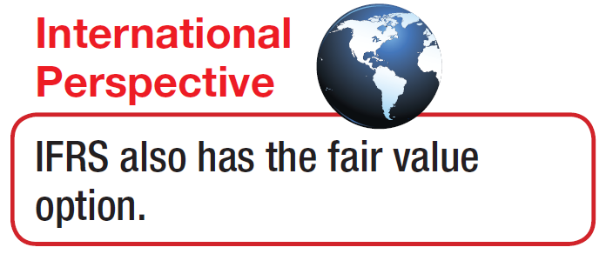
Special Issues
Fair Value Option
Companies may elect at time the financial instrument is
  originally recognized or
  when some event triggers a new basis of accounting.
Must continue to use fair value measurement for the specific instrument until the company no longer owns this instrument.
If not elected at date of recognition, company may never use fair value option on that specific instrument.
LO 7 Explain the fair value option.

Slide 71
Valuation of Notes Receivable
Illustration: Escobar Company has notes receivable that have a fair value of $810,000 and a carrying amount of $620,000. Escobar decides on December 31, of the current year, to use the fair value option for these receivables. This is the first valuation of these recently acquired receivables. At December 31, Escobar makes an adjusting entry to record the increase in value of Notes Receivable and to record the unrealized holding gain, as follows.
Notes Receivable 190,000
Unrealized Holding Gain or Loss—Income 190,000
LO 7 Explain the fair value option.

Slide 72
7
Cash and Receivables
LEARNING OBJECTIVES
After studying this chapter, you should be able to:
Identify items considered cash.
Indicate how to report cash and related items.
Define receivables and identify the different types of receivables.
Explain accounting issues related to recognition of accounts receivable.
Explain accounting issues related to valuation of accounts receivable.
Explain accounting issues related to recognition and valuation of notes receivable.
Explain the fair value option.
Explain accounting issues related to disposition of accounts and notes receivable.
Describe how to report and analyze receivables.

Slide 73
Disposition of Accounts and Notes Receivable
Owner may transfer accounts or notes receivables to another company for cash. Reasons:
Competition.
Sell receivables because money is tight.
Billing and collection are time-consuming and costly.
Transfer accomplished by:
Secured borrowing.
Sale of receivables.
LO 8 Explain accounting issues related to disposition of accounts and notes receivable.

Slide 74
Disposition of Accounts and Notes Receivable
Secured Borrowing
Illustration: March 1, 2014, Howat Mills, Inc. provides (assigns) $700,000 of its accounts receivable to Citizens Bank as collateral for a $500,000 note. Howat Mills continues to collect the accounts receivable; the account debtors are not notified of the arrangement. Citizens Bank assesses a finance charge of 1 percent of the accounts receivable and interest on the note of 12 percent. Howat Mills makes monthly payments to the bank for all cash it collects on the receivables.
LO 8 Explain accounting issues related to disposition of accounts and notes receivable.

Slide 75
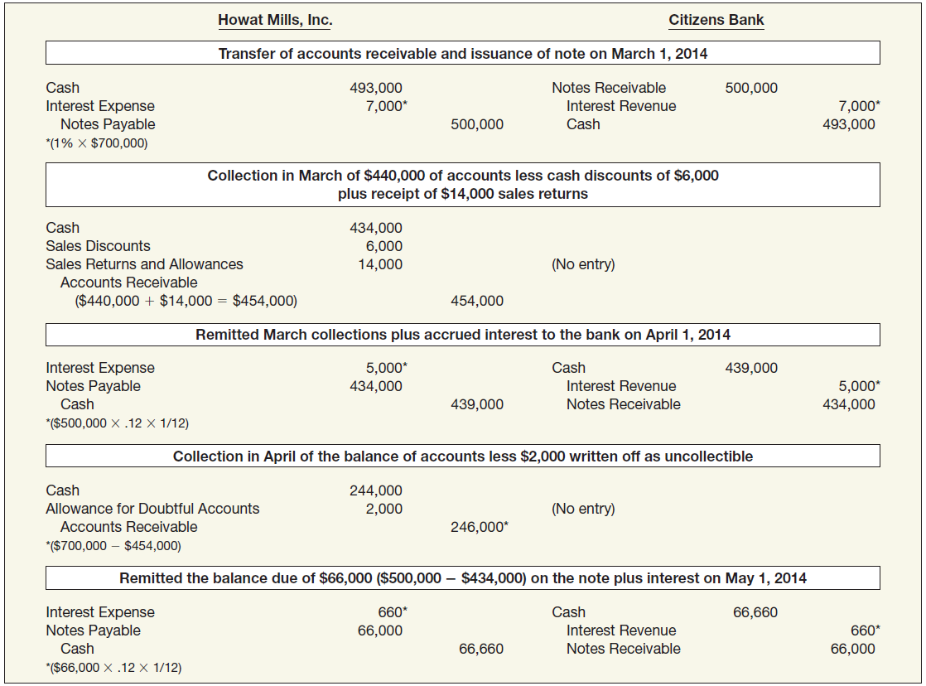
Secured Borrowing
Illustration 7-16
LO 8

Slide 76
Secured Borrowing
Illustration: On April 1, 2014, Prince Company assigns $500,000 of its
accounts receivable to the Third National Bank as collateral for a $300,000 loan due July 1, 2014. The assignment agreement calls for Prince Company to continue to collect the receivables. Third National Bank assesses a finance charge of 2% of the accounts receivable, and interest on the loan is 10% (a realistic rate of interest for a note of this type).
Instructions:
Prepare the April 1, 2014, journal entry for Prince Company.
Prepare the journal entry for Prince’s collection of $350,000 of the accounts receivable during the period from April 1, 2014, through June 30, 2014.
On July 1, 2014, Prince paid Third National all that was due from the loan it secured on April 1, 2014.
LO 8 Explain accounting issues related to disposition of accounts and notes receivable.

Slide 77
Secured Borrowing
Instructions:
Prepare the April 1, 2014, journal entry for Prince Company.
Prepare the journal entry for Prince’s collection of $350,000.
On July 1, 2014, Prince paid Third National all that was.
a)
Cash 290,000
Finance Charge ($500,000 x 2%) 10,000
Notes Payable 300,000
b)
Cash 350,000
Accounts Receivable 350,000
c)
Notes Payable 300,000
Interest Expense (10% x $300,000 x 3/12) 7,500
Cash 307,500
LO 8

Slide 78
Disposition of Accounts and Notes Receivable
Sales of Receivables
Sale Without Recourse
Purchaser assumes risk of collection.
Transfer is outright sale of receivable.
Seller records loss on sale.
Sale With Recourse
Seller guarantees payment to purchaser.
Financial components approach used to record transfer.
LO 8 Explain accounting issues related to disposition of accounts and notes receivable.

Slide 79
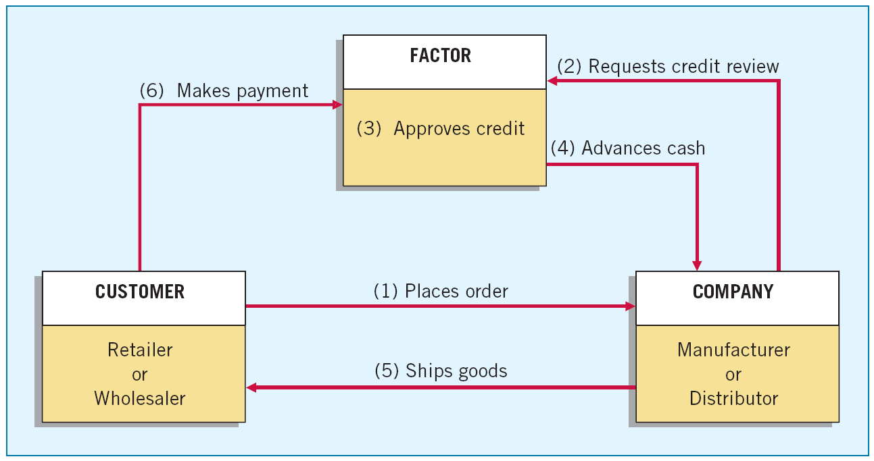
Sales of Receivables
Factors are finance companies or banks that buy receivables from businesses for a fee.
Illustration 7-17
LO 8

Slide 80
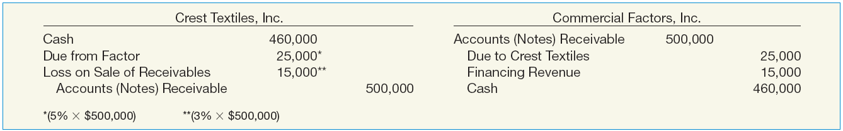
Sales of Receivables
Illustration: Crest Textiles, Inc. factors $500,000 of accounts receivable with Commercial Factors, Inc., on a without recourse basis. Commercial Factors assesses a finance charge of 3 percent of the amount of accounts receivable and retains an amount equal to 5 percent of the accounts receivable (for probable adjustments). Crest Textiles and Commercial Factors make the following journal entries for the receivables transferred without recourse.
Illustration 7-18
LO 8 Explain accounting issues related to disposition of accounts and notes receivable.

Slide 81
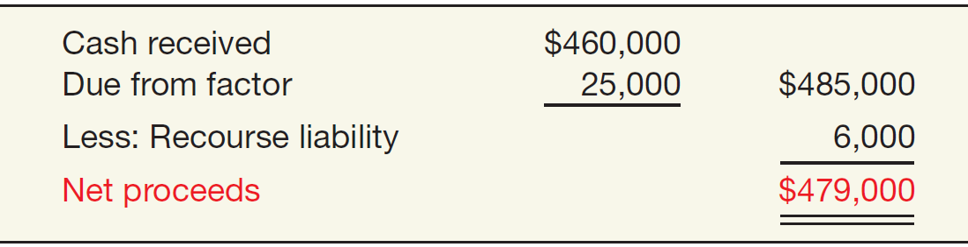
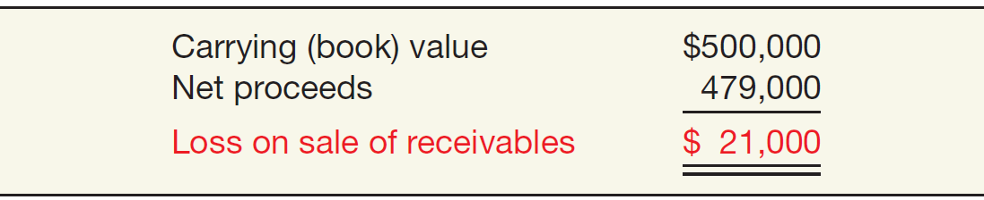
Sales of Receivables
Illustration: Assume Crest Textiles sold the receivables on a with recourse basis. Crest Textiles determines that this recourse obligation has a fair value of $6,000. To determine the loss on the sale of the receivables, Crest Textiles computes the net proceeds from the sale as follows.
Illustration 7-19
Net Proceeds
Computation
Illustration 7-20
Loss on Sale Computation
LO 8

Slide 82
Sales of Receivables
Illustration: Prepare the journal entries for both Crest Textiles and Commercial Factors for the receivables sold with recourse.
Crest Textiles, Inc.
Cash 460,000
Due from Factor 25,000
Loss on Sale of Receivables 21,000
Accounts (Notes) Receivable 500,000
Recourse Liability 6,000
Commercial Factors, Inc.
Accounts Receivable 500,000
Due to Customer (Crest Textiles) 25,000
Interest Revenue 15,000
Cash 460,000
LO 8

Slide 83
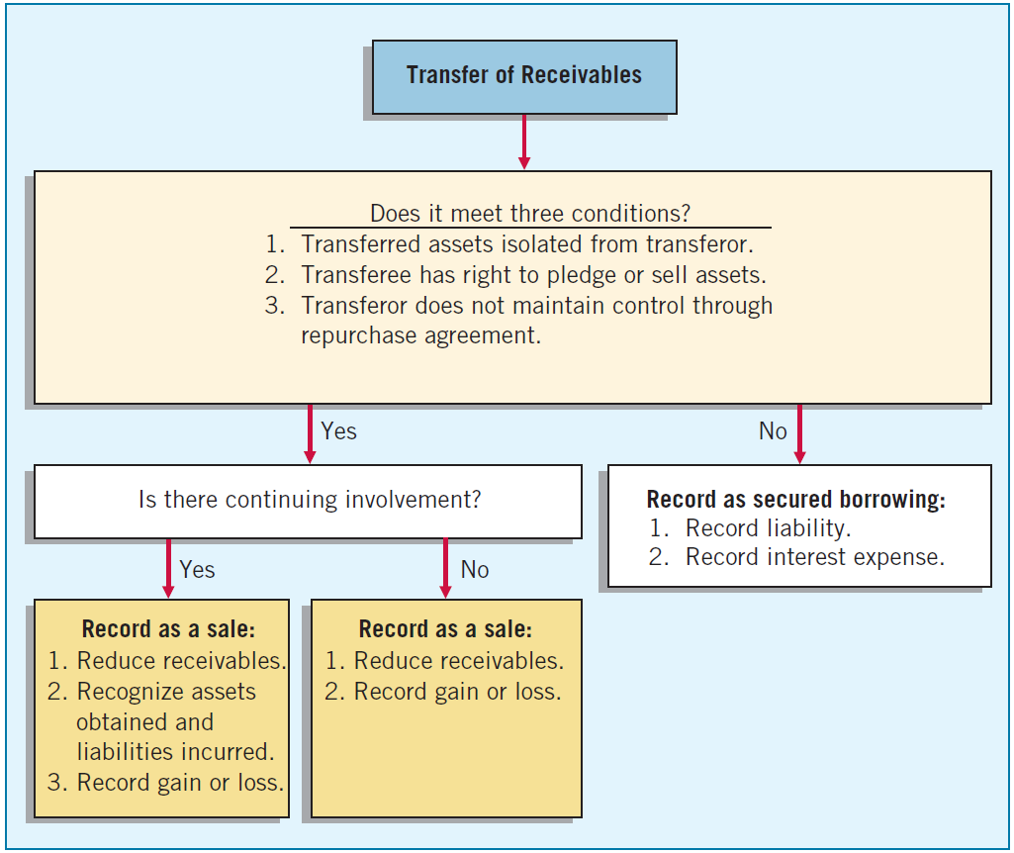
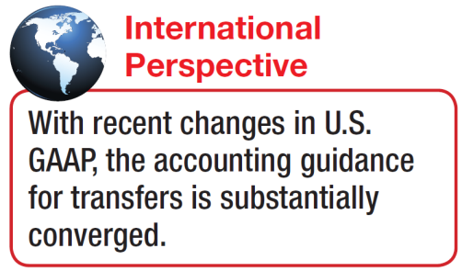
Secured Borrowing versus Sale
The FASB concluded that a sale occurs only if the seller surrenders control of the receivables to the buyer.
Three conditions must be met.
Illustration 7-22
LO 8

Slide 84
7
Cash and Receivables
LEARNING OBJECTIVES
After studying this chapter, you should be able to:
Identify items considered cash.
Indicate how to report cash and related items.
Define receivables and identify the different types of receivables.
Explain accounting issues related to recognition of accounts receivable.
Explain accounting issues related to valuation of accounts receivable.
Explain accounting issues related to recognition and valuation of notes receivable.
Explain the fair value option.
Explain accounting issues related to disposition of accounts and notes receivable.
Describe how to report and analyze receivables.

Slide 85
Presentation and Analysis
Presentation of Receivables
Segregate the different types of receivables that a company possesses, if material.
Appropriately offset the valuation accounts against the proper receivable accounts.
Determine that receivables classified in the current assets section will be converted into cash within the year or the operating cycle, whichever is longer.
Disclose any loss contingencies that exist on the receivables.
Disclose any receivables designated or pledged as collateral.
Disclose the nature of credit risk inherent in the receivables.
LO 9 Describe how to report and analyze receivables.

Slide 86
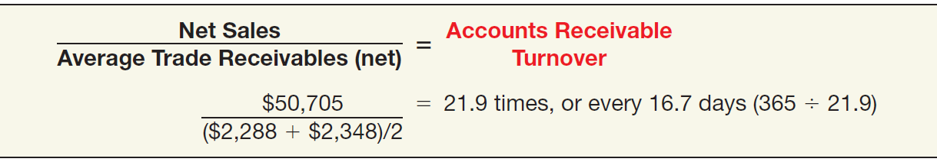
Presentation and Analysis
Analysis of Receivables
Accounts Receivable Turnover Ratio:
  Use to evaluate the liquidity of accounts receivable.
  Measures the number of times, on average, a company collects receivables during the period.
Illustration 7-24
LO 9 Describe how to report and analyze receivables.

