Slide 1
8
Valuation of Inventories: A Cost-Basis Approach
LEARNING OBJECTIVES
After studying this chapter, you should be able to:
Identify major classifications of inventory.
Distinguish between perpetual and periodic inventory systems.
Determine the goods included in inventory and the effects of inventory errors on the financial statements.
Understand the items to include as inventory cost.
Describe and compare the cost flow assumptions used to account for inventories.
Explain the significance and use of a LIFO reserve.
Understand the effect of LIFO liquidations.
Explain the dollar-value LIFO method.
Identify the major advantages and disadvantages of LIFO.
Understand why companies select given inventory methods.

Slide 2
Inventory Issues
Classification
Inventories are asset:
items held for sale in the ordinary course of business, or
goods to be used in the production of goods to be sold.
Businesses with Inventory
Merchandiser
or
Manufacturer
LO 1 Identify major classifications of inventory.

Slide 3
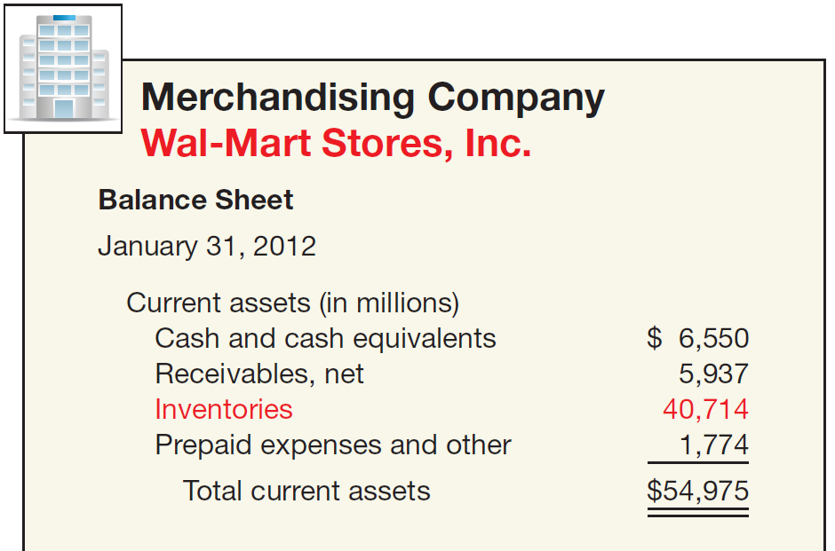
Inventory Issues
Classification
Illustration 8-1
One inventory account.
Purchase merchandise in a form ready for sale.
LO 1 Identify major classifications of inventory.

Slide 4
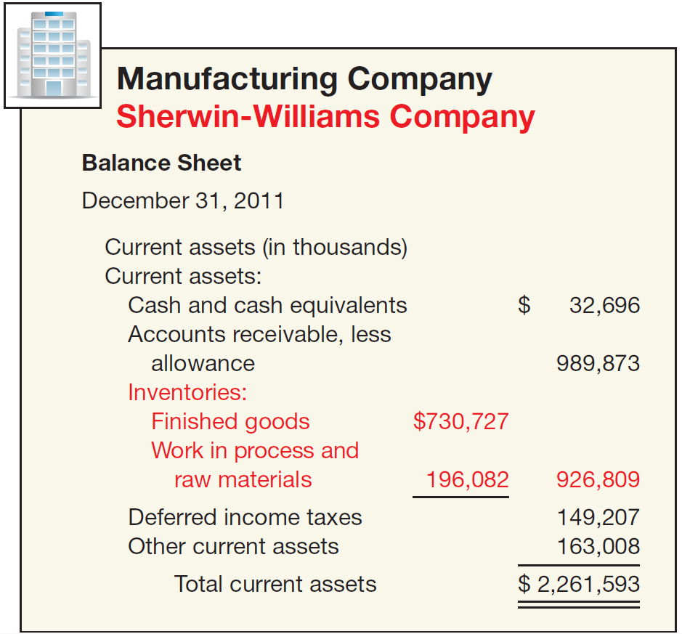
Inventory Issues
Classification
Illustration 8-1
Three accounts
Raw Materials
Work in Process
Finished Goods
LO 1 Identify major classifications of inventory.

Slide 5
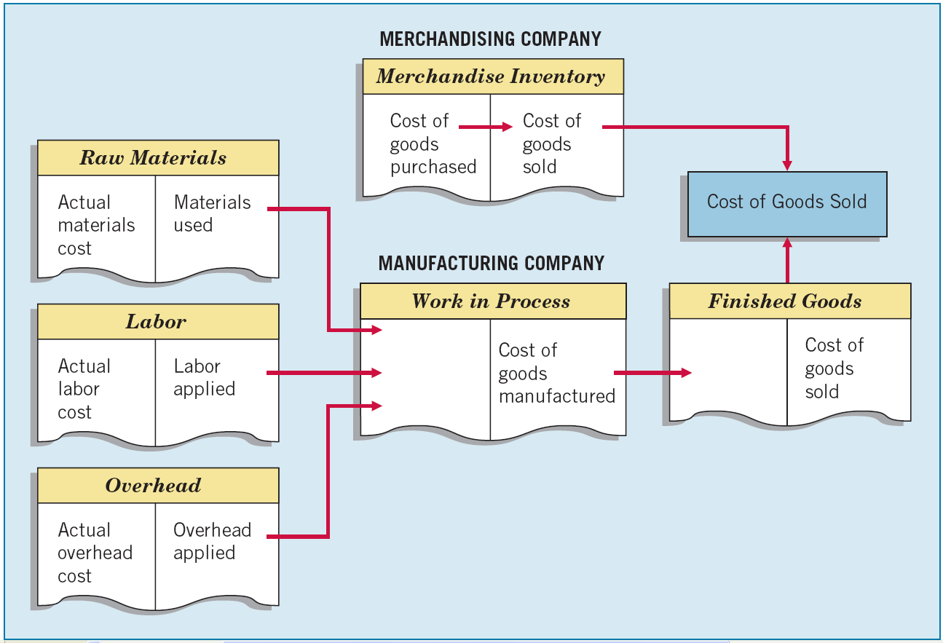
Inventory Issues
Illustration 8-2
Classification
LO 1

Slide 6
8
Valuation of Inventories: A Cost-Basis Approach
LEARNING OBJECTIVES
After studying this chapter, you should be able to:
Identify major classifications of inventory.
Distinguish between perpetual and periodic inventory systems.
Determine the goods included in inventory and the effects of inventory errors on the financial statements.
Understand the items to include as inventory cost.
Describe and compare the cost flow assumptions used to account for inventories.
Explain the significance and use of a LIFO reserve.
Understand the effect of LIFO liquidations.
Explain the dollar-value LIFO method.
Identify the major advantages and disadvantages of LIFO.
Understand why companies select given inventory methods.

Slide 7
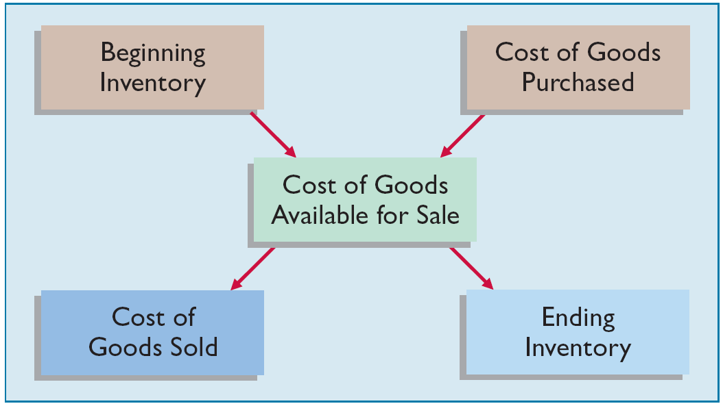
Inventory Issues
Inventory Cost Flow
Illustration 8-3
Two types of systems for maintaining inventory records — perpetual system or periodic system.
LO 2 Distinguish between perpetual and periodic inventory systems.

Slide 8
Inventory Cost Flow
Perpetual System
Purchases of merchandise are debited to Inventory.
Freight-in is debited to Inventory. Purchase returns and allowances and purchase discounts are credited to Inventory.
Cost of goods sold is debited and Inventory is credited for each sale.
Subsidiary records show quantity and cost of each type of inventory on hand.
The perpetual inventory system provides a continuous record of Inventory and Cost of Goods Sold.
LO 2 Distinguish between perpetual and periodic inventory systems.

Slide 9
Inventory Cost Flow
Periodic System
Purchases of merchandise are debited to Purchases.
Ending Inventory determined by physical count.
Calculation of Cost of Goods Sold:
Beginning inventory $ 100,000
Purchases, net + 800,000
Goods available for sale 900,000
Ending inventory - 125,000
Cost of goods sold $ 775,000
LO 2 Distinguish between perpetual and periodic inventory systems.

Slide 10
Inventory Cost Flow
Comparing Perpetual and Periodic System
Illustration: Fesmire Company had the following transactions during the current year.
Record these transactions using the Perpetual and Periodic systems.
LO 2 Distinguish between perpetual and periodic inventory systems.

Slide 11
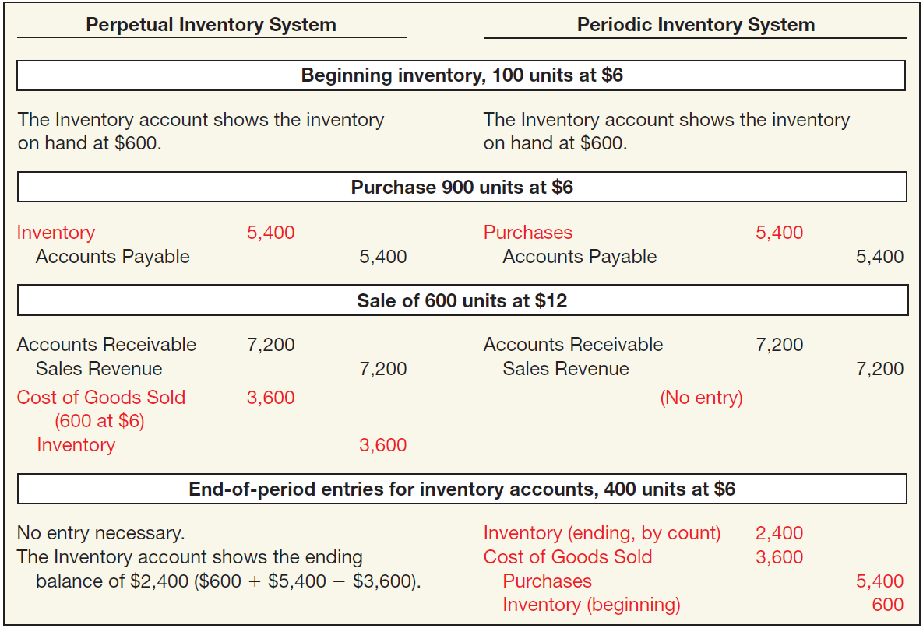
Inventory Cost Flow
Illustration 8-4
Advance slide in presentation mode to reveal answer.
LO 2

Slide 12
Inventory Cost Flow
Illustration: Assume that at the end of the reporting period, the perpetual inventory account reported an inventory balance of $4,000. However, a physical count indicates inventory of $3,800 is actually on hand. The entry to record the necessary write-down is as follows.
Inventory Over and Short 200
Inventory 200
Note: Inventory Over and Short adjusts Cost of Goods Sold. In practice, companies sometimes report Inventory Over and Short in the “Other revenues and gains” or “Other expenses and losses” section of the income statement.
LO 2 Distinguish between perpetual and periodic inventory systems.

Slide 13
Inventory Issues
Inventory Control
All companies need periodic verification of the inventory records
by actual count, weight, or measurement,
with counts compared with detailed inventory records.
Companies should take the physical inventory
near the end of their fiscal year,
to properly report inventory quantities in their annual accounting reports.
LO 2 Distinguish between perpetual and periodic inventory systems.

Slide 14
Basic Issues in Inventory Valuation
Valuation requires determining
The physical goods (goods on hand, goods in transit, consigned goods, special sales agreements).
The costs to include (product vs. period costs).
The cost flow assumption (specific Identification, average cost, FIFO, LIFO, retail, etc.).
LO 2 Distinguish between perpetual and periodic inventory systems.

Slide 15
8
Valuation of Inventories: A Cost-Basis Approach
LEARNING OBJECTIVES
After studying this chapter, you should be able to:
Identify major classifications of inventory.
Distinguish between perpetual and periodic inventory systems.
Determine the goods included in inventory and the effects of inventory errors on the financial statements.
Understand the items to include as inventory cost.
Describe and compare the cost flow assumptions used to account for inventories.
Explain the significance and use of a LIFO reserve.
Understand the effect of LIFO liquidations.
Explain the dollar-value LIFO method.
Identify the major advantages and disadvantages of LIFO.
Understand why companies select given inventory methods.

Slide 16
Physical Goods Included in Inventory
A company should record purchases when it obtains legal title to the goods.
Illustration 8-6
LO 3 Determine the goods included in inventory and the effects of inventory errors on the financial statements.

Slide 17
Physical Goods Included in Inventory
Effect of Inventory Errors
Ending Inventory Misstated
Illustration 8-7
The effect of an error on net income in one year will be counterbalanced in the next, however the income statement will be misstated for both years.
LO 3 Determine the goods included in inventory and the effects of inventory errors on the financial statements.

Slide 18
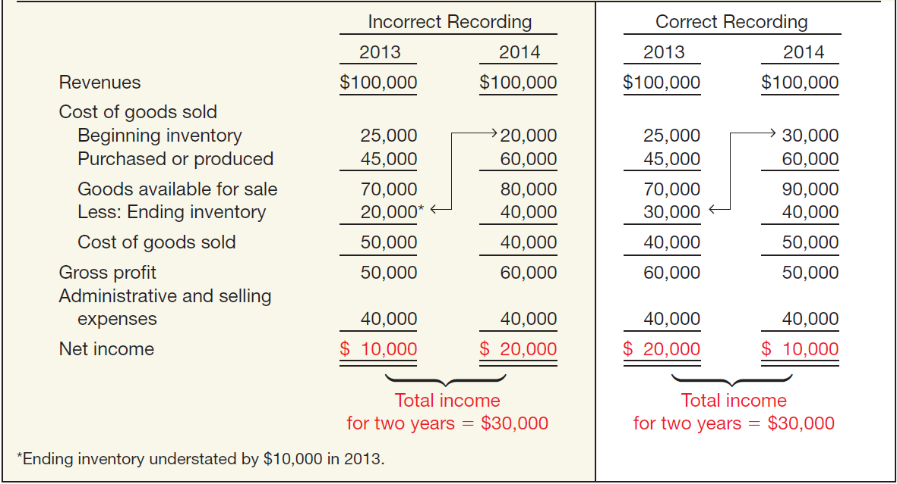
Effect of Inventory Errors
Illustration: Jay Weiseman Corp. understates its ending inventory by $10,000 in 2013; all other items are correctly stated.
Illustration 8-8
LO 3

Slide 19
Effect of Inventory Errors
Effect of Inventory Errors
Purchases and Inventory Misstated
Illustration 8-9
The understatement does not affect cost of goods sold and net income because the errors offset one another.
LO 3 Determine the goods included in inventory and the effects of inventory errors on the financial statements.

Slide 20
8
Valuation of Inventories: A Cost-Basis Approach
LEARNING OBJECTIVES
After studying this chapter, you should be able to:
Identify major classifications of inventory.
Distinguish between perpetual and periodic inventory systems.
Determine the goods included in inventory and the effects of inventory errors on the financial statements.
Understand the items to include as inventory cost.
Describe and compare the cost flow assumptions used to account for inventories.
Explain the significance and use of a LIFO reserve.
Understand the effect of LIFO liquidations.
Explain the dollar-value LIFO method.
Identify the major advantages and disadvantages of LIFO.
Understand why companies select given inventory methods.

Slide 21
Costs Included in Inventory
Product Costs
Costs directly connected with bringing the goods to the buyer’s place of business and converting such goods to a salable condition.
Period Costs
Generally selling, general, and administrative expenses.
Treatment of Purchase Discounts
Gross vs. Net Method
LO 4 Understand the items to include as inventory cost.

Slide 22
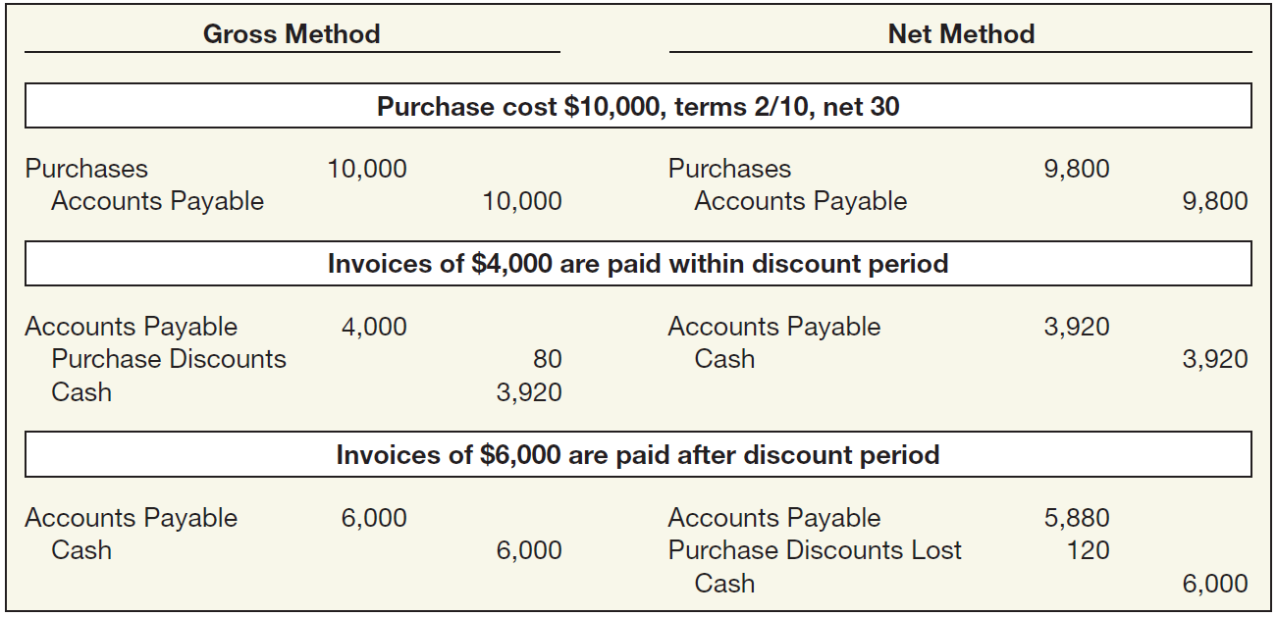
Costs Included in Inventory
Treatment of Purchase Discounts
Illustration 8-11
**
*
Advance slide in presentation mode to reveal answer.
* $4,000 x 2% = $80
** $10,000 x 98% = $9,800
LO 4

Slide 23
8
Valuation of Inventories: A Cost-Basis Approach
LEARNING OBJECTIVES
After studying this chapter, you should be able to:
Identify major classifications of inventory.
Distinguish between perpetual and periodic inventory systems.
Determine the goods included in inventory and the effects of inventory errors on the financial statements.
Understand the items to include as inventory cost.
Describe and compare the cost flow assumptions used to account for inventories.
Explain the significance and use of a LIFO reserve.
Understand the effect of LIFO liquidations.
Explain the dollar-value LIFO method.
Identify the major advantages and disadvantages of LIFO.
Understand why companies select given inventory methods.

Slide 24
Which Cost Flow Assumptions to Adopt?
Specific Identification
vs.
FIFO --- LIFO --- Average Cost
Cost Flow Assumption Adopted
does NOT need to be consistent with
Physical Movement of Goods
Method adopted should be one that most clearly reflects periodic income.
LO5 Describe and compare the cost flow assumptions used to account for inventories.

Slide 25
Which Cost Flow Assumptions to Adopt?
Illustration: Call-Mart Inc. had the following transactions in its first month of operations.
Calculate Goods Available for Sale
Beginning inventory (2,000 x $4) $ 8,000
Purchases:
6,000 x $4.40 26,400
2,000 x 4.75 9,500
Goods available for sale $43,900
LO 5

Slide 26
Which Cost Flow Assumptions to Adopt?
Specific Identification
Includes in cost of goods sold the costs of the specific items sold.
Used when handling a relatively small number of costly, easily distinguishable items.
Matches actual costs against actual revenue.
Cost flow matches the physical flow of the goods.
May allow a company to manipulate net income.
LO5 Describe and compare the cost flow assumptions used to account for inventories.

Slide 27
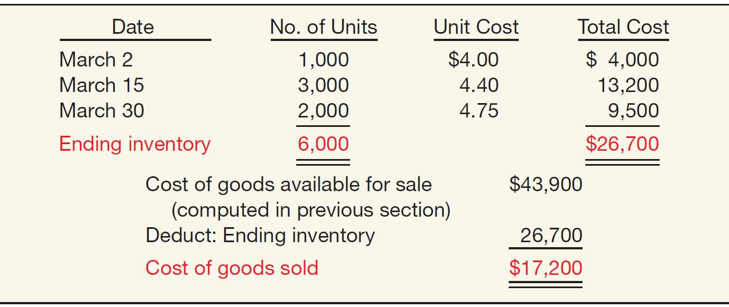
Specific Identification
Illustration: Call-Mart Inc.’s 6,000 units of inventory consists of 1,000 units from the March 2 purchase, 3,000 from the March 15 purchase, and 2,000 from the March 30 purchase. Compute the amount of ending inventory and cost of goods sold.
Illustration 8-12
Advance slide in presentation mode to reveal answer.

Slide 28
Which Cost Flow Assumptions to Adopt?
Average-Cost
Prices items in the inventory on the basis of the average cost of all similar goods available during the period.
Not as subject to income manipulation.
Measuring a specific physical flow of inventory is often impossible.
LO5 Describe and compare the cost flow assumptions used to account for inventories.

Slide 29
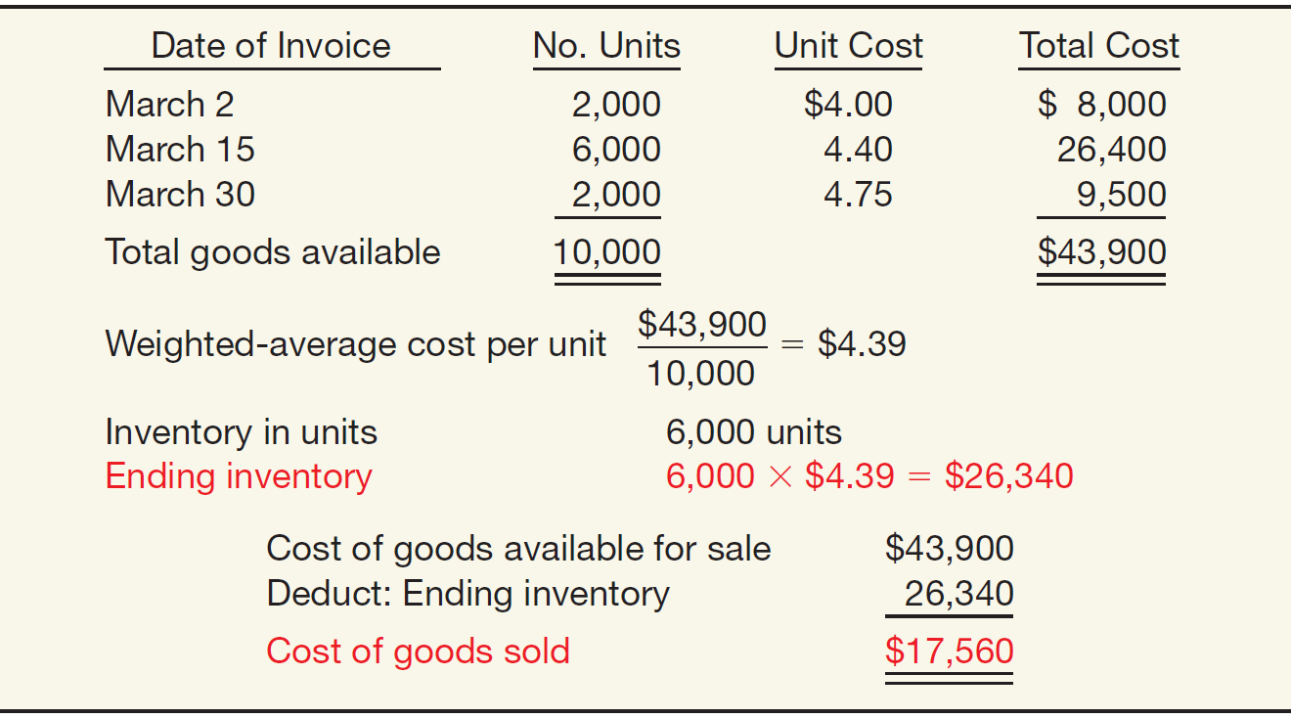
Average-Cost
Weighted-Average Method
Illustration 8-13
Advance slide in presentation mode to reveal answer.
LO 5

Slide 30
Average-Cost
Moving-Average Method
Illustration 8-14
In this method, Call-Mart computes a new average unit cost each time it makes a purchase.
Advance slide in presentation mode to reveal answer.
LO5 Describe and compare the cost flow assumptions used to account for inventories.

Slide 31
Which Cost Flow Assumptions to Adopt?
First-In, First-Out (FIFO)
Prices items in the inventory on the basis of the average cost of all similar goods available during the period.
Assumes goods are used in the order in which they are purchased.
Approximates the physical flow of goods.
Ending inventory is close to current cost.
Fails to match current costs against current revenues.
LO5 Describe and compare the cost flow assumptions used to account for inventories.

Slide 32
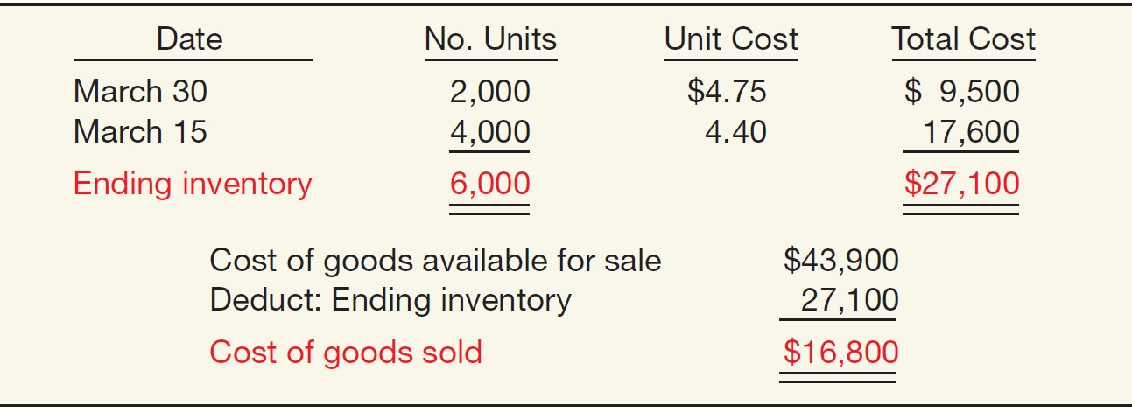
First-In, First-Out (FIFO)
Periodic Inventory System
Illustration 8-15
Determine cost of ending inventory by taking the cost of the most recent purchase and working back until it accounts for all units in the inventory.
Advance slide in presentation mode to reveal answer.
LO5 Describe and compare the cost flow assumptions used to account for inventories.

Slide 33
First-In, First-Out (FIFO)
Perpetual Inventory System
Illustration 8-16
In all cases where FIFO is used, the inventory and cost of goods sold would be the same at the end of the month whether a perpetual or periodic system is used.
Advance slide in presentation mode to reveal answer.
LO5 Describe and compare the cost flow assumptions used to account for inventories.

Slide 34
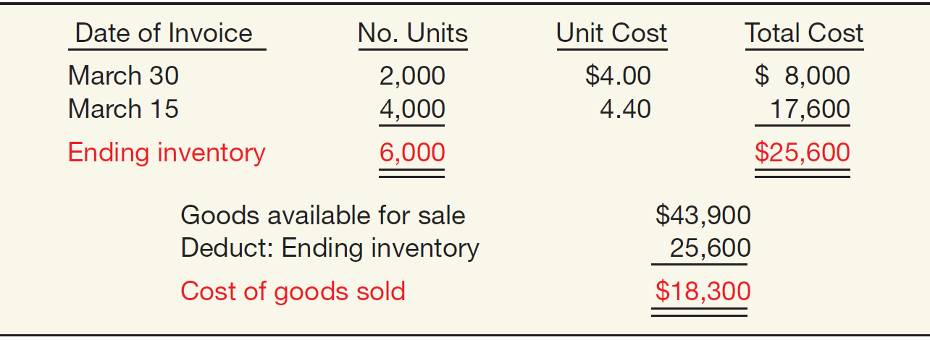
Last-In, First-Out (LIFO)
Periodic Inventory System
Illustration 8-17
The cost of the total quantity sold or issued during the month comes from the most recent purchases.
Advance slide in presentation mode to reveal answer.
LO5 Describe and compare the cost flow assumptions used to account for inventories.

Slide 35
Last-In, First-Out (LIFO)
Perpetual Inventory System
Illustration 8-18
The LIFO method results in different ending inventory and cost of goods sold amounts than the amounts calculated under the periodic method.
Advance slide in presentation mode to reveal answer.
LO5 Describe and compare the cost flow assumptions used to account for inventories.

Slide 36
8
Valuation of Inventories: A Cost-Basis Approach
LEARNING OBJECTIVES
After studying this chapter, you should be able to:
Identify major classifications of inventory.
Distinguish between perpetual and periodic inventory systems.
Determine the goods included in inventory and the effects of inventory errors on the financial statements.
Understand the items to include as inventory cost.
Describe and compare the cost flow assumptions used to account for inventories.
Explain the significance and use of a LIFO reserve.
Understand the effect of LIFO liquidations.
Explain the dollar-value LIFO method.
Identify the major advantages and disadvantages of LIFO.
Understand why companies select given inventory methods.

Slide 37
Special Issues Related to LIFO
LIFO Reserve
Many companies use
LIFO for tax and external financial reporting purposes.
FIFO, average cost, or standard cost system for internal reporting purposes.
Reasons:
Pricing decisions.
Recordkeeping easier.
Profit-sharing or bonus arrangements.
LIFO troublesome for interim periods.
LO 6 Explain the significance and use of a LIFO reserve.

Slide 38
Special Issues Related to LIFO
LIFO Reserve is the difference between the inventory method used for internal reporting purposes and LIFO.
Illustration: Acme Boot Company uses the FIFO method for internal
reporting purposes and LIFO for external reporting purposes. At January 1, 2014, the Allowance to Reduce Inventory to LIFO balance is $20,000. At December 31, 2014, the balance should be $50,000. As a result, Acme Boot realizes a LIFO effect and makes the following entry at year-end.
Journal entry to reduce inventory to LIFO:
Cost of Goods Sold 30,000
Allowance to Reduce Inventory to LIFO 30,000
LO 6 Explain the significance and use of a LIFO reserve.

Slide 39
Special Issues Related to LIFO
LIFO Reserve
Companies should disclose either the LIFO reserve or the replacement cost of the inventory
Illustration 8-19
LO 6 Explain the significance and use of a LIFO reserve.

Slide 40
8
Valuation of Inventories: A Cost-Basis Approach
LEARNING OBJECTIVES
After studying this chapter, you should be able to:
Identify major classifications of inventory.
Distinguish between perpetual and periodic inventory systems.
Determine the goods included in inventory and the effects of inventory errors on the financial statements.
Understand the items to include as inventory cost.
Describe and compare the cost flow assumptions used to account for inventories.
Explain the significance and use of a LIFO reserve.
Understand the effect of LIFO liquidations.
Explain the dollar-value LIFO method.
Identify the major advantages and disadvantages of LIFO.
Understand why companies select given inventory methods.

Slide 41
Special Issues Related to LIFO
LIFO Liquidation
Older, low cost inventory is sold resulting in a lower cost of goods sold, higher net income, and higher taxes.
The specific-goods approach to costing LIFO inventories is often unrealistic for two reasons:
Accounting cost of tracking each inventory item is expensive.
Erosion of the LIFO inventory can easily occur (LIFO liquidation) which often distorts net income and leads to substantial tax payments.
LO 7 Understand the effect of LIFO liquidations.

Slide 42
LIFO Liquidation
Illustration: Basler Co. has 30,000 pounds of steel in its inventory on December 31, 2014, with cost determined on a specific-goods LIFO approach.
LO 7 Understand the effect of LIFO liquidations.

Slide 43
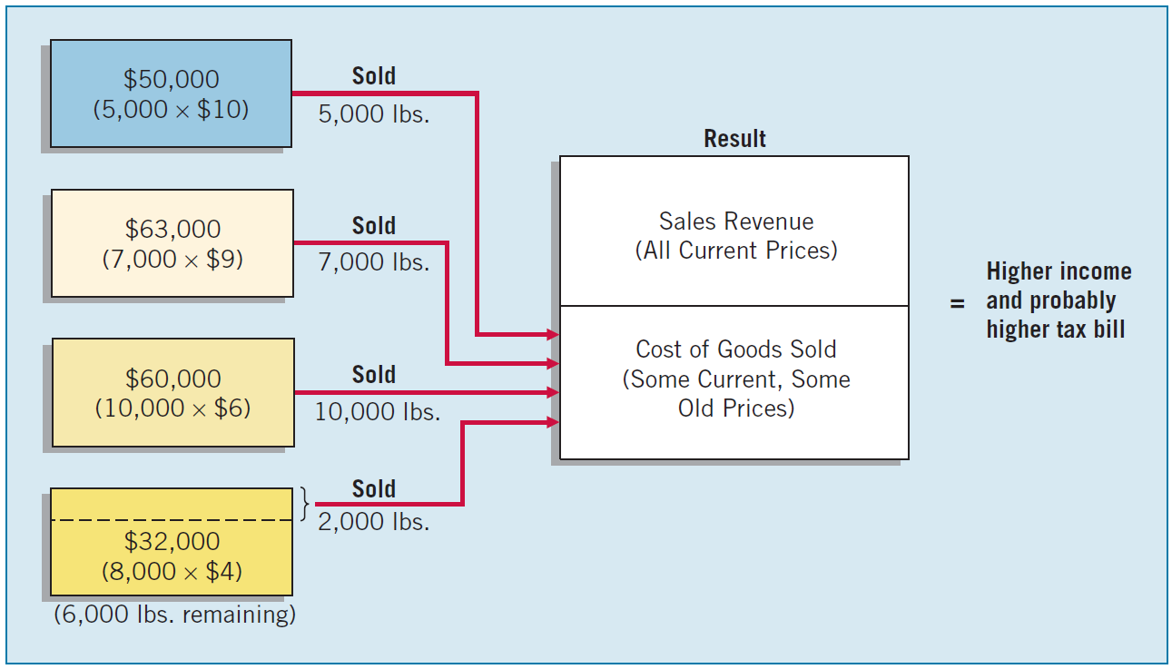
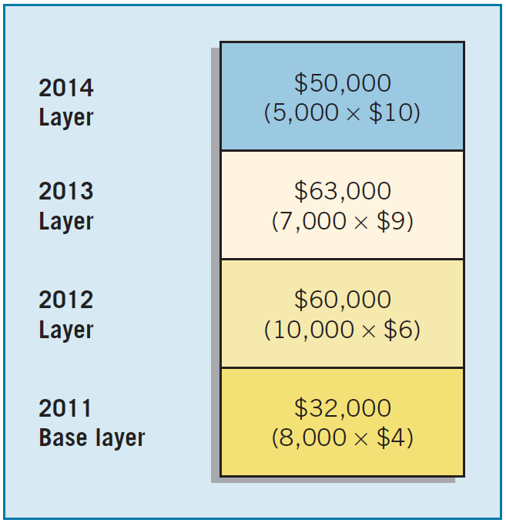
LIFO Liquidation
Illustration: At the end of 2015, only 6,000 pounds of steel remained in inventory.
Illustration 8-21
Illustration 8-20
LO 7 Understand the effect of LIFO liquidations.

Slide 44
8
Valuation of Inventories: A Cost-Basis Approach
LEARNING OBJECTIVES
After studying this chapter, you should be able to:
Identify major classifications of inventory.
Distinguish between perpetual and periodic inventory systems.
Determine the goods included in inventory and the effects of inventory errors on the financial statements.
Understand the items to include as inventory cost.
Describe and compare the cost flow assumptions used to account for inventories.
Explain the significance and use of a LIFO reserve.
Understand the effect of LIFO liquidations.
Explain the dollar-value LIFO method.
Identify the major advantages and disadvantages of LIFO.
Understand why companies select given inventory methods.

Slide 45
Special Issues Related to LIFO
Dollar-Value LIFO
Increases and decreases in a pool are measured in terms of total dollar value, not physical quantity of goods.
Advantage:
Broader range of goods in pool.
Permits replacement of goods that are similar.
Helps protect LIFO layers from erosion.
LO 8 Explain the dollar-value LIFO method.

Slide 46
Dollar-Value LIFO
Illustration: The following information relates to the Whitefish Company.
Use the dollar-value LIFO method to compute the ending inventory for 2012 through 2014.
LO 8 Explain the dollar-value LIFO method.

Slide 47
Dollar-Value LIFO
LO 8

Slide 48
Dollar-Value LIFO
LO 8

Slide 49
Dollar-Value LIFO
LO 8

Slide 50
Dollar-Value LIFO
Selecting a Price Index
Many companies use the general price-level index that the federal government publishes each month.
Most popular is the Consumer Price Index for Urban Consumers (CPI-U).
Companies also use more-specific external price indexes.
Company may compute its own specific internal price index.
Illustration 8-26
Formula for Computing a Price Index
LO 8 Explain the dollar-value LIFO method.

Slide 51
Special Issues Related to LIFO
Comparison of LIFO Approaches
Specific-goods LIFO - costing goods on a unit basis is expensive and time consuming.
Specific-goods Pooled LIFO approach.
Reduces record keeping and clerical costs.
More difficult to erode the layers.
Using quantities as measurement basis can lead to untimely LIFO liquidations.
Dollar-value LIFO is used by most companies.
LO 8 Explain the dollar-value LIFO method.

Slide 52
8
Valuation of Inventories: A Cost-Basis Approach
LEARNING OBJECTIVES
After studying this chapter, you should be able to:
Identify major classifications of inventory.
Distinguish between perpetual and periodic inventory systems.
Determine the goods included in inventory and the effects of inventory errors on the financial statements.
Understand the items to include as inventory cost.
Describe and compare the cost flow assumptions used to account for inventories.
Explain the significance and use of a LIFO reserve.
Understand the effect of LIFO liquidations.
Explain the dollar-value LIFO method.
Identify the major advantages and disadvantages of LIFO.
Understand why companies select given inventory methods.

Slide 53
Special Issues Related to LIFO
Advantages
Disadvantages
Matching
Tax Benefits/Improved Cash Flow
Future Earnings Hedge
Reduced Earnings
Inventory Understated
Physical Flow
Involuntary Liquidation / Poor Buying Habits
LO 9 Identify the major advantages and disadvantages of LIFO.

Slide 54
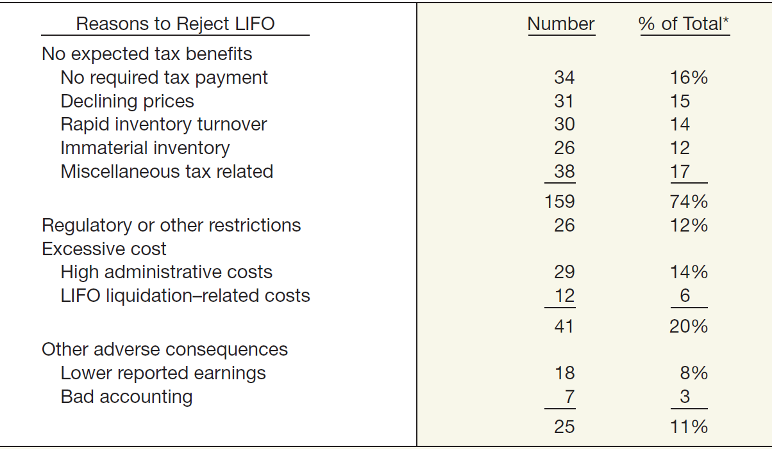
Special Issues Related to LIFO
Illustration 8-29
Why Do Companies Reject LIFO? Summary of Responses
LO 9 Identify the major advantages and disadvantages of LIFO.

Slide 55
8
Valuation of Inventories: A Cost-Basis Approach
LEARNING OBJECTIVES
After studying this chapter, you should be able to:
Identify major classifications of inventory.
Distinguish between perpetual and periodic inventory systems.
Determine the goods included in inventory and the effects of inventory errors on the financial statements.
Understand the items to include as inventory cost.
Describe and compare the cost flow assumptions used to account for inventories.
Explain the significance and use of a LIFO reserve.
Understand the effect of LIFO liquidations.
Explain the dollar-value LIFO method.
Identify the major advantages and disadvantages of LIFO.
Understand why companies select given inventory methods.

Slide 56
Basis for Selection of Inventory Method
LIFO is generally preferred:
If selling prices and revenues are increasing faster than costs and
If a company has a fairly constant “base stock.”
LIFO is not appropriate:
Where prices tend to lag behind costs,
If specific identification traditionally used, and
Where unit costs tend to decrease as production increases.
LO 10 Understand why companies select given inventory methods.

Slide 57
Basis for Selection of Inventory Method
Tax consequences are another consideration.
Switching from FIFO to LIFO usually results in an immediate tax benefit.
Concern about reduced income resulting from adoption of LIFO has even less substance now because the IRS has also relaxed the LIFO conformity rule.
Companies are able to disclose FIFO income numbers in the financial reports if they so desire.
LO 10 Understand why companies select given inventory methods.

Slide 58
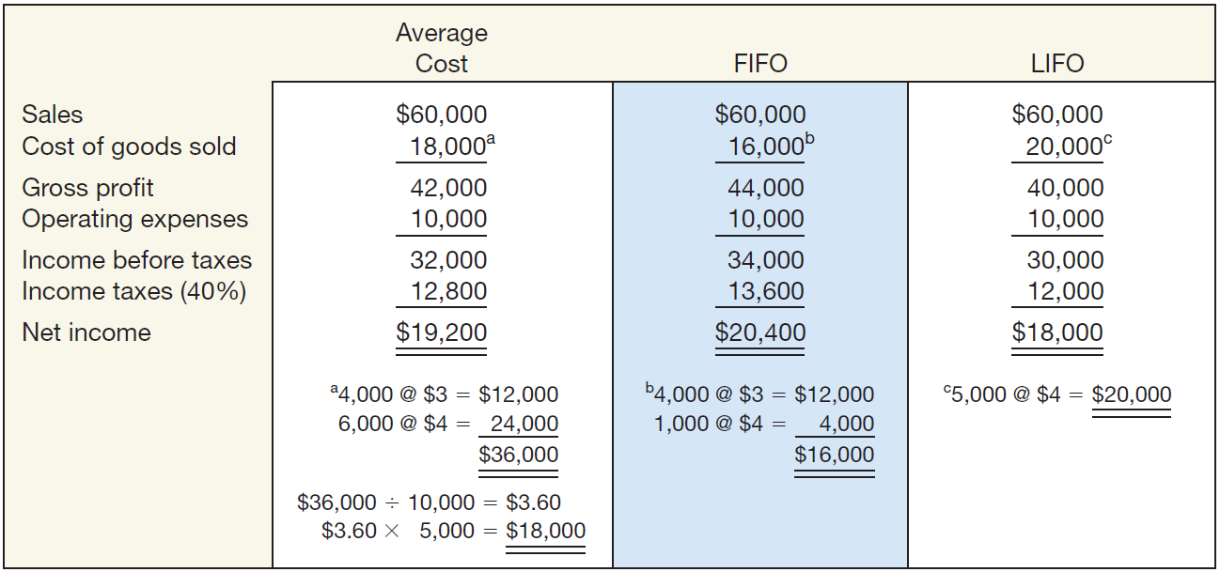
Inventory Valuation Methods - Summary
Illustration 8-31
Notice that gross profit and net income are lowest under LIFO, highest under FIFO, and somewhere in the middle under average-cost.
LO 10

Slide 59
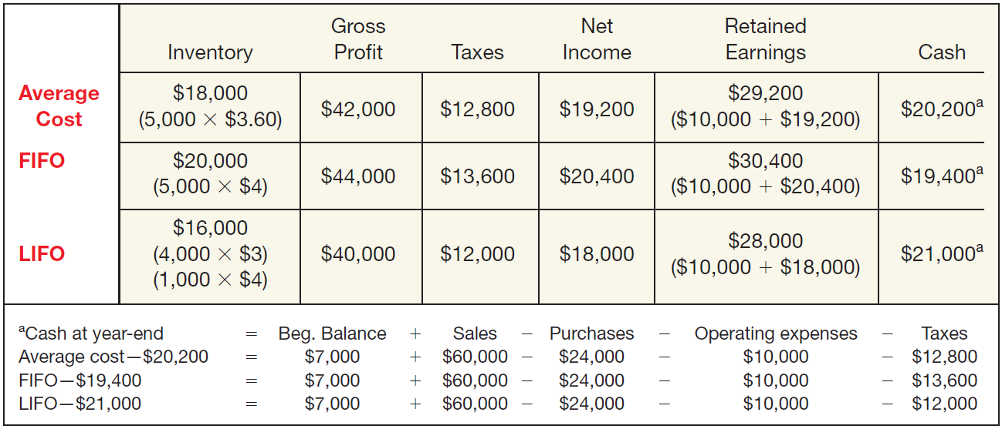
Inventory Valuation Methods - Summary
Illustration 8-32
LIFO results in the highest cash balance at year-end (because taxes are
lower). This example assumes that prices are rising. The opposite result occurs if prices are declining.
LO 10

