Slide 1
9
Inventories: Additional Valuation Issues
LEARNING OBJECTIVES
After studying this chapter, you should be able to:
Describe and apply the lower-of-cost-or-market rule.
Explain when companies value inventories at net realizable value.
Explain when companies use the relative sales value method to value inventories.
Discuss accounting issues related to purchase commitments.
Determine ending inventory by applying the gross profit method.
Determine ending inventory by applying the retail inventory method.
Explain how to report and analyze inventory.

Slide 2
Lower-of-Cost-or-Market
A company abandons the historical cost principle when the future utility (revenue-producing ability) of the asset drops below its original cost.
Market = Replacement Cost.
Value goods at cost or cost to replace, whichever is lower.
Loss should be recorded when loss occurs, not in the period of sale.
LO 1 Describe and apply the lower-of-cost-or-market rule.

Slide 3
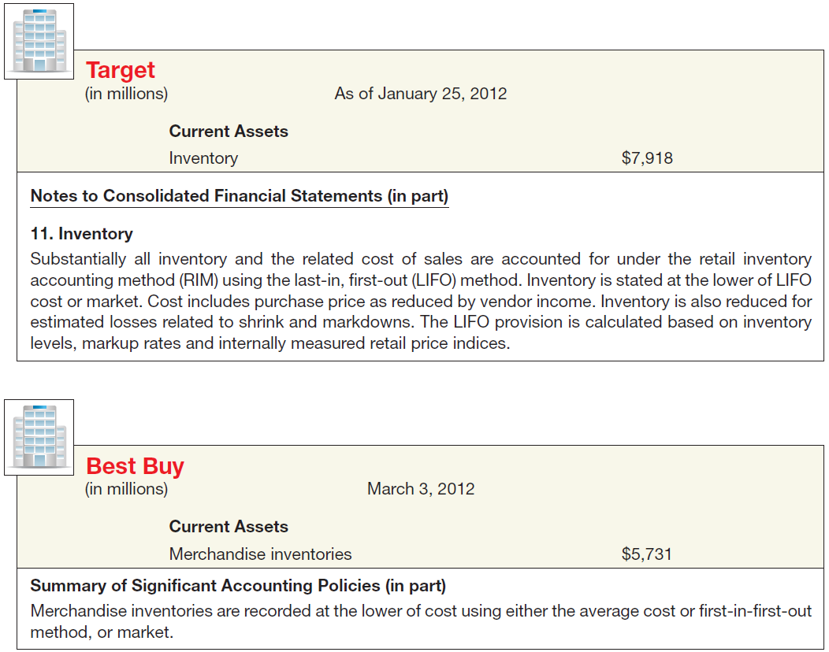
Lower-of-Cost-or-Market
Illustration 9-1 Lower-of-Cost-or-Market Disclosures
LO 1

Slide 4
Lower-of-Cost-or-Market
Ceiling and Floor
Why use Replacement Cost (RC) for Market?
Decline in the RC usually = decline in selling price.
RC allows a consistent rate of gross profit.
If reduction in RC fails to indicate reduction in utility, then two additional valuation limitations are used:
Ceiling - net realizable value and
Floor - net realizable value less a normal profit margin.
LO 1 Describe and apply the lower-of-cost-or-market rule.

Slide 5
Lower-of-Cost-or-Market
Net realizable value (NRV) is the is the estimated selling price in the ordinary course of business, less reasonably predictable costs of completion and disposal (often referred to as net selling price).
Illustration 9-2
LO 1 Describe and apply the lower-of-cost-or-market rule.

Slide 6
Lower-of-Cost-or-Market
What is the rationale for the Ceiling and Floor limitations?
Illustration 9-3
Ceiling = NRV
Not
>
Replacement
Cost
Cost
Market
Not
<
Floor =
NRV less Normal
Profit Margin
GAAP
LCM
LO 1 Describe and apply the lower-of-cost-or-market rule.

Slide 7
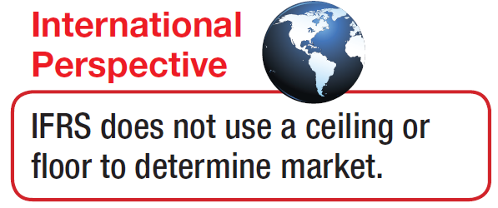
Lower-of-Cost-or-Market
What is the rationale for the Ceiling and Floor limitations?
Ceiling – prevents overstatement of the value of obsolete, damaged, or shopworn inventories.
Floor – deters understatement of inventory and overstatement of the loss in the current period.
LO 1 Describe and apply the lower-of-cost-or-market rule.

Slide 8
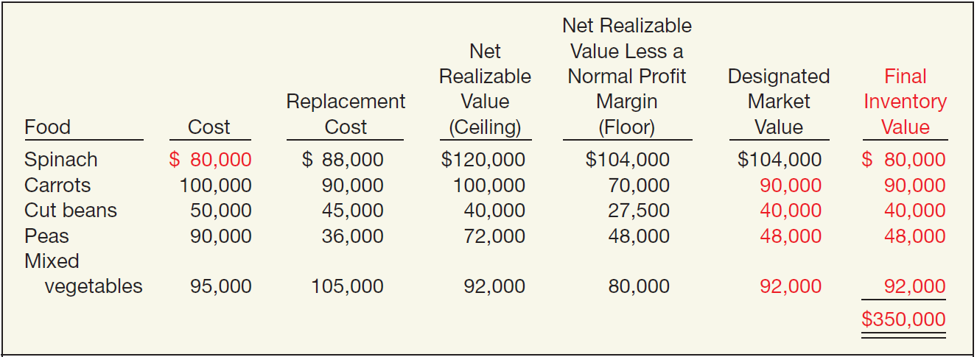
Lower-of-Cost-or-Market
How Lower-of-Cost-or-Market Works
Illustration 9-5
Advance slide in presentation mode to reveal answers.
LO 1 Describe and apply the lower-of-cost-or-market rule.

Slide 9
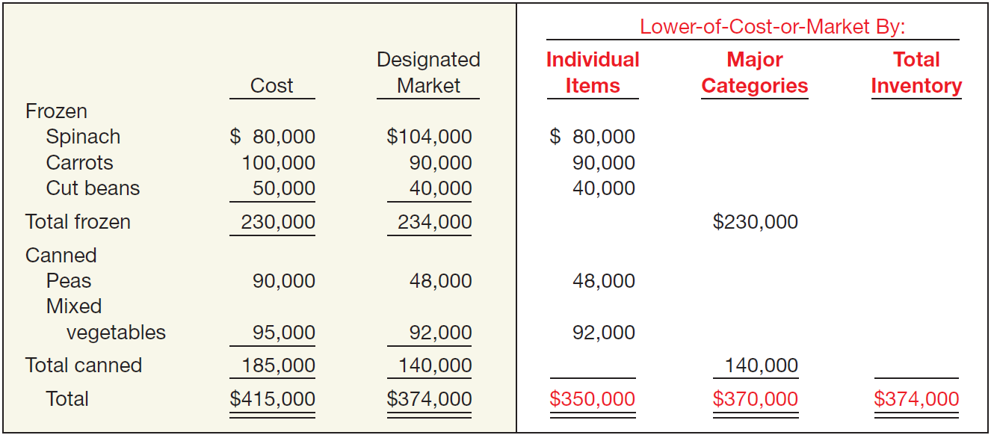
Lower-of-Cost-or-Market
Methods of Applying Lower-of-Cost-or-Market
Illustration 9-6
Advance slide in presentation mode to reveal answers.
LO 1 Describe and apply the lower-of-cost-or-market rule.

Slide 10
Lower-of-Cost-or-Market
Recording “Market” Instead of Cost
Ending inventory (cost) $ 82,000
Ending inventory (market) 70,000
Adjustment to LCM $ 12,000
Loss Method
Loss Due to Decline in Inventory 12,000
Allowance to Reduce Inventory to Market 12,000
COGS
Method
Cost of Goods Sold 12,000
Inventory 12,000
LO 1 Describe and apply the lower-of-cost-or-market rule.

Slide 11
Lower-of-Cost-or-Market
Balance Sheet
LO 1 Describe and apply the lower-of-cost-or-market rule.

Slide 12
Lower-of-Cost-or-Market
Income Statement
LO 1

Slide 13
Lower-of-Cost-or-Market
Illustration: Remmers Company manufactures desks. The company attempts to obtain a 20% gross margin on selling price. At December 31, 2014, the following finished desks appear in the company’s inventory.
The 2014 catalog was in effect through November 2014, and the 2015 catalog is effective as of December 1, 2015.
Instructions: At what amount should each of the four desks appear in the company’s December 31, 2015, inventory, assuming that the company has adopted a lower-of-FIFO-cost-or-market approach for valuation of inventories on an individual-item basis?
LO 1

Slide 14
Lower-of-Cost-or-Market
Ceiling = 450
(500 – 50)
Not
>
Replacement
Cost = 460
Cost = 470
Market = 450
Not
<
Floor = 350
(450-(500 x 20%))
LCM = 450
LO 1

Slide 15
Lower-of-Cost-or-Market
Ceiling = 480
(540 – 60)
Not
>
Replacement
Cost = 430
Cost = 450
Market = 430
Not
<
Floor = 372
(480-(540 x 20%))
LCM = 430
LO 1

Slide 16
Lower-of-Cost-or-Market
Ceiling = 820
(900 – 80)
Not
>
Replacement
Cost = 610
Cost = 830
Market = 640
Not
<
Floor = 640
(820-(900 x 20%))
LCM = 640
LO 1

Slide 17
Lower-of-Cost-or-Market
Ceiling = 1,070
(1,200 – 130)
Not
>
Replacement
Cost = 1,000
Cost = 960
Market = 1,000
Not
<
Floor = 830
(1,070-(1,200 x 20%))
LCM = 960
LO 1

Slide 18
Lower-of-Cost-or-Market
Use of an Allowance—Multiple Periods
In general, accountants leave the allowance account on the books. They merely adjust the balance at the next year-end to agree with the discrepancy between cost and the lower-of-cost-or-market at that balance sheet date.
Illustration 9-10
LO 1 Describe and apply the lower-of-cost-or-market rule.

Slide 19
Lower-of-Cost-or-Market
Evaluation of Lower-of-Cost-or-Market Rule
Some Deficiencies:
Expense recorded when loss in utility occurs. Profit on sale recognized at the point of sale.
Inventory valued at cost in one year and at market in the next year.
Net income in year of loss is lower. Net income in subsequent period may be higher than normal if expected reductions in sales price do not materialize.
LCM uses a “normal profit” in determining inventory values, which is a subjective measure.
LO 1 Describe and apply the lower-of-cost-or-market rule.

Slide 20
9
Inventories: Additional Valuation Issues
LEARNING OBJECTIVES
After studying this chapter, you should be able to:
Describe and apply the lower-of-cost-or-market rule.
Explain when companies value inventories at net realizable value.
Explain when companies use the relative sales value method to value inventories.
Discuss accounting issues related to purchase commitments.
Determine ending inventory by applying the gross profit method.
Determine ending inventory by applying the retail inventory method.
Explain how to report and analyze inventory.

Slide 21
Valuation Bases
Valuation at Net Realizable Value
Permitted by GAAP under the following conditions:
a controlled market with a quoted price applicable to all quantities, and
no significant costs of disposal
or
too difficult to obtain cost figures.
LO 2 Explain when companies value inventories at net realizable value.

Slide 22
9
Inventories: Additional Valuation Issues
LEARNING OBJECTIVES
After studying this chapter, you should be able to:
Describe and apply the lower-of-cost-or-market rule.
Explain when companies value inventories at net realizable value.
Explain when companies use the relative sales value method to value inventories.
Discuss accounting issues related to purchase commitments.
Determine ending inventory by applying the gross profit method.
Determine ending inventory by applying the retail inventory method.
Explain how to report and analyze inventory.

Slide 23
Valuation Bases
Valuation Using Relative Sales Value
Used when buying varying units in a single lump-sum purchase.
Illustration: Woodland Developers purchases land for $1 million that it will subdivide into 400 lots. These lots are of different sizes and shapes but can be roughly sorted into three groups graded A, B, and C. As Woodland sells the lots, it apportions the purchase cost of $1 million among the lots sold and the lots remaining on hand. Calculate the cost of lots sold and gross profit.
LO 3 Explain when companies use the relative sales value method to value inventories.

Slide 24
Valuation Bases
Illustration 9-11
Allocation of Costs,
Using Relative Sales Value
Illustration 9-12
Determination of Gross Profit,
Using Relative Sales Value
LO 3 Explain when companies use the relative sales value method to value inventories.

Slide 25
9
Inventories: Additional Valuation Issues
LEARNING OBJECTIVES
After studying this chapter, you should be able to:
Describe and apply the lower-of-cost-or-market rule.
Explain when companies value inventories at net realizable value.
Explain when companies use the relative sales value method to value inventories.
Discuss accounting issues related to purchase commitments.
Determine ending inventory by applying the gross profit method.
Determine ending inventory by applying the retail inventory method.
Explain how to report and analyze inventory.

Slide 26
Valuation Bases
Purchase Commitments—A Special Problem
Generally seller retains title to the merchandise.
Buyer recognizes no asset or liability.
If material, the buyer should disclose contract details in note in the financial statements.
If the contract price is greater than the market price, and the buyer expects that losses will occur when the purchase is effected, the buyer should recognize losses in the period during which such declines in market prices take place.
LO 4 Discuss accounting issues related to purchase commitments.

Slide 27
Valuation Bases
Illustration: St. Regis Paper Co. signed timber-cutting contracts to be executed in 2015 at a price of $10,000,000. Assume further that the market price of the timber cutting rights on December 31, 2014, dropped to $7,000,000. St. Regis would make the following entry on December 31, 2014.
Unrealized Holding Gain or Loss—Income 3,000,000
Estimated Liability on Purchase Commitment 3,000,000
Other expenses and losses in the Income statement.
Current liabilities on the balance sheet.
LO 4 Discuss accounting issues related to purchase commitments.

Slide 28
Valuation Bases
Illustration: When St. Regis cuts the timber at a cost of $10 million, it would make the following entry.
Purchases (Inventory) 7,000,000
Est. Liability on Purchase Commitment 3,000,000
Cash 10,000,000
Assume the Congress permitted St. Regis to reduce its contract price and therefore its commitment by $1,000,000.
Est. Liability on Purchase Commitment 1,000,000
Unrealized Holding Gain or Loss—Income 1,000,000
LO 4 Discuss accounting issues related to purchase commitments.

Slide 29
9
Inventories: Additional Valuation Issues
LEARNING OBJECTIVES
After studying this chapter, you should be able to:
Describe and apply the lower-of-cost-or-market rule.
Explain when companies value inventories at net realizable value.
Explain when companies use the relative sales value method to value inventories.
Discuss accounting issues related to purchase commitments.
Determine ending inventory by applying the gross profit method.
Determine ending inventory by applying the retail inventory method.
Explain how to report and analyze inventory.

Slide 30
Gross Profit Method of Estimating Inventory
Substitute Measure to Approximate Inventory
Beginning inventory plus purchases equal total goods to be accounted for.
Goods not sold must be on hand.
The sales, reduced to cost, deducted from the sum of the opening inventory plus purchases, equal ending inventory.
LO 5 Determine ending inventory by applying the gross profit method.

Slide 31
Gross Profit Method
Illustration: Cetus Corp. has a beginning inventory of $60,000 and purchases of $200,000, both at cost. Sales at selling price amount to $280,000. The gross profit on selling price is 30 percent. Cetus applies the gross margin method as follows.
Illustration 9-14
LO 5 Determine ending inventory by applying the gross profit method.

Slide 32
Gross Profit Method
Computation of Gross Profit Percentage
Illustration: In Illustration 9-14, the gross profit was a given. But how did Cetus derive that figure? To see how to compute a gross profit percentage, assume that an article cost $15 and sells for $20, a gross profit of $5.
Illustration 9-15
LO 5 Determine ending inventory by applying the gross profit method.

Slide 33
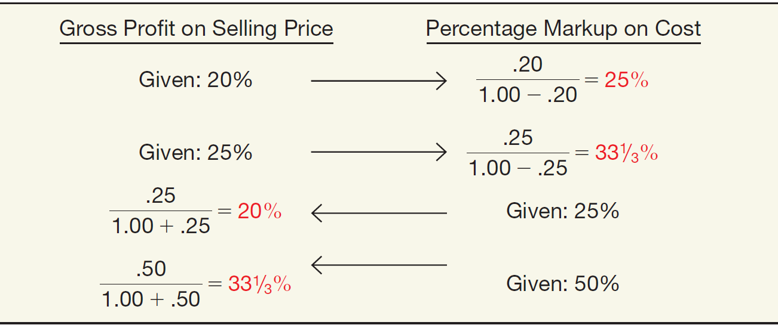
Gross Profit Method
Illustration 9-16 Formulas Relating to Gross Profit
Illustration 9-17
Application of Gross Profit Formulas
LO 5

Slide 34
Gross Profit Method
Illustration: Astaire Company uses the gross profit method to estimate inventory for monthly reporting purposes. Presented below is information for the month of May.
Instructions:
(a) Compute the estimated inventory at May 31, assuming that the gross profit is 25% of sales.
(b) Compute the estimated inventory at May 31, assuming that the gross profit is 25% of cost.
LO 5

Slide 35
Gross Profit Method
(a) Compute the estimated inventory at May 31, assuming that the gross profit is 25% of sales.
LO 5 Determine ending inventory by applying the gross profit method.

Slide 36
Gross Profit Method
(b) Compute the estimated inventory at May 31, assuming that the gross profit is 25% of cost.
25%
100% + 25%
= 20% of sales
LO 5 Determine ending inventory by applying the gross profit method.

Slide 37
Gross Profit Method
Evaluation of Gross Profit Method
Disadvantages:
Provides an estimate of ending inventory.
Uses past percentages in calculation.
A blanket gross profit rate may not be representative.
Normally unacceptable for financial reporting purposes. GAAP requires a physical inventory as additional verification.
LO 5 Determine ending inventory by applying the gross profit method.

Slide 38
9
Inventories: Additional Valuation Issues
LEARNING OBJECTIVES
After studying this chapter, you should be able to:
Describe and apply the lower-of-cost-or-market rule.
Explain when companies value inventories at net realizable value.
Explain when companies use the relative sales value method to value inventories.
Discuss accounting issues related to purchase commitments.
Determine ending inventory by applying the gross profit method.
Determine ending inventory by applying the retail inventory method.
Explain how to report and analyze inventory.

Slide 39
Retail Inventory Method
A method used by retailers, to value inventory without a physical count, by converting retail prices to cost.
Requires retailers to keep:
Total cost and retail value of goods purchased.
Total cost and retail value of the goods available for sale.
Sales for the period.
Methods
Conventional Method
Cost Method
LIFO Retail
Dollar-value LIFO
LO 6 Determine ending inventory by applying the retail inventory method.

Slide 40
Retail Inventory Method
Illustration: Fuque Inc. uses the retail inventory method to estimate ending inventory for its monthly financial statements. The following data pertain to a single department for the month of October.
Instructions:
Prepare a schedule computing estimate retail inventory using the following methods:
(1) Conventional (LCM)
(2) Cost
LO 6 Determine ending inventory by applying the retail inventory method.

Slide 41
Retail Inventory Method
/
=
LO 6 Determine ending inventory by applying the retail inventory method.

Slide 42
Retail Inventory Method
/
=
LO 6 Determine ending inventory by applying the retail inventory method.

Slide 43
Retail Inventory Method
Special Items Relating to Retail Method
Freight costs
Purchase returns
Purchase discounts and allowances
Transfers-in
Normal shortages
Abnormal shortages
Employee discounts
When sales are recorded gross, companies do not recognize sales discounts.
LO 6 Determine ending inventory by applying the retail inventory method.

Slide 44
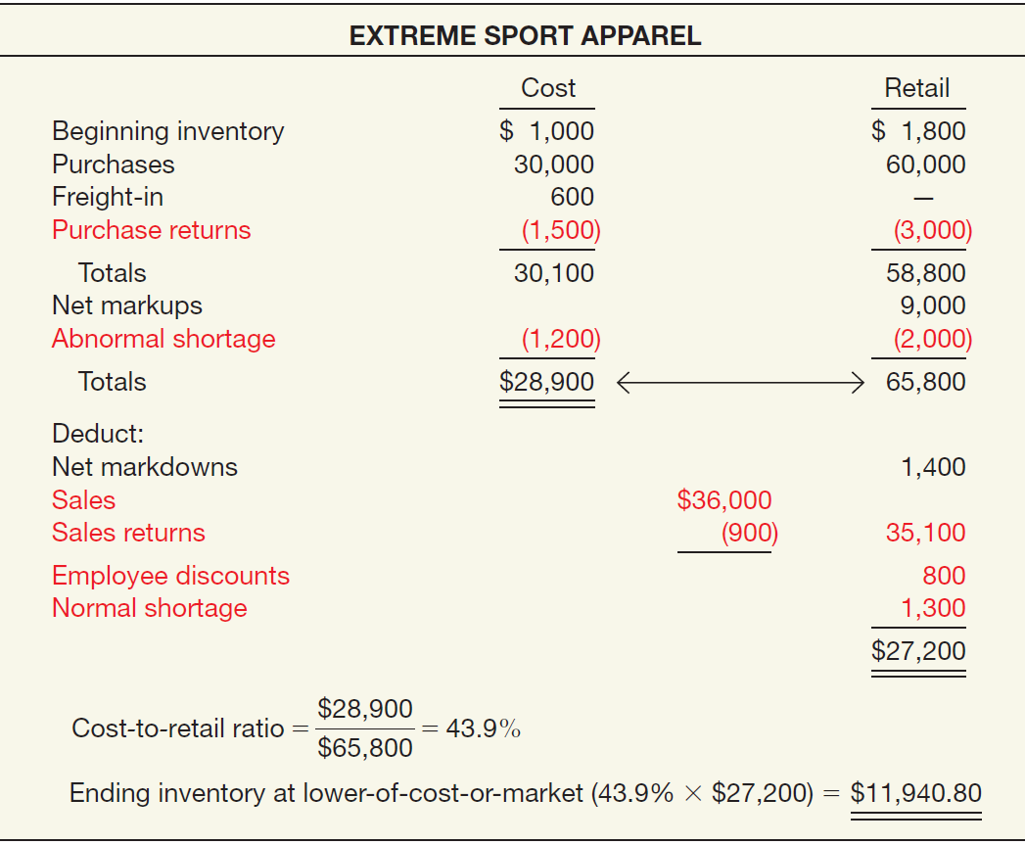
Retail Inventory Method
Special Items
Illustration 9-23
LO 6

Slide 45
Retail Inventory Method
Evaluation of Retail Inventory Method
Used for the following reasons:
To permit the computation of net income without a physical count of inventory.
Control measure in determining inventory shortages.
Regulating quantities of merchandise on hand.
Insurance information.
Some companies refine the retail method by computing inventory separately by departments or class of merchandise with similar gross profits.
LO 6 Determine ending inventory by applying the retail inventory method.

Slide 46
9
Inventories: Additional Valuation Issues
LEARNING OBJECTIVES
After studying this chapter, you should be able to:
Describe and apply the lower-of-cost-or-market rule.
Explain when companies value inventories at net realizable value.
Explain when companies use the relative sales value method to value inventories.
Discuss accounting issues related to purchase commitments.
Determine ending inventory by applying the gross profit method.
Determine ending inventory by applying the retail inventory method.
Explain how to report and analyze inventory.

Slide 47
Presentation and Analysis
Presentation of Inventories
Accounting standards require disclosure of:
Composition of the inventory, inventory financing arrangements, and the inventory costing methods employed.
Consistent application of costing methods from one period to another.
Inventory composition either in the balance sheet or in a separate schedule in the notes.
LO 7 Explain how to report and analyze inventory.

Slide 48
Presentation and Analysis
Presentation of Inventories
Accounting standards require disclosure of:
Significant or unusual financing arrangements relating to inventories.
Inventories pledged as collateral for a loan in the current assets section rather than as an offset to the liability.
Basis on which it states inventory amounts (lower of-cost-or-market) and the method used in determining cost (LIFO, FIFO, average cost, etc.).
LO 7 Explain how to report and analyze inventory.

Slide 49
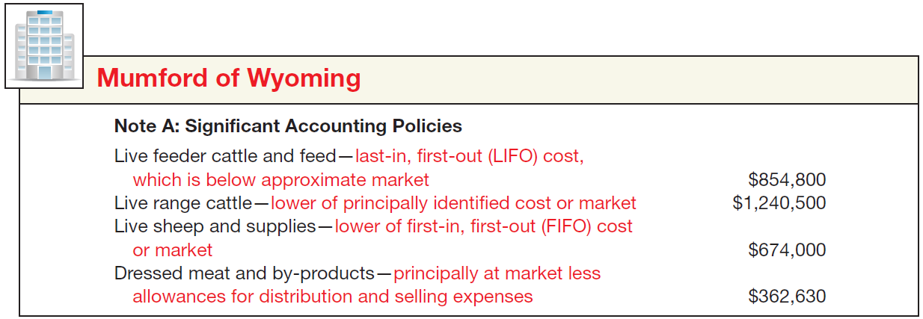
Presentation and Analysis
Presentation of Inventories
Illustration 9-24
Disclosure of Inventory
Methods
LO 7 Explain how to report and analyze inventory.

Slide 50
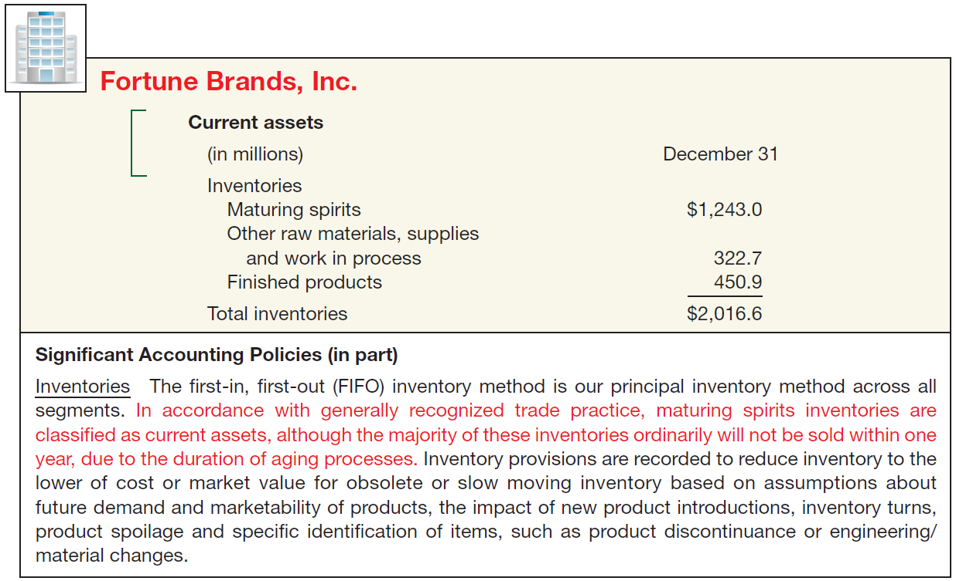
Presentation and Analysis
Presentation of Inventories
Illustration 9-25
Disclosure of Trade Practice in Valuing Inventories
LO 7

Slide 51
Presentation and Analysis
Analysis of Inventories
Common ratios used in the management and evaluation of inventory levels are inventory turnover and average days to sell the inventory.
LO 7 Explain how to report and analyze inventory.

Slide 52
Presentation and Analysis
Inventory Turnover Ratio
Measures the number of times on average a company sells the inventory during the period.
Illustration: In its 2011 annual report Kellogg Company reported a beginning inventory of $1,056 million, an ending inventory of $1,132 million, and cost of goods sold of $7,750 million for the year.
Illustration 9-26
LO 7 Explain how to report and analyze inventory.

Slide 53
Presentation and Analysis
Average Days to Sell Inventory
Measure represents the average number of days’ sales for which a company has inventory on hand.
Illustration 9-26
Average Days to Sell
365 days / 7.08 times = every 51.5 days
LO 7 Explain how to report and analyze inventory.

