Slide 1
10
Acquisition and Disposition of Property, Plant, and Equipment
LEARNING OBJECTIVES
After studying this chapter, you should be able to:
Describe property, plant, and equipment.
Identify the costs to include in initial valuation of property, plant, and equipment.
Describe the accounting problems associated with self-constructed assets.
Describe the accounting problems associated with interest capitalization.
Understand accounting issues related to acquiring and valuing plant assets.
Describe the accounting treatment for costs subsequent to acquisition.
Describe the accounting treatment for the disposal of property, plant, and equipment.

Slide 2
Property, Plant, and Equipment
Property, plant, and equipment are assets of a durable nature. Other terms commonly used are plant assets and fixed assets.
“Used in operations” and not for resale.
Long-term in nature and usually depreciated.
Possess physical substance.
Includes:
Land,
Building structures (offices, factories, warehouses), and
Equipment (machinery, furniture, tools).
LO 1 Describe property, plant, and equipment.

Slide 3
10
Acquisition and Disposition of Property, Plant, and Equipment
LEARNING OBJECTIVES
After studying this chapter, you should be able to:
Describe property, plant, and equipment.
Identify the costs to include in initial valuation of property, plant, and equipment.
Describe the accounting problems associated with self-constructed assets.
Describe the accounting problems associated with interest capitalization.
Understand accounting issues related to acquiring and valuing plant assets.
Describe the accounting treatment for costs subsequent to acquisition.
Describe the accounting treatment for the disposal of property, plant, and equipment.

Slide 4
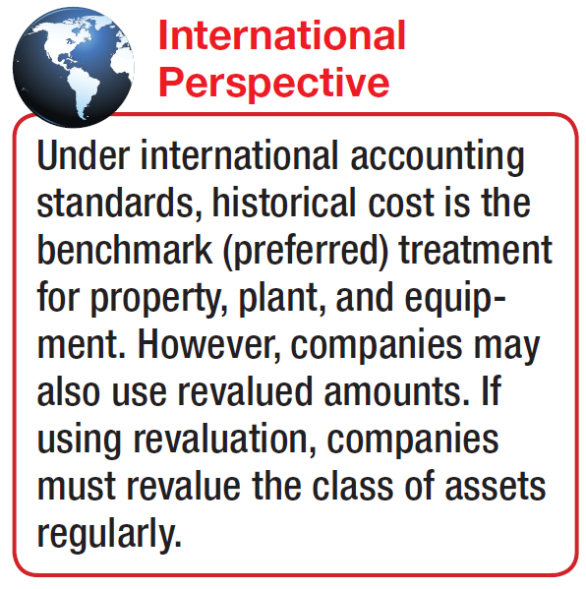
Property, Plant, and Equipment
Acquisition of Property, Plant, and Equipment
Historical cost measures the cash or cash equivalent price of obtaining the asset and bringing it to the location and condition necessary for its intended use.
Main reasons for historical cost valuation:
Historical cost is reliable.
Companies should not anticipate gains and losses but should recognize gains and losses only when the asset is sold.
LO 2 Identify the costs to include in initial valuation of property, plant, and equipment.

Slide 5
Acquisition of PP&E
Cost of Land
Includes all expenditures to acquire land and ready it for use. Costs typically include:
purchase price;
closing costs, such as title to the land, attorney’s fees, and recording fees;
costs of grading, filling, draining, and clearing;
assumption of any liens, mortgages, or encumbrances on the property; and
additional land improvements that have an indefinite life.
LO 2

Slide 6
Acquisition of PP&E
Cost of Land
Improvements with limited lives, such as private driveways, walks, fences, and parking lots, are recorded as Land Improvements and depreciated.
Land acquired and held for speculation is classified as an investment.
Land held by a real estate concern for resale should be classified as inventory.
LO 2 Identify the costs to include in initial valuation of property, plant, and equipment.

Slide 7
Acquisition of PP&E
Cost of Buildings
Includes all expenditures related directly to acquisition or construction. Costs include:
materials, labor, and overhead costs incurred during construction and
professional fees and building permits.
LO 2 Identify the costs to include in initial valuation of property, plant, and equipment.

Slide 8
Acquisition of PP&E
Cost of Equipment
Include all expenditures incurred in acquiring the equipment and preparing it for use. Costs include:
purchase price,
freight and handling charges,
insurance on the equipment while in transit,
cost of special foundations if required,
assembling and installation costs, and
costs of conducting trial runs.
LO 2 Identify the costs to include in initial valuation of property, plant, and equipment.

Slide 9
Acquisition of PP&E
Illustration: The expenditures and receipts below are related to land, land improvements, and buildings acquired for use in a business enterprise. Determine how the following should be classified:
Money borrowed to pay building contractor
Payment for construction from note proceeds
Cost of land fill and clearing
Delinquent real estate taxes on property assumed
Premium on 6-month insurance policy during construction
Refund of 1-month insurance premium because construction completed early
Notes Payable
Building
Land
Land
Building
(Building)
LO 2

Slide 10
Acquisition of PP&E
Illustration: The expenditures and receipts below are related to land, land improvements, and buildings acquired for use in a business enterprise. Determine how the following should be classified:
(g) Architect’s fee on building
(h) Cost of real estate purchased as a plant site (land $200,000 and building $50,000)
(i) Commission fee paid to real estate agency
(j) Installation of fences around property
(k) Cost of razing and removing building
Proceeds from salvage of demolished building
Cost of parking lots and driveways
Cost of trees and shrubbery (permanent)
Building
Land
Land
Land Improvements
Land
(Land)
Land Improvements
Land
LO 2

Slide 11
10
Acquisition and Disposition of Property, Plant, and Equipment
LEARNING OBJECTIVES
After studying this chapter, you should be able to:
Describe property, plant, and equipment.
Identify the costs to include in initial valuation of property, plant, and equipment.
Describe the accounting problems associated with self-constructed assets.
Describe the accounting problems associated with interest capitalization.
Understand accounting issues related to acquiring and valuing plant assets.
Describe the accounting treatment for costs subsequent to acquisition.
Describe the accounting treatment for the disposal of property, plant, and equipment.

Slide 12
Acquisition of PP&E
Self-Constructed Assets
Costs include:
Materials and direct labor
Overhead can be handled in two ways:
Assign no fixed overhead.
Assign a portion of all overhead to the construction process.
Companies use the second method extensively.
LO 3 Describe the accounting problems associated with self-constructed assets.

Slide 13
10
Acquisition and Disposition of Property, Plant, and Equipment
LEARNING OBJECTIVES
After studying this chapter, you should be able to:
Describe property, plant, and equipment.
Identify the costs to include in initial valuation of property, plant, and equipment.
Describe the accounting problems associated with self-constructed assets.
Describe the accounting problems associated with interest capitalization.
Understand accounting issues related to acquiring and valuing plant assets.
Describe the accounting treatment for costs subsequent to acquisition.
Describe the accounting treatment for the disposal of property, plant, and equipment.

Slide 14
Acquisition of PP&E
Interest Costs During Construction
Three approaches have been suggested to account for the interest incurred in financing the construction.
Illustration 10-1
Increase to Cost of Asset
$ 0
$ ?
Capitalize no interest during construction
Capitalize all costs of funds
Capitalize actual costs incurred during construction
GAAP
LO 4 Describe the accounting problems associated with interest capitalization.

Slide 15
Acquisition of PP&E
Interest Costs During Construction
GAAP requires — capitalizing actual interest (with modification).
Consistent with historical cost.
Capitalization considers three items:
Qualifying assets.
Capitalization period.
Amount to capitalize.
LO 4 Describe the accounting problems associated with interest capitalization.

Slide 16
Interest Capitalization
Qualifying Assets
Require a period of time to get them ready for their intended use.
Two types of assets:
Assets under construction for a company’s own use.
Assets intended for sale or lease that are constructed or produced as discrete projects.
LO 4 Describe the accounting problems associated with interest capitalization.

Slide 17
Interest Capitalization
Capitalization Period
Begins when:
Expenditures for the asset have been made.
Activities for readying the asset are in progress .
Interest costs are being incurred.
Ends when:
The asset is substantially complete and ready for use.
LO 4 Describe the accounting problems associated with interest capitalization.

Slide 18
Interest Capitalization
Amount to Capitalize
Capitalize the lesser of:
Actual interest costs.
2. Avoidable interest - the amount of interest cost during the period that a company could theoretically avoid if it had not made expenditures for the asset.
LO 4 Describe the accounting problems associated with interest capitalization.

Slide 19
Interest Capitalization
Interest Capitalization Illustration: Assume a company borrowed $200,000 at 12% interest from State Bank on Jan. 1, 2014, for specific purposes of constructing special-purpose equipment to be used in its operations. Construction on the equipment began on Jan. 1, 2014, and the following expenditures were made prior to the project’s completion on Dec. 31, 2014:
Other general debt existing on Jan. 1, 2014:
$500,000, 14%, 10-year bonds payable
$300,000, 10%, 5-year note payable
LO 4

Slide 20
Interest Capitalization
Step 1 - Determine which assets qualify for capitalization of interest.
Special purpose equipment qualifies because it requires a period of time to get ready and it will be used in the company’s operations.
Step 2 - Determine the capitalization period.
The capitalization period is from Jan. 1, 2014 through Dec. 31, 2014, because expenditures are being made and interest costs are being incurred during this period while construction is taking place.
LO 4 Describe the accounting problems associated with interest capitalization.

Slide 21
Interest Capitalization
Step 3 - Compute weighted-average accumulated expenditures.
A company weights the construction expenditures by the amount of time (fraction of a year or accounting period) that it can incur interest cost on the expenditure.
LO 4 Describe the accounting problems associated with interest capitalization.

Slide 22
Interest Capitalization
Step 4 - Compute the Actual and Avoidable Interest.
Selecting Appropriate Interest Rate:
For the portion of weighted-average accumulated expenditures that is less than or equal to any amounts borrowed specifically to finance construction of the assets, use the interest rate incurred on the specific borrowings.
For the portion of weighted-average accumulated expenditures that is greater than any debt incurred specifically to finance construction of the assets, use a weighted average of interest rates incurred on all other outstanding debt during the period.
LO 4 Describe the accounting problems associated with interest capitalization.

Slide 23
Interest Capitalization
Step 4 - Compute the Actual and Avoidable Interest.
Actual Interest
Weighted-average interest rate on general debt
$100,000 $800,000
= 12.5%
Avoidable Interest
LO 4 Describe the accounting problems associated with interest capitalization.

Slide 24
Interest Capitalization
Step 5 – Capitalize the lesser of Avoidable interest or Actual interest.
Journal entry to Capitalize Interest:
Equipment 30,250
Interest Expense 30,250
LO 4 Describe the accounting problems associated with interest capitalization.

Slide 25
Interest Capitalization
Comprehensive Illustration: On November 1, 2013, Shalla Company contracted Pfeifer Construction Co. to construct a building for $1,400,000 on land costing $100,000 (purchased from the contractor and included in the first payment). Shalla made the following payments to the construction company during 2014.
LO 4 Describe the accounting problems associated with interest capitalization.

Slide 26
Interest Capitalization
Pfeifer Construction completed the building, ready for occupancy, on December 31, 2014. Shalla had the following debt outstanding at December 31, 2014.
Specific Construction Debt
1. 15%, 3-year note to finance purchase of land and construction of the building, dated December 31, 2013, with interest payable annually on December 31
Other Debt
2. 10%, 5-year note payable, dated December 31, 2010, with interest payable annually on December 31
3. 12%, 10-year bonds issued December 31, 2009, with interest payable annually on December 31
$750,000
$550,000
$600,000
Compute weighted-average accumulated expenditures for 2014.
LO 4 Describe the accounting problems associated with interest capitalization.

Slide 27
Interest Capitalization
Compute weighted-average accumulated expenditures for 2014.
Illustration 10-4
Advance slide in presentation mode to reveal answers.
LO 4

Slide 28
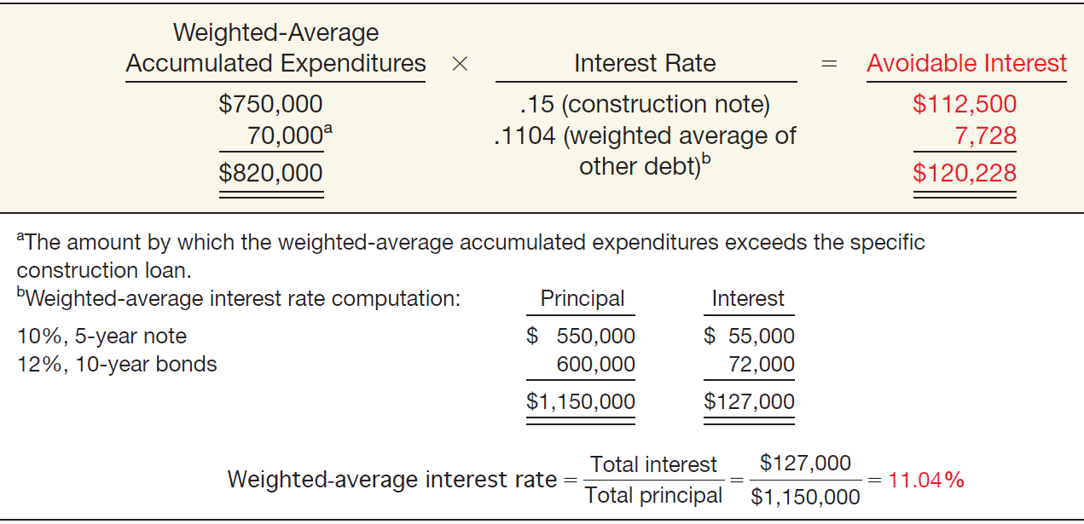
Interest Capitalization
Compute the avoidable interest.
Illustration 10-5
Advance slide in presentation mode to reveal answers.
LO 4

Slide 29
Interest Capitalization
Compute the actual interest cost, which represents the maximum amount of interest that it may capitalize during 2014.
Illustration 10-6
The interest cost that Shalla capitalizes is the lesser of $120,228 (avoidable interest) and $239,500 (actual interest), or $120,228.
LO 4 Describe the accounting problems associated with interest capitalization.

Slide 30
Interest Capitalization
Shalla records the following journal entries during 2014:
January 1 Land 100,000
Buildings (or CIP) 110,000
Cash 210,000
March 1 Buildings 300,000
Cash 300,000
May 1 Buildings 540,000
Cash 540,000
December 31 Buildings 450,000
Cash 450,000
Buildings (Capitalized Interest) 120,228
Interest Expense 119,272
Cash 239,500
LO 4

Slide 31
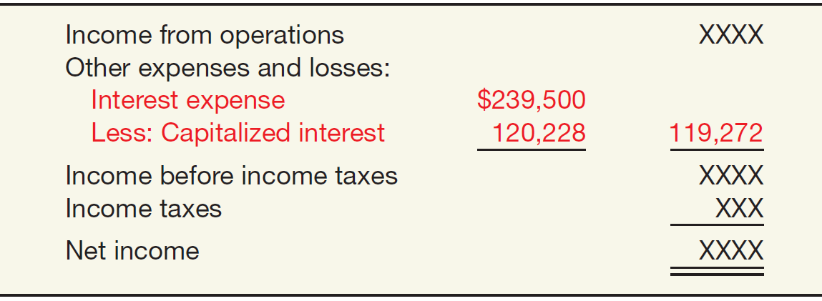
Interest Capitalization
At December 31, 2014, Shalla discloses the amount of interest capitalized either as part of the income statement or in the notes accompanying the financial statements.
Illustration 10-7
Illustration 10-8
LO 4 Describe the accounting problems associated with interest capitalization.

Slide 32
WHAT’S YOUR PRINCIPLE
WHAT ‘S IN YOUR INTEREST?
The requirement to capitalize interest can significantly impact financial statements. For example, when earnings of building manufacturer Jim Walter’s Corporation dropped from $1.51 to $1.17 per share, the company offset 11 cents per share of the decline by capitalizing the interest on coal mining projects and several plants under construction.
How do statement users determine the impact of interest capitalization on a company’s bottom line? They examine the
notes to the financial statements. Companies with material interest capitalization must disclose the amounts of capitalized interest relative to total interest costs. For example,
Anadarko Petroleum Corporation capitalized nearly 30 percent of its total interest costs in a recent year and provided the following footnote related to capitalized interest.
Financial Footnotes
Total interest costs Incurred during the year were $82,415,000. Of this amount, the Company capitalized $24,716,000. Capitalized interest is included as part of the cost of oil and gas properties. The capitalization rates are based on the Company’s weighted-average cost of borrowings used to finance the expenditures.
LO 4 Describe the accounting problems associated with interest capitalization.

Slide 33
Interest Capitalization
Special Issues Related to Interest Capitalization
Expenditures for Land
Interest costs capitalized are part of the cost of the plant, not the land.
Interest Revenue
In general, companies should not net or offset interest revenue against interest cost.
LO 4 Describe the accounting problems associated with interest capitalization.

Slide 34
10
Acquisition and Disposition of Property, Plant, and Equipment
LEARNING OBJECTIVES
After studying this chapter, you should be able to:
Describe property, plant, and equipment.
Identify the costs to include in initial valuation of property, plant, and equipment.
Describe the accounting problems associated with self-constructed assets.
Describe the accounting problems associated with interest capitalization.
Understand accounting issues related to acquiring and valuing plant assets.
Describe the accounting treatment for costs subsequent to acquisition.
Describe the accounting treatment for the disposal of property, plant, and equipment.

Slide 35
Valuation of PP&E
Companies should record property, plant, and equipment:
at the fair value of what they give up or
at the fair value of the asset received,
whichever is more clearly evident.
LO 5 Understand accounting issues related to acquiring and valuing plant assets.

Slide 36
Valuation of PP&E
Cash Discounts — Discount for prompt payment.
Deferred-Payment Contracts — Assets purchased on long-term credit contracts at the present value of the consideration exchanged.
Lump-Sum Purchases — Allocate the total cost among the various assets on the basis of their relative fair market values.
Issuance of Stock — The market price of the stock issued is a fair indication of the cost of the property acquired.
LO 5 Understand accounting issues related to acquiring and valuing plant assets.

Slide 37
Valuation of PP&E
Exchanges of Nonmonetary Assets
Ordinarily accounted for on the basis of:
the fair value of the asset given up or
the fair value of the asset received,
whichever is clearly more evident.
Companies should recognize immediately any gains or losses on the exchange when the transaction has commercial substance.
LO 5 Understand accounting issues related to acquiring and valuing plant assets.

Slide 38
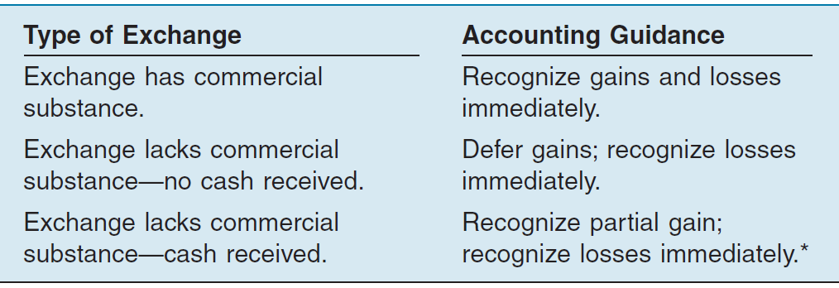
Valuation of PP&E
Meaning of Commercial Substance
Exchange has commercial substance if the future cash flows change as a result of the transaction. That is, if the two parties’ economic positions change, the transaction has commercial substance.
Illustration 10-10
* If cash is 25% or more of the fair value of the exchange, recognize entire gain because earnings process is complete.
LO 5 Understand accounting issues related to acquiring and valuing plant assets.

Slide 39
Valuation of PP&E
Exchanges—Loss Situation
Companies recognize a loss immediately whether the exchange has commercial substance or not.
Rationale: Companies should not value assets at more than their cash equivalent price; if the loss were deferred, assets would be overstated.
LO 5 Understand accounting issues related to acquiring and valuing plant assets.

Slide 40
Valuation of PP&E
Illustration: Information Processing, Inc. trades its used machine for a new model at Jerrod Business Solutions Inc. The exchange has commercial substance. The used machine has a book value of $8,000 (original cost $12,000 less $4,000 accumulated depreciation) and a fair value of $6,000. The new model lists for $16,000. Jerrod gives Information Processing a trade-in allowance of $9,000 for the used machine. Information Processing computes the cost of the new asset as follows.
Illustration 10-11
LO 5

Slide 41
Valuation of PP&E
Illustration: Information Processing records this transaction as follows:
Equipment 13,000
Accumulated Depreciation—Equipment 4,000
Loss on Disposal of Equipment 2,000
Equipment 12,000
Cash 7,000
Illustration 10-12
Loss on Disposal
LO 5 Understand accounting issues related to acquiring and valuing plant assets.

Slide 42
Valuation of PP&E
Exchanges—Gain Situation
Has Commercial Substance. Company usually records the cost of a nonmonetary asset acquired in exchange for another nonmonetary asset at the fair value of the asset given up, and immediately recognizes a gain.
LO 5 Understand accounting issues related to acquiring and valuing plant assets.

Slide 43
Valuation of PP&E
Illustration: Interstate Transportation Company exchanged a number of used trucks plus cash for a semi-truck. The used trucks have a combined book value of $42,000 (cost $64,000 less $22,000 accumulated depreciation). Interstate’s purchasing agent, experienced in the secondhand market, indicates that the used trucks have a fair market value of $49,000. In addition to the trucks, Interstate must pay $11,000 cash for the semi-truck. Interstate computes the cost of the semi-truck as follows.
Illustration 10-13
LO 5 Understand accounting issues related to acquiring and valuing plant assets.

Slide 44
Valuation of PP&E
Illustration: Interstate records the exchange transaction as follows:
Truck (semi) 60,000
Accumulated Depreciation—Trucks 22,000
Trucks (used) 64,000
Gain on Disposal of Trucks 7,000
Cash 11,000
Illustration 10-14
Gain on Disposal
LO 5 Understand accounting issues related to acquiring and valuing plant assets.

Slide 45
Valuation of PP&E
Exchanges—Gain Situation
Lacks Commercial Substance—No Cash Received. Now assume that Interstate Transportation Company exchange lacks commercial substance.
Interstate defers the gain of $7,000 and reduces the basis of the semi-truck.
LO 5 Understand accounting issues related to acquiring and valuing plant assets.

Slide 46
Valuation of PP&E
Illustration: Interstate records the exchange transaction as follows:
Trucks (semi) 53,000
Accumulated Depreciation—Trucks 22,000
Trucks (used) 64,000
Cash 11,000
Illustration 10-15
LO 5 Understand accounting issues related to acquiring and valuing plant assets.

Slide 47
Valuation of PP&E
Exchanges—Gain Situation
Lacks Commercial Substance—Some Cash Received. When a company receives cash (sometimes referred to as “boot”) in an exchange that lacks commercial substance, it may immediately recognize a portion of the gain. The general formula for gain recognition when an exchange includes some cash is as follows:
Illustration 10-16
LO 5 Understand accounting issues related to acquiring and valuing plant assets.

Slide 48
Valuation of PP&E
Illustration: Queenan Corporation traded in used machinery with a book value of $60,000 (cost $110,000 less accumulated depreciation $50,000) and a fair value of $100,000. It receives in exchange a machine with a fair value of $90,000 plus cash of $10,000.
Illustration 10-17
LO 5 Understand accounting issues related to acquiring and valuing plant assets.

Slide 49
Valuation of PP&E
The portion of the gain a company recognizes is the ratio of monetary assets (cash in this case) to the total consideration received.
Illustration 10-18
Advance slide in presentation mode to reveal answers.
LO 5

Slide 50
Valuation of PP&E
Queenan would record the following entry.
Illustration 10-19
Cash 10,000
Machine (new) 54,000
Accumulated Depreciation—Machinery 50,000
Machine 110,000
Gain on Disposal of Machinery 4,000
LO 5 Understand accounting issues related to acquiring and valuing plant assets.

Slide 51
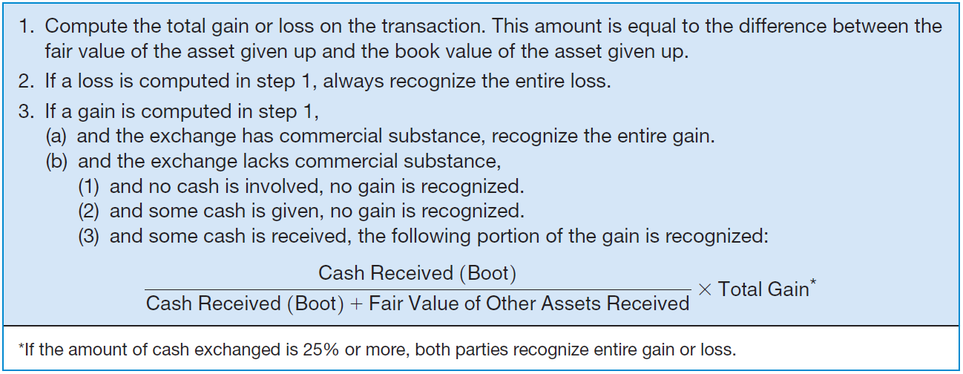
Valuation of PP&E
Summary of Gain and Loss Recognition on Exchanges of Non-Monetary Assets
Illustration 10-20
LO 5 Understand accounting issues related to acquiring and valuing plant assets.

Slide 52
Valuation of PP&E
Illustration: Santana Company exchanged equipment used in its manufacturing operations plus $2,000 in cash for similar equipment used in the operations of Delaware Company. The following information pertains to the exchange.
Instructions: Prepare the journal entries to record the exchange on the books of both companies.
LO 5 Understand accounting issues related to acquiring and valuing plant assets.

Slide 53
Valuation of PP&E
Calculation of Gain or Loss
LO 5 Understand accounting issues related to acquiring and valuing plant assets.

Slide 54
Valuation of PP&E
Has Commercial Substance
Santana:
Equipment 15,500
Accumulated Depreciation 19,000
Cash 2,000
Equipment 28,000
Gain on Exchange 4,500
Delaware:
Cash 2,000
Equipment 13,500
Accumulated Depreciation 10,000
Loss on Exchange 2,500
Equipment 28,000
LO 5

Slide 55
Valuation of PP&E
Santana (Has Commercial Substance):
Equipment 15,500
Accumulated Depreciation 19,000
Cash 2,000
Equipment 28,000
Gain on Disposal of Equipment 4,500
Santana (LACKS Commercial Substance):
Equipment (15,500 – 4,500) 11,000
Accumulated Depreciation 19,000
Cash 2,000
Equipment 28,000
LO 5

Slide 56
Valuation of PP&E
Delaware (Has Commercial Substance):
Cash 2,000
Equipment 13,500
Accumulated Depreciation 10,000
Loss on Disposal of Equipment 2,500
Equipment 28,000
Delaware (LACKS Commercial Substance):
Cash 2,000
Equipment 13,500
Accumulated Depreciation 10,000
Loss on Disposal of Equipment 2,500
Equipment 28,000
LO 5 Understand accounting issues related to acquiring and valuing plant assets.

Slide 57
Valuation of PP&E
Accounting for Contributions
Companies should use:
the fair value of the asset to establish its value on the books and
should recognize contributions received as revenues in the period received.
LO 5 Understand accounting issues related to acquiring and valuing plant assets.

Slide 58
Valuation of PP&E
Contributions
Illustration: Max Wayer Meat Packing, Inc. has recently accepted a donation of land with a fair value of $150,000 from the Memphis Industrial Development Corp. In return Max Wayer Meat Packing promises to build a packing plant in Memphis. Max Wayer’s entry is:
Land 150,000
Contribution Revenue 150,000
LO 5 Understand accounting issues related to acquiring and valuing plant assets.

Slide 59
Valuation of PP&E
Contributions
When a company contributes a non-monetary asset, it should record the amount of the donation as an expense at the fair value of the donated asset.
Illustration: Kline Industries donates land to the city of Los Angeles for a city park. The land cost $80,000 and has a fair value of $110,000. Kline Industries records this donation as follows.
Contribution Expense 110,000
Land 80,000
Gain on Disposal of Land 30,000
LO 5 Understand accounting issues related to acquiring and valuing plant assets.

Slide 60
10
Acquisition and Disposition of Property, Plant, and Equipment
LEARNING OBJECTIVES
After studying this chapter, you should be able to:
Describe property, plant, and equipment.
Identify the costs to include in initial valuation of property, plant, and equipment.
Describe the accounting problems associated with self-constructed assets.
Describe the accounting problems associated with interest capitalization.
Understand accounting issues related to acquiring and valuing plant assets.
Describe the accounting treatment for costs subsequent to acquisition.
Describe the accounting treatment for the disposal of property, plant, and equipment.

Slide 61
Costs Subsequent to Acquisition
In general, costs incurred to achieve greater future benefits should be capitalized, whereas expenditures that simply maintain a given level of services should be expensed.
In order to capitalize costs, one of three conditions must be present:
useful life must be increased,
quantity of units produced must be increased, and
quality of units produced must be enhanced.
LO 6 Describe the accounting treatment for costs subsequent to acquisition.

Slide 62
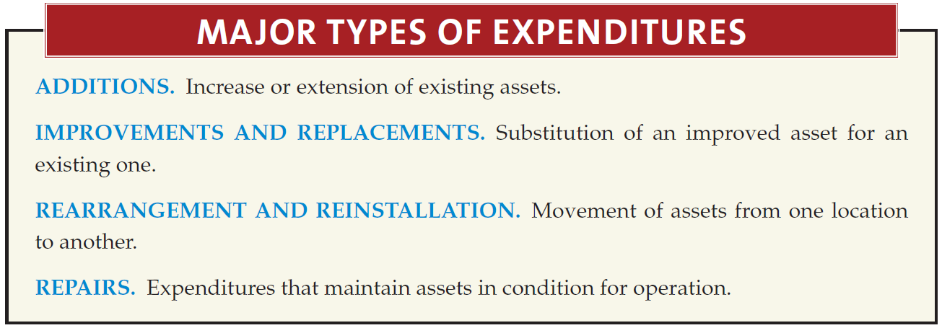
Costs Subsequent to Acquisition
LO 6 Describe the accounting treatment for costs subsequent to acquisition.

Slide 63
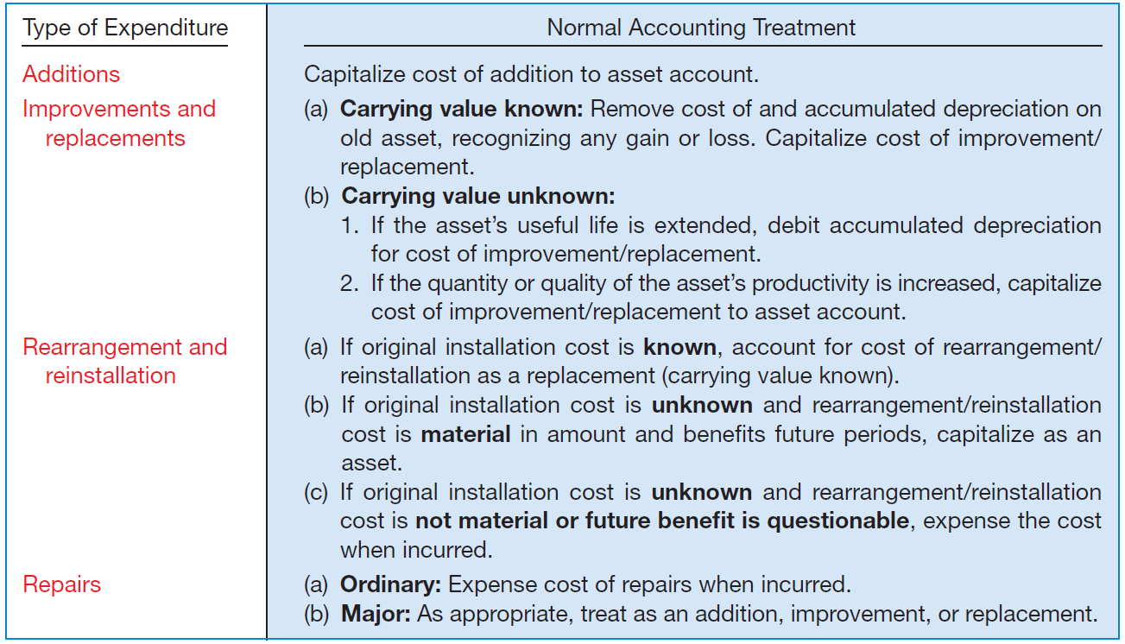
Costs Subsequent to Acquisition
Summary
Illustration 10-21

Slide 64
10
Acquisition and Disposition of Property, Plant, and Equipment
LEARNING OBJECTIVES
After studying this chapter, you should be able to:
Describe property, plant, and equipment.
Identify the costs to include in initial valuation of property, plant, and equipment.
Describe the accounting problems associated with self-constructed assets.
Describe the accounting problems associated with interest capitalization.
Understand accounting issues related to acquiring and valuing plant assets.
Describe the accounting treatment for costs subsequent to acquisition.
Describe the accounting treatment for the disposal of property, plant, and equipment.

Slide 65
Disposition of PP&E
A company may retire plant assets voluntarily or dispose of them by
Sale,
Exchange,
Involuntary conversion, or
Abandonment.
Depreciation must be taken up to the date of disposition.
LO 7 Describe the accounting treatment for the disposal of property, plant, and equipment.

Slide 66
Disposition of PP&E
Sale of Plant Assets
Illustration: Barret Company recorded depreciation on a machine costing $18,000 for 9 years at the rate of $1,200 per year. If it sells the machine in the middle of the tenth year for $7,000, Barret records depreciation to the date of sale as:
Depreciation Expense ($1,200 x 1/2) 600
Accumulated Depreciation 600
LO 7 Describe the accounting treatment for the disposal of property, plant, and equipment.

Slide 67
Disposition of PP&E
Illustration: Barret Company recorded depreciation on a machine costing $18,000 for 9 years at the rate of $1,200 per year. If it sells the machine in the middle of the tenth year for $7,000, Barret records depreciation to the date of sale. Record the entry to record the sale of the asset:
Cash 7,000
Accumulated Depreciation 11,400
Machinery 18,000
Gain on Disposal of Machinery 400
LO 7 Describe the accounting treatment for the disposal of property, plant, and equipment.

Slide 68
Disposition of PP&E
Involuntary Conversion
Sometimes an asset’s service is terminated through some type of involuntary conversion such as fire, flood, theft, or condemnation.
Companies report the difference between the amount recovered (e.g., from a condemnation award or insurance recovery), if any, and the asset’s book value as a gain or loss.
They treat these gains or losses like any other type of disposition.
LO 7 Describe the accounting treatment for the disposal of property, plant, and equipment.

Slide 69
Disposition of PP&E
Illustration: Camel Transport Corp. had to sell a plant located on company property that stood directly in the path of an interstate highway. For a number of years, the state had sought to purchase the land on which the plant stood, but the company resisted. The state ultimately exercised its right of eminent domain, which the courts upheld. In settlement, Camel received $500,000, which substantially exceeded the $200,000 book value of the plant and land (cost of $400,000 less accumulated depreciation of $200,000). Camel made the following entry.
Cash 500,000
Accumulated Depreciation—Plant Assets 200,000
Plant Assets 400,000
Gain on Disposal of Plant Assets 300,000
LO 7 Describe the accounting treatment for the disposal of property, plant, and equipment.

