Slide 1
11
Depreciation, Impairment, and Depletion
LEARNING OBJECTIVES
After studying this chapter, you should be able to:
Explain the concept of depreciation.
Identify the factors involved in the depreciation process.
Compare activity, straight-line, and decreasing-charge methods of depreciation.
Explain special depreciation methods.
Explain the accounting issues related to asset impairment.
Explain the accounting procedures for depletion of natural resources.
Explain how to report and analyze property, plant, equipment, and natural resources.

Slide 2
Depreciation—Method of Cost Allocation
Depreciation is the accounting process of allocating the cost of tangible assets to expense in a systematic and rational manner to those periods expected to benefit from the use of the asset.
Allocating costs of long-lived assets:
Fixed assets = Depreciation expense
Intangibles = Amortization expense
Natural resources = Depletion expense
LO 1 Explain the concept of depreciation.

Slide 3
11
Depreciation, Impairment, and Depletion
LEARNING OBJECTIVES
After studying this chapter, you should be able to:
Explain the concept of depreciation.
Identify the factors involved in the depreciation process.
Compare activity, straight-line, and decreasing-charge methods of depreciation.
Explain special depreciation methods.
Explain the accounting issues related to asset impairment.
Explain the accounting procedures for depletion of natural resources.
Explain how to report and analyze property, plant, equipment, and natural resources.

Slide 4
Depreciation—Method of Cost Allocation
Factors Involved in the Depreciation Process
Three basic questions:
What depreciable base is to be used?
What is the asset’s useful life?
What method of cost apportionment is best?
LO 2 Identify the factors involved in the depreciation process.

Slide 5
Depreciation—Method of Cost Allocation
Factors Involved in the Depreciation Process
Depreciable Base for the Asset
Illustration 11-1
LO 2 Identify the factors involved in the depreciation process.

Slide 6
Depreciation—Method of Cost Allocation
Factors Involved in the Depreciation Process
Estimation of Service Lives
Service life often differs from physical life.
Companies retire assets for two reasons:
Physical factors (casualty or expiration of physical life).
Economic factors (inadequacy, supersession, and obsolescence).
LO 2 Identify the factors involved in the depreciation process.

Slide 7
11
Depreciation, Impairment, and Depletion
LEARNING OBJECTIVES
After studying this chapter, you should be able to:
Explain the concept of depreciation.
Identify the factors involved in the depreciation process.
Compare activity, straight-line, and decreasing-charge methods of depreciation.
Explain special depreciation methods.
Explain the accounting issues related to asset impairment.
Explain the accounting procedures for depletion of natural resources.
Explain how to report and analyze property, plant, equipment, and natural resources.

Slide 8
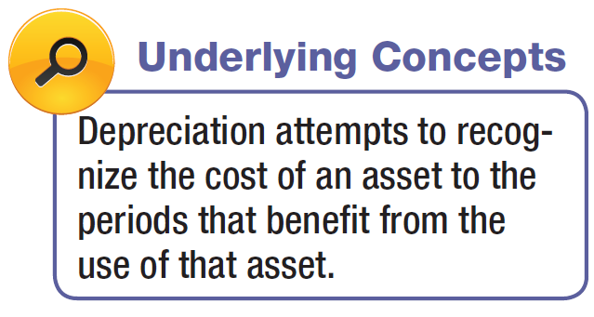
Depreciation—Method of Cost Allocation
Methods of Depreciation
The profession requires the method employed be “systematic and rational.” Methods used include:
Activity method (units of use or production).
Straight-line method.
Sum-of-the-years’-digits.
Declining-balance method.
Group and composite methods.
Hybrid or combination methods.
Decreasing charge methods
Special methods
LO 3 Compare activity, straight-line, and decreasing-charge methods of depreciation.

Slide 9
Depreciation—Method of Cost Allocation
Activity Method
Illustration 11-2
Stanley Coal Mines Facts
Illustration: If Stanley uses the crane for 4,000 hours the first year, the depreciation charge is:
Illustration 11-3
LO 3

Slide 10
Depreciation—Method of Cost Allocation
Straight-Line Method
Illustration 11-2
Stanley Coal Mines Facts
Illustration: Stanley computes depreciation as follows:
Illustration 11-4
LO 3

Slide 11
Depreciation—Method of Cost Allocation
Decreasing-Charge Methods
Illustration 11-2
Stanley Coal Mines Facts
Sum-of-the-Years’-Digits. Each fraction uses the sum of the years as a denominator (5 + 4 + 3 + 2 + 1 = 15). The numerator is the number of years of estimated life remaining as of the beginning of the year.
Alternate sum-of-the-years’ calculation
n(n+1)
5(5+1)
=
=
15
2
2
LO 3

Slide 12
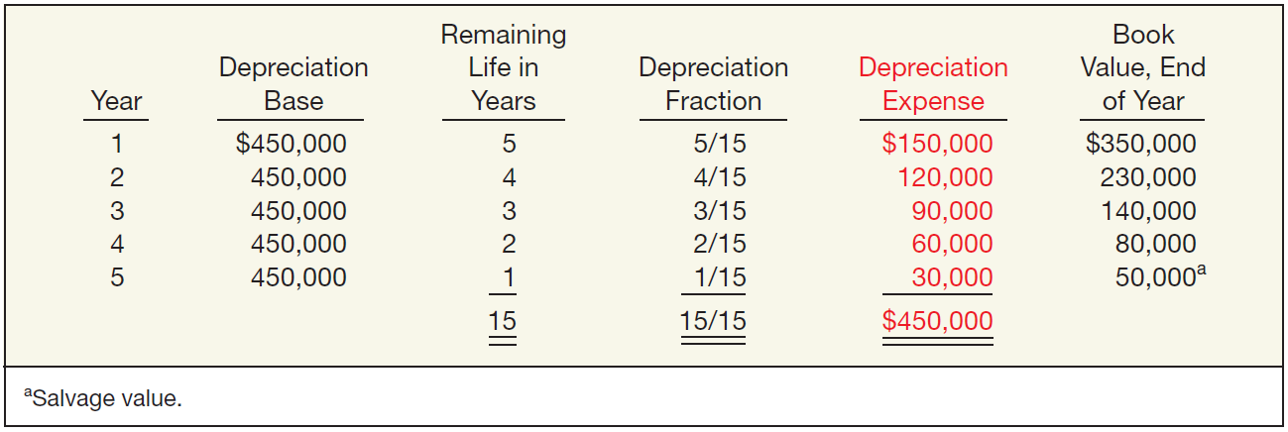
Depreciation—Method of Cost Allocation
Sum-of-the-Years’-Digits
Illustration 11-6
LO 3 Compare activity, straight-line, and decreasing-charge methods of depreciation.

Slide 13
Depreciation—Method of Cost Allocation
Decreasing-Charge Methods
Illustration 11-2
Stanley Coal Mines Facts
Declining-Balance Method.
Utilizes a depreciation rate (percentage) that is some multiple of the straight-line method.
Does not deduct the salvage value in computing the depreciation base.
LO 3 Compare activity, straight-line, and decreasing-charge methods of depreciation.

Slide 14
Depreciation—Method of Cost Allocation
Declining-Balance Method
Illustration 11-7
LO 3 Compare activity, straight-line, and decreasing-charge methods of depreciation.

Slide 15
Depreciation—Method of Cost Allocation
Illustration—(Four Methods): Maserati Corporation purchased a new machine for its assembly process on August 1, 2014. The cost of this machine was $150,000. The company estimated that the machine would have a salvage value of $24,000 at the end of its service life. Its life is estimated at 5 years and its working hours are estimated at 21,000 hours. Year-end is December 31.
Instructions: Compute the depreciation expense under the following methods.
(a) Straight-line depreciation. (c) Sum-of-the-years’-digits.
(b) Activity method (d) Double-declining balance.
LO 3 Compare activity, straight-line, and decreasing-charge methods of depreciation.

Slide 16
Depreciation—Method of Cost Allocation
Straight-line Method
Advance slide in presentation mode to reveal answer.
LO 3 Compare activity, straight-line, and decreasing-charge methods of depreciation.

Slide 17
Depreciation—Method of Cost Allocation
Activity Method
(Assume 800 hours used in 2014)
Advance slide in presentation mode to reveal answer.
LO 3

Slide 18
Depreciation—Method of Cost Allocation
Sum-of-the-Years’-Digits Method
5/12 = .416667
7/12 = .583333
LO 3
Advance slide in presentation mode to reveal answer.

Slide 19
Depreciation—Method of Cost Allocation
Double-Declining Balance Method
Advance slide in presentation mode to reveal answer.
LO 3

Slide 20
11
Depreciation, Impairment, and Depletion
LEARNING OBJECTIVES
After studying this chapter, you should be able to:
Explain the concept of depreciation.
Identify the factors involved in the depreciation process.
Compare activity, straight-line, and decreasing-charge methods of depreciation.
Explain special depreciation methods.
Explain the accounting issues related to asset impairment.
Explain the accounting procedures for depletion of natural resources.
Explain how to report and analyze property, plant, equipment, and natural resources.

Slide 21
Depreciation—Method of Cost Allocation
Special Depreciation Methods
Two methods of depreciating multiple-asset accounts exist:
Group method used when the assets are similar in nature and have approximately the same useful lives.
Composite approach used when the assets are dissimilar and have different lives.
The choice of method depends on the nature of the assets involved.
The computation for group or composite methods is essentially the same: find an average and depreciate on that basis.
LO 4 Explain special depreciation methods.

Slide 22
Group and Composite Methods
Illustration: Mooney Motors establishes the composite depreciation rate for its fleet of cars, trucks, and campers as shown below.
Illustration 11-8
LO 4 Explain special depreciation methods.

Slide 23
Group and Composite Methods
If Mooney retires an asset before or after the average service life of the group is reached, it buries the resulting gain or loss in the Accumulated Depreciation account.
Illustration: Suppose that Mooney Motors sold one of the campers with a cost of $5,000 for $2,600 at the end of the third year. The entry is:
Accumulated Depreciation 2,400
Cash 2,600
Cars, Trucks, and Campers 5,000
LO 4 Explain special depreciation methods.

Slide 24
Group and Composite Methods
If Mooney purchases a new type of asset (mopeds, for example), it must compute a new depreciation rate and apply this rate in subsequent periods.
Illustration 11-9
Disclosure of Group
Depreciation Method
LO 4 Explain special depreciation methods.

Slide 25
Special Depreciation Methods
Hybrid or Combination Methods
Companies are also free to develop tailor-made depreciation methods, provided the method results in the allocation of an asset’s cost over the asset’s life in a systematic and rational manner.
Illustration 11-10
Disclosure of Hybrid Depreciation Method
LO 4 Explain special depreciation methods.

Slide 26
Depreciation—Method of Cost Allocation
Special Depreciation Issues
How should companies compute depreciation for partial periods?
Does depreciation provide for the replacement of assets?
How should companies handle revisions in depreciation rates?
See slides for LO 3
Funds for the replacement of assets come from revenues.
LO 4 Explain special depreciation methods.

Slide 27
Depreciation—Method of Cost Allocation
Revision of Depreciation Rates
Changes in estimates are a continual and inherent part of any estimation process.
Accounted for in the current period and prospective periods.
No change to previously reported results.
LO 4 Explain special depreciation methods.

Slide 28
Revision of Depreciation Rates
Arcadia HS, purchased equipment for $510,000 which was estimated to have a useful life of 10 years with a residual value of $10,000 at the end of that time. Depreciation has been recorded for 7 years on a straight-line basis. In 2014 (year 8), it is determined that the total estimated life should be 15 years with a residual value of $5,000 at the end of that time.
Questions:
What is the journal entry to correct the prior years’ depreciation?
Calculate the depreciation expense for 2014.
No Entry
Required
LO 4 Explain special depreciation methods.

Slide 29
Revision of Depreciation Rates
After 7 years
Equipment cost $510,000
Salvage value - 10,000
Depreciable base 500,000
Useful life (original) 10 years
Annual depreciation $ 50,000
First, establish NBV at date of change in estimate.
x 7 years = $350,000
Balance Sheet (Dec. 31, 2013)
Equipment
$510,000
Accumulated depreciation
350,000
Net book value (NBV)
$160,000
LO 4 Explain special depreciation methods.

Slide 30
Revision of Depreciation Rates
After 7 years
Net book value $160,000
Salvage value (new) 5,000
Depreciable base 155,000
Useful life remaining 8 years
Annual depreciation $ 19,375
Depreciation Expense calculation for 2012.
Journal entry for 2012
Depreciation Expense 19,375
Accumulated Depreciation 19,375
LO 4 Explain special depreciation methods.

Slide 31
11
Depreciation, Impairment, and Depletion
LEARNING OBJECTIVES
After studying this chapter, you should be able to:
Explain the concept of depreciation.
Identify the factors involved in the depreciation process.
Compare activity, straight-line, and decreasing-charge methods of depreciation.
Explain special depreciation methods.
Explain the accounting issues related to asset impairment.
Explain the accounting procedures for depletion of natural resources.
Explain how to report and analyze property, plant, equipment, and natural resources.

Slide 32
Impairments
When the carrying amount of an asset is not recoverable, a company records a write-off referred to as an impairment.
Events leading to an impairment:
Significant decrease in the fair value of an asset.
Significant change in the manner in which an asset is used.
Adverse change in legal factors or in the business climate that affects the value of an asset.
An accumulation of costs in excess of the amount originally expected to acquire or construct an asset.
A projection or forecast that demonstrates continuing losses associated with an asset.
LO 5

Slide 33
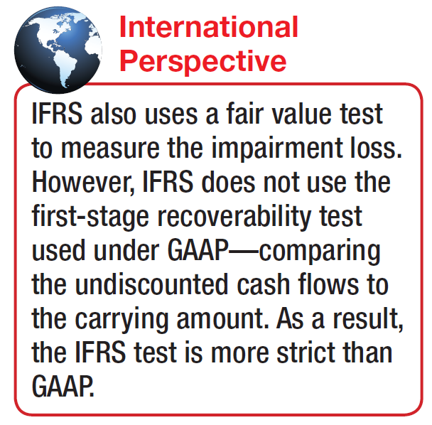
Impairments
Measuring Impairments
Review events for possible impairment.
If the review indicates impairment, apply the recoverability test. If the sum of the expected future net cash flows from the long-lived asset is less than the carrying amount of the asset, an impairment has occurred.
3. Assuming an impairment, the impairment loss is the amount by which the carrying amount of the asset exceeds the fair value of the asset. The fair value is the market value or the present value of expected future net cash flows.
LO 5 Explain the accounting issues related to asset impairment.

Slide 34
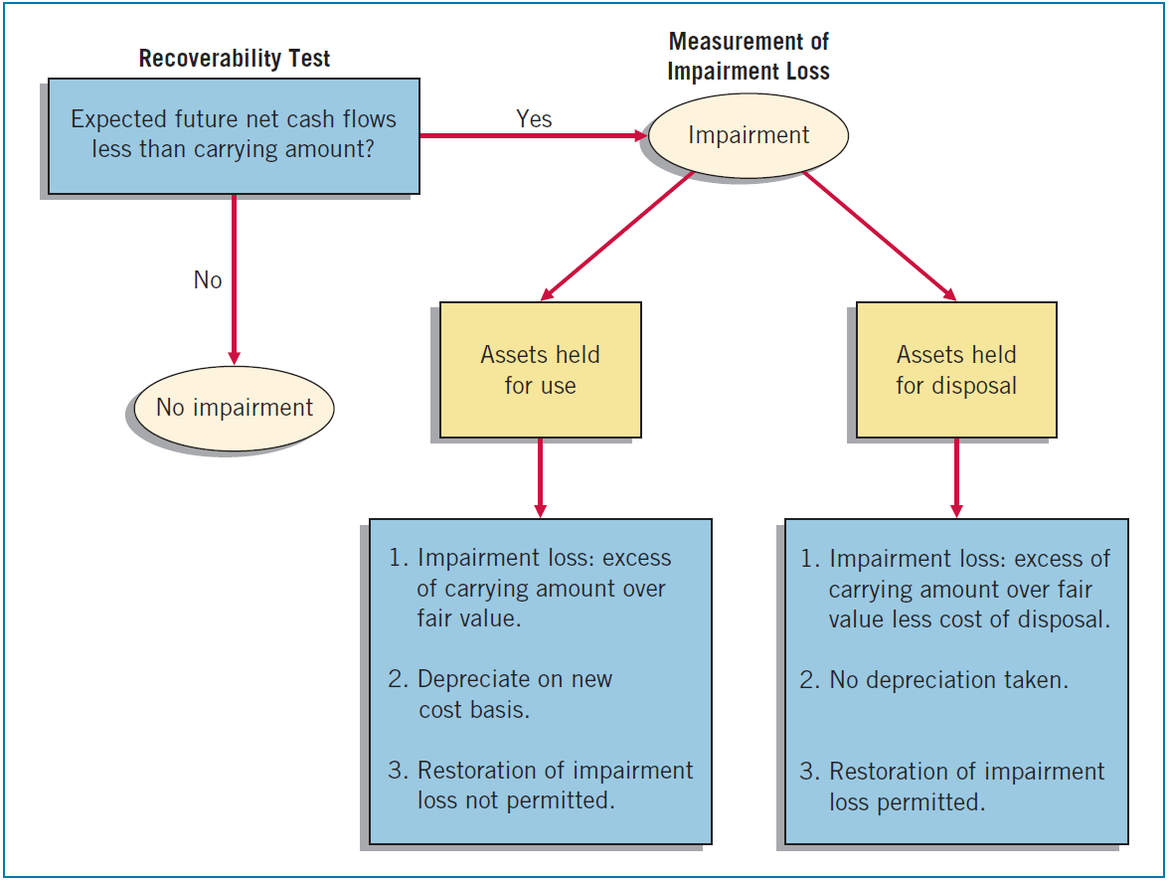
Impairments
Illustration 11-16
Graphic of Accounting for Impairments
Loss reported as part of income from continuing operations, in the “Other expenses and losses” section.
LO 5

Slide 35
Impairments
Recoverability Text
Illustration 1: M. Alou Inc. has equipment that, due to changes in its use, it reviews for possible impairment. The equipment’s carrying amount is $600,000 ($800,000 cost less $200,000 accumulated depreciation). Alou determines the expected future net cash flows (undiscounted) from the use of the equipment and its eventual disposal to be $650,000. Determine whether an impairment has occurred.
No Impairment
Advance slide in presentation mode to reveal answer.
LO 5

Slide 36
Impairments
Recoverability Text
Illustration 2: M. Alou Inc. has equipment that, due to changes in its use, it reviews for possible impairment. The equipment’s carrying amount is $600,000 ($800,000 cost less $200,000 accumulated depreciation). Alou determines the expected future net cash flows (undiscounted) from the use of the equipment and its eventual disposal to be $580,000. Determine whether an impairment has occurred.
Impairment
Advance slide in presentation mode to reveal answer.
LO 5

Slide 37
Impairments
Measurement of Loss
Illustration 2: The recoverability test indicates that the expected future net cash flows of $580,000 from the use of the asset are less than its carrying amount of $600,000. Therefore, an impairment has occurred. Assume this asset has a fair value of $525,000. Determine the impairment loss, if any.
Impairment
Loss
Advance slide in presentation mode to reveal answer.
LO 5

Slide 38
Impairments
Measurement of Loss
Illustration 2:
M. Alou records the impairment loss as follows:
Loss on Impairment 75,000
Accumulated Depreciation 75,000
LO 5

Slide 39
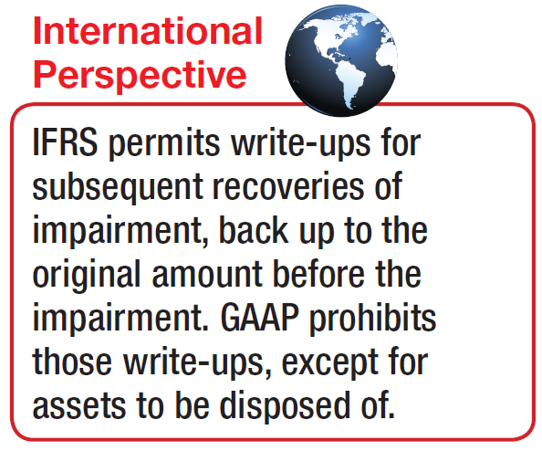
Impairments
Restoration of Impairment Loss
After recording an impairment loss,
the reduced carrying amount becomes its new cost basis.
No change in the new cost basis except for depreciation or amortization in future periods or for additional impairments.
No restoration of impairment loss for an asset held for use.
Rationale is that the new cost basis puts the impaired asset on an equal basis with other assets that are unimpaired.
LO 5 Explain the accounting issues related to asset impairment.

Slide 40
Impairments
Impairment of Assets to Be Disposed Of
Assets held for disposal are like inventory; companies
Should report them at the lower-of-cost-or-net realizable value.
Can write up or down an asset held for disposal in future periods, as long as the carrying value after the write-up never exceeds the carrying amount of the asset before the impairment.
Should report losses or gains related to these impaired assets as part of income from continuing operations.
LO 5 Explain the accounting issues related to asset impairment.

Slide 41
11
Depreciation, Impairment, and Depletion
LEARNING OBJECTIVES
After studying this chapter, you should be able to:
Explain the concept of depreciation.
Identify the factors involved in the depreciation process.
Compare activity, straight-line, and decreasing-charge methods of depreciation.
Explain special depreciation methods.
Explain the accounting issues related to asset impairment.
Explain the accounting procedures for depletion of natural resources.
Explain how to report and analyze property, plant, equipment, and natural resources.

Slide 42
Depletion
Natural resources, often called wasting assets, include petroleum, minerals, and timber.
They have two main features:
complete removal (consumption) of the asset, and
replacement of the asset only by an act of nature.
Depletion is the process of allocating the cost of natural resources.
LO 6 Explain the accounting procedures for depletion of natural resources.

Slide 43
Depletion
Establishing a Depletion Base
Computation of the depletion base involves four factors:
Acquisition cost.
Exploration costs.
Development costs.
Restoration costs.
LO 6 Explain the accounting procedures for depletion of natural resources.

Slide 44
Depletion
Write-off of Resource Cost
Normally, companies compute depletion (cost depletion) on a units-of-production method (activity approach). Depletion is a function of the number of units extracted during the period.
Calculation:
Total cost – Salvage value
= Depletion cost per unit
Total estimated units available
Units extracted x Cost per unit
= Depletion
LO 6 Explain the accounting procedures for depletion of natural resources.

Slide 45
Depletion
Illustration: MaClede Co. acquired the right to use 1,000 acres of land in Alaska to mine for gold. The lease cost is $50,000, and the related exploration costs on the property are $100,000. Intangible development costs incurred in opening the mine are $850,000. MaClede estimates that the mine will provide approximately 100,000 ounces of gold.
Illustration 11-17
Advance slide in presentation mode to reveal answer.
LO 6

Slide 46
Depletion
If MaClede extracts 25,000 ounces in the first year, then the depletion for the year is $250,000 (25,000 ounces x $10).
Inventory (gold) 250,000
Gold Mine 250,000
Some companies use an Accumulated Depletion account. In that case, MaClede’s balance sheet would presented as follows:
Illustration 11-18
MaClede debits cost of goods sold when the gold is sold.
LO 6

Slide 47
Depletion
Estimating Recoverable Reserves
Same as accounting for changes in estimates.
Revise the depletion rate on a prospective basis.
Divide the remaining cost by the new estimate of the recoverable reserves.
LO 6 Explain the accounting procedures for depletion of natural resources.

Slide 48
Depletion
Liquidating Dividends - Dividends greater than the amount of accumulated net income.
Illustration: Callahan Mining had a retained earnings balance of $1,650,000, accumulated depletion on mineral properties of $2,100,000, and paid-in capital in excess of par of $5,435,493. Callahan’s board declared a dividend of $3 a share on the 1,000,000 shares outstanding. It records the $3,000,000 cash dividend as follows.
Retained Earnings 1,650,000
Paid-in Capital in Excess of Par 1,350,000
Cash 3,000,000
LO 6 Explain the accounting procedures for depletion of natural resources.

Slide 49
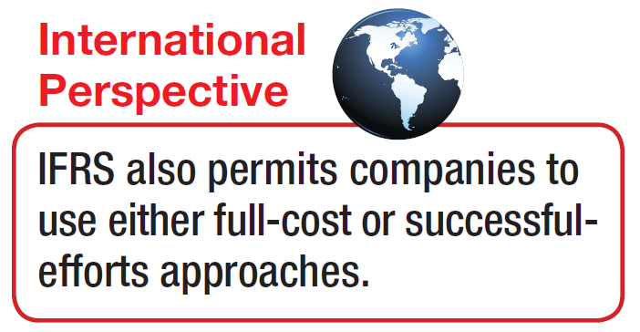
Depletion
Continuing Controversy
Cost of drilling
a dry hole is a cost needed to find the commercially profitable wells.
Oil and Gas Industry:
Full cost concept
Successful efforts concept
Companies should capitalize only the costs of successful projects.
LO 6 Explain the accounting procedures for depletion of natural resources.

Slide 50
11
Depreciation, Impairment, and Depletion
LEARNING OBJECTIVES
After studying this chapter, you should be able to:
Explain the concept of depreciation.
Identify the factors involved in the depreciation process.
Compare activity, straight-line, and decreasing-charge methods of depreciation.
Explain special depreciation methods.
Explain the accounting issues related to asset impairment.
Explain the accounting procedures for depletion of natural resources.
Explain how to report and analyze property, plant, equipment, and natural resources.

Slide 51
Presentation and Analysis
Presentation of Property, Plant, Equipment, and Natural Resources
Because of the significant impact on the financial statements of the depreciation method(s) used, companies should disclose the following.
Depreciation expense for the period.
Balances of major classes of depreciable assets, by nature and function.
Accumulated depreciation.
A general description of the method or methods used in computing depreciation with respect to major classes of depreciable assets.
LO 7

Slide 52
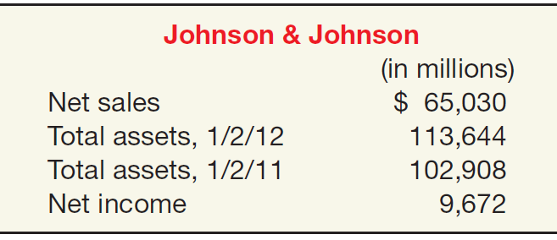
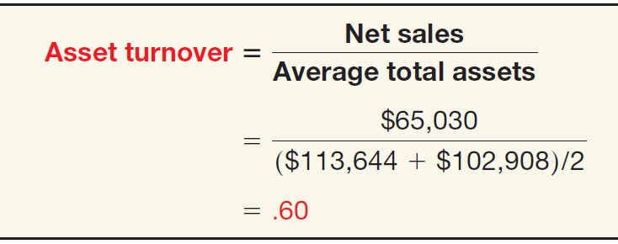
Presentation and Analysis
Analysis of Property, Plant, and Equipment
Asset Turnover Ratio
Measure of a firm’s ability to generate sales from a particular investment in assets.
Illustration 11-20
Advance slide in presentation mode to reveal answer.
LO 7

Slide 53
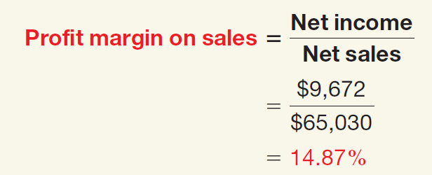
Presentation and Analysis
Analysis of Property, Plant, and Equipment
Profit Margin on Sales
Measure of the ability to generate operating income from a particular level of sales.
Illustration 11-21
Advance slide in presentation mode to reveal answer.
LO 7

Slide 54
Presentation and Analysis
Analysis of Property, Plant, and Equipment
Rate of Return on Assets
Measures a firm’s success in using assets to generate earnings.
Illustration 11-22
Advance slide in presentation mode to reveal answer.
LO 7

Slide 55
Presentation and Analysis
Analyst obtains further insight into the behavior of ROA by disaggregating it into components of profit margin on sales and asset turnover as follows:
Rate of Return on Assets
Profit Margin on Sales
Asset Turnover
=
x
Net Income
Net Income
Net Sales
=
x
Average Total Assets
Net Sales
Average Total Assets
LO 7 Explain how to report and analyze property, plant, equipment, and natural resources.

Slide 56
Presentation and Analysis
Analyst obtains further insight into the behavior of ROA by disaggregating it into components of profit margin on sales and asset turnover as follows:
Rate of Return on Assets
Profit Margin on Sales
Asset Turnover
=
x
$9,672
$9,672
$65,030
=
x
($113,644 + $102,908) / 2
$65,030
($113,644 + $102,908) / 2
8.93%
=
14.87%
x
.60
LO 7 Explain how to report and analyze property, plant, equipment, and natural resources.

