Slide 1
LEARNING OBJECTIVES
12
Intangible Assets
After studying this chapter, you should be able to:
Describe the characteristics of intangible assets.
Identify the costs to include in the initial valuation of intangible assets.
Explain the procedure for amortizing intangible assets.
Describe the types of intangible assets.
Explain the accounting issues for recording goodwill.
Explain the accounting issues related to intangible-asset impairments.
Identify the conceptual issues related to research and development costs.
Describe the accounting for research and development and similar costs.
Indicate the presentation of intangible assets and related items.

Slide 2
PREVIEW OF CHAPTER
12
Intermediate Accounting
15th Edition
Kieso Weygandt Warfield

Slide 3
INTANGIBLE ASSET ISSUES
Characteristics
Cola Company’s success comes from its secret formula for making Coca-Cola, not
its plant facilities.
Lack physical existence.
Not financial instruments.
Normally classified as long-term asset.
Common types of intangibles:
Patents
Copyrights
Franchises or licenses
Trademarks or trade names
Goodwill
LO 1 Describe the characteristics of intangible assets.

Slide 4
INTANGIBLE ASSET ISSUES
Valuation
Purchased Intangibles
Recorded at cost.
Includes all costs necessary to make the intangible asset ready for its intended use.
Typical costs include:
Purchase price.
Legal fees.
Other incidental expenses.
LO 2 Identify the costs to include in the initial valuation of intangible assets.

Slide 5
INTANGIBLE ASSET ISSUES
Valuation
Internally Created Intangibles
Generally expensed.
Only capitalize direct costs incurred in developing the intangible, such as legal costs.
Google expensed the R&D costs incurred to develop its valuable search engine.
LO 2 Identify the costs to include in the initial valuation of intangible assets.

Slide 6
INTANGIBLE ASSET ISSUES
Amortization of Intangibles
Limited-Life Intangibles
Amortize by systematic charge to expense over useful life.
Credit asset account or accumulated amortization.
Useful life should reflect the periods over which the asset will contribute to cash flows.
Amortization should be cost less residual value.
Companies should evaluate the limited-life intangibles for impairment.
LO 3 Explain the procedure for amortizing intangible assets.

Slide 7
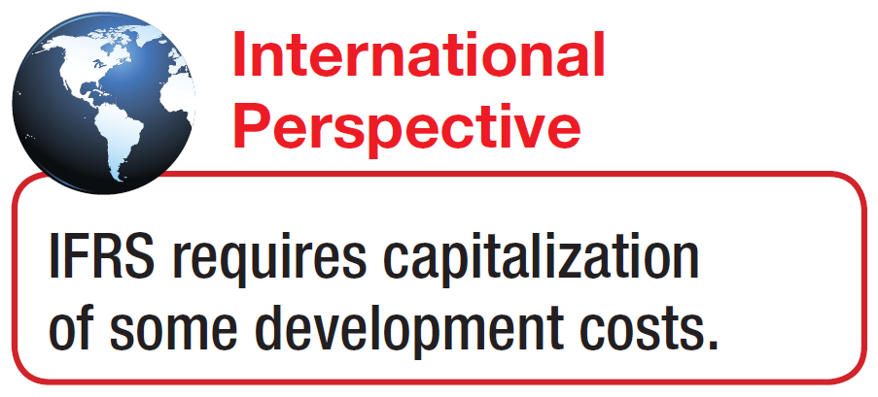
INTANGIBLE ASSET ISSUES
Amortization of Intangibles
Indefinite-Life Intangibles
No foreseeable limit on time the asset is expected to provide cash flows.
Must test indefinite-life intangibles for impairment at least annually.
No amortization.
LO 3 Explain the procedure for amortizing intangible assets.

Slide 8
INTANGIBLE ASSET ISSUES
Amortization of Intangibles
ILLUSTRATION 12-1
Accounting Treatment
for Intangibles
LO 3 Explain the procedure for amortizing intangible assets.

Slide 9
TYPES OF INTANGIBLE ASSETS
Six Major Categories:
Marketing-related.
Customer-related.
Artistic-related.
Contract-related.
Technology-related.
Goodwill.
LO 4 Describe the types of intangible assets.

Slide 10
TYPES OF INTANGIBLE ASSETS
Marketing-Related Intangible Assets
Examples:
Trademarks or trade names, newspaper mastheads, Internet domain names, and non-competition agreements.
In the United States trademarks or trade names have legal protection for indefinite number of 10 year renewal periods.
Capitalize acquisition costs.
No amortization.
LO 4 Describe the types of intangible assets.

Slide 11
TYPES OF INTANGIBLE ASSETS
Customer-Related Intangible Assets
Examples:
Customer lists, order or production backlogs, and both contractual and non-contractual customer relationships.
Capitalize acquisition costs.
Amortized to expense over useful life.
LO 4 Describe the types of intangible assets.

Slide 12
TYPES OF INTANGIBLE ASSETS
Illustration: Green Market Inc. acquires the customer list of a large newspaper for $6,000,000 on January 1, 2014. Green Market expects to benefit from the information evenly over a three-year period. Record the purchase of the customer list and the amortization of the customer list at the end of each year.
Jan. 1
2014
Customer List 6,000,000
Cash 6,000,000
Dec. 31
2014
2015
2016
Amortization Expense 2,000,000
Customer List * 2,000,000
* or Accumulated Amortization
LO 4 Describe the types of intangible assets.

Slide 13
TYPES OF INTANGIBLE ASSETS
Artistic-Related Intangible Assets
Examples:
Plays, literary works, musical works, pictures, photographs, and video and audiovisual material.
Copyright granted for the life of the creator plus 70 years.
Capitalize costs of acquiring and defending.
Amortized to expense over useful life.
Mickey Mouse
and
LO 4

Slide 14
TYPES OF INTANGIBLE ASSETS
Contract-Related Intangible Assets
Examples:
Franchise and licensing agreements, construction permits, broadcast rights, and service or supply contracts.
Franchise (or license) with a limited life should be amortized to expense over the life of the franchise.
Franchise with an indefinite life should be carried at cost and not amortized.
LO 4

Slide 15
TYPES OF INTANGIBLE ASSETS
Technology-Related Intangible Assets
Examples:
Patented technology and trade secrets granted by the U.S. Patent and Trademark Office.
Patent gives holder exclusive use for a period of 20 years.
Capitalize costs of purchasing a patent.
Expense any R&D costs in developing a patent.
Amortize over legal life or useful life, whichever is shorter.
LO 4 Describe the types of intangible assets.

Slide 16
TYPES OF INTANGIBLE ASSETS
Illustration: Harcott Co. incurs $180,000 in legal costs on January 1, 2014, to successfully defend a patent. The patent’s useful life is 20 years, amortized on a straight-line basis. Harcott records the legal fees and the amortization at the end of 2014 as follows.
Jan. 1
Patents 180,000
Cash 180,000
Dec. 31
Amortization Expense 9,000
Patents (or Accumulated Amortization) 9,000
LO 4 Describe the types of intangible assets.

Slide 17
TYPES OF INTANGIBLE ASSETS
Goodwill
Conceptually, represents the future economic benefits arising from the other assets acquired in a business combination that are not individually identified and separately recognized.
Only recorded when an entire business is purchased.
Goodwill is measured as the excess of ...
cost of the purchase over the FMV of the identifiable net assets (assets less liabilities) purchased.
Internally created goodwill should not be capitalized.
LO 5 Explain the accounting issues for recording goodwill.

Slide 18
RECORDING GOODWILL
Illustration: Multi-Diversified, Inc. decides that it needs a parts division to supplement its existing tractor distributorship. The president of Multi-Diversified is interested in buying Tractorling Company. The illustration presents the statement of financial position of Tractorling Company.
ILLUSTRATION 12-3
LO 5 Explain the accounting issues for recording goodwill.

Slide 19
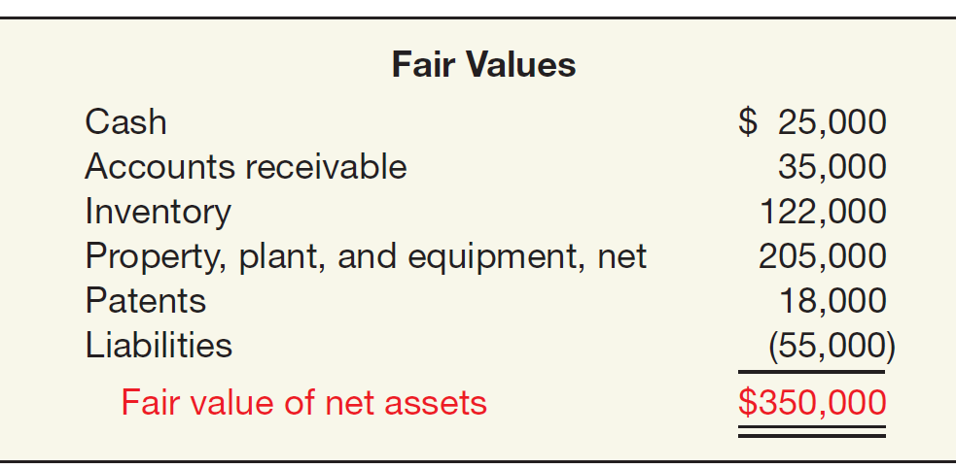
RECORDING GOODWILL
Illustration: Multi-Diversified investigates Tractorling’s underlying assets to determine their fair values.
ILLUSTRATION 12-4
Tractorling Company decides to accept Multi-Diversified’s offer of $400,000. What is the value of the goodwill, if any?
LO 5 Explain the accounting issues for recording goodwill.

Slide 20
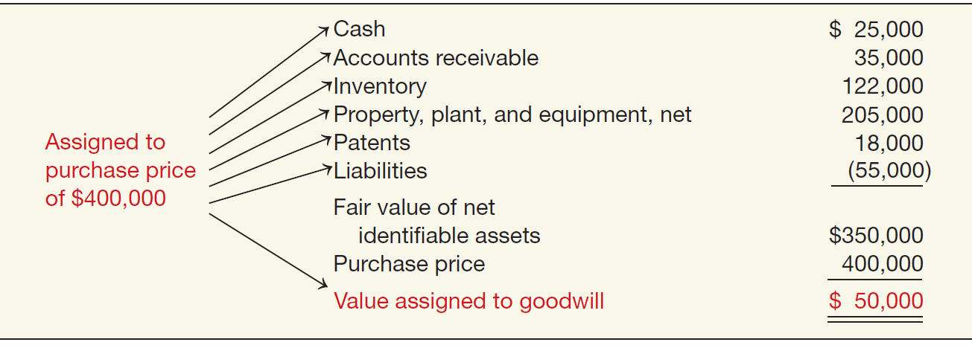
RECORDING GOODWILL
Illustration: Determination of Goodwill.
ILLUSTRATION 12-5
LO 5 Explain the accounting issues for recording goodwill.

Slide 21
RECORDING GOODWILL
Illustration: Multi-Diversified records this transaction as follows.
Cash 25,000
Accounts Receivables 35,000
Inventory 122,000
Property, Plant, and Equipment 205,000
Patents 18,000
Goodwill 50,000
Liabilities 55,000
Cash 400,000
LO 5 Explain the accounting issues for recording goodwill.

Slide 22
RECORDING GOODWILL
Example: Global Corporation purchased the net assets of Local Company for $300,000 on December 31, 2014. The balance sheet of Local Company just prior to acquisition is:
FMV of Net Assets = $200,000
LO 5 Explain the accounting issues for recording goodwill.

Slide 23
RECORDING GOODWILL
Example: Global Corporation purchased the net assets of Local Company for $300,000 on December 31, 2014. The value assigned to goodwill is determined as follows:
Book Value = $130,000
Revaluation
$70,000
Fair Value = $200,000
Goodwill
$100,000
Purchase Price = $300,000
LO 5 Explain the accounting issues for recording goodwill.

Slide 24
RECORDING GOODWILL
Example: Global Corporation purchased the net assets of Local Company for $300,000 on December 31, 2014. The value assigned to goodwill is determined as follows:
LO 5 Explain the accounting issues for recording goodwill.

Slide 25
RECORDING GOODWILL
Example: Global Corporation purchased the net assets of Local Company for $300,000 on December 31, 2014. Prepare the journal entry to record the purchase of the net assets of Local.
Journal entry recorded by Global:
Cash 15,000
Receivables 10,000
Inventory 70,000
Equipment 130,000
Goodwill 100,000
Accounts payable 25,000
Cash 300,000
LO 5 Explain the accounting issues for recording goodwill.

Slide 26
RECORDING GOODWILL
Goodwill Write-Off
Goodwill considered to have an indefinite life.
Should not be amortized.
Only adjust carrying value when goodwill is impaired.
Bargain Purchase
Purchase price less than the fair value of net assets acquired.
Amount is recorded as a gain by the purchaser.
LO 5 Explain the accounting issues for recording goodwill.

Slide 27
IMPAIRMENT OF INTANGIBLE ASSETS
Impairment of Limited-Life Intangibles
Same as impairment for long-lived assets in Chapter 11.
If the sum of the expected future net cash flows (undiscounted) is less than the carrying amount of the asset, an impairment has occurred (recoverability test).
The impairment loss is the amount by which the carrying amount of the asset exceeds the fair value of the asset (fair value test).
The loss is reported as part of income from continuing operations, “Other expenses and losses” section.
LO 6 Explain the accounting issues related to intangible-asset impairments.

Slide 28
IMPAIRMENT OF INTANGIBLE ASSETS
Illustration: Lerch, Inc. has a patent on how to extract oil from shale
rock. Unfortunately, several recent non-shale oil discoveries adversely affected the demand for shale-oil technology. As a result, Lerch performs a recoverability test. It finds that the expected future net cash flows from this patent are $35 million. Lerch’s patent has a carrying amount of $60 million. Discounting the expected future net cash flows at its market rate of interest, Lerch determines the fair value of its patent to be $20 million. Perform the recoverability test.
Expected future net cash flows $ 35,000,000
Carrying value 60,000,000
Asset impaired $ (25,000,000)
LO 6 Explain the accounting issues related to intangible-asset impairments.

Slide 29
IMPAIRMENT OF INTANGIBLE ASSETS
Illustration: Perform the fair value test and the journal entry (if any) to record the impairment of the asset.
Carrying amount of patent $ 60,000,000
Fair value 20,000,000
Loss on impairment $ 40,000,000
Loss on impairment 40,000,000
Patents 40,000,000
Companies may not recognize restoration of the previously recognized impairment loss.
LO 6 Explain the accounting issues related to intangible-asset impairments.

Slide 30
IMPAIRMENT OF INTANGIBLE ASSETS
Impairment of Indefinite-Life Intangibles Other than Goodwill
Should be tested for impairment at least annually.
Impairment test is a fair value test.
If the fair value of asset is less than the carrying amount, an impairment loss is recognized for the difference.
Recoverability test is not used.
LO 6 Explain the accounting issues related to intangible-asset impairments.

Slide 31
IMPAIRMENT OF INTANGIBLE ASSETS
Illustration: Arcon Radio purchased a broadcast license for $2,000,000. Arcon Radio has renewed the license with the FCC twice, at a minimal cost. Because it expects cash flows to last indefinitely, Arcon reports the license as an indefinite-life intangible asset. Recently the FCC decided to auction these licenses to the highest bidder instead of renewing them. Arcon Radio expects cash flows for the remaining two years of its existing license. It performs an impairment test and determines that the fair value of the intangible asset is $1,500,000.
ILLUSTRATION 12-7
LO 6 Explain the accounting issues related to intangible-asset impairments.

Slide 32
IMPAIRMENT OF INTANGIBLE ASSETS
Impairment of Goodwill
Two Step Process:
Step 1: If fair value is less than the carrying amount of the net assets (including goodwill), then perform a second step to determine possible impairment.
Step 2: Determine the fair value of the goodwill (implied value of goodwill) and compare to carrying amount.
LO 6 Explain the accounting issues related to intangible-asset impairments.

Slide 33
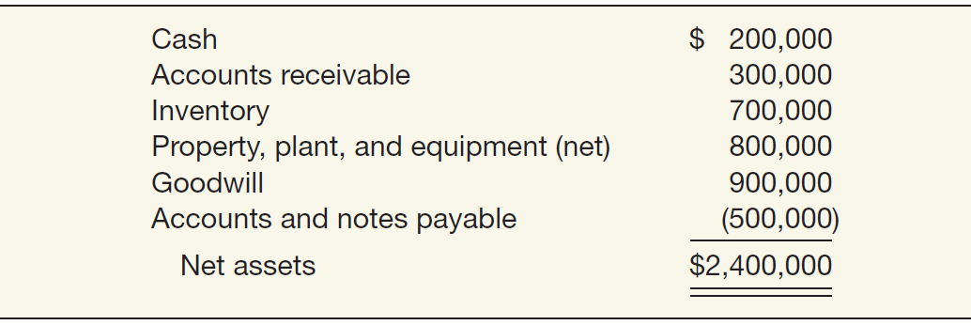
IMPAIRMENT OF INTANGIBLE ASSETS
Illustration: Kohlbuy Corporation has three divisions. It purchased one division, Pritt Products, four years ago for $2 million. Kohlbuy management is now reviewing the division for purposes of recognizing an impairment. Illustration 12-8 lists the Pritt Division’s net assets, including the associated goodwill of $900,000 from the purchase.
ILLUSTRATION 12-8
Assume that the fair value of the Pritt Division is $1,900,000.
LO 6

Slide 34
IMPAIRMENT OF INTANGIBLE ASSETS
Illustration: Prepare the journal entry (if any) to record the impairment.
ILLUSTRATIONS 12-9 and 12-10
Step 1: The fair value of the reporting unit is below its carrying value. Therefore, an impairment has occurred.
Step 2:
$ 1,900,000
1,500,000
400,000
900,000
$ (500,000)
Loss on impairment 500,000
Goodwill 500,000
LO 6 Explain the accounting issues related to intangible-asset impairments.

Slide 35
IMPAIRMENT OF INTANGIBLE ASSETS
Impairment Summary
ILLUSTRATION 12-11
LO 6 Explain the accounting issues related to intangible-asset impairments.

Slide 36
RESEARCH AND DEVELOPMENT COSTS
Research and development (R&D) costs are not in themselves intangible assets.
Frequently results in something that a company patents or copyrights such as:
new product,
process,
idea,
formula,
composition, or
literary work.
Companies must expense all research and development costs when incurred.
LO 7 Identify the conceptual issues related to research and development costs.

Slide 37
RESEARCH AND DEVELOPMENT COSTS
Identifying R & D Activities
ILLUSTRATION 12-13
Research Activities
Planned search or critical investigation aimed at discovery of new knowledge.
Examples
Laboratory research aimed at discovery of new knowledge; searching for applications of new research findings.
Development Activities
Translation of research findings or other knowledge into a plan or design for a new product or process or for a significant improvement to an existing product or process whether intended for sale or use.
Examples
Conceptual formulation and design of possible product or process alternatives; construction of prototypes and
operation of pilot plants.
LO 7 Identify the conceptual issues related to research and development costs.

Slide 38
PRESENTATION OF INTANGIBLES
Presentation of Intangible Assets
Balance Sheet
Intangible assets shown as a separate item.
Reporting is similar to the reporting of property, plant, and equipment.
Contra accounts are not normally shown for intangibles.
Companies should report as a separate item all intangible assets other than goodwill.
LO 9 Indicate the presentation of intangible assets and related items.

Slide 39
PRESENTATION OF INTANGIBLES
Presentation of Intangible Assets and Research and Development Costs
Income Statement
Report amortization expense and impairment losses in continuing operations.
Total R&D costs charged to expense must be disclosed.
LO 9 Indicate the presentation of intangible assets and related items.

Slide 40
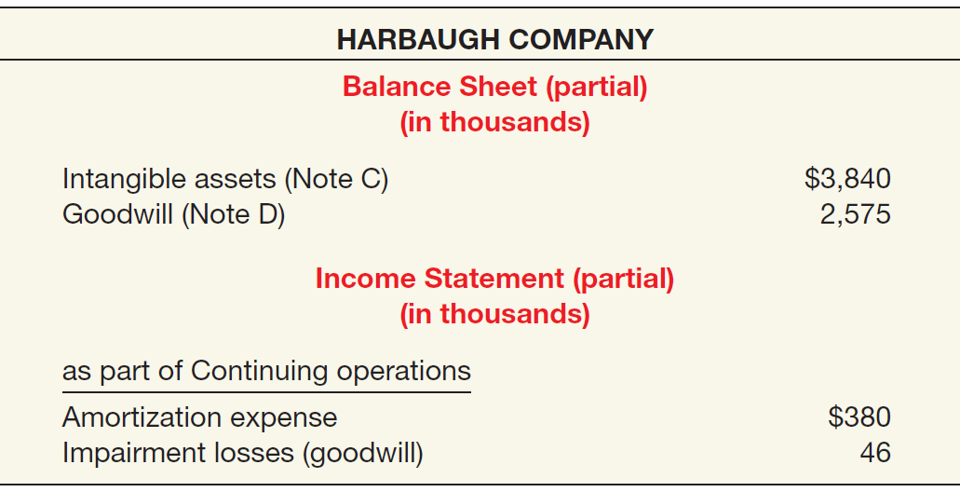
PRESENTATION OF INTANGIBLES
ILLUSTRATION 12-15
LO 9 Indicate the presentation of intangible assets and related items.

Slide 41
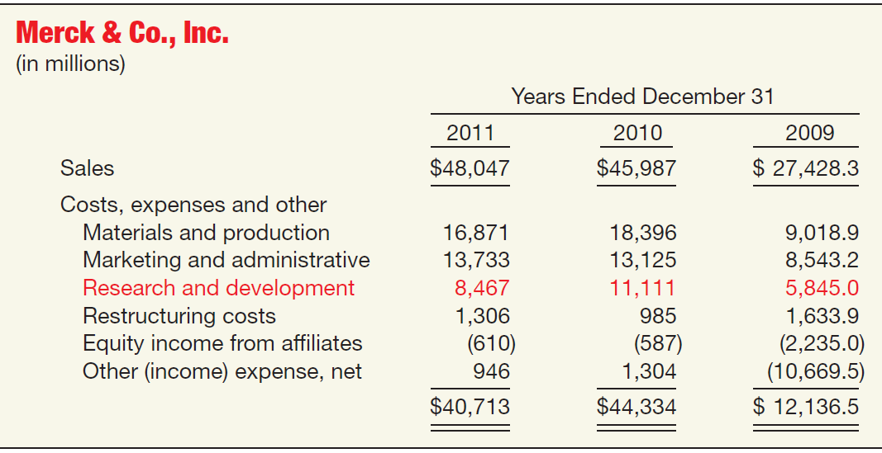
PRESENTATION OF INTANGIBLES
ILLUSTRATION 12-16
LO 9 Indicate the presentation of intangible assets and related items.

