Slide 1
1
Financial Accounting and Accounting Standards
Intermediate Accounting
Kieso, Weygandt, and Warfield

Slide 2
Financial Statements and Financial Reporting
Essential characteristics of accounting are:
the identification, measurement, and communication of financial information about
economic entities to
interested parties.
LO 1 Identify the major financial statements and other means of financial reporting.

Slide 3
Financial Statements and Financial Reporting
Economic Entity
Financial Statements
Additional Information
Financial Information
Accounting?
Identifies
and
Measures
and
Communicates
Balance Sheet
Income Statement
Statement of Cash Flows
Statement of Owners’ or Stockholders’ Equity
Note Disclosures
President’s letter
Prospectuses
Reports filed with governmental agencies
News releases
Forecasts
Environmental impact statements
Etc.
GAAP
LO 1 Identify the major financial statements and other means of financial reporting.

Slide 4
Financial Statements and Financial Reporting
Review Question
What is the purpose of information presented in notes to the financial statements?
a. To provide disclosure required by generally accepted accounting principles.
b. To correct improper presentation in the financial statements.
c. To provide recognition of amounts not included in the totals of the financial statements.
d. To present management’s responses to auditor comments.
LO 1 Identify the major financial statements and other means of financial reporting.

Slide 5
Financial Statements and Financial Reporting
Accounting and Capital Allocation
Resources are limited. Efficient use of resources often determines whether a business thrives.
Illustration 1-1
Capital Allocation Process
LO 2 Explain how accounting assists in the efficient use of scare resources.

Slide 6
Accounting and Capital Allocation
Review Question
An effective process of capital allocation is critical to a healthy economy, which
a. promotes productivity.
b. encourages innovation.
c. provides an efficient and liquid market for buying and selling securities.
d. All of the above.
LO 2 Explain how accounting assists in the efficient use of scare resources.

Slide 7
Financial Statements and Financial Reporting
Objectives of Financial Reporting
Provide financial information about the reporting entity that is useful to
present and potential equity investors,
lenders, and
other creditors
in making decisions in their capacity as capital providers.
LO 3 Identify the objectives of financial reporting.

Slide 8
Objective of Financial Accounting
General-Purpose Financial Statements
Provide financial reporting information to a wide variety of users.
Provide the most useful information possible at the least cost.
Equity Investors and Creditors
Investors are the primary user group.
LO 3 Identify the objectives of financial reporting.

Slide 9
Objective of Financial Accounting
Entity Perspective
Companies viewed as separate and distinct from their owners.
Decision-Usefulness
Investors are interested in assessing the company’s
ability to generate net cash inflows and
management’s ability to protect and enhance the capital providers’ investments.
LO 3 Identify the objectives of financial reporting.

Slide 10
Need to Develop Standards
Various users need financial information
Financial Statements
Balance Sheet
Income Statement
Statement of Stockholders’ Equity
Statement of Cash Flows
Note Disclosure
The accounting profession has attempted to develop a set of standards that are generally accepted and universally practiced.
Generally Accepted Accounting Principles (GAAP)
LO 4 Explain the need for accounting standards.

Slide 11
Parties Involved in Standard Setting
Three organizations:
Securities and Exchange Commission (SEC).
American Institute of Certified Public Accountants (AICPA).
Financial Accounting Standards Board (FASB).
LO 5 Identify the major policy-setting bodies and their role in the standard-setting process.

Slide 12
Parties Involved in Standard Setting
Securities and Exchange Commission (SEC)
Established by federal government.
Requires filing of audited financial statements by companies that issue securities to the public or are listed on a stock exchange
Accounting and reporting for public companies..
http://www.sec.gov/
Encouraged private standard-setting body.
SEC requires public companies to adhere to GAAP.
SEC Oversight.
Enforcement Authority.
Relies on FASB to develop accounting standards
LO 5 Identify the major policy-setting bodies and their role in the standard-setting process.

Slide 13
Parties Involved in Standard Setting
American Institute of CPAs (AICPA)
http://www.aicpa.org/
National professional organization of practicing Certified Public Accountants (CPAs)
Important contributor to the development of GAAP
Established the following:
Committee on Accounting Procedures
Accounting Principles Board
1939 to 1959
Issued 51 Accounting Research Bulletins (ARBs)
Problem-by-problem approach failed
1959 to 1973
Issued 31 Accounting Principle Board Opinions (APBOs)
Wheat Committee recommendations adopted in 1973
LO 5

Slide 14
Parties Involved in Standard Setting
Financial Accounting Standards Board (FASB)
Wheat Committee’s recommendations resulted in creation of FASB.
Financial Accounting Foundation
Selects members of the FASB.
Funds their activities.
Exercises general oversight.
Financial Accounting Standards Board
Mission to establish and improve standards of financial accounting and reporting.
Financial Accounting Standards Advisory Council
Consult on major policy issues.
LO 5

Slide 15
Financial Accounting Standards Board
Missions is to establish and improve standards of financial accounting and reporting. Differences between FASB and APB include:
Smaller Membership.
Full-time, Remunerated Membership.
Greater Autonomy.
Increased Independence.
Broader Representation.
http://www.fasb.org/
LO 5 Identify the major policy-setting bodies and their role in the standard-setting process.

Slide 16
Financial Accounting Standards Board
Review
The first step taken in the establishment of a typical FASB statement is
a. The board conducts research and analysis and a discussion memorandum is issued.
b. A public hearing on the proposed standard is held.
c. The board evaluates the research and public response and issues an exposure draft.
d. Topics are identified and placed on the board’s agenda.
LO 5 Identify the major policy-setting bodies and their role in the standard-setting process.

Slide 17
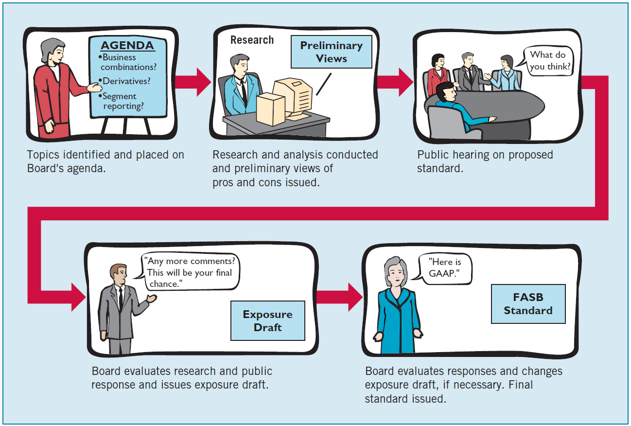
Financial Accounting Standards Board
Illustration 1-3
The Due Process System of the FASB
LO 5 Identify the major policy-setting bodies and their role in the standard-setting process.

Slide 18
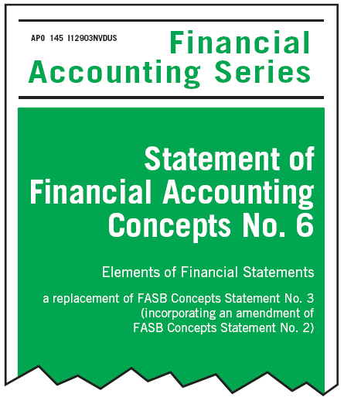
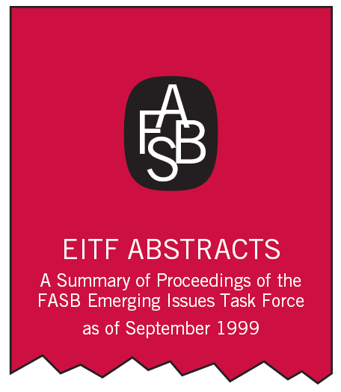
Financial Accounting Standards Board
Types of Pronouncements
Accounting Standard updates: Standards, Interpretations, and Staff Positions – standards issued are GAAP; interpretations that modify or extend existing standards; staff positions provide interpretive guidance and minor amendments
Financial Accounting Concepts: fundamental objectives and concepts used to develop future standards
Emerging Issues Task Force Statements: deals with new and unusual financial transactions that may potentially create differing financial reporting practices
LO 5 Identify the major policy-setting bodies and their role in the standard-setting process.

Slide 19
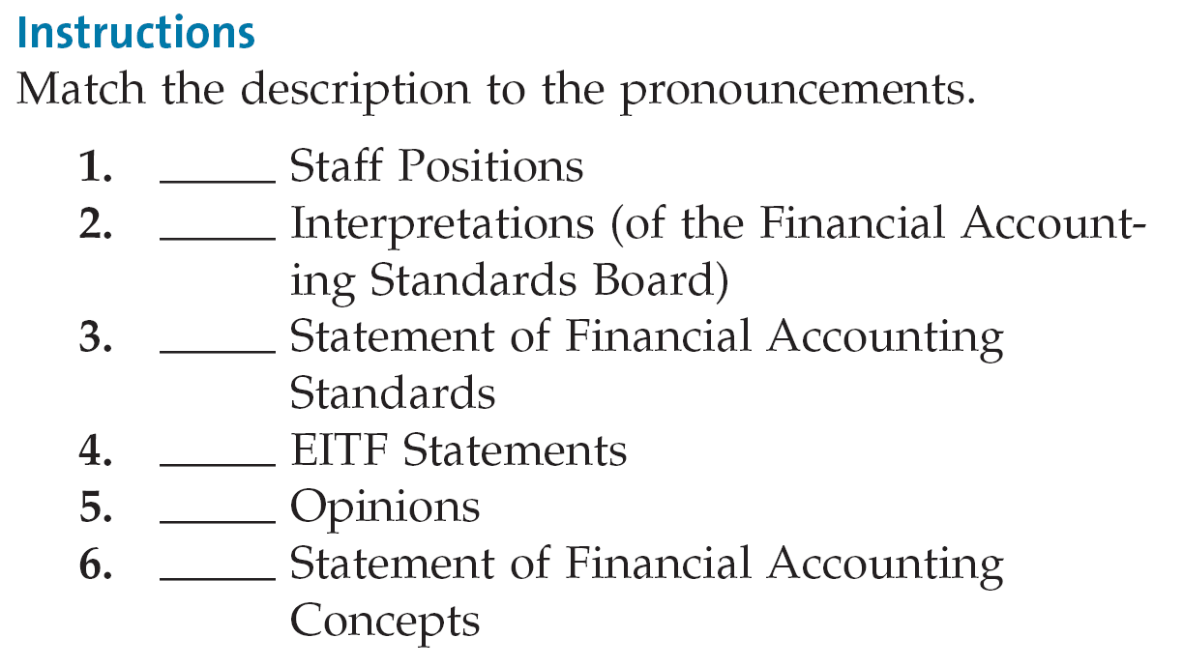
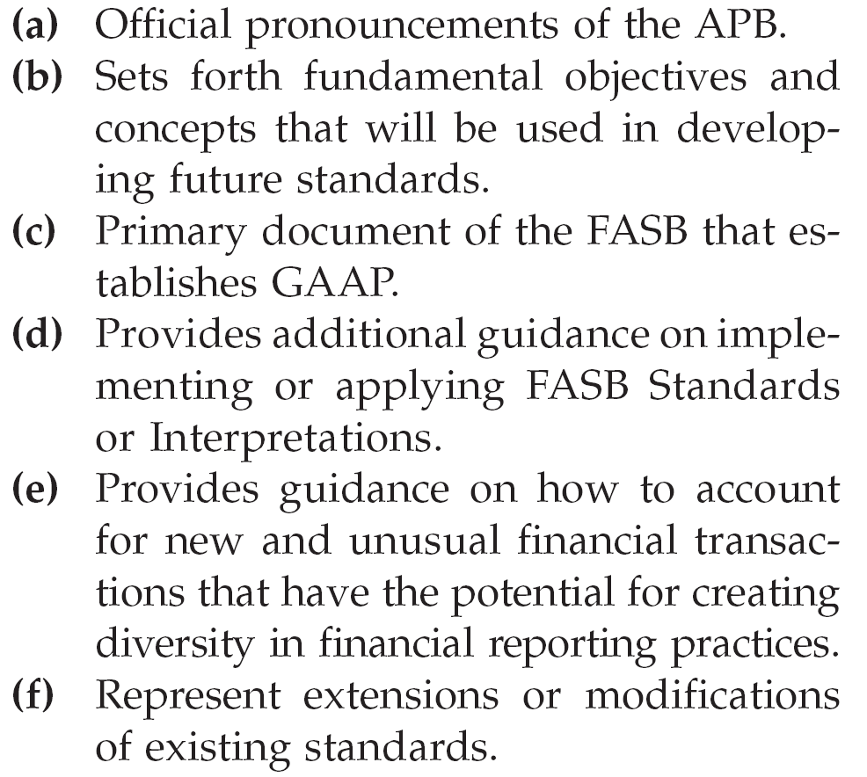
Types of Pronouncements
CA1-14 (Accounting Pronouncements): Standard setting bodies have issued a number of authoritative pronouncements. A list is provided on the left, below, with a description of these pronouncements on the right.
(d)
(f)
(c)
(e)
(a)
(b)
LO 5

Slide 20
Parties Involved in Standard Setting
Changing Role of AICPA
The AICPA established the Accounting Standards Executive Committee (AcSEC):
Audit and Accounting Guides: summarize the accounting practices of specific industries and provide specific guidance on matters not addressed by the FASB
Statements of Position (SOP): provide guidance on financial reporting topics until the FASB sets standards on the issue in question.
Practice Bulletins: indicate the AcSEC’s views on narrow financial reporting issues not considered by the FASB.
AICPA and AcSEC no longer issues authoritative accounting guidance for public companies.
PCAOB oversees the development of auditing standards.
LO 5 Identify the major policy-setting bodies and their role in the standard-setting process.

Slide 21
Generally Accepted Accounting Principles
Principles that have substantial authoritative support.
Major sources of GAAP:
FASB Standards, Interpretations, and Staff Positions.
APB Opinions.
AICPA Accounting Research Bulletins.
LO 6 Explain the meaning of generally accepted accounting principles (GAAP) and the role of the Codification for GAAP.

Slide 22
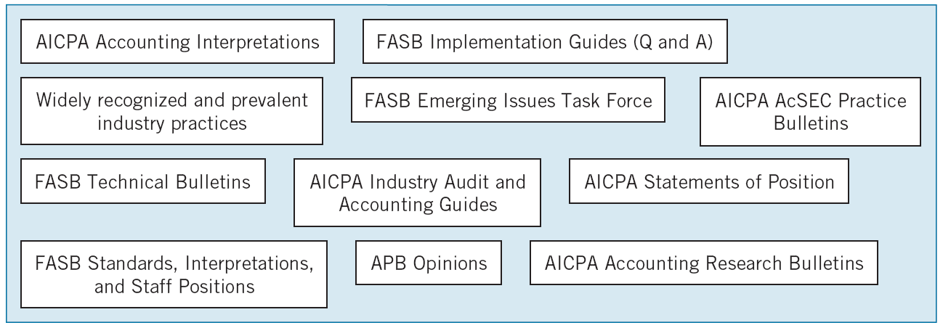
Generally Accepted Accounting Principles
Illustration 1-4 GAAP Documents
LO 6 Explain the meaning of generally accepted accounting principles (GAAP) and the role of the Codification for GAAP.

Slide 23
Generally Accepted Accounting Principles
Review
Which of the following accounting pronouncements is the most authoritative?
a. FASB Statement of Financial Accounting Concepts.
b. FASB Technical Bulletins.
c. AICPA Accounting Principles Board Opinion.
d. AICPA Statement of Position.
LO 6 Explain the meaning of generally accepted accounting principles (GAAP) and the role of the Codification for GAAP.

Slide 24
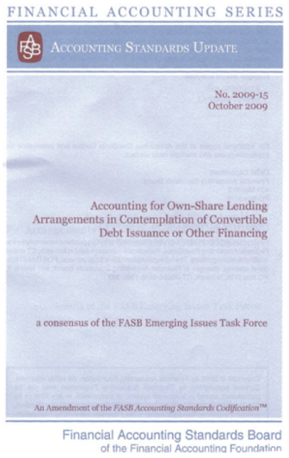
Generally Accepted Accounting Principles
FASB Codification
Goal in developing the Codification is to provide in one place all the authoritative literature related to a particular topic.
Creates one level of GAAP, which is considered authoritative.
All other accounting literature is considered non-authoritative.
FASB has developed the Financial Accounting Standards Board Codification Research System (CRS). CRS is an online real-time database that provides easy access to the Codification.
LO 6

Slide 25
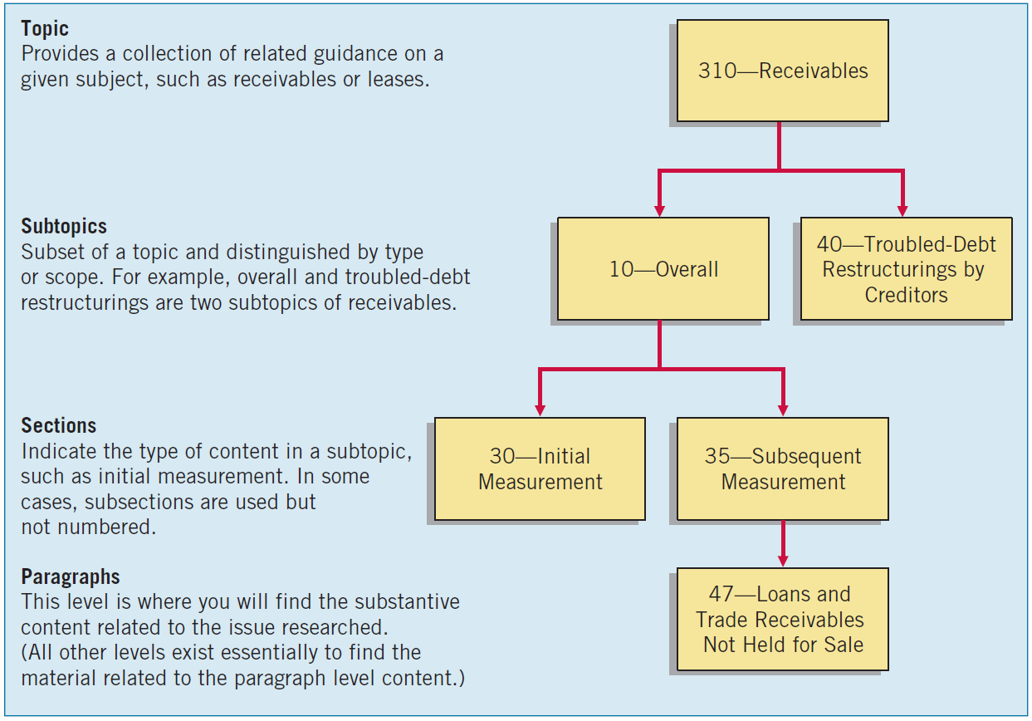
Generally Accepted Accounting Principles
Illustration 1-5
FASB Codification
Framework
LO 6

Slide 26
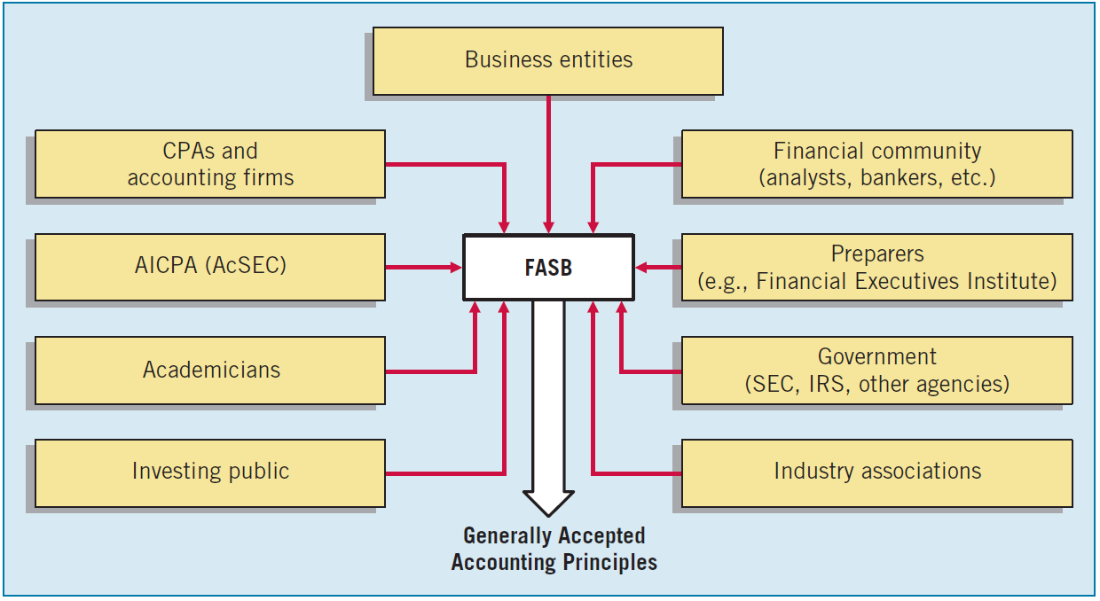
Issues in Financial Reporting
Illustration 1-6
User Groups that Influence the Formulation of Accounting Standards
GAAP in a Political Environment
GAAP is as much a product of political action as they are of careful logic or empirical findings.
LO 7 Describe the impact of user groups on the rule-making process.

Slide 27
Issues in Financial Reporting
Expectation GAAP
What the public thinks accountants should do vs. what accountants think they can do.
Difficult to close in light of accounting scandals.
Sarbanes-Oxley Act (2002).
This law has increased the resources for SEC to combat fraud and curb poor reporting practices.
There are new policing efforts, codes of ethics, new auditor independence rules and materiality guidelines for financial reporting.
Public Company Accounting Oversight Board (PCAOB). for enforcement and establishment of auditing, quality control and independence of standards and rules.
Although accounting cannot be held responsible for every financial catastrophe, the accounting professional bodies should continue to develop a highly transparent, clear and reliable system for financial reporting.
LO 7 Describe the impact of user groups on the rule-making process.

Slide 28
Issues in Financial Reporting
Financial Reporting Challenges
Non-financial measurements.
Forward-looking information.
Soft assets.
Timeliness
Understandibility
LO 8 Describe some of the challenges facing financial reporting.

Slide 29
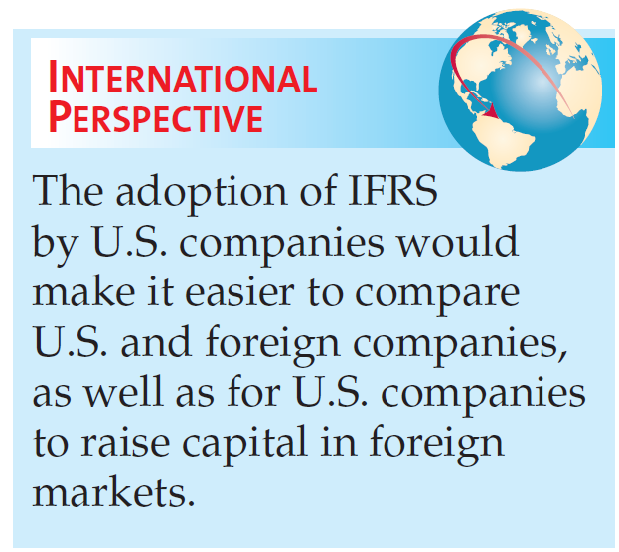
Issues in Financial Reporting
International Accounting Standards
Two sets of standards accepted for international use:
U.S. GAAP, issued by the FASB.
International Financial Reporting Standards (IFRS), issued by the IASB.
FASB and IASB recognize that global markets will best be served if only one set of GAAP is used.
LO 8 Describe some of the challenges facing financial reporting.

Slide 30
Issues in Financial Reporting
CA1-9 (GAAP Terminology): With accounting and finance, it often helps to be fluent in abbreviations and acronyms.
Instructions:
Presented below is a list of common accounting acronyms. Identify the term for which each acronym stands, and provide a brief definition of each term.
(a) AICPA (e) FAF (i) CPA
(b) CAP (f) FASAC (j) FASB
(c) ARB (g) SOP (k) SEC
(d) APB (h) GAAP (l) IASB
LO 8 Describe some of the challenges facing financial reporting.

Slide 31
Issues in Financial Reporting
Ethics in the Environment of Financial Accounting
In accounting, we frequently encounter ethical dilemmas.
GAAP does not always provide an answer.
Doing the right thing is not always easy or obvious.
LO 9 Understand issues related to ethics and financial accounting.

Slide 32
RELEVANT FACTS
International standards are referred to as International Financial Reporting Standards (IFRS), developed by the International Accounting Standards Board (IASB). Recent events in the global capital markets have underscored the importance of financial disclosure and transparency not only in the United States but in markets around the world. As a result, many are examining which accounting and financial disclosure rules should be followed.
U.S standards, referred to as generally accepted accounting principles (GAAP), are developed by the Financial Accounting Standards Board (FASB). The fact that there are differences between what is in this textbook (which is based on U.S. standards) and IFRS should not be surprising because the FASB and IASB have responded to different user needs.

Slide 33
RELEVANT FACTS
The internal control standards applicable to Sarbanes-Oxley (SOX) apply only to large public companies listed on U.S. exchanges. There is a continuing debate as to whether non-U.S. companies should have to comply with this extra layer of regulation. Debate about international companies (non-U.S.) adopting SOX-type standards centers on whether the benefits exceed the costs. The concern is that the higher costs of SOX compliance are making the U.S. securities markets less competitive.
The textbook mentions a number of ethics violations, such as WorldCom, AIG, and Lehman Brothers. These problems have also occurred internationally, for example, at Satyam Computer Services (India), Parmalat (Italy), and Royal Ahold (the Netherlands).

Slide 34
RELEVANT FACTS
IFRS tends to be simpler in its accounting and disclosure requirements; some people say more “principles-based.” GAAP is more detailed; some people say more “rules-based.” This difference in approach has resulted in a debate about the merits of “principles-based” versus “rules-based” standards.
The SEC allows foreign companies that trade shares in U.S. markets to file their IFRS financial statements without reconciliation to GAAP.

Slide 35
International Standard-Setting Organizations:
International Accounting Standards Board (IASB)
Issues International Financial Reporting Standards (IFRS).
Standards used on most foreign exchanges.
Standards used by foreign companies listing on U.S. securities exchanges.
IFRS used in over 115 countries.

Slide 36
International Organization of Securities Commissions (IOSCO)
Does not set accounting standards.
Dedicated to ensuring that global markets can operate in an efficient and effective basis.
http://www.iosco.org/

Slide 37
International Accounting Standards Board (IASB)
Composed of four organizations—
International Accounting Standards Committee Foundation (IASCF).
International Accounting Standards Board (IASB).
Standards Advisory Council.
International Financial Reporting Interpretations Committee (IFRIC).
http://www.iasb.org

Slide 38
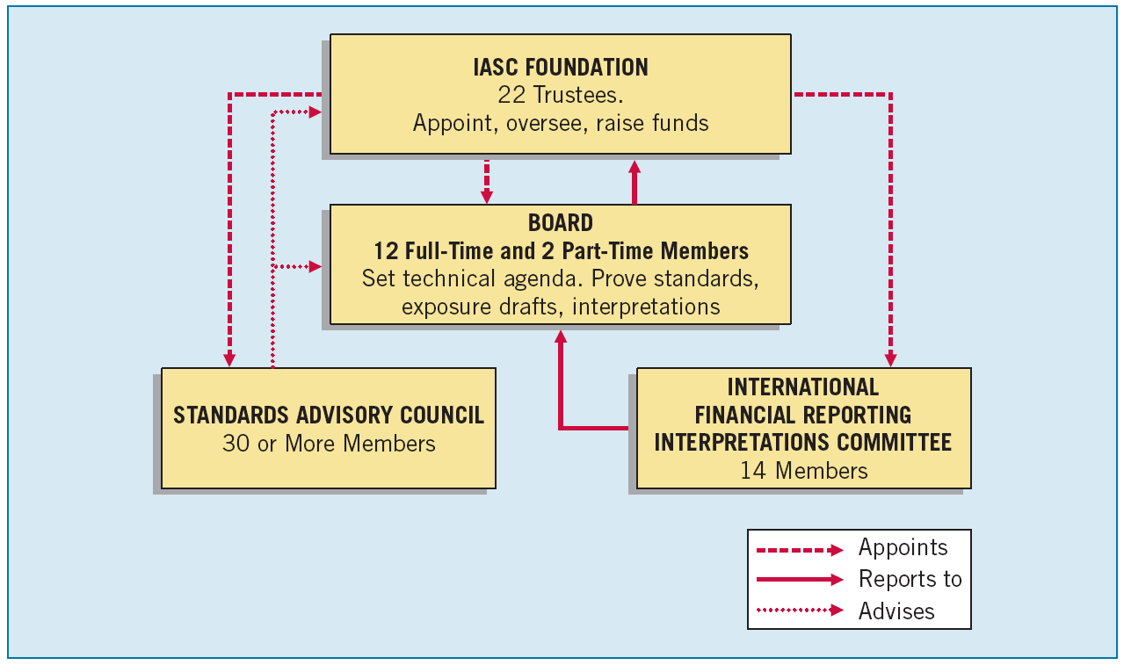
Illustration IFRS1-2
International Standard-Setting Structure

Slide 39
Types of Pronouncements
Bangladesh Financial Reporting Standards (BFRS)
The Financial Reporting Standards prescribed by the Institute of Chartered Accountants in Bangladesh (ICAB) are known as Bangladesh Financial Reporting Standards (BFRS, including Bangladesh Accounting Standards, BAS).
As at January 2013, a version of all IFRS (and IAS) issued by the IASB had been adopted as BFRS by the ICAB, with the following exceptions:
IAS 29 Financial Reporting in Hyperinflationary Economies (adopted but will not enter into force on or after 1 January 2015)
- IFRS 9 Financial Instruments (Not yet adopted but under review process)

Slide 40
Review Question
IFRS stands for:
International Federation of Reporting Services.
Independent Financial Reporting Standards.
International Financial Reporting Standards.
Integrated Financial Reporting Services.

Slide 41
Review Question
The major key players on the international side are the:
IASB and FASB.
SEC and FASB.
IOSCO and the SEC.
IASB and IOSCO.

Slide 42
Review Question
Which body from the U.S. side is similar to the IASB?
SEC.
FASB.
FASC.
FAF.

Slide 43
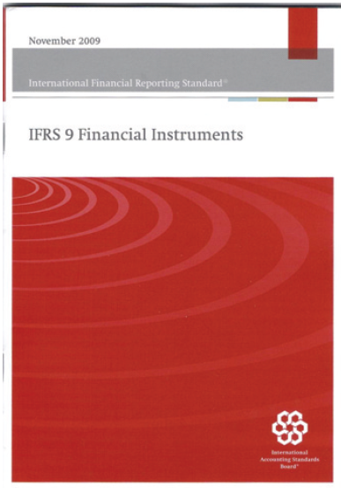
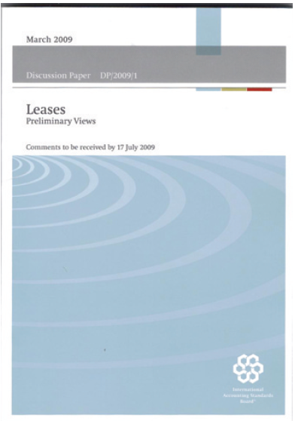
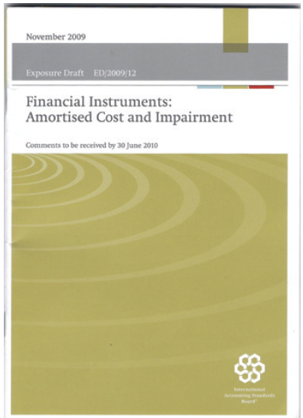
Types of Pronouncements
International Financial Reporting Standards.
Framework for financial reporting.
International financial reporting interpretations.

Slide 44
Hierarchy of IFRS
Companies first look to:
International Financial Reporting Standards;
International Accounting Standards; and
Interpretations originated by the International Financial Reporting Interpretations Committee (IFRIC) or the former Standing Interpretations Committee (SIC).

Slide 45
Review Question
IFRS is comprised of:
International Financial Reporting Standards and FASB financial reporting standards.
International Financial Reporting Standards, International Accounting Standards, and international accounting interpretations.
International Accounting Standards and international accounting interpretations.
FASB financial reporting standards and International Accounting Standards.

Slide 46
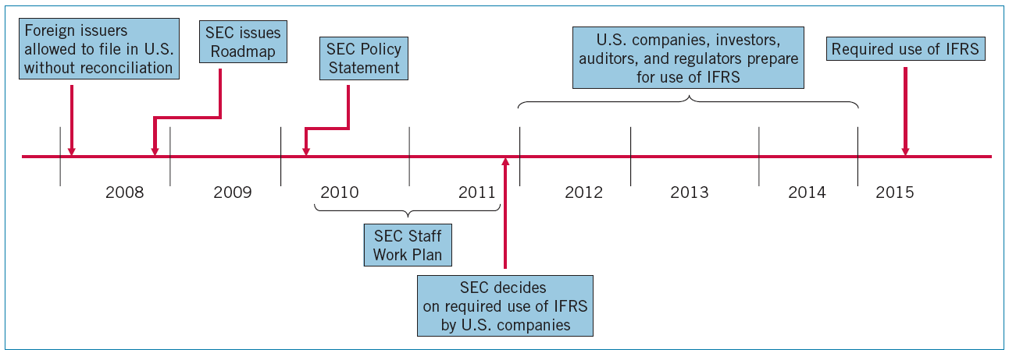
International Convergence
The SEC appears committed to move to IFRS, assuming that certain conditions are met.
Illustration IFRS1-3
SEC Roadmap

Slide 47
International Convergence
The SEC will decide, sometime in 2011, whether to mandate the use of IFRS.
It is likely that not all companies would be required immediately to change to IFRS, but there would be a transition period in which this would be accomplished.

