Slide 1
4
Income Statement and Related Information
Intermediate Accounting
Kieso, Weygandt, and Warfield

Slide 2
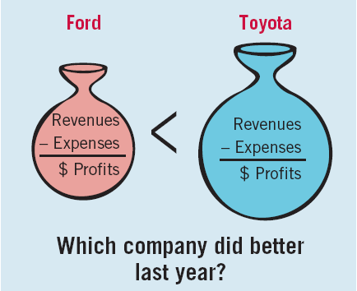
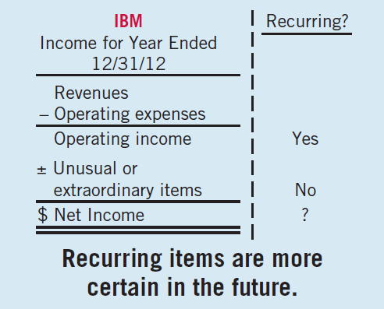
Income Statement
Usefulness
Evaluate past performance.
Predicting future performance.
Help assess the risk or uncertainty of achieving future cash flows.
LO 1 Understand the uses and limitations of an income statement.

Slide 3
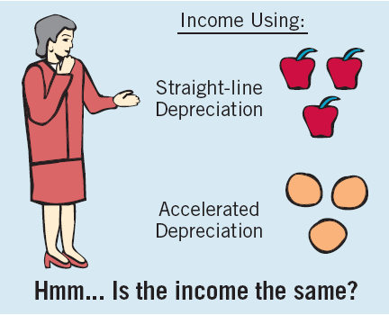
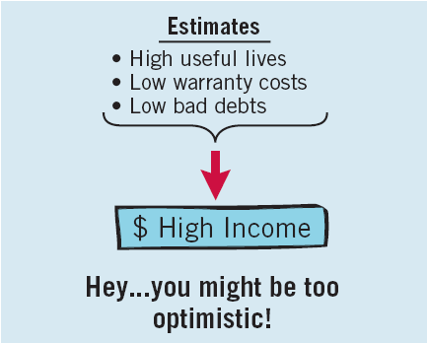
Income Statement
Limitations
Companies omit items that cannot be measured reliably.
Income is affected by the accounting methods employed.
Income measurement involves judgment.
LO 1 Understand the uses and limitations of an income statement.

Slide 4
Income Statement
Quality of Earnings
Companies have incentives to manage income to meet or beat Wall Street expectations, so that
market price of stock increases and
value of stock options increase.
Quality of earnings is reduced if earnings management results in information that is less useful for predicting future earnings and cash flows.
LO 1 Understand the uses and limitations of an income statement.

Slide 5
Format of the Income Statement
Elements of the Income Statement
Revenues – Inflows or other enhancements of assets or settlements of its liabilities that constitute the entity’s ongoing major or central operations.
Examples of Revenue Accounts
Sales
Fee revenue
Interest revenue
Dividend revenue
Rent revenue
LO 1 Understand the uses and limitations of an income statement.

Slide 6
Format of the Income Statement
Elements of the Income Statement
Expenses – Outflows or other using-up of assets or incurrences of liabilities that constitute the entity’s ongoing major or central operations.
Examples of Expense Accounts
Cost of goods sold
Depreciation expense
Interest expense
Rent expense
Salary expense
LO 1 Understand the uses and limitations of an income statement.

Slide 7
Format of the Income Statement
Elements of the Income Statement
Gains – Increases in equity (net assets) from peripheral or incidental transactions.
Losses - Decreases in equity (net assets) from peripheral or incidental transactions.
Gains and losses can result from
sale of investments or plant assets,
settlement of liabilities,
write-offs of assets.
LO 1 Understand the uses and limitations of an income statement.

Slide 8
Single-Step Format
Single-Step Income Statement
Revenues
Expenses
Net Income
Single- Step
No distinction between Operating and Non-operating categories.
LO 2 Prepare a single-step income statement.

Slide 9
Single-Step Format
E4-4: Prepare an income statement from the data below.
LO 2 Prepare a single-step income statement.

Slide 10
Single-Step Format
Review
The single-step income statement emphasizes
the gross profit figure.
total revenues and total expenses.
extraordinary items more than it is emphasized in the multiple-step income statement.
the various components of income from continuing operations.
LO 2 Prepare a single-step income statement.

Slide 11
Format of the Income Statement
Multiple-Step Income Statement
Separates operating transactions from nonoperating transactions.
Matches costs and expenses with related revenues.
Highlights certain intermediate components of income that analysts use.
LO 3 Prepare a multiple-step income statement.

Slide 12
Multiple-Step Format
Intermediate Components of the Income Statement
Operating section
Nonoperating section
Income tax
Discontinued operations
Extraordinary items
Earnings per share
LO 3 Prepare a multiple-step income statement.

Slide 13
Multiple-Step Format
The presentation divides information into major sections.
1. Operating Section
2. Nonoperating Section
3. Income tax
LO 3 Prepare a multiple-step income statement.

Slide 14
Multiple-Step Format
Illustration (E4-4): Prepare an income statement from the data below.

Slide 15
Multiple-Step Format
Review
A separation of operating and non operating activities of a company exists in
both a multiple-step and single-step income statement.
a multiple-step but not a single-step income statement.
a single-step but not a multiple-step income statement.
neither a single-step nor a multiple-step income statement.
LO 3 Prepare a multiple-step income statement.

Slide 16
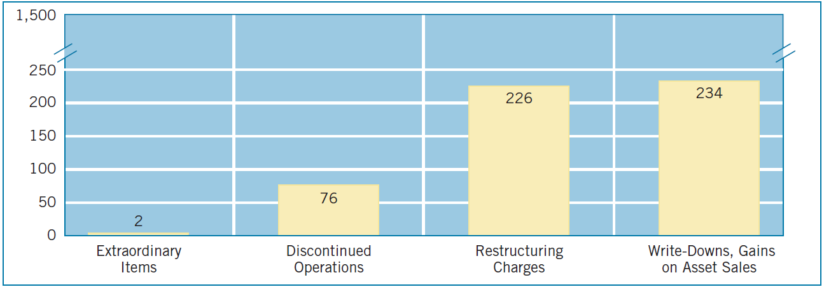
Reporting Irregular Items
Companies are required to report irregular items in the financial statements so users can determine the long-run earning power of the company.
Illustration 4-5
Number of Irregular Items Reported in a Recent Year by 500 Large Companies
LO 4 Explain how to report irregular items.

Slide 17
Reporting Irregular Items
Irregular items fall into six categories
Discontinued operations.
Extraordinary items.
Unusual gains and losses.
Changes in accounting principle.
Changes in estimates.
Corrections of errors.
LO 4 Explain how to report irregular items.

Slide 18
Reporting Irregular Items
Discontinued Operations
Occurs when,
(a) company eliminates the
results of operations and
cash flows of a component.
there is no significant continuing involvement in that component.
Amount reported “net of tax.”
LO 4 Explain how to report irregular items.

Slide 19
Reporting Discontinued Operations
Illustration: KC Corporation had after tax income from continuing operations of $55,000,000 for the year. During the year, it disposed of its restaurant division at a pretax loss of $270,000. Prior to disposal, the division operated at a pretax loss of $450,000 for the year. Assume a tax rate of 30%. Prepare a partial income statement for KC.
Income from continuing operations $55,000,000
Discontinued operations:
Loss from operations, net of $135,000 tax 315,000
Loss on disposal, net of $81,000 tax 189,000
Total loss on discontinued operations 504,000
Net income $54,496,000
LO 4 Explain how to report irregular items.

Slide 20
Reporting Discontinued Operations
Discontinued Operations are reported after “Income from continuing operations.”
Previously labeled as “Net Income”.
Moved to
LO 4

Slide 21
Reporting Irregular Items
Extraordinary items are nonrecurring material items that differ significantly from a company’s typical business activities.
Extraordinary Item must be both of an
Unusual Nature and
Occur Infrequently
Company must consider the environment in which it operates.
Amount reported “net of tax.”
LO 4 Explain how to report irregular items.

Slide 22
Reporting Extraordinary Items
Are these items Extraordinary?
(a) A large portion of a tobacco manufacturer’s crops are destroyed by a hail storm. Severe damage from hail storms in the locality where the manufacturer grows tobacco is rare.
(b) A citrus grower's Florida crop is damaged by frost.
(c) A company sells a block of common stock of a publicly traded company. The block of shares, which represents less than 10% of the publicly-held company, is the only security investment the company has ever owned.
YES
NO
YES
LO 4 Explain how to report irregular items.

Slide 23
Reporting Extraordinary Items
Are these items Extraordinary?
(d) A large diversified company sells a block of shares from its portfolio of securities which it has acquired for investment purposes. This is the first sale from its portfolio of securities.
(e) An earthquake destroys one of the oil refineries owned by a large multi-national oil company. Earthquakes are rare in this geographical location.
(f) A company experiences a material loss in the repurchase of a large bond issue that has been outstanding for 3 years. The company regularly repurchases bonds of this nature.
NO
YES
NO
LO 4

Slide 24
Reporting Extraordinary Items
Illustration: KC Corporation had after tax income from continuing operations of $55,000,000 during the year. In addition, it suffered an unusual and infrequent pretax loss of $770,000 from a volcano eruption. The corporation’s tax rate is 30%. Prepare a partial income statement for KC Corporation beginning with income from continuing operations.
Income from continuing operations $55,000,000
Extraordinary loss, net of $231,000 tax 539,000
Net income $54,461,000
($770,000 x 30% = $231,000 tax)
LO 4 Explain how to report irregular items.

Slide 25
Reporting Extraordinary Items
Extraordinary Items are reported after “Income from continuing operations.”
Previously labeled as “Net Income”.
Moved to
LO 4

Slide 26
Reporting Extraordinary Items
Illustration 4-8
Income Statement Presentation of Extraordinary Items
LO 4

Slide 27
Reporting Irregular Items
Reporting when both Discontinued Operations and Extraordinary Items are present.
Discontinued Operations
Extraordinary Items
LO 4

Slide 28
Reporting Irregular Items
Review
Irregular transactions such as discontinued operations and extraordinary items should be reported separately in
a. both a single-step and multiple-step income statement.
b. a single-step income statement only.
c. a multiple-step income statement only.
d. neither a single-step nor a multiple-step income statement.
LO 4 Explain how to report irregular items.

Slide 29
Reporting Irregular Items
Unusual Gains and Losses
Material items that are unusual or infrequent, but not both, should be reported in a separate section just above “Income from continuing operations before income taxes.”
Examples can include:
Write-downs of inventories
Foreign exchange transaction gains and losses
The Board prohibits net-of-tax treatment for these items.
LO 4 Explain how to report irregular items.

Slide 30
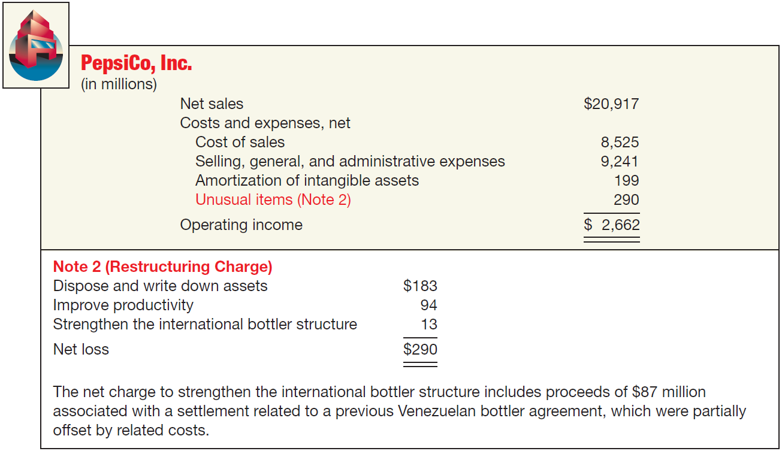
Reporting Irregular Items
Unusual Gains and Losses
Illustration 4-9
Income Statement Presentation of Unusual Charges
LO 4 Explain how to report irregular items.

Slide 31
Reporting Irregular Items
Changes in Accounting Principles
Retrospective adjustment.
Cumulative effect adjustment to beginning retained earnings.
Approach preserves comparability.
Examples include:
change from FIFO to average cost.
change from the percentage-of-completion to the completed-contract method.
LO 4 Explain how to report irregular items.

Slide 32
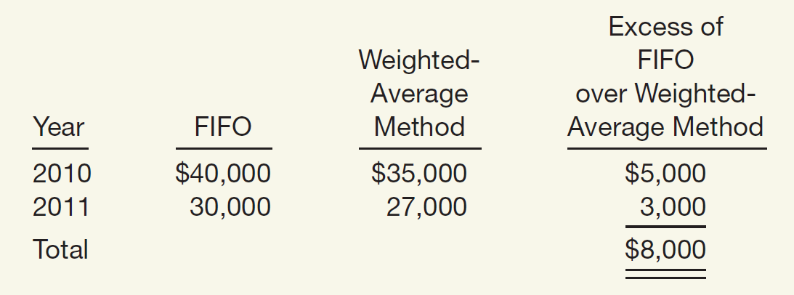
Reporting Irregular Items
Change in Accounting Principle: Gaubert Inc. decided in March 2012 to change from FIFO to weighted-average inventory pricing. Gaubert’s income before taxes, using the new weighted-average method in 2012, is $30,000.
Pretax Income Data
Illustration 4-10
Calculation of a Change in
Accounting Principle
Illustration 4-11
Income Statement
Presentation of a Change
in Accounting Principle (Based on 30% tax rate)
LO 4 Explain how to report irregular items.

Slide 33
Reporting Irregular Items
Changes in Estimate
Accounted for in the period of change and future periods.
Not handled retrospectively.
Not considered errors or extraordinary items.
Examples include:
Useful lives and salvage values of depreciable assets.
Allowance for uncollectible receivables.
Inventory obsolescence.
LO 4 Explain how to report irregular items.

Slide 34
Change in Estimate Example
Change in Estimate: Arcadia HS, purchased equipment for $510,000 which was estimated to have a useful life of 10 years with a salvage value of $10,000 at the end of that time. Depreciation has been recorded for 7 years on a straight-line basis. In 2012 (year 8), it is determined that the total estimated life should be 15 years with a salvage value of $5,000 at the end of that time.
Questions:
What is the journal entry to correct the prior years’ depreciation?
Calculate the depreciation expense for 2012.
LO 4 Explain how to report irregular items.

Slide 35
Change in Estimate Example
After 7 years
Equipment cost $510,000
Salvage value - 10,000
Depreciable base 500,000
Useful life (original) 10 years
Annual depreciation $ 50,000
First, establish NBV at date of change in estimate.
x 7 years = $350,000
Balance Sheet (Dec. 31, 2011)
Fixed Assets:
Equipment
$510,000
Accumulated depreciation
350,000
Net book value (NBV)
$160,000
LO 4 Explain how to report irregular items.

Slide 36
Change in Estimate Example
After 7 years
Net book value $160,000
Salvage value (new) 5,000
Depreciable base 155,000
Useful life remaining 8 years
Annual depreciation $ 19,375
Depreciation Expense calculation for 2012.
Journal entry for 2012
Depreciation expense 19,375
Accumulated depreciation 19,375
LO 4 Explain how to report irregular items.

Slide 37
Reporting Irregular Items
Corrections of Errors
Result from:
mathematical mistakes.
mistakes in application of accounting principles.
oversight or misuse of facts.
Corrections treated as prior period adjustments.
Adjustment to the beginning balance of retained earnings.
LO 4 Explain how to report irregular items.

Slide 38
Reporting Irregular Items
Corrections of Errors: To illustrate, in 2013, Hillsboro Co. determined that it incorrectly overstated its accounts
receivable and sales revenue by $100,000 in 2010. In 2013, Hillboro makes the following entry to correct for this error (ignore income taxes).
Retained earnings 100,000
Accounts receivable 100,000
LO 4 Explain how to report irregular items.

Slide 39
Special Reporting Issues
Intraperiod Tax Allocation
Relates the income tax expense to the specific items that give rise to the amount of the tax expense.
Income tax is allocated to the following items:
(1) Income from continuing operations before tax.
(2) Discontinued operations.
(3) Extraordinary items.
LO 5 Explain intraperiod tax allocation.

Slide 40
Special Reporting Issues
Intraperiod Tax Allocation
Extraordinary Gain: Schindler Co. has income before income tax and extraordinary item of $250,000. It has an extraordinary gain of $100,000 from a condemnation settlement received on one its properties. Assuming a 30 percent income tax rate.
Illustration 4-13
LO 5 Explain intraperiod tax allocation.

Slide 41
Special Reporting Issues
Intraperiod Tax Allocation
Extraordinary Loss: Schindler Co. has income before income tax and extraordinary item of $250,000. It has an extraordinary loss from a major casualty of $100,000. Assuming a 30 percent income tax rate.
Illustration 4-14
LO 5 Explain intraperiod tax allocation.

Slide 42
Example of Intraperiod Tax Allocation
Note: losses reduce the total tax
Calculation of Total Tax
$24,000
(135)
(61)
(231)
$23,573
LO 5 Explain intraperiod tax allocation.

Slide 43
Special Reporting Issues
Earnings Per Share
Net income - Preferred dividends
Weighted average number of shares outstanding
An important business indicator.
Measures the dollars earned by each share of common stock.
Must be disclosed on the the income statement.
LO 6 Identify where to report earnings per share information.

Slide 44
Special Reporting Issues
Earnings Per Share (BE4-8): In 2012, Hollis Corporation reported net income of $1,000,000. It declared and paid preferred stock dividends of $250,000. During 2012, Hollis had a weighted average of 190,000 common shares outstanding. Compute Hollis’s 2012 earnings per share.
Net income - Preferred dividends
Weighted average number of shares outstanding
$1,000,000
- $250,000
=
$3.95 per share
190,000
LO 6 Identify where to report earnings per share information.

Slide 45
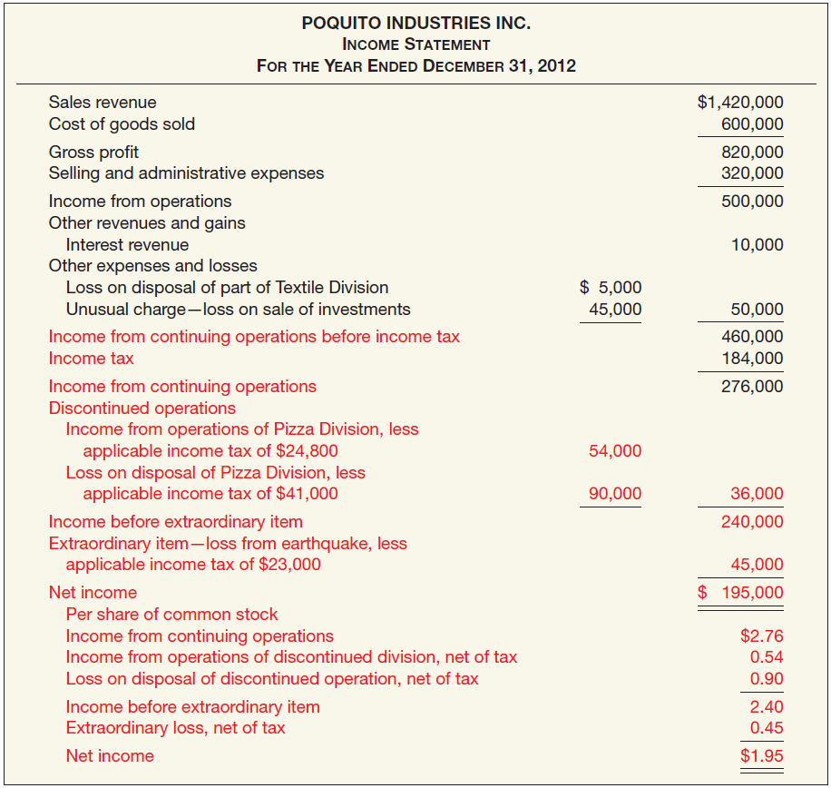
Special Reporting Issues
Illustration 4-17
Divide by weighted-average shares outstanding
EPS
LO 6

Slide 46
Special Reporting Issues
Retained Earnings Statement
Increase
Decrease
Net income
Change in accounting principle
Error corrections
Net loss
Dividends
Change in accounting principles
Error corrections
LO 7 Prepare a retained earnings statement.

Slide 47
Special Reporting Issues
Before issuing the report for the year ended December 31, 2012, you discover a $50,000 error (net of tax) that caused 2011 inventory to be overstated (overstated inventory caused COGS to be lower and thus net income to be higher in 2011). Would this discovery have any impact on the reporting of the Statement of Retained Earnings for 2012?
LO 7 Prepare a retained earnings statement.

Slide 48
Special Reporting Issues
LO 7 Prepare a retained earnings statement.

Slide 49
Special Reporting Issues
Restrictions on Retained Earnings
Disclosed
In notes to the financial statements.
As Appropriated Retained Earnings.
LO 7 Prepare a retained earnings statement.

Slide 50
Special Reporting Issues
Comprehensive Income
All changes in equity during a period except those resulting from investments by owners and distributions to owners.
Includes:
all revenues and gains, expenses and losses reported in net income, and
all gains and losses that bypass net income but affect stockholders’ equity.
LO 8 Explain how to report other comprehensive income.

Slide 51
Special Reporting Issues
Comprehensive Income
Other Comprehensive Income
+
Unrealized gains and losses on available-for-sale securities.
Translation gains and losses on foreign currency.
Plus others
Reported in Stockholders’ Equity
LO 8 Explain how to report other comprehensive income.

Slide 52
Special Reporting Issues
Review
Gains and losses that bypass net income but affect stockholders' equity are referred to as
comprehensive income.
other comprehensive income.
prior period income.
unusual gains and losses.
LO 8 Explain how to report other comprehensive income.

Slide 53
Special Reporting Issues
Companies must display the components of other comprehensive income in one of three ways:
A second separate income statement;
A combined income statement of comprehensive income; or
As part of the statement of stockholders’ equity
LO 8 Explain how to report other comprehensive income.

Slide 54
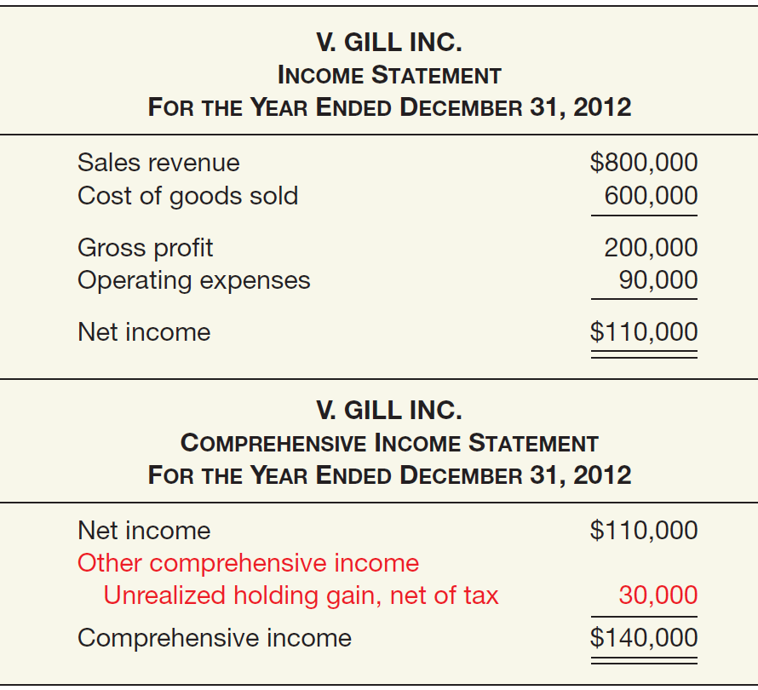
Special Reporting Issues
Comprehensive Income
Illustration 4-19
Second income statement
LO 8

Slide 55
Special Reporting Issues
Comprehensive Income
Combined statement
LO 8

Slide 56
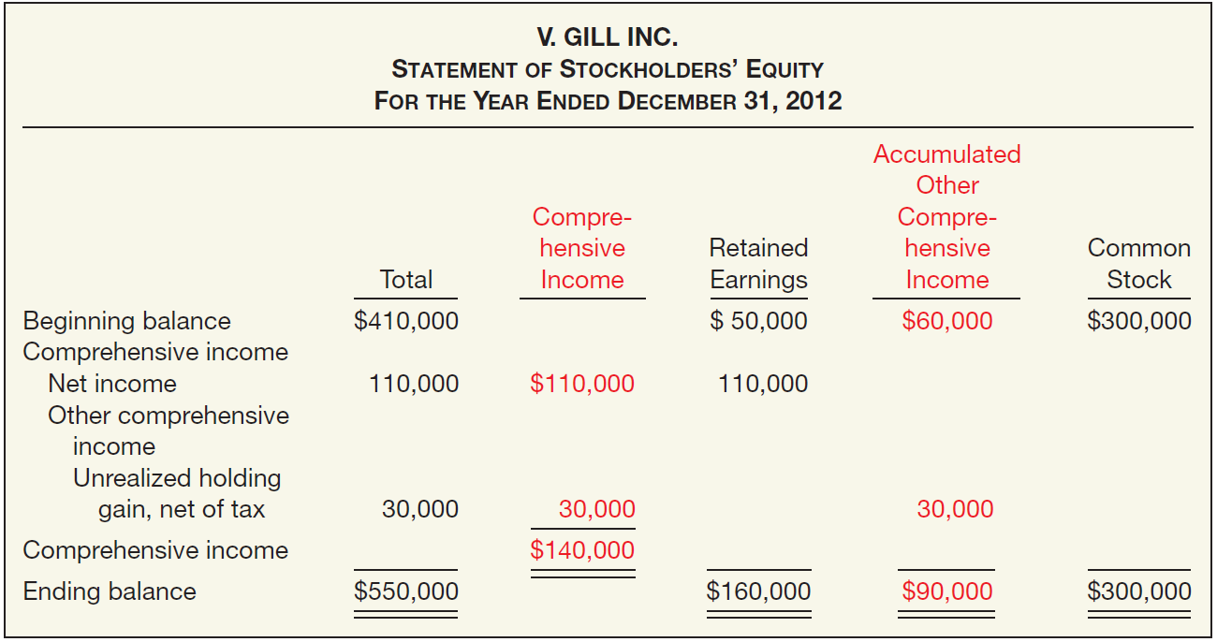
Special Reporting Issues
Comprehensive Income – Statement of Stockholder’s Equity
Illustration 4-20
LO 8 Explain how to report other comprehensive income.

Slide 57
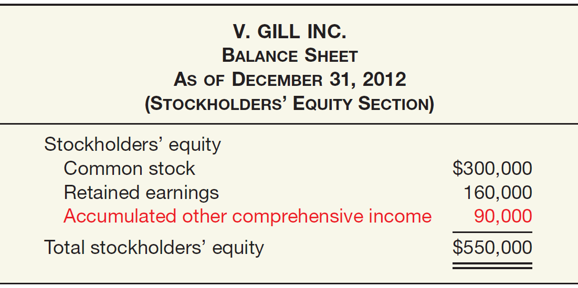
Special Reporting Issues
Comprehensive Income – Balance Sheet Presentation
Illustration 4-21
Presentation of
Accumulated Other
Comprehensive Income in the Balance Sheet
Regardless of the display format used, the accumulated other comprehensive income of $90,000 is reported in the stockholders’ equity section of the balance sheet.
LO 8 Explain how to report other comprehensive income.

Slide 58
Special Reporting Issues
Review
The FASB decided that the components of other comprehensive income must be displayed
in a second separate income statement.
in a combined income statement of comprehensive income.
as a part of the statement of stockholders‘ equity.
Any of these options is permissible.
LO 8 Explain how to report other comprehensive income.

Slide 59
RELEVANT FACTS
Presentation of the income statement under GAAP follows either a single-step or multiple-step format. IFRS does not mention a single-step or multiple-step approach. Extraordinary items are prohibited under IFRS.
Under IFRS, companies must classify expenses by either nature or function. GAAP does not have that requirement, but the U.S. SEC requires a functional presentation.
IFRS identifies certain minimum items that should be presented on the income statement. GAAP has no minimum information requirements. However, the SEC rules have more rigorous presentation requirements.

Slide 60
RELEVANT FACTS
IFRS does not define key measures like income from operations. SEC regulations define many key measures and provide requirements and limitations on companies reporting non-GAAP/IFRS information.
GAAP does not require companies to indicate the amount of net income attributable to non-controlling interest.
GAAP and IFRS follow the same presentation guidelines for discontinued operations, but IFRS defines a discontinued operation more narrowly. Both standard- setters have indicated a willingness to develop a similar definition to be used in the joint project on financial statement presentation.

Slide 61
RELEVANT FACTS
Both GAAP and IFRS have items that are recognized in equity as part of comprehensive income but do not affect net income. GAAP provides three possible formats for presenting this information: single income statement, combined statement of comprehensive income, in the statement of stockholders’ equity. Most companies that follow GAAP present this information in the statement of stockholders’ equity. IFRS allows a separate statement of comprehensive income or a combined statement.
Under IFRS, revaluation of property, plant, and equipment, and intangible assets is permitted and is reported as other comprehensive income. The effect of this difference is that application of IFRS results in more transactions affecting equity but not net income.

Slide 62
IFRS SELF-TEST QUESTION
Which of the following is not reported in an income statement under IFRS?
Discontinued operations.
Extraordinary items.
Cost of goods sold.
Income tax.

Slide 63
IFRS SELF-TEST QUESTION
Which of the following statements is correct regarding income reporting under IFRS?
IFRS does not permit revaluation of property, plant, and equipment, and intangible assets.
IFRS provides the same options for reporting comprehensive income as GAAP.
Companies must classify expenses either by nature or function.
IFRS provides a definition for all items presented in the income statement.

Slide 64
IFRS SELF-TEST QUESTION
Which of the following is not an acceptable way of displaying the components of other comprehensive income under IFRS?
Within the statement of retained earnings.
Second income statement.
Combined statement of comprehensive income.
All of the above are acceptable.

