Slide 1
Balance Sheet and Statement of Cash Flows
5
Intermediate Accounting
Kieso, Weygandt, and Warfield

Slide 2
Balance Sheet
Balance Sheet, also referred to as the statement of financial position:
Reports assets, liabilities, and equity at a specific date.
Provides information about resources, obligations to creditors, and equity in net resources.
Helps in predicting amounts, timing, and uncertainty of future cash flows.
LO 1 Explain the uses and limitations of a balance sheet.

Slide 3
Balance Sheet
Usefulness of the Balance Sheet
Computing rates of return.
Evaluating the capital structure.
Assess risk and future cash flows.
Analyze the company’s:
Liquidity,
Solvency, and
Financial flexibility.
LO 1 Explain the uses and limitations of a balance sheet.

Slide 4
Balance Sheet
Limitations of the Balance Sheet
Most assets and liabilities are reported at historical cost.
Use of judgments and estimates.
Many items of financial value are omitted.
LO 1 Explain the uses and limitations of a balance sheet.

Slide 5
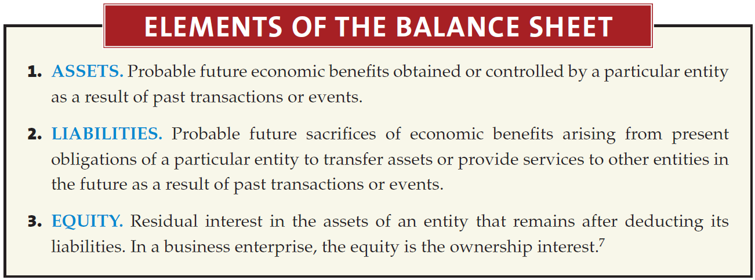
Balance Sheet
Classification
LO 2 Identify the major classifications of the balance sheet.

Slide 6
Balance Sheet
Classification
Illustration 5-1
In practice you usually see little departure from these major subdivisions.
LO 2 Identify the major classifications of the balance sheet.

Slide 7
Classification in the Balance Sheet
Current Assets
Cash and other assets a company expects to convert into cash, sell, or consume either in one year or in the operating cycle, whichever is longer.
Illustration 5-2
LO 2 Identify the major classifications of the balance sheet.

Slide 8
Classification in the Balance Sheet
Review
The correct order to present current assets is
Cash, accounts receivable, prepaid items, inventories.
Cash, accounts receivable, inventories, prepaid items.
Cash, inventories, accounts receivable, prepaid items.
Cash, inventories, prepaid items, accounts receivable.
LO 2 Identify the major classifications of the balance sheet.

Slide 9
Balance Sheet – “Current Assets”
Cash
Generally any monies available “on demand.”
Cash equivalents - short-term highly liquid investments that mature within three months or less.
Restrictions or commitments must be disclosed.
Illustration 5-3
LO 2

Slide 10
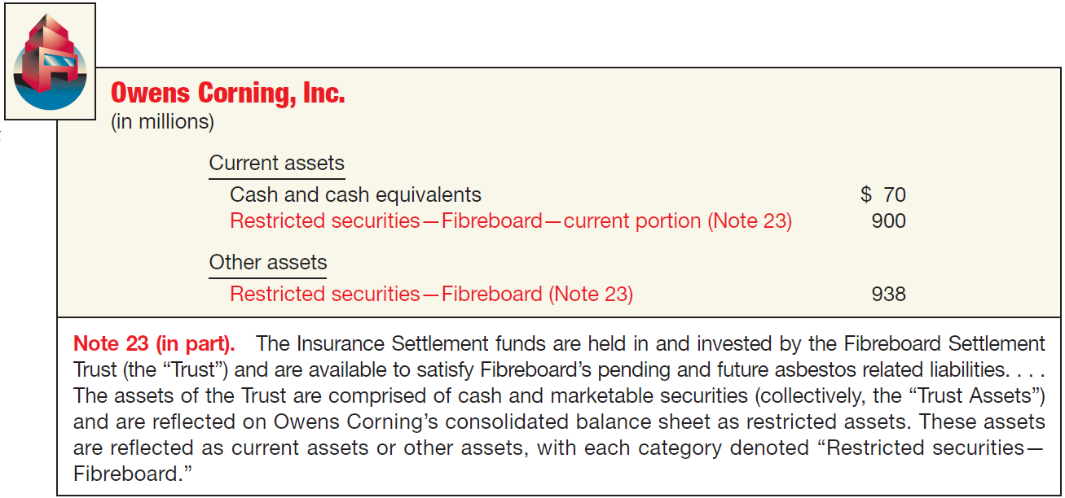
Balance Sheet – “Current Assets”
Cash
Illustration 5-4
Balance Sheet—Restricted Cash
LO 2 Identify the major classifications of the balance sheet.

Slide 11
Balance Sheet – “Current Assets”
Short-Term Investments
Portfolios
Type
Valuation
Classification
Held-to-Maturity
Debt
Amortized
Cost
Current or Noncurrent
Trading
Debt or
Equity
Fair Value
Current
Available-
for-Sale
Debt or
Equity
Fair Value
Current or Noncurrent
LO 2 Identify the major classifications of the balance sheet.

Slide 12
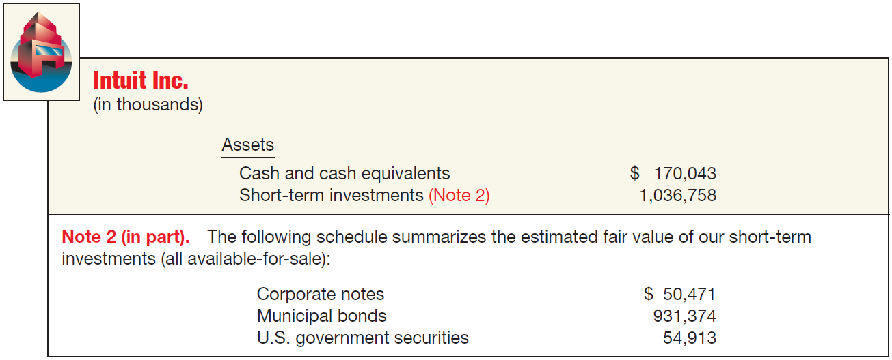
Balance Sheet – “Current Assets”
Short-Term Investments
Illustration 5-5
Balance Sheet Presentation of Investments in Securities
LO 2 Identify the major classifications of the balance sheet.

Slide 13
Balance Sheet – “Current Assets”
Receivables
Major categories of receivables should be shown in the balance sheet or the related notes.
A company should clearly identify
Anticipated loss due to uncollectibles.
Amount and nature of any nontrade receivables.
Receivables used as collateral.
LO 2 Identify the major classifications of the balance sheet.

Slide 14
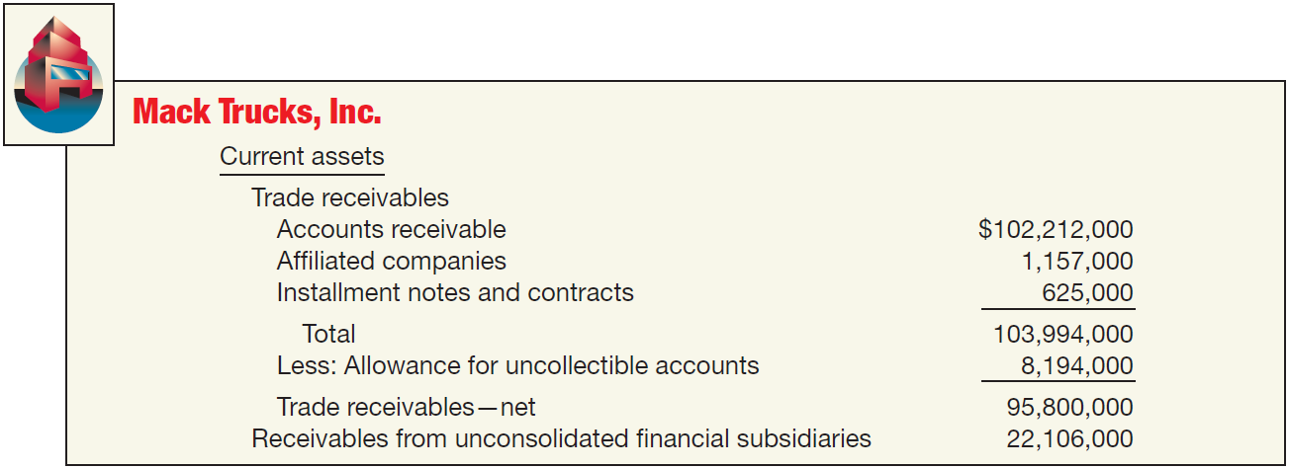
Balance Sheet – “Current Assets”
Receivables
Illustration 5-6
Balance Sheet Presentation
of Receivables
LO 2 Identify the major classifications of the balance sheet.

Slide 15
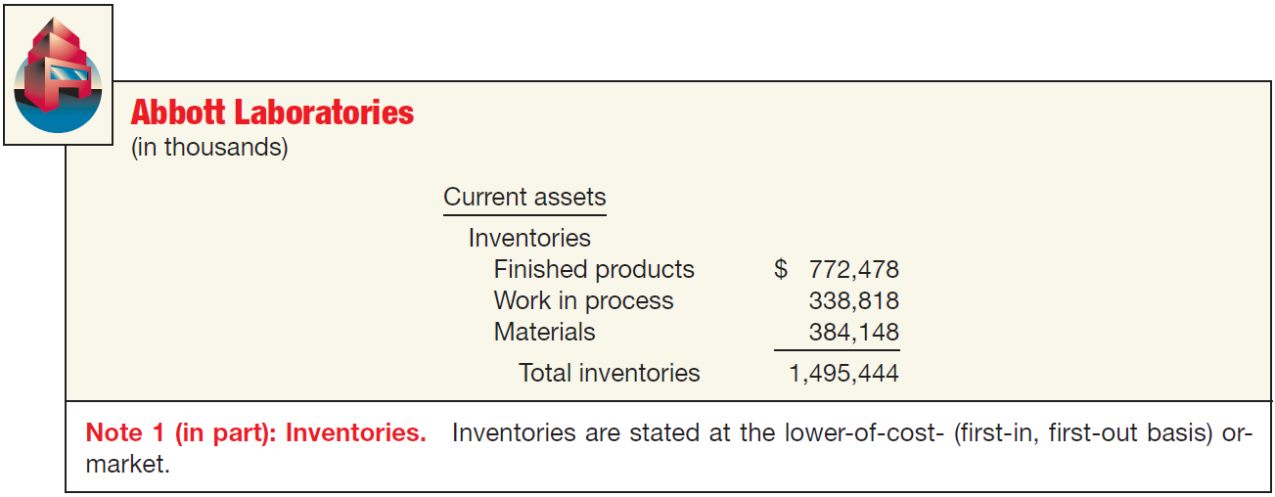
Balance Sheet – “Current Assets”
Inventories
Disclose:
Basis of valuation (e.g., lower-of-cost-or-market).
Cost flow assumption (e.g., FIFO or average cost).
Illustration 5-6
LO 2

Slide 16
Balance Sheet – “Current Assets”
Prepaid Expenses
Payment of cash, that is recorded as an asset because service or benefit will be received in the future.
Cash Payment
BEFORE
Expense Recorded
Prepayments often occur in regard to:
insurance
supplies
advertising
rent
taxes
LO 2 Identify the major classifications of the balance sheet.

Slide 17
Balance Sheet – “Current Assets”
Prepaid Expenses
Illustration 5-9
LO 2 Identify the major classifications of the balance sheet.

Slide 18
Balance Sheet – “Current Assets”
Current Assets - “Summary”
Cash and other assets a company expects to
convert into cash,
sell, or
consume
either in one year or in the operating cycle, whichever is longer.
LO 2 Identify the major classifications of the balance sheet.

Slide 19
Classification in the Balance Sheet
Non-Current Assets
Long-term Investments
Securities (bonds, common stock, or long-term notes).
Tangible fixed assets not currently used in operations (land held for speculation).
Special funds (sinking fund, pension fund, or plant expansion fund.
Non-consolidated subsidiaries or affilated companies.
LO 2 Identify the major classifications of the balance sheet.

Slide 20
Balance Sheet – “Noncurrent Assets”
Long-Term Investments
Portfolios
Type
Valuation
Classification
Held-to-Maturity
Debt
Amortized
Cost
Current or Noncurrent
Trading
Debt or
Equity
Fair Value
Current
Available-
for-Sale
Debt or
Equity
Fair Value
Current or Noncurrent
LO 2 Identify the major classifications of the balance sheet.

Slide 21
Balance Sheet – “Noncurrent Assets”
Long-Term Investments
Securities
bonds,
stock, and
long-term notes
For marketable securities, management’s intent determines current or noncurrent classification.
LO 2

Slide 22
Balance Sheet – “Noncurrent Assets”
Long-Term Investments
Fixed Assets
Land held for speculation
LO 2

Slide 23
Balance Sheet – “Noncurrent Assets”
Long-Term Investments
Special Funds
Sinking fund
Pensions fund
Cash surrender value of life insurance
LO 2

Slide 24
Balance Sheet – “Noncurrent Assets”
Long-Term Investments
Nonconsolidated Subsidiaries or Affiliated Companies
LO 2

Slide 25
Balance Sheet – “Noncurrent Assets”
Long-Term Investments
Illustration 5-10
Balance Sheet Presentation of
Long-Term Investments
LO 2 Identify the major classifications of the balance sheet.

Slide 26
Balance Sheet – “Noncurrent Assets”
Property, Plant, and Equipment
Tangible long-lived assets used in the regular operations of the business.
Physical property such as land, buildings, machinery, furniture, tools, and wasting resources (minerals).
With the exception of land, a company either depreciates (e.g., buildings) or depletes (e.g., oil reserves) these assets.
LO 2 Identify the major classifications of the balance sheet.

Slide 27
Balance Sheet – “Noncurrent Assets”
Property, Plant, and Equipment
Tangible assets used in the regular operations of the business.
LO 2 Identify the major classifications of the balance sheet.

Slide 28
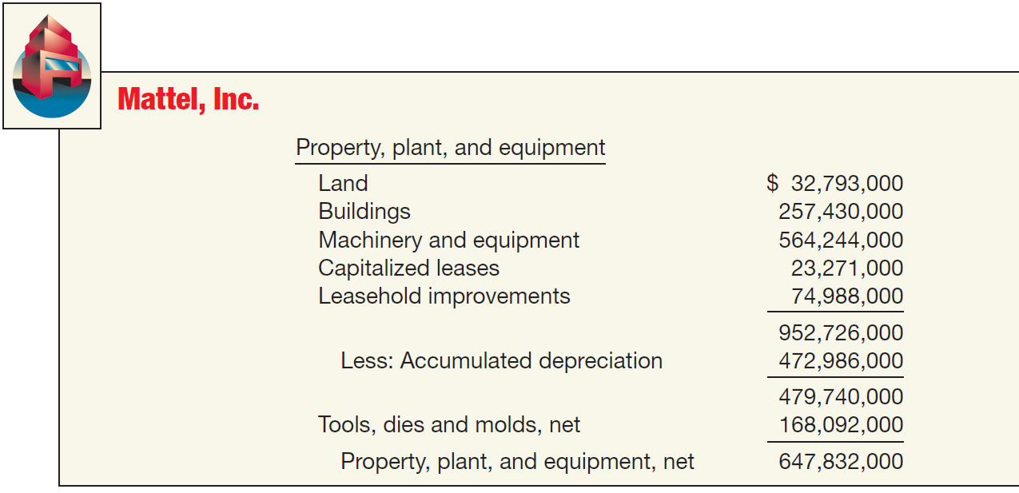
Balance Sheet – “Noncurrent Assets”
Illustration 5-11
Balance Sheet Presentation of Property, Plant, and Equipment
LO 2 Identify the major classifications of the balance sheet.

Slide 29
Balance Sheet – “Noncurrent Assets”
Intangibles
Lack physical substance and are not financial instruments.
Limited life intangibles amortized.
Indefinite-life intangibles tested for impairment.
LO 2

Slide 30
Balance Sheet – “Noncurrent Assets”
Intangibles (BE5-6): Patrick Corporation adjusted trial balance contained the following asset accounts at December 31, 2012: Prepaid Rent $12,000; Goodwill $50,000; Franchise Fees Receivable $2,000; Franchises $47,000; Patents $33,000; Trademarks $10,000. Prepare the intangible assets section of the balance sheet.
Intangibles
Goodwill $ 50,000
Franchises 47,000
Patents 33,000
Trademarks 10,000
Total $140,000
LO 2 Identify the major classifications of the balance sheet.

Slide 31
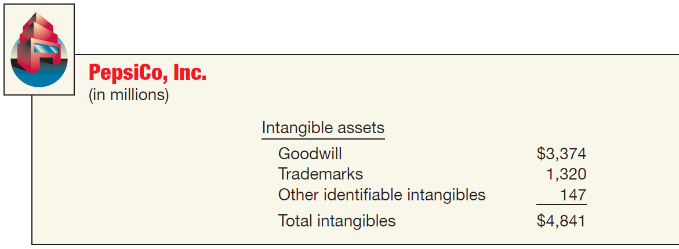
Balance Sheet – “Noncurrent Assets”
Intangible Assets
Illustration 5-12
Balance Sheet Presentation of
Intangible Assets
LO 2 Identify the major classifications of the balance sheet.

Slide 32
Balance Sheet – “Noncurrent Assets”
Other Assets
Items vary in practice. Can include:
Long-term prepaid expenses
Non-current receivables
Assets in special funds
Property held for sale
Restricted cash or securities
LO 2 Identify the major classifications of the balance sheet.

Slide 33
Balance Sheet – “Noncurrent Assets”
Other Assets
This section should include only unusual items sufficiently different from assets in the other categories.
LO 2

Slide 34
Classification in the Balance Sheet
Current Liabilities
“Obligations that a company reasonably expects to liquidate either through the use of current assets or the creation of other current liabilities.”
LO 2 Identify the major classifications of the balance sheet.

Slide 35
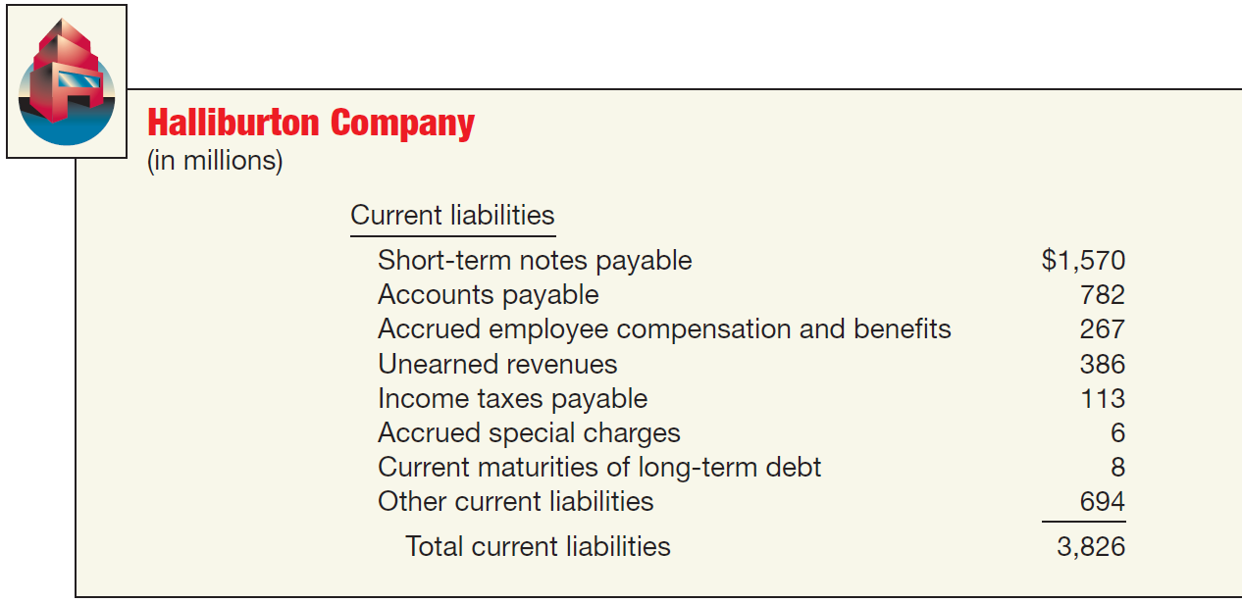
Classification in the Balance Sheet
Current Liabilities
Illustration 5-13
Balance Sheet Presentation of Current Liabilities
LO 2 Identify the major classifications of the balance sheet.

Slide 36
Classification in the Balance Sheet
Long-Term Liabilities
“Obligations that a company does not reasonably expect to liquidate within the normal operating cycle.”
All covenants and restrictions must be disclosed.
LO 2 Identify the major classifications of the balance sheet.

Slide 37
Balance Sheet – “Long-Term Liabilities”
Long-Term Liabilities (BE5-9): Included in Adams Company’s December 31, 2012, trial balance are the following accounts: Accounts Payable $220,000; Pension Asset/Liability $375,000; Discount on Bonds Payable $29,000; Unearned Revenue $41,000; Bonds Payable $400,000; Salaries and Wages Payable $27,000; Interest Payable $12,000; Income Taxes Payable $29,000. Prepare the long-term liabilities section of the balance sheet.
Long-term liabilities
Pension Asset/liability $375,000
Bonds payable 400,000
Discount on bonds payable (29,000)
Total 746,000
LO 2 Identify the major classifications of the balance sheet.

Slide 38
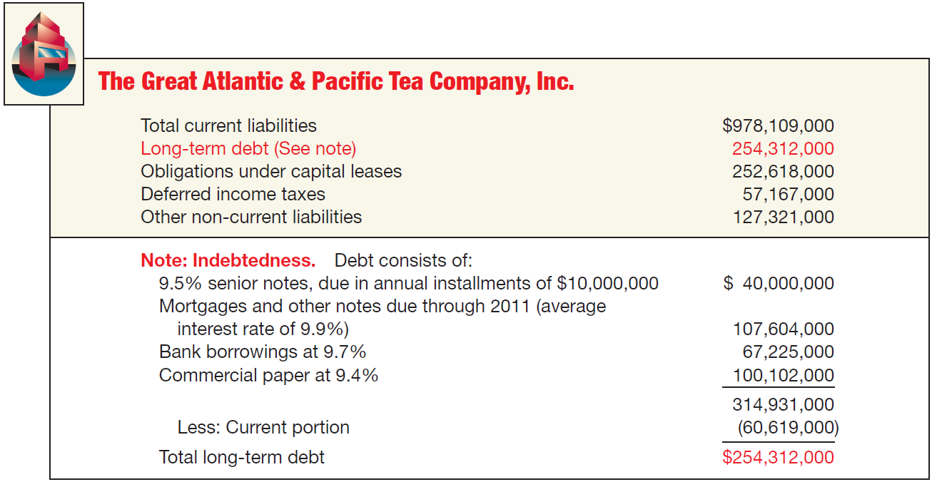
Balance Sheet – “Long-Term Liabilities”
Non-Current Liabilities
Illustration 5-14
Balance Sheet Presentation of Non-Current Liabilities
LO 2 Identify the major classifications of the balance sheet.

Slide 39
Balance Sheet – “Owner’s Equity”
Owners’ Equity
LO 2 Identify the major classifications of the balance sheet.

Slide 40
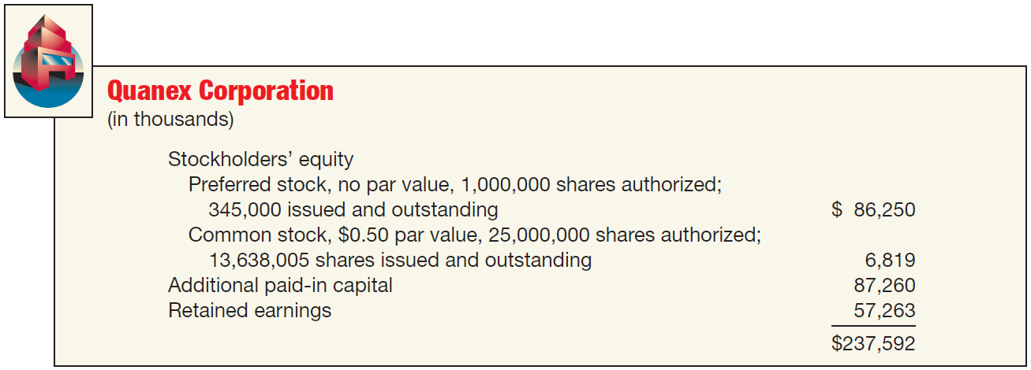
Balance Sheet – “Owner’s Equity”
Owners’ Equity
Illustration 5-15
Balance Sheet Presentation of Stockholders’ Equity
LO 2 Identify the major classifications of the balance sheet.

Slide 41
Classification in the Balance Sheet
Account
Classification
(a) Investment in preferred stock
(a) Current asset/Investment
(b) Treasury stock
(b) Stockholders’ Equity
(c) Common stock
(c) Stockholders’ Equity
(d) Cash dividends payable
(d) Current liability
(e) Accumulated depreciation
(e) Contra-asset
(f) Interest payable
(f) Current liability
(g) Deficit
(g) Stockholders’ Equity
(h) Trading securities
(h) Current asset
(i) Unearned revenue
(i) Current liability
LO 2 Identify the major classifications of the balance sheet.

Slide 42
Balance Sheet Format
Classified Balance Sheet
Account form
Report form
Accounting Trends and Techniques—2009 (New York: AICPA) indicates that all of the 500 companies surveyed use either the “report form” (438) or the “account form” (62), sometimes collectively referred to as the “customary form.”
LO 3 Prepare a classified balance sheet using the report and account formats.

Slide 43
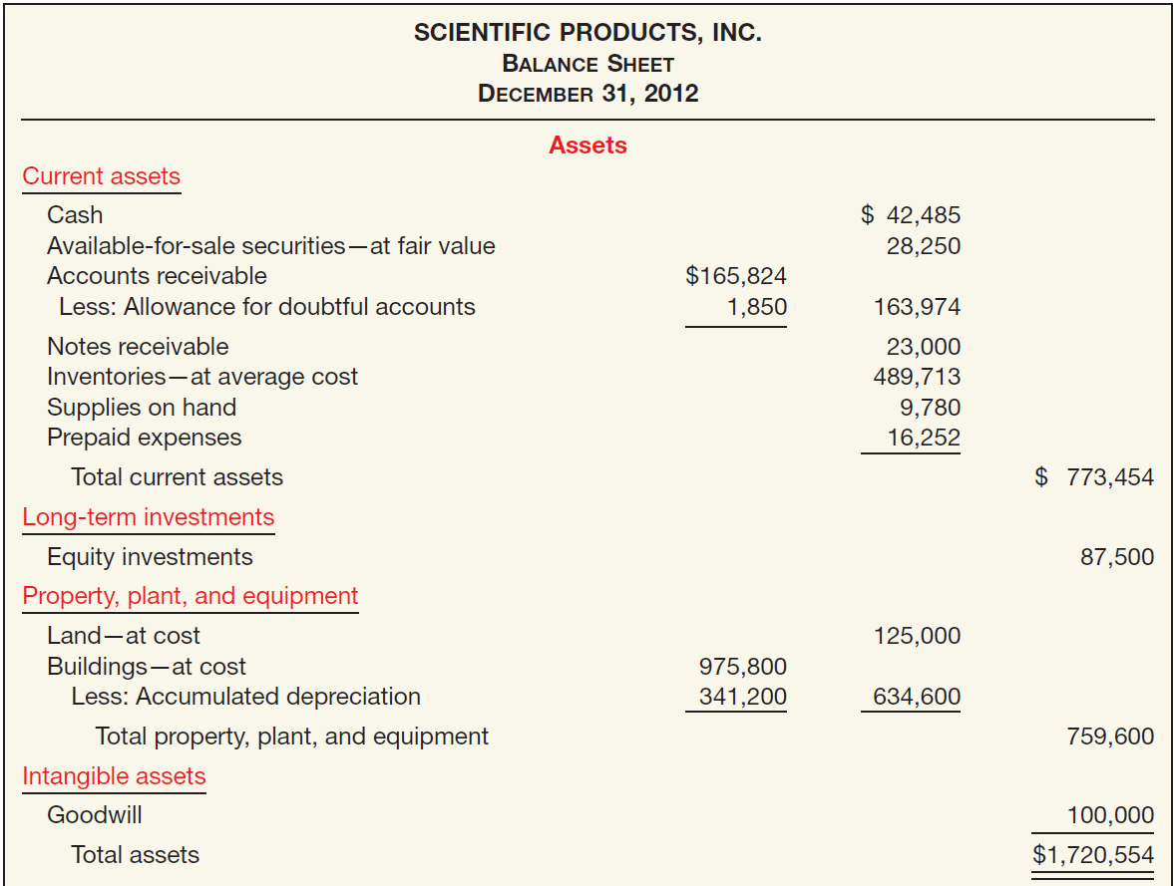
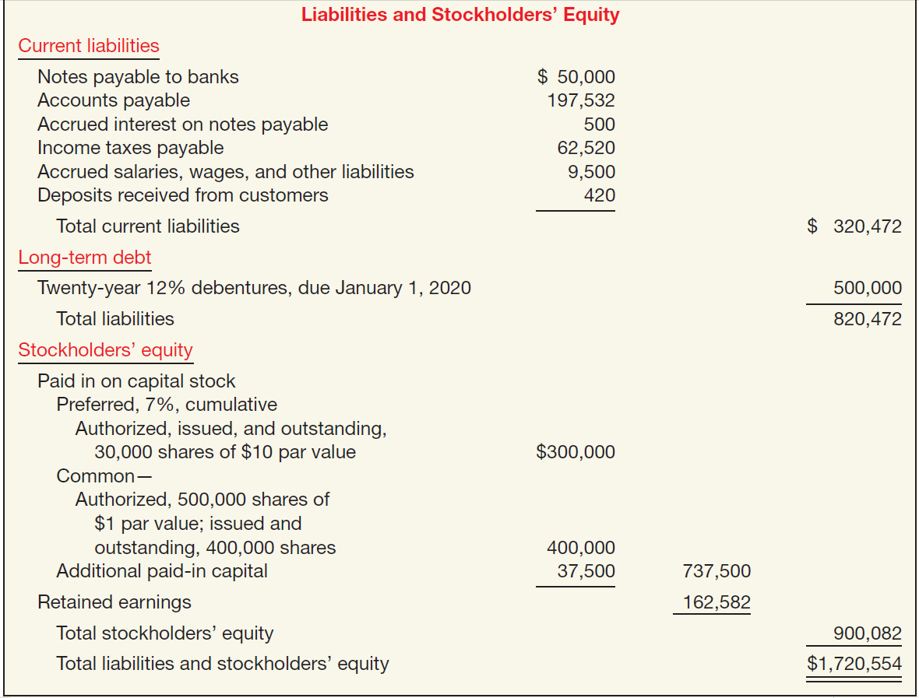
Balance Sheet Format
Account Form
Illustration 5-16
LO 3 Prepare a classified balance sheet using the report and account formats.

Slide 44
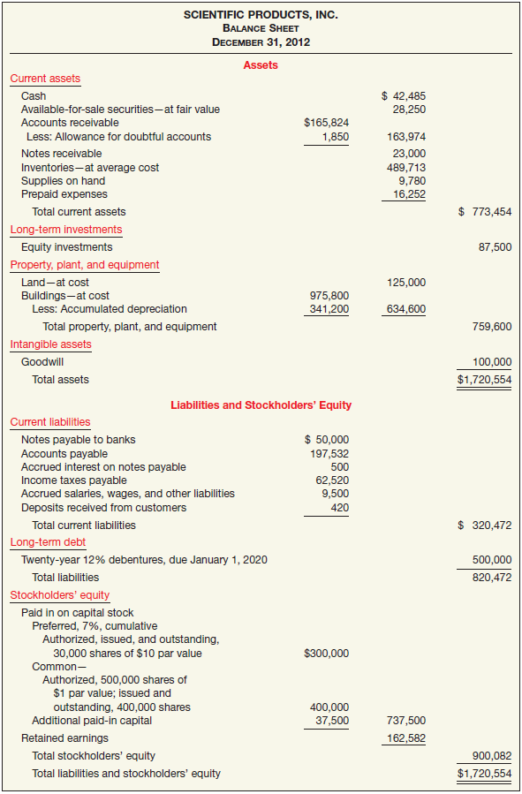
Balance Sheet Format
Report Form
Illustration 5-16
LO 3

Slide 45
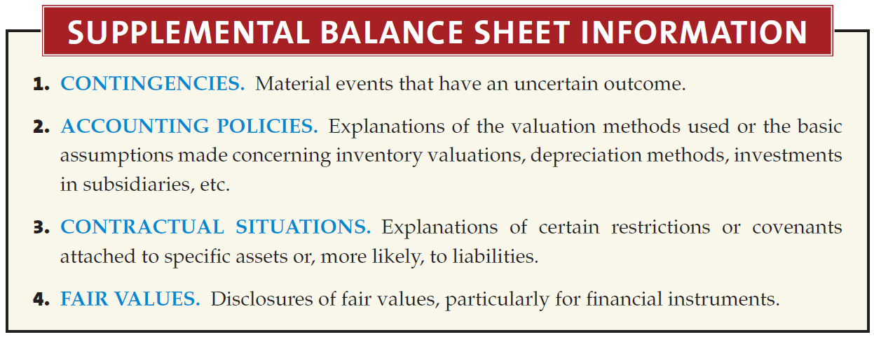
Supplemental Disclosures
Four types of information that are supplemental to account titles and amounts presented in the balance sheet:
LO 8 Determine which balance sheet information requires supplemental disclosure.

Slide 46
Techniques of Disclosure
Parenthetical Explanations
Notes
Cross-Reference and Contra Items
Supporting Schedules
Terminology
LO 9 Describe the major disclosure techniques for the balance sheet.

Slide 47
RELEVANT FACTS
IFRS recommends but does not require the use of the title “statement of financial position” rather than balance sheet.
IFRS requires a classified statement of financial position except in very limited situations. IFRS follows the same guidelines as this textbook for distinguishing between current and noncurrent assets and liabilities. However under GAAP, public companies must follow SEC regulations, which require specific line items. In addition, specific GAAP standards mandate certain forms of reporting this information.
Under IFRS, current assets are usually listed in the reverse order of liquidity. For example, under GAAP cash is listed first, but under IFRS it is listed last.

Slide 48
RELEVANT FACTS
IFRS has many differences in terminology that you will notice in this textbook.
Both IFRS and GAAP require disclosures about (1) accounting policies followed, (2) judgments that management has made in the process of applying the entity’s accounting policies, and (3) the key assumptions and estimation uncertainty that could result in a material adjustment to the carrying amounts of assets and liabilities within the next financial year. Comparative prior period information must be presented and financial statements must be prepared annually.
Use of the term “reserve” is discouraged in GAAP, but there is no such prohibition in IFRS.

Slide 49
IFRS SELF-TEST QUESTION
Current assets under IFRS are listed generally:
by importance.
in the reverse order of their expected conversion to cash.
by longevity.
alphabetically.

Slide 50
IFRS SELF-TEST QUESTION
Companies that use IFRS:
may report all their assets on the statement of financial position at fair value.
are not allowed to net assets (assets 2 liabilities) on their statement of financial positions.
may report noncurrent assets before current assets on the statement of financial position.
do not have any guidelines as to what should be reported on the statement of financial position.

Slide 51
IFRS SELF-TEST QUESTION
A company has purchased a tract of land and expects to build a production plant on the land in approximately 5 years. During the 5 years before construction, the land will be idle. Under IFRS, the land should be reported as:
land expense.
property, plant, and equipment.
an intangible asset.
a long-term investment.

