Slide 1
Intangible Assets
12
Intermediate Accounting
Kieso, Weygandt, and Warfield

Slide 2
Intangible Asset Issues
Characteristics
Lack physical existence.
Not financial instruments.
Normally classified as long-term asset.
Common types of intangibles:
Patents
Copyrights
Franchises or licenses
Trademarks or trade names
Goodwill
LO 1 Describe the characteristics of intangible assets.

Slide 3
Intangible Asset Issues
Valuation
Purchased Intangibles:
Recorded at cost.
Includes all costs necessary to make the intangible asset ready for its intended use.
Typical costs include:
Purchase price.
Legal fees.
Other incidental expenses.
LO 2 Identify the costs to include in the initial valuation of intangible assets.

Slide 4
Intangible Asset Issues
Valuation
Internally Created Intangibles:
Generally expensed.
Only capitalize direct costs incurred in developing the intangible, such as legal costs.
LO 2 Identify the costs to include in the initial valuation of intangible assets.

Slide 5
Intangible Asset Issues
Amortization of Intangibles
Limited-Life Intangibles:
Amortize by systematic charge to expense over useful life.
Credit asset account or accumulated amortization.
Useful life should reflect the periods over which the asset will contribute to cash flows.
Amortization should be cost less residual value.
LO 3 Explain the procedure for amortizing intangible assets.

Slide 6
Intangible Asset Issues
Amortization of Intangibles
Indefinite-Life Intangibles:
No foreseeable limit on time the asset is expected to provide cash flows.
No amortization.
Must test indefinite-life intangibles for impairment at least annually.
LO 3 Explain the procedure for amortizing intangible assets.

Slide 7
Types of Intangibles
Goodwill
Conceptually, represents the future economic benefits arising from the other assets acquired in a business combination that are not individually identified and separately recognized.
Only recorded when an entire business is purchased.
Goodwill is measured as the excess of ...
cost of the purchase over the FMV of the identifiable net assets purchased.
Internally created goodwill should not be capitalized.
LO 5 Explain the conceptual issues related to goodwill.

Slide 8
Recording Goodwill
Illustration: Multi-Diversified, Inc. decides that it needs a parts division to supplement its existing tractor distributorship. The president of Multi-Diversified is interested in buying Tractorling Company. The illustration presents the statement of financial position of Tractorling Company.
Illustration 12-3
LO 6 Describe the accounting procedures for recording goodwill.

Slide 9
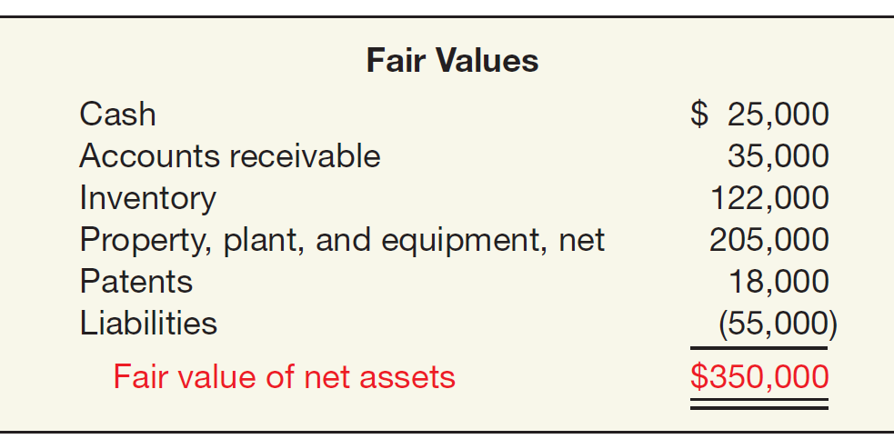
Recording Goodwill
Illustration: Multi-Diversified investigates Tractorling’s underlying assets to determine their fair values.
Illustration 12-4
Tractorling Company decides to accept Multi-Diversified’s offer of $400,000. What is the value of the goodwill, if any?
LO 6 Describe the accounting procedures for recording goodwill.

Slide 10
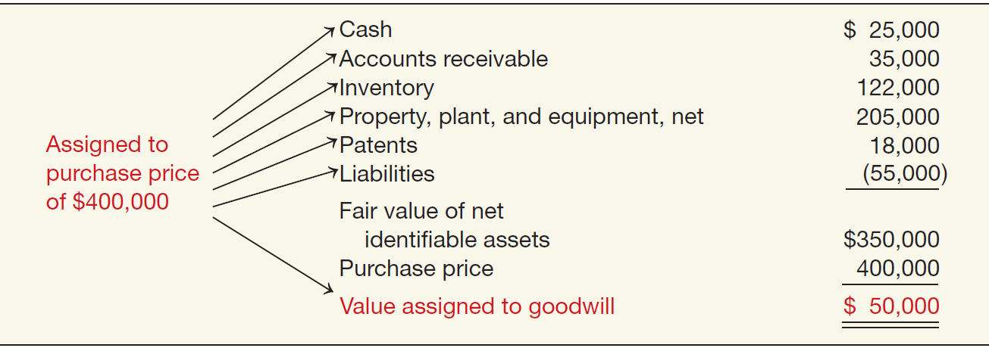
Recording Goodwill
Illustration: Determination of Goodwill.
Illustration 12-5
LO 6 Describe the accounting procedures for recording goodwill.

Slide 11
Recording Goodwill
Illustration: Multi-Diversified records this transaction as follows.
Property, Plant, and Equipment 205,000
Patents 18,000
Inventories 122,000
Receivables 35,000
Cash 25,000
Goodwill 50,000
Liabilities 55,000
Cash 400,000
LO 6 Describe the accounting procedures for recording goodwill.

Slide 12
Recording Goodwill
Example: Global Corporation purchased the net assets of Local Company for $300,000 on December 31, 2012. The balance sheet of Local Company just prior to acquisition is:
FMV of Net Assets = $200,000
LO 6 Describe the accounting procedures for recording goodwill.

Slide 13
Recording Goodwill
Example: Global Corporation purchased the net assets of Local Company for $300,000 on December 31, 2012. The value assigned to goodwill is determined as follows:
Book Value = $130,000
Revaluation
$70,000
Fair Value = $200,000
Goodwill
$100,000
Purchase Price = $300,000
LO 6 Describe the accounting procedures for recording goodwill.

Slide 14
Recording Goodwill
Example: Global Corporation purchased the net assets of Local Company for $300,000 on December 31, 2012. The value assigned to goodwill is determined as follows:
LO 6 Describe the accounting procedures for recording goodwill.

Slide 15
Recording Goodwill
Example: Global Corporation purchased the net assets of Local Company for $300,000 on December 31, 2012. Prepare the journal entry to record the purchase of the net assets of Local.
Journal entry recorded by Global:
Cash 15,000
Receivables 10,000
Inventory 70,000
Equipment 130,000
Goodwill 100,000
Accounts payable 25,000
Cash 300,000
LO 6 Describe the accounting procedures for recording goodwill.

Slide 16
Goodwill
Goodwill Write-off
Goodwill considered to have an indefinite life.
Should not be amortized.
Only adjust carrying value when goodwill is impaired.
Bargain Purchase
Purchase price less than the fair value of net assets acquired.
Amount is recorded as a gain by the purchaser.
LO 6 Describe the accounting procedures for recording goodwill.

Slide 17
Impairment of Intangible Assets
Impairment of Limited-Life Intangibles
Same as impairment for long-lived assets in Chapter 11.
If the sum of the expected future net cash flows is less than the carrying amount of the asset, an impairment has occurred (recoverability test).
The impairment loss is the amount by which the carrying amount of the asset exceeds the fair value of the asset (fair value test).
The loss is reported as part of income from continuing operations, “Other expenses and losses” section.
LO 7 Explain the accounting issues related to intangible-asset impairments.

Slide 18
Impairment of Intangible Assets
E12-14: (Copyright Impairment) Presented below is information related to copyrights owned by Botticelli Company at December 31, 2012.
The copyright has a remaining useful life of 10 years.
Prepare the journal entry (if any) to record the impairment of the asset at December 31, 2012.
Prepare the journal entry to record amortization expense for 2013 related to the copyrights.
LO 7 Explain the accounting issues related to intangible-asset impairments.

Slide 19
Impairment of Intangible Assets
Recoverability test: If the sum of the expected future net cash flows is less than the carrying amount of the asset, an impairment has occurred.
Asset is Impaired
LO 7 Explain the accounting issues related to intangible-asset impairments.

Slide 20
Impairment of Intangible Assets
Prepare the journal entry (if any) to record the impairment of the asset at December 31, 2012.
Loss on impairment 1,100,000
Copyrights 1,100,000
LO 7 Explain the accounting issues related to intangible-asset impairments.

Slide 21
Impairment of Intangible Assets
(b) Prepare the journal entry to record amortization expense for 2013 related to the copyrights.
Amortization expense 320,000
Copyrights 320,000
÷
LO 7 Explain the accounting issues related to intangible-asset impairments.

Slide 22
Impairment of Intangible Assets
Impairment of Indefinite-Life Intangibles Other than Goodwill
Should be tested for impairment at least annually.
Impairment test is a fair value test.
If the fair value of asset is less than the carrying amount, an impairment loss is recognized for the difference.
Recoverability test is not used.
LO 7 Explain the accounting issues related to intangible-asset impairments.

Slide 23
Impairment of Intangible Assets
Illustration: Arcon Radio purchased a broadcast license for $2,000,000. Arcon Radio has renewed the license with the FCC twice, at a minimal cost. Because it expects cash flows to last indefinitely, Arcon reports the license as an indefinite-life intangible asset. Recently the FCC decided to auction these licenses to the highest bidder instead of renewing them. Arcon Radio expects cash flows for the remaining two years of its existing license. It performs an impairment test and determines that the fair value of the intangible asset is $1,500,000.
Illustration 12-7
LO 7 Explain the accounting issues related to intangible-asset impairments.

Slide 24
Impairment of Intangible Assets
Impairment of Goodwill
Two Step Process:
Step 1: If fair value is less than the carrying amount of the net assets (including goodwill), then perform a second step to determine possible impairment.
Step 2: Determine the fair value of the goodwill (implied value of goodwill) and compare to carrying amount.
LO 7 Explain the accounting issues related to intangible-asset impairments.

Slide 25
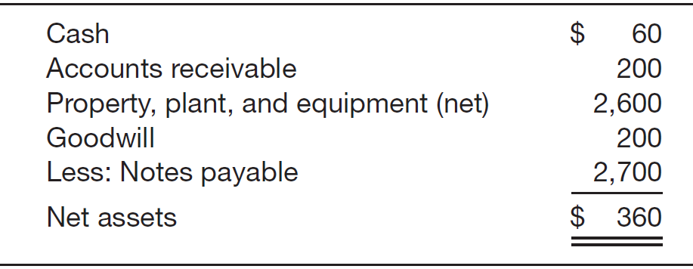
Impairment of Intangible Assets
E12-15: (Goodwill Impairment) Presented below is net asset information related to the Mischa Division of Santana, Inc. as of December 31, 2012 (in millions):
Management estimated its future net cash flows from the division to be $400 million. Management has also received an offer to purchase the division for $335 million. All identifiable assets’ and liabilities’ book and fair value amounts are the same.
LO 7 Explain the accounting issues related to intangible-asset impairments.

Slide 26
Impairment of Intangible Assets
E12-15 Instructions
(a) Prepare the journal entry (if any) to record the impairment at December 31, 2012.
Step 1: The fair value of the reporting unit is below its carrying value. Therefore, an impairment has occurred.
Step 2:
$ 335
160
175
200
$ (25)
Loss on impairment 25,000,000
Goodwill 25,000,000
LO 7 Explain the accounting issues related to intangible-asset impairments.

Slide 27
Impairment of Intangible Assets
E12-15 Instructions
(b) At December 31, 2011, it is estimated that the division’s fair value increased to $345 million. Prepare the journal entry (if any) to record this increase in fair value.
No entry necessary.
Adjusted carrying amount of the goodwill is its new accounting basis.
Subsequent reversal of recognized impairment losses is not permitted under SFAS No. 142.
LO 7 Explain the accounting issues related to intangible-asset impairments.

Slide 28
Impairment of Intangible Assets
Summary of Impairment Tests
Illustration 12-11
LO 7 Explain the accounting issues related to intangible-asset impairments.

Slide 29
Research and Development Costs
Research and development (R&D) costs are not in themselves intangible assets.
Frequently results in something that a company patents or copyrights such as:
new product,
process,
idea,
formula,
composition, or
literary work.
LO 8 Identify the conceptual issues related to research and development costs.

Slide 30
Presentations of Intangibles and Related Items
Presentation of Intangible Assets
Balance Sheet
Intangible assets shown as a separate item.
Reporting is similar to the reporting of property, plant, and equipment.
Contra accounts may not be shown for intangibles.
Companies should report as a separate item all intangible assets other than goodwill.
LO 10 Indicate the presentation of intangible assets and related items.

Slide 31
Presentations of Intangibles and Related Items
Presentation of Intangible Assets
Income Statement
Report amortization expense and impairment losses in continuing operations.
Total R&D costs charged to expense must be disclosed.
LO 10 Indicate the presentation of intangible assets and related items.

Slide 32
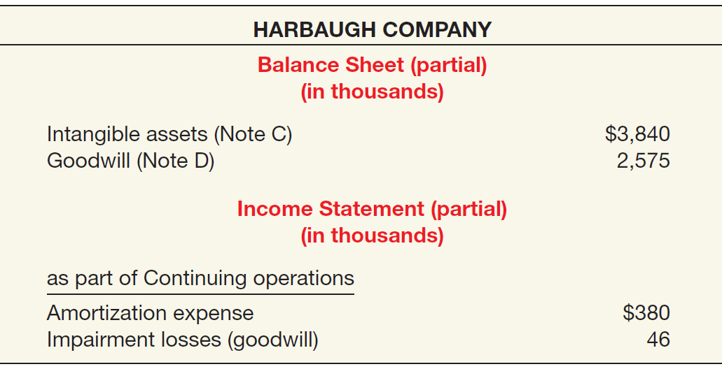
Presentations of Intangibles
Illustration 12-15
LO 10 Indicate the presentation of intangible assets and related items.

