Slide 1
Current Liabilities and Contingencies
13
Intermediate Accounting
Kieso, Weygandt, and Warfield

Slide 2
What is a Liability?
FASB, defines liabilities as:
“Probable Future Sacrifices of Economic Benefits arising from present obligations of a particular entity to transfer assets or provide services to other entities in the future as a result of past transactions or events.”

Slide 3
What is a Current Liability?
Current liabilities are “obligations whose liquidation is reasonably expected to require use of existing resources properly classified as current assets, or the creation of other current liabilities.”
The operating cycle is the period of time elapsing between the acquisition of goods and services and the final cash realization resulting from sales and subsequent collections.
LO 1 Describe the nature, type, and valuation of current liabilities.

Slide 4
What is a Current Liability?
Typical Current Liabilities:
Accounts payable.
Notes payable.
Current maturities of long-term debt.
Short-term obligations expected to be refinanced.
Dividends payable.
Customer advances and deposits.
Unearned revenues.
Sales taxes payable.
Income taxes payable.
Employee-related liabilities.
LO 1 Describe the nature, type, and valuation of current liabilities.

Slide 5
What is a Current Liability?
Accounts Payable (trade accounts payable)
Balances owed to others for goods, supplies, or services purchased on open account.
Time lag between the receipt of services or acquisition of title to assets and the payment for them.
Terms of the sale (e.g., 2/10, n/30 or 1/10, E.O.M.) usually state period of extended credit, commonly 30 to 60 days.
LO 1 Describe the nature, type, and valuation of current liabilities.

Slide 6
What is a Current Liability?
Notes Payable
Written promises to pay a certain sum of money on a specified future date.
Arise from purchases, financing, or other transactions.
Notes classified as short-term or long-term.
Notes may be interest-bearing or zero-interest-bearing.
LO 1 Describe the nature, type, and valuation of current liabilities.

Slide 7
What is a Current Liability?
Interest-Bearing Note Issued
Illustration: Castle National Bank agrees to lend $100,000 on March 1, 2012, to Landscape Co. if Landscape signs a $100,000, 6 percent, four-month note. Landscape records the cash received on March 1 as follows:
Cash 100,000
Notes Payable 100,000
LO 1 Describe the nature, type, and valuation of current liabilities.

Slide 8
What is a Current Liability?
If Landscape prepares financial statements semiannually, it makes the following adjusting entry to recognize interest expense and interest payable at June 30:
Interest calculation =
($100,000 x 6% x 4/12) = $2,000
Interest expense 2,000
Interest payable 2,000
LO 1 Describe the nature, type, and valuation of current liabilities.

Slide 9
What is a Current Liability?
At maturity (July 1), Landscape records payment of the note and accrued interest as follows.
Notes payable 100,000
Interest payable 2,000
Cash 102,000
LO 1 Describe the nature, type, and valuation of current liabilities.

Slide 10
What is a Current Liability?
Zero-Bearing Note Issued
Illustration: On March 1, Landscape issues a $102,000, four-month, zero-interest-bearing note to Castle National Bank. The present value of the note is $100,000. Landscape records this transaction as follows.
Cash 100,000
Discount on notes payable 2,000
Notes payable 102,000
LO 1 Describe the nature, type, and valuation of current liabilities.

Slide 11
What is a Current Liability?
If Landscape prepares financial statements semiannually, it makes the following adjusting entry to recognize interest expense and the increase in the note payable of $2,000 at June 30.
Interest expense 2,000
Discount on notes payable 2,000
At maturity (July 1), Landscape must pay the note, as follows.
Notes payable 102,000
Cash 102,000
LO 1 Describe the nature, type, and valuation of current liabilities.

Slide 12
What is a Current Liability?
E13-2: (Accounts and Notes Payable) The following are selected 2012 transactions of Darby Corporation.
Sept. 1 - Purchased inventory from Orion Company on account for $50,000. Darby records purchases gross and uses a periodic inventory system.
Oct. 1 - Issued a $50,000, 12-month, 8% note to Orion in payment of account.
Oct. 1 - Borrowed $75,000 from the Shore Bank by signing a 12-month, zero-interest-bearing $81,000 note.
Prepare journal entries for the selected transactions.
LO 1 Describe the nature, type, and valuation of current liabilities.

Slide 13
What is a Current Liability?
Sept. 1 - Purchased inventory from Orion Company on account for $50,000. Darby records purchases gross and uses a periodic inventory system.
Sept. 1 Purchases 50,000
Accounts payable 50,000
LO 1 Describe the nature, type, and valuation of current liabilities.

Slide 14
What is a Current Liability?
Oct. 1 - Issued a $50,000, 12-month, 8% note to Orion in payment of account.
Oct. 1 Accounts payable 50,000
Notes payable 50,000
Interest calculation =
($50,000 x 8% x 3/12) = $1,000
Dec. 31 Interest expense 1,000
Interest payable 1,000
LO 1 Describe the nature, type, and valuation of current liabilities.

Slide 15
What is a Current Liability?
Oct. 1 - Borrowed $75,000 from the Shore Bank by signing a 12-month, zero-interest-bearing $81,000 note.
Oct. 1 Cash 75,000
Discount on notes payable 6,000
Notes payable 81,000
Interest calculation =
($6,000 x 3/12) = $1,500
Dec. 31 Interest expense 1,500
Discount on notes payable 1,500
LO 1 Describe the nature, type, and valuation of current liabilities.

Slide 16
What is a Current Liability?
Current Maturities of Long-Term Debt
Portion of bonds, mortgage notes, and other long-term indebtedness that matures within the next fiscal year.
Exclude long-term debts maturing currently if they are to be:
Retired by assets accumulated that have not been shown as current assets,
Refinanced, or retired from the proceeds of a new debt issue, or
Converted into capital stock.
LO 1 Describe the nature, type, and valuation of current liabilities.

Slide 17
What is a Current Liability?
Short-Term Obligations Expected to Be Refinanced
Exclude from current liabilities if both of the following conditions are met:
Must intend to refinance the obligation on a long-term basis.
Must demonstrate an ability to refinance:
Actual refinancing.
Enter into a financing agreement.
LO 2 Explain the classification issues of short-term debt expected to be refinanced.

Slide 18
What is a Current Liability?
Short-Term Obligations Expected to be Refinanced
NO
Mgmt. Intends of Refinance
Classify as Current Liability
YES
Demonstrates Ability to Refinance
NO
YES
Actual Refinancing after balance sheet date but before issue date
Financing Agreement Noncancellable with Capable Lender
or
Exclude Short-Term Obligations from Current Liabilities and Reclassify as LT Debt
LO 2 Explain the classification issues of short-term debt expected to be refinanced.

Slide 19
What is a Current Liability?
E13-3 (Refinancing of Short-Term Debt): On December 31, 2012, Alexander Company had $1,200,000 of short-term debt in the form of notes payable due February 2, 2013. On January 21, 2013, the company issued 25,000 shares of its common stock for $36 per share, receiving $900,000 proceeds after brokerage fees and other costs of issuance. On February 2, 2013, the proceeds from the stock sale, supplemented by an additional $300,000 cash, are used to liquidate the $1,200,000 debt. The December 31, 2012, balance sheet is issued on February 23, 2013.
Instructions
Show how the $1,200,000 of short-term debt should be presented on the December 31, 2012, balance sheet, including note disclosure
LO 2 Explain the classification issues of short-term debt expected to be refinanced.

Slide 20
What is a Current Liability?
Partial Balance Sheet
Current liabilities:
Notes payable
Long-term debt:
Notes payable refinanced
Total liabilities
$ 300,000
900,000
$1,200,000
LO 2 Explain the classification issues of short-term debt expected to be refinanced.

Slide 21
What is a Current Liability?
Dividends Payable
Amount owed by a corporation to its stockholders as a result of board of directors’ authorization.
Generally paid within three months.
Undeclared dividends on cumulative preferred stock not recognized as a liability.
Dividends payable in the form of additional shares of stock are not recognized as a liability.
Reported in equity.
LO 2 Explain the classification issues of short-term debt expected to be refinanced.

Slide 22
What is a Current Liability?
Customer Advances and Deposits
Returnable cash deposits received from customers and employees.
May be classified as current or long-term liabilities.
LO 2 Explain the classification issues of short-term debt expected to be refinanced.

Slide 23
What is a Current Liability?
Unearned Revenues
Payment received before delivering goods or rendering services?
Illustration 13-3
Unearned and Earned Revenue Accounts
LO 2 Explain the classification issues of short-term debt expected to be refinanced.

Slide 24
What is a Current Liability?
BE13-5: Sports Pro Magazine sold 12,000 annual subscriptions on August 1, 2012, for $18 each. Prepare Sports Pro’s August 1, 2012, journal entry and the December 31, 2012, annual adjusting entry.
Aug. 1 Cash 216,000
Unearned revenue 216,000
(12,000 x $18)
Dec. 31 Unearned revenue 90,000
Subscription revenue 90,000
($216,000 x 5/12 = $90,000)
LO 2 Explain the classification issues of short-term debt expected to be refinanced.

Slide 25
What is a Current Liability?
Sales Taxes Payable
Retailers must collect sales taxes from customers on transfers of tangible personal property and on certain services and then remit to the proper governmental authority.
LO 2 Explain the classification issues of short-term debt expected to be refinanced.

Slide 26
What is a Current Liability?
BE13-7: Dillons Corporation made credit sales of $30,000 which are subject to 6% sales tax. The corporation also made cash sales which totaled $20,670 including the 6% sales tax. (a) prepare the entry to record Dillons’ credit sales. (b) Prepare the entry to record Dillons’ cash sales.
Accounts receivable 31,800
Sales 30,000
Sales tax payable ($30,000 x 6% = $1,800) 1,800
Cash 20,670
Sales ($20,670 ÷ 1.06 = $19,500) 19,500
Sales tax payable 1,170
LO 2

Slide 27
What is a Current Liability?
Income Tax Payable
Businesses must prepare an income tax return and compute the income tax payable.
Taxes payable are a current liability.
Corporations must make periodic tax payments.
Differences between taxable income and accounting income sometimes occur (Chapter 19).
LO 2 Explain the classification issues of short-term debt expected to be refinanced.

Slide 28
What is a Current Liability?
Employee-Related Liabilities
Amounts owed to employees for salaries or wages are reported as a current liability.
Current liabilities may include:
Payroll deductions.
Compensated absences.
Bonuses.
LO 3 Identify types of employee-related liabilities.

Slide 29
What is a Current Liability?
Payroll Deductions
Taxes:
Social Security Taxes
Income Tax Withholding
Illustration 13-5
Summary of Payroll Liabilities
LO 3 Identify types of employee-related liabilities.

Slide 30
What is a Current Liability?
Illustration: Assume a weekly payroll of $10,000 entirely subject to F.I.C.A. and Medicare (7.65%), federal (0.8%) and state (4%) unemployment taxes, with income tax withholding of $1,320 and union dues of $88 deducted. The company records the salaries and wages paid and the employee payroll deductions as follows:
Wages and salaries expense 10,000
Withholding taxes payable 1,320
FICA taxes payable 765
Union dues payable 88
Cash 7,827
LO 3 Identify types of employee-related liabilities.

Slide 31
What is a Current Liability?
Illustration: Assume a weekly payroll of $10,000 entirely subject to F.I.C.A. and Medicare (7.65%), federal (0.8%) and state (4%) unemployment taxes, with income tax withholding of $1,320 and union dues of $88 deducted. The company records the employers payroll taxes as follows:
Payroll tax expense 1,245
FICA taxes payable 765
FUTA taxes payable 80
SUTA taxes payable 400
LO 3 Identify types of employee-related liabilities.

Slide 32
What is a Current Liability?
Compensated Absences
Paid absences for vacation, illness, and holidays.
Accrue a liability if all the following conditions exist.
The employer’s obligation is attributable to employees’ services already rendered.
The obligation relates to rights that vest or accumulate.
Payment of the compensation is probable.
The amount can be reasonably estimated.
LO 3 Identify types of employee-related liabilities.

Slide 33
What is a Current Liability?
Illustration: Amutron Inc. began operations on January 1, 2012. The company employs 10 individuals and pays each $480 per week. Employees earned 20 unused vacation weeks in 2012. In 2013, the employees used the vacation weeks, but now they each earn €540 per week. Amutron accrues the accumulated vacation pay on December 31, 2012, as follows.
Salaries and wages expense 9,600
Salaries and wages payable 9,600
In 2013, it records the payment of vacation pay as follows.
Salaries and wages payable 9,600
Salaries and wages expense 1,200
Cash 10,800
LO 3

Slide 34
What is a Current Liability?
Profit-Sharing and Bonus Plans
Payments to certain or all employees in addition to their regular salaries or wages.
Bonuses paid are an operating expense.
Unpaid bonuses should be reported as a current liability.
LO 3 Identify types of employee-related liabilities.

Slide 35
Contingencies
“An existing condition, situation, or set of circumstances involving uncertainty as to possible gain (gain contingency) or loss (loss contingency) to an enterprise that will ultimately be resolved when one or more future events occur or fail to occur.”*
* FASB ASC 450-10-05-4. [Predecessor literature: “Accounting for Contingencies,” Statement of Financial Accounting Standards No. 5 (Stamford, Conn.: FASB, 1975), par. 1.]
LO 4 Identify the criteria used to account for and disclose gain and loss contingencies.

Slide 36
Gain Contingencies
Typical Gain Contingencies are:
Possible receipts of monies from gifts, donations, and bonuses.
Possible refunds from the government in tax disputes.
Pending court cases with a probable favorable outcome.
Tax loss carryforwards (Chapter 19).
Gain contingencies are not recorded.
Disclosed only if probability of receipt is high.
LO 4 Identify the criteria used to account for and disclose gain and loss contingencies.

Slide 37
Loss Contingencies
Contingent Liability
The likelihood that the future event will confirm the incurrence of a liability can range from probable to remote.
FASB uses three areas of probability:
Probable.
Reasonably possible.
Remote.
LO 4 Identify the criteria used to account for and disclose gain and loss contingencies.

Slide 38
Loss Contingencies
Probability
Accounting
Probable
Accrue
Reasonably
Possible
Footnote
Remote
Ignore
LO 4 Identify the criteria used to account for and disclose gain and loss contingencies.

Slide 39
Loss Contingencies
BE13-10: Scorcese Inc. is involved in a lawsuit at December 31, 2012. (a) Prepare the December 31 entry assuming it is probable that Scorcese will be liable for $900,000 as a result of this suit. (b) Prepare the December 31 entry, if any, assuming it is not probable that Scorcese will be liable for any payment as a result of this suit.
(a) Lawsuit loss 900,000
Lawsuit liability 900,000
(b) No entry is necessary. The loss is not accrued because it is not probable that a liability has been incurred at 12/31/12.
LO 4 Identify the criteria used to account for and disclose gain and loss contingencies.

Slide 40
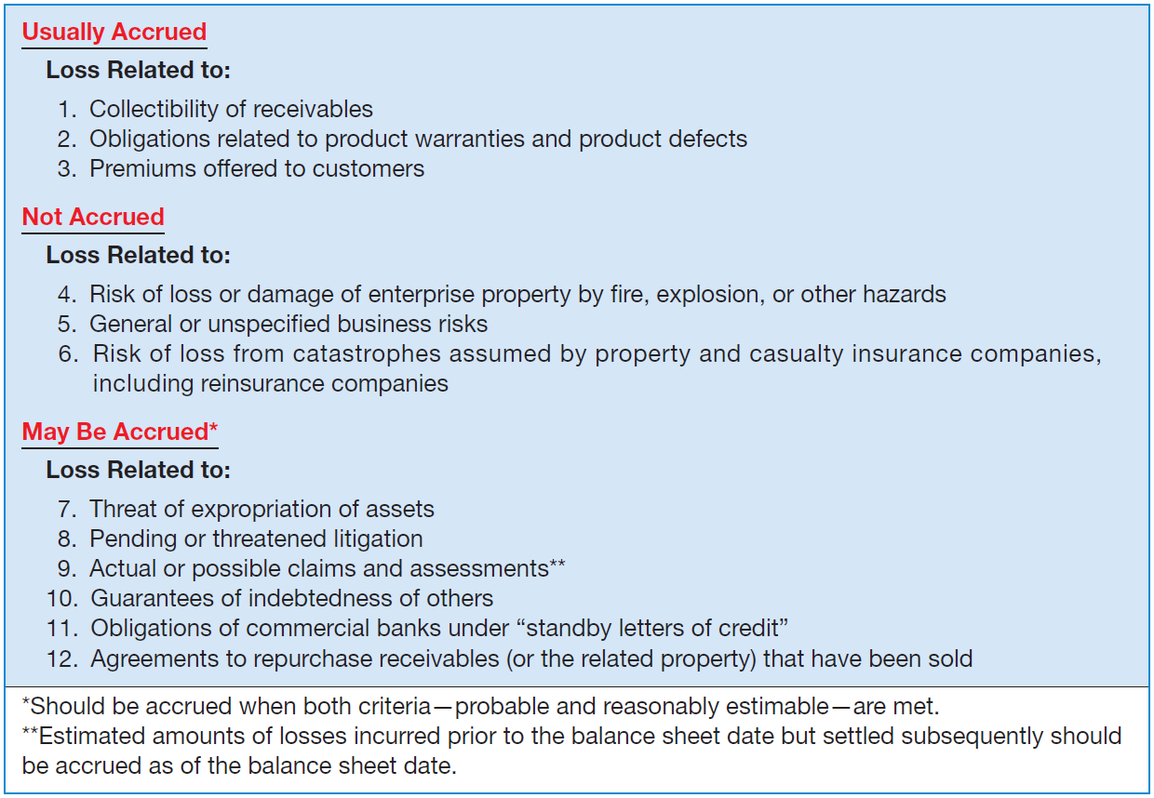
Loss Contingencies
Illustration 13-10
LO 4 Identify the criteria used to account for and disclose gain and loss contingencies.

Slide 41
Loss Contingencies
Common loss contingencies:
Litigation, claims, and assessments.
Guarantee and warranty costs.
Premiums and coupons.
Environmental liabilities.
LO 4 Identify the criteria used to account for and disclose gain and loss contingencies.

Slide 42
Loss Contingencies
Litigation, Claims, and Assessments
Companies must consider the following factors, in determining whether to record a liability with respect to pending or threatened litigation and actual or possible claims and assessments.
Time period in which the action occurred.
Probability of an unfavorable outcome.
Ability to make a reasonable estimate of the loss.
LO 5 Explain the accounting for different types of loss contingencies.

Slide 43
Loss Contingencies
Guarantee and Warranty Costs
Promise made by a seller to a buyer to make good on a deficiency of quantity, quality, or performance in a product.
If it is probable that customers will make warranty claims and a company can reasonably estimate the costs involved, the company must record an expense.
LO 5 Explain the accounting for different types of loss contingencies.

Slide 44
Loss Contingencies
Guarantee and Warranty Costs
Two basic methods of accounting for warranty costs:
Cash-Basis method
Expense warranty costs as incurred, because
it is not probable that a liability has been incurred, or
it cannot reasonably estimate the amount of the liability.
LO 5 Explain the accounting for different types of loss contingencies.

Slide 45
Loss Contingencies
Guarantee and Warranty Costs
Two basic methods of accounting for warranty costs:
Accrual-Basis method
Charge warranty costs to operating expense in the year of sale.
Method is the generally accepted method.
Referred to as the expense warranty approach.
LO 5 Explain the accounting for different types of loss contingencies.

Slide 46
Loss Contingencies
BE13-13: Streep Factory provides a 2-year warranty with one of its products which was first sold in 2012. In that year, Streep spent $70,000 servicing warranty claims. At year-end, Streep estimates that an additional $400,000 will be spent in the future to service warranty claims related to 2012 sales. Prepare Streep’s journal entry to record the $70,000 expenditure, and the December 31 adjusting entry.
2012 Warranty expense 70,000
Cash 70,000
12/31/12 Warranty expense 400,000
Warranty liability 400,000
LO 5 Explain the accounting for different types of loss contingencies.

Slide 47
Loss Contingencies
Premiums and Coupons
Companies should charge the costs of premiums and coupons to expense in the period of the sale that benefits from the plan.
Accounting:
Company estimates the number of outstanding premium offers that customers will present for redemption.
Company charges the cost of premium offers to Premium Expense and credits Estimated Liability for Premiums.
LO 5 Explain the accounting for different types of loss contingencies.

Slide 48
Loss Contingencies
Illustration: Fluffy Cakemix Company offered its customers a large nonbreakable mixing bowl in exchange for 25 cents and 10 boxtops. The mixing bowl costs Fluffy Cakemix Company 75 cents, and the company estimates that customers will redeem 60 percent of the boxtops. The premium offer began in June 2012 and resulted in the transactions journalized below. Fluffy Cakemix Company records purchase of 20,000 mixing bowls as follows.
Inventory of Premium 15,000
Cash 15,000
$20,000 x .75 = $15,000
LO 5 Explain the accounting for different types of loss contingencies.

Slide 49
Loss Contingencies
Illustration: The entry to record sales of 300,000 boxes of cake mix would be:
300,000 x .80 = $240,000
Cash 240,000
Sales Revenue 240,000
Fluffy records the actual redemption of 60,000 boxtops, the receipt of 25 cents per 10 boxtops, and the delivery of the mixing bowls as follows.
Cash [(60,000 / 10) x $0.25] 1,500
Premium Expense 3,000
Inventory of Premium 4,500
Computation: (60,000 / 10) x $0.75 = $4,500
LO 5

Slide 50
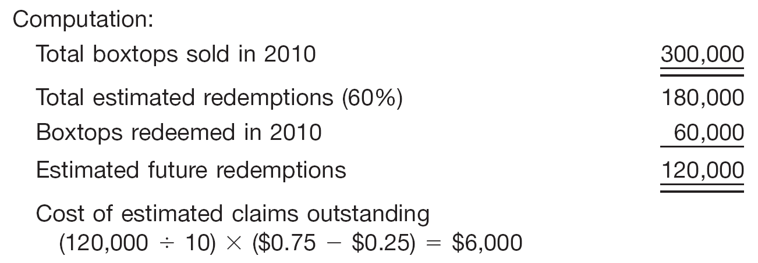
Loss Contingencies
Illustration: Finally, Fluffy makes an end-of-period adjusting entry for estimated liability for outstanding premium offers (boxtops) as follows.
Premium Expense 6,000
Premium Liability 6,000
LO 5 Explain the accounting for different types of loss contingencies.

Slide 51
Loss Contingencies
Environmental Liabilities
A company must recognize an asset retirement obligation (ARO) when it has an existing legal obligation associated with the retirement of a long-lived asset and when it can reasonably estimate the amount of the liability.
NOTE: The SEC argues that if the liability is within a range, and no amount within the range is the best estimate, then management should recognize the minimum amount of the range.
LO 5 Explain the accounting for different types of loss contingencies.

Slide 52
Loss Contingencies
Environmental Liabilities
Obligating Events. Examples of existing legal obligations, which require recognition of a liability include, but are not limited to:
decommissioning nuclear facilities;
dismantling, restoring, and reclamation of oil and gas properties;
certain closure, reclamation, and removal costs of mining facilities;
closure and post-closure costs of landfills.
LO 5 Explain the accounting for different types of loss contingencies.

Slide 53
Loss Contingencies
Illustration: On January 1, 2012, Wildcat Oil Company erected an oil platform in the Gulf of Mexico. Wildcat is legally required to dismantle and remove the platform at the end of its useful life, estimated to be five years. Wildcat estimates that dismantling and removal will cost $1,000,000. Based on a 10 percent discount rate, the fair value of the asset retirement obligation is estimated to be $620,920 ($1,000,000 x .62092). Wildcat records this ARO as follows.
Drilling platform 620,920
Asset retirement obligation 620,920
LO 5 Explain the accounting for different types of loss contingencies.

Slide 54
Loss Contingencies
Illustration: During the life of the asset, Wildcat allocates the asset retirement cost to expense. Using the straight-line method, Wildcat makes the following entries to record this expense.
December 31, 2012, 2013, 2014, 2015, 2016
Depreciation expense ($620,920 / 5) 124,184
Accumulated depreciation 124,184
LO 5 Explain the accounting for different types of loss contingencies.

Slide 55
Loss Contingencies
Illustration: In addition, Wildcat must accrue interest expense each period. Wildcat records interest expense and the related increase in the asset retirement obligation on December 31, 2012, as follows.
December 31, 2012
Interest expense ($620,092 x 10%) 62,092
Asset retirement obligation 62,092
LO 5 Explain the accounting for different types of loss contingencies.

Slide 56
Loss Contingencies
Illustration: On January 10, 2017, Wildcat contracts with Rig Reclaimers, Inc. to dismantle the platform at a contract price of $995,000. Wildcat makes the following journal entry to
record settlement of the ARO.
January 10, 2017
Asset retirement obligation 1,000,000
Gain on settlement of ARO 5,000
Cash 995,000
LO 5 Explain the accounting for different types of loss contingencies.

Slide 57
Presentation and Analysis
Presentation of Current Liabilities
Usually reported at their full maturity value.
Difference between present value and the maturity value is considered immaterial.
LO 6 Indicate how to present and analyze liabilities and contingencies.

Slide 58
Presentation and Analysis
Presentation of Current Liabilities
If a company excludes a short-term obligation from current liabilities because of refinancing, it should include the following in the note to the financial statements:
A general description of the financing agreement.
The terms of any new obligation incurred or to be incurred.
The terms of any equity security issued or to be issued.
LO 6 Indicate how to present and analyze liabilities and contingencies.

Slide 59
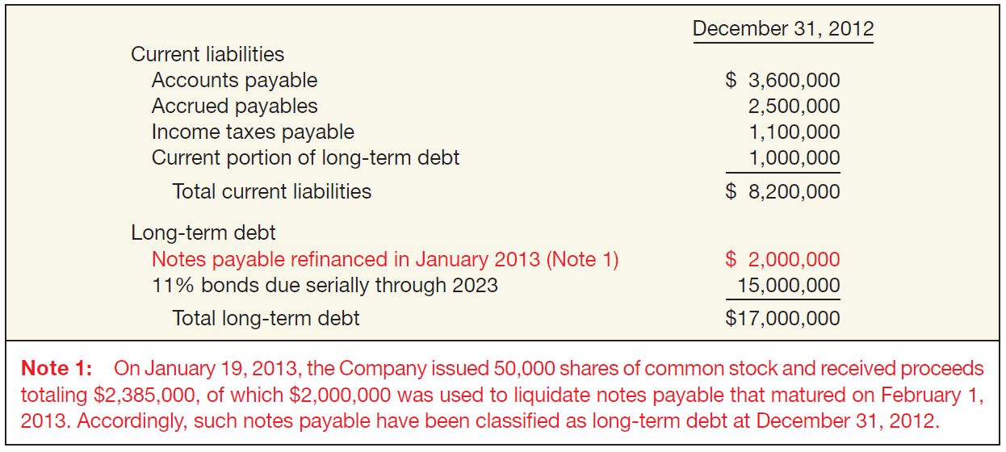
Presentation and Analysis
Presentation of Current Liabilities
Actual Refinancing of Short-Term Debt
Illustration 13-14
LO 6 Indicate how to present and analyze liabilities and contingencies.

Slide 60
Presentation and Analysis
Presentation of Contingencies
Disclosure should include:
Nature of the contingency.
An estimate of the possible loss or range of loss.
Companies should disclose certain other contingent liabilities.
Guarantees of indebtedness of others.
Obligations of commercial banks under “stand-by letters of credit.”
Guarantees to repurchase receivables (or any related property) that have been sold or assigned.
LO 6

Slide 61
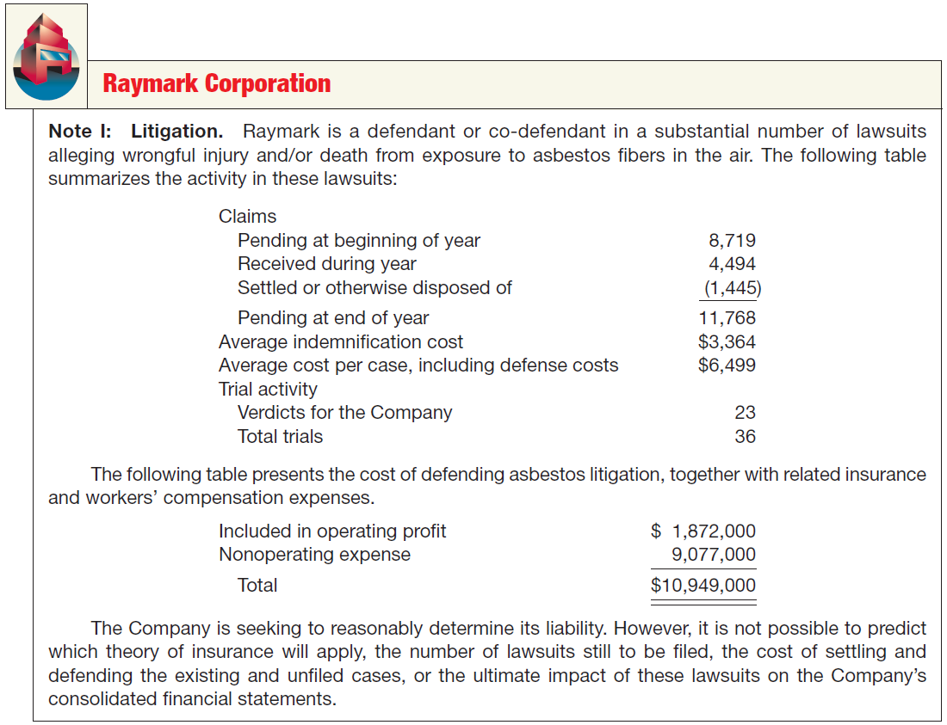
Presentation and Analysis
Illustration 13-15
Disclosure of Loss
Contingency through
Litigation
LO 6

Slide 62
Analysis of Current Liabilities
Liquidity regarding a liability is the expected time to elapse before its payment. Two ratios to help assess liquidity are:
Illustration: Compute these two ratios using the information for Best Buy Co. in Illustration 13-13.
Illustration 13-19
LO 6 Indicate how to present and analyze liabilities and contingencies.

Slide 63
Analysis of Current Liabilities
E13-17: (Ratio Computations and Discussion) Costner Company has been operating for several years, and on December 31, 2012, presented the following balance sheet.
Compute the current ratio:
$210,000
=
3.0 to 1
70,000
Compute the acid-test ratio:
$115,000
=
1.64 to 1
70,000
LO 6 Indicate how to present and analyze liabilities and contingencies.

Slide 64
RELEVANT FACTS
Similar to U.S. practice, IFRS requires that companies present current and non-current liabilities on the face of the statement of financial position (balance sheet), with current liabilities generally presented in order of liquidity. However, many companies using IFRS present non-current liabilities before current liabilities on the statement of financial position.
The basic definition of a liability under GAAP and IFRS is very similar. In a more technical way, liabilities are defined by the IASB as a present obligation of the entity arising from past events, the settlement of which is expected to result in an outflow from the entity of resources embodying economic benefits. Liabilities may be legally enforceable via a contract or law but need not be; that is, they can arise due to normal business practices or customs.

Slide 65
RELEVANT FACTS
IFRS requires that companies classify liabilities as current or non-current on the face of the statement of financial position (balance sheet), except in industries where a presentation based on liquidity would be considered to provide more useful information (such as financial institutions).
Under IFRS, the measurement of a provision related to a contingency is based on the best estimate of the expenditure required to settle the obligation. If a range of estimates is predicted and no amount in the range is more likely than any other amount in the range, the “mid-point” of the range is used to measure the liability. In GAAP, the minimum amount in a range is used.

Slide 66
RELEVANT FACTS
Both IFRS and GAAP prohibit the recognition of liabilities for future losses. However, IFRS permits recognition of a restructuring liability, once a company has committed to a restructuring plan. GAAP has additional criteria (i.e., related to communicating the plan to employees) before a restructuring liability can be established.
IFRS and GAAP are similar in the treatment of asset retirement obligations (AROs). However, the recognition criteria for an ARO are more stringent under GAAP.
Under IFRS, short-term obligations expected to be refinanced can be classified as noncurrent if the refinancing is completed by the financial statement date. GAAP uses the date the financial statements are issued.

Slide 67
RELEVANT FACTS
IFRS uses the term provisions to refer to estimated liabilities. Under IFRS, contingencies are not recorded but are often disclosed. The accounting for provisions under IFRS and estimated liabilities under GAAP are very similar.
GAAP uses the term “contingency” in a different way than IFRS. Contingent liabilities are not recognized in the financial statements under IFRS, whereas under GAAP a contingent liability is sometimes recognized.

Slide 68
IFRS SELF-TEST QUESTION
Under IFRS, a provision is the same as:
a contingent liability.
an estimated liability.
a contingent gain.
None of the above.

Slide 69
IFRS SELF-TEST QUESTION
A typical provision is:
bonds payable.
cash.
a warranty liability.
accounts payable.

Slide 70
IFRS SELF-TEST QUESTION
In determining the amount of a provision, a company using IFRS should generally measure:
using the midpoint of the range between the lowest possible loss and the highest possible loss.
using the minimum amount of the loss in the range.
using the best estimate of the amount of the loss expected to occur.
using the maximum amount of the loss in the range.

