Slide 1
15
Stockholders’ Equity
LEARNING OBJECTIVES
After studying this chapter, you should be able to:
Discuss the characteristics of the corporate form of organization.
Identify the key components of stockholders’ equity.
Explain the accounting procedures for issuing shares of stock.
Describe the accounting for treasury stock.
Explain the accounting for and reporting of preferred stock.
Describe the policies used in distributing dividends.
Identify the various forms of dividend distributions.
Explain the accounting for small and large stock dividends, and for share splits.
Indicate how to present and analyze stockholders’ equity.

Slide 2
The Corporate Form of Organization
Three primary forms of business organization
Proprietorship
Partnership
Corporation
Special characteristics of the corporate form:
Influence of state corporate law.
Use of capital stock or share system.
Development of a variety of ownership interests.
LO 1

Slide 3
The Corporate Form of Organization
State Corporate Law
Corporation must submit articles of incorporation to the state in which incorporation is desired.
State issues a corporation charter.
Advantage to incorporate in a state whose laws favor the corporate form of business organization.
Delaware
Accounting for stockholder’s equity follows the provisions of each states business incorporation act.
LO 1

Slide 4
The Corporate Form of Organization
Capital Stock or Share System
In the absence of restrictive provisions, each share carries the following rights:
To share proportionately in profits and losses.
To share proportionately in management (the right to vote for directors).
To share proportionately in assets upon liquidation.
To share proportionately in any new issues of stock of the same class—called the preemptive right.
LO 1

Slide 5
The Corporate Form of Organization
Variety of Ownership Interests
Common stock is the residual corporate interest.
Bears ultimate risks of loss.
Receives the benefits of success.
Not guaranteed dividends nor assets upon dissolution.
Preferred stock is a special class of stock is created by contract, when stockholders’ sacrifice certain rights in return for other rights or privileges, usually dividend preference.
LO 1

Slide 6
15
Stockholders’ Equity
LEARNING OBJECTIVES
After studying this chapter, you should be able to:
Discuss the characteristics of the corporate form of organization.
Identify the key components of stockholders’ equity.
Explain the accounting procedures for issuing shares of stock.
Describe the accounting for treasury stock.
Explain the accounting for and reporting of preferred stock.
Describe the policies used in distributing dividends.
Identify the various forms of dividend distributions.
Explain the accounting for small and large stock dividends, and for share splits.
Indicate how to present and analyze stockholders’ equity.

Slide 7
Corporate Capital
Common Stock
Account
Contributed Capital
Additional Paid-in Capital
Account
Preferred Stock
Account
Two Primary Sources of Equity
Retained Earnings
Account
Assets – Liabilities = Equity
Less:
Treasury Stock
Account
LO 2

Slide 8
15
Stockholders’ Equity
LEARNING OBJECTIVES
After studying this chapter, you should be able to:
Discuss the characteristics of the corporate form of organization.
Identify the key components of stockholders’ equity.
Explain the accounting procedures for issuing shares of stock.
Describe the accounting for treasury stock.
Explain the accounting for and reporting of preferred stock.
Describe the policies used in distributing dividends.
Identify the various forms of dividend distributions.
Explain the accounting for small and large stock dividends, and for share splits.
Indicate how to present and analyze stockholders’ equity.

Slide 9
Corporate Capital
Issuance of Stock
Shares authorized - Shares sold - Shares issued
Accounting problems:
Par value stock.
No-par stock.
Stock issued in combination with other securities.
Stock issued in noncash transactions.
Costs of issuing stock.
LO 3

Slide 10
Corporate Capital
Par Value Stock
Low par values help companies avoid a contingent liability.
Corporations maintain accounts for:
Preferred Stock or Common Stock.
Paid-in Capital in Excess of Par (also called Additional Paid-in Capital)
LO 3

Slide 11
Corporate Capital
Illustration: Blue Diamond Corporation issued 300 shares of $10 par value common stock for $4,500. Prepare the journal entry to record the issuance of the shares.
Cash 4,500
Common Stock (300 x $10) 3,000
Paid-in Capital in Excess of Par Value 1,500
LO 3

Slide 12
Corporate Capital
No-Par Stock
Reasons for issuance:
Avoids contingent liability.
Avoids confusion over recording par value versus fair market value.
A major disadvantage of no-par stock is that some states levy a high tax on these issues. In addition, in some states the total issue price for no-par stock may be considered legal capital, which could reduce the flexibility in paying dividends.
LO 3

Slide 13
Corporate Capital
Illustration: Muroor Electronics Corporation is organized with authorized common stock of 10,000 shares without par value. If Muroor Electronics issues 500 shares for cash at $10 per share, it makes the following entry.
Cash 5,000
Common Stock 5,000
LO 3

Slide 14
Corporate Capital
Illustration: Some states require that no-par stock have a stated value. If a company issued 1,000 of the shares with a $5 stated value at $15 per share for cash, it makes the following entry.
Cash 15,000
Common Stock 5,000
Paid-in Capital in Excess of Stated Value 10,000
LO 3

Slide 15
Corporate Capital
Stock Issued with Other Securities (Lump-Sum)
Two methods of allocating proceeds:
Proportional method.
Incremental method.
LO 3

Slide 16
Corporate Capital
Illustration: Beveridge Corporation issued 300 shares of $10 par value common stock and 100 shares of $50 par value preferred stock for a lump sum of $13,500. Common stock has a market value of $20 per share, and preferred stock has a market value of $90 per share.
Proportional Method
LO 3

Slide 17
Corporate Capital
Prepare the journal entry to record issuance of shares.
Proportional Method
Cash 13,500
Preferred Stock (100 x $50) 5,000
Paid-in Capital in Excess of Par – Preferred 3,100
Common Stock (300 x $10) 3,000
Paid-in Capital in Excess of Par – Common 2,400
LO 3

Slide 18
Corporate Capital
Illustration: Beveridge Corporation issued 300 shares of $10 par value common stock and 100 shares of $50 par value preferred stock for a lump sum of $13,500. The common stock has a market value of $20 per share, and the value of preferred stock is unknown.
Incremental Method
LO 3

Slide 19
Corporate Capital
Prepare the journal entry to record issuance of shares.
Incremental Method
Cash 13,500
Preferred Stock (100 x $50) 5,000
Paid-in Capital in Excess of Par – Preferred 2,500
Common Stock (300 x $10) 3,000
Paid-in Capital in Excess of Par – Common 3,000
LO 3

Slide 20
Corporate Capital
Stock Issued in Noncash Transactions
The general rule: Companies should record stock issued for services or property other than cash at the
fair value of the stock issued or
fair value of the noncash consideration received,
whichever is more clearly determinable.
LO 3

Slide 21
Corporate Capital
Illustration: The following series of transactions illustrates the procedure for recording the issuance of 10,000 shares of $10 par value common stock for a patent for Arganda Company, in various circumstances.
1. Arganda cannot readily determine the fair value of the patent, but it knows the fair value of the stock is $140,000.
Patents 140,000
Common Stock 100,000
Paid-in Capital in Excess of Par - Common 40,000
LO 3

Slide 22
Corporate Capital
2. Arganda cannot readily determine the fair value of the stock, but it determines the fair value of the patent is $150,000.
Patents 150,000
Common stock 100,000
Paid-in Capital in Excess of Par - Common 50,000
LO 3

Slide 23
Corporate Capital
3. Arganda cannot readily determine the fair value of the stock nor the fair value of the patent. An independent consultant values the patent at $125,000 based on discounted expected cash flows.
Patents 125,000
Common stock 100,000
Paid-in Capital in Excess of Par - Common 25,000
LO 3

Slide 24
Corporate Capital
Costs of Issuing Stock
Direct costs incurred to sell stock, such as
underwriting costs,
accounting and legal fees,
printing costs, and
taxes,
should be reported as a reduction of the amounts paid in (Paid-in Capital in Excess of Par).
LO 3

Slide 25
15
Stockholders’ Equity
LEARNING OBJECTIVES
After studying this chapter, you should be able to:
Discuss the characteristics of the corporate form of organization.
Identify the key components of stockholders’ equity.
Explain the accounting procedures for issuing shares of stock.
Describe the accounting for treasury stock.
Explain the accounting for and reporting of preferred stock.
Describe the policies used in distributing dividends.
Identify the various forms of dividend distributions.
Explain the accounting for small and large stock dividends, and for share splits.
Indicate how to present and analyze stockholders’ equity.

Slide 26
Corporate Capital
Reacquisition of Stock
Corporations purchase their outstanding stock to:
Provide tax-efficient distributions of excess cash to stockholders.
Increase earnings per share and return on equity.
Provide stock for employee stock compensation contracts or to meet potential merger needs.
Thwart takeover attempts or to reduce the number of stockholders.
Make a market in the stock.
LO 4

Slide 27
Corporate Capital
Purchase of Treasury Stock
Two acceptable methods:
Cost method (more widely used).
Par (Stated) value method.
Treasury stock reduces stockholders’ equity.
LO 4

Slide 28
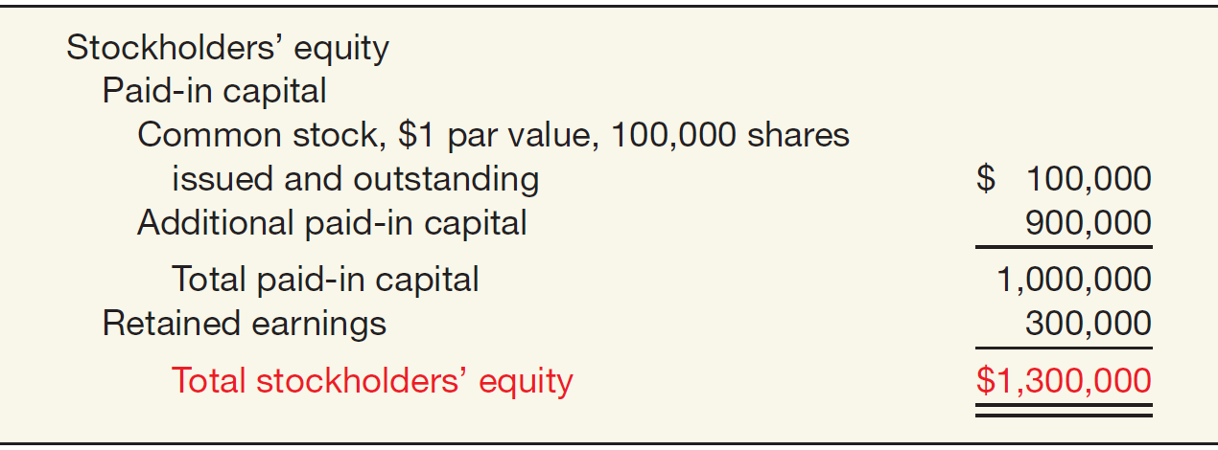
Corporate Capital
Illustration: Cripe Company issued 100,000 shares of $1 par value common stock at a price of $10 per share. In addition, it has retained earnings of $300,000.
Illustration 15-4
LO 4

Slide 29
Corporate Capital
Illustration: Cripe Company issued 100,000 shares of $1 par value common stock at a price of $10 per share. In addition, it has retained earnings of $300,000.
On January 20, Cripe acquires 10,000 of its shares at $11 per share. Cripe records the reacquisition as follows.
Treasury Stock 110,000
Cash 110,000
LO 4

Slide 30
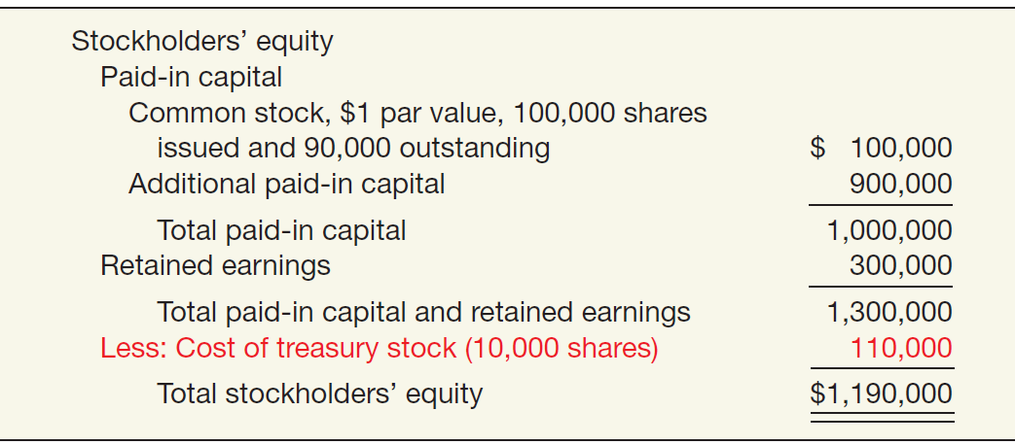
Corporate Capital
Illustration: The stockholders’ equity section for Cripe after purchase of the treasury stock.
Illustration 15-5
LO 4

Slide 31
Corporate Capital
Sale of Treasury Stock
Above Cost
Below Cost
Both increase total assets and stockholders’ equity.
LO 4

Slide 32
Corporate Capital
Sale of Treasury Stock above Cost. Cripe acquired 10,000 treasury share at $11 per share. It now sells 1,000 shares at $15 per share on March 10. Cripe records the entry as follows.
Cash 15,000
Treasury Stock 11,000
Paid-in Capital from Treasury Stock 4,000
LO 4

Slide 33
Corporate Capital
Sale of Treasury Stock below Cost. Cripe sells an additional 1,000 treasury shares on March 21 at $8 per share, it records the sale as follows.
Cash 8,000
Paid-in Capital from Treasury Stock 3,000
Treasury Stock 11,000
LO 4

Slide 34
Corporate Capital
Illustration 15-6
Illustration: Assume that Cripe sells an additional 1,000 shares at $8 per share on April 10.
Cash 8,000
Paid-in Capital from Treasury Stock 1,000
Retained Earnings 2,000
Treasury Stock 11,000
LO 4

Slide 35
Corporate Capital
Retiring Treasury Stock
Decision results in
cancellation of the treasury stock and
a reduction in the number of shares of issued stock.
LO 4

Slide 36
15
Stockholders’ Equity
LEARNING OBJECTIVES
After studying this chapter, you should be able to:
Discuss the characteristics of the corporate form of organization.
Identify the key components of stockholders’ equity.
Explain the accounting procedures for issuing shares of stock.
Describe the accounting for treasury stock.
Explain the accounting for and reporting of preferred stock.
Describe the policies used in distributing dividends.
Identify the various forms of dividend distributions.
Explain the accounting for small and large stock dividends, and for share splits.
Indicate how to present and analyze stockholders’ equity.

Slide 37
Preferred Stock
Features often associated with preferred stock.
Preference as to dividends.
Preference as to assets in the event of liquidation.
Convertible into common stock.
Callable at the option of the corporation.
Nonvoting.
LO 5

Slide 38
Preferred Stock
Features of Preferred Stock
Cumulative
Participating
Convertible
Callable
Redeemable
A corporation may attach whatever preferences or restrictions, as long as it does not violate its
state incorporation law.
LO 5

Slide 39
Preferred Stock
Illustration: Bishop Co. issues 10,000 shares of $10 par value preferred stock for $12 cash per share. Bishop records the issuance as follows:
Cash 120,000
Preferred stock 100,000
Paid-in Capital in Excess of Par - Preferred 20,000
LO 5

Slide 40
15
Stockholders’ Equity
LEARNING OBJECTIVES
After studying this chapter, you should be able to:
Discuss the characteristics of the corporate form of organization.
Identify the key components of stockholders’ equity.
Explain the accounting procedures for issuing shares of stock.
Describe the accounting for treasury stock.
Explain the accounting for and reporting of preferred stock.
Describe the policies used in distributing dividends.
Identify the various forms of dividend distributions.
Explain the accounting for small and large stock dividends, and for share splits.
Indicate how to present and analyze stockholders’ equity.

Slide 41
Dividend Policy
Few companies pay dividends in amounts equal to their legally available retained earnings. Why?
Maintain agreements with creditors.
Meet state incorporation requirements.
To finance growth or expansion.
To smooth out dividend payments.
To build up a cushion against possible losses.
LO 6

Slide 42
15
Stockholders’ Equity
LEARNING OBJECTIVES
After studying this chapter, you should be able to:
Discuss the characteristics of the corporate form of organization.
Identify the key components of stockholders’ equity.
Explain the accounting procedures for issuing shares of stock.
Describe the accounting for treasury stock.
Explain the accounting for and reporting of preferred stock.
Describe the policies used in distributing dividends.
Identify the various forms of dividend distributions.
Explain the accounting for small and large stock dividends, and for share splits.
Indicate how to present and analyze stockholders’ equity.

Slide 43
Dividend Policy
Types of Dividends
Cash dividends.
Property dividends.
Liquidating dividends.
Stock dividends.
All dividends, except for stock dividends, reduce the total stockholders’ equity in the corporation.
LO 7

Slide 44
Dividend Policy
Cash Dividends
Board of directors vote on the declaration of cash dividends.
A declared cash dividend is a liability.
Companies do not declare or pay cash dividends on treasury stock.
Three dates:
Date of declaration
Date of record
Date of payment
LO 7

Slide 45
Dividend Policy
Illustration: David Freight Corp. on June 10 declared a cash dividend of 50 cents a share on 1.8 million shares payable July 16 to all stockholders of record June 24.
At date of declaration (June 10)
Retained Earnings 900,000
Dividends Payable 900,000
At date of record (June 24) No entry
At date of payment (July 16)
Dividends Payable 900,000
Cash 900,000
LO 7

Slide 46
Dividend Policy
Property Dividends
Dividends payable in assets other than cash.
Restate at fair value the property it will distribute, recognizing any gain or loss.
LO 7

Slide 47
Dividend Policy
Illustration: Hopkins, Inc. transferred to stockholders some of its equity investments costing $1,250,000 by declaring a property dividend on December 28, 2013, to be distributed on January 30, 2014, to stockholders of record on January 15, 2014. At the date of declaration, the securities have a market value of $2,000,000. Hopkins makes the following entries.
At date of declaration (December 28, 2013)
Equity Investments 750,000
Unrealized Holding Gain or Loss—Income 750,000
Retained Earnings 2,000,000
Property Dividends Payable 2,000,000
LO 7

Slide 48
Dividend Policy
Illustration: Hopkins, Inc. transferred to stockholders some of its equity investments costing $1,250,000 by declaring a property dividend on December 28, 2013, to be distributed on January 30, 2014, to stockholders of record on January 15, 2014. At the date of declaration, the securities have a market value of $2,000,000. Hopkins makes the following entries.
At date of distribution (January 30, 2014)
Property Dividends Payable 2,000,000
Equity Investments 2,000,000
LO 7

Slide 49
Dividend Policy
Liquidating Dividends
Any dividend not based on earnings reduces corporate paid-in capital.
The portion of these dividends in excess of accumulated income represents a return of part of the stockholder’s investment.
LO 7

Slide 50
Dividend Policy
Illustration: Horaney Mines Inc. issued a “dividend” to its common stockholders of $1,200,000. The cash dividend announcement noted stockholders should consider $900,000 as income and the remainder a return of capital. Horaney Mines records the dividend as follows.
Date of declaration
Retained Earnings 900,000
Paid-in Capital in Excess of Par-Common 300,000
Dividends Payable 1,200,000
Date of payment
Dividends Payable 1,200,000
Cash 1,200,000
LO 7

Slide 51
15
Stockholders’ Equity
LEARNING OBJECTIVES
After studying this chapter, you should be able to:
Discuss the characteristics of the corporate form of organization.
Identify the key components of stockholders’ equity.
Explain the accounting procedures for issuing shares of stock.
Describe the accounting for treasury stock.
Explain the accounting for and reporting of preferred stock.
Describe the policies used in distributing dividends.
Identify the various forms of dividend distributions.
Explain the accounting for small and large stock dividends, and for share splits.
Indicate how to present and analyze stockholders’ equity.

Slide 52
Dividend Policy
Stock Dividends and Stock Splits
Stock Dividends
Issuance by a company of its own stock to stockholders on a pro rata basis, without receiving any consideration.
Used when management wishes to “capitalize” part of earnings.
If stock dividend is less than 20–25 percent of the common shares outstanding, company transfers fair market value from retained earnings (small stock dividend).
LO 8

Slide 53
Dividend Policy
Illustration: Koebele Corporation has outstanding 1,000 shares of $100 par value common stock and retained earnings of $50,000. If Koebele declares a 10 percent stock dividend, it issues 100 additional shares to current stockholders. If the fair value of the stock at the time of the stock dividend is $130 per share, the entry is:
Date of declaration
Retained Earnings 13,000
Common Stock Dividend Distributable 10,000
Paid-in Capital in Excess of Par-Common 3,000
Date of distribution
Common Stock Dividend Distributable 10,000
Common Stock 10,000
LO 8

Slide 54
Dividend Policy
Stock Split
To reduce the market value of shares.
No entry recorded for a stock split.
Decrease par value and increase number of shares.
Illustration 15-10
LO 8

Slide 55
Dividend Policy
Stock Split and Stock Dividend Differentiated
Large Stock Dividend - 20–25 percent of the number of shares previously outstanding.
Same effect on market price as a stock split.
Par value transferred from retained earnings to capital stock.
LO 8

Slide 56
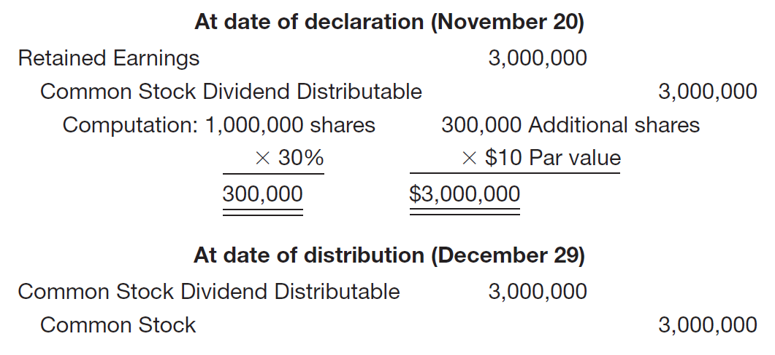
Dividend Policy
Illustration: Luna Steel, Inc. declared a 30 percent share dividend on November 20, payable December 29 to stockholders of record December 12. At the date of declaration, 1,000,000 shares, par value $10, are outstanding and with a fair value of $200 per share. The entries are:
LO 8

Slide 57
Dividend Policy
Restrictions on Retained Earnings
Restrictions are best disclosed by note.
Restrictions may be based on the retention of a certain retained earnings balance, the ability to maintain certain working capital requirements, additional borrowing, and other considerations.
Illustration 15-12
Disclosure of Restrictions on
Retained Earnings and Dividends
LO 8

Slide 58
15
Stockholders’ Equity
LEARNING OBJECTIVES
After studying this chapter, you should be able to:
Discuss the characteristics of the corporate form of organization.
Identify the key components of stockholders’ equity.
Explain the accounting procedures for issuing shares of stock.
Describe the accounting for treasury stock.
Explain the accounting for and reporting of preferred stock.
Describe the policies used in distributing dividends.
Identify the various forms of dividend distributions.
Explain the accounting for small and large stock dividends, and for share splits.
Indicate how to present and analyze stockholders’ equity.

Slide 59
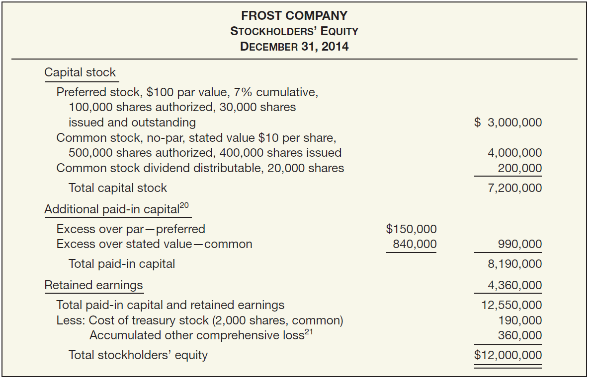
Presentation and Analysis of Equity
Presentation
Illustration 15-13
LO 9

Slide 60
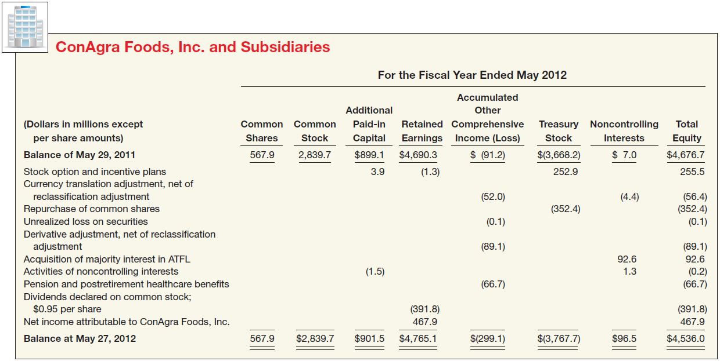
Presentation and Analysis of Equity
Statement of Stockholders’ Equity
Illustration 15-14
LO 9

Slide 61
Presentation and Analysis of Equity
Analysis
Analysts use stockholders’ equity ratios to evaluate a company’s profitability and long-term solvency.
Three ratios:
Rate of return on common stock equity.
Payout ratio.
Book value per share.
LO 9

Slide 62
Analysis
Rate of Return on Common Stock Equity
Illustration: Marshall's Inc. had net income of $360,000, declared and paid preferred dividends of $54,000, and average common stockholders’ equity of $2,550,000.
Illustration 15-15
Ratio shows how many dollars of net income the company earned for each dollar invested by the owners.
LO 9

Slide 63
Analysis
Payout Ratio
Illustration: Midgley Co. has cash dividends of $100,000 and net income of $500,000, and no preferred stock outstanding.
Illustration 15-16
In the fourth quarter of 2011, 36 percent of the earnings of the S&P 500 was distributed via dividends.
LO 9

Slide 64
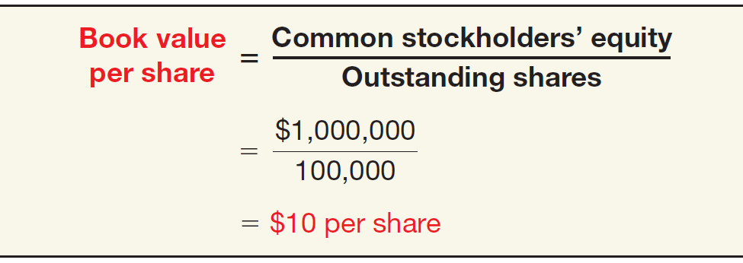
Analysis
Book Value per Share
Illustration: Uretz Corporation’s common stockholders’ equity is $1,000,000 and it has 100,000 shares of common stock outstanding
Illustration 15-17
Amount each share would receive if the company were liquidated on the basis of amounts reported on the balance sheet.
LO 9

Slide 65
RELEVANT FACTS - Similarities
The accounting for the issuance of shares and purchase of treasury stock are similar under both IFRS and GAAP.
The accounting for declaration and payment of dividends and the accounting for stock splits are similar under both IFRS and GAAP.
LO 11 Compare the procedures for accounting for stockholders’ equity under GAAP and IFRS.

Slide 66
RELEVANT FACTS - Differences
Major differences relate to terminology used, introduction of concepts such as revaluation surplus, and presentation of stockholders’ equity information.
Many countries have different investor groups than the United States. For example, in Germany, financial institutions like banks are not only the major creditors but often are the largest shareholders as well.
The accounting for treasury share retirements differs between IFRS and GAAP. Under GAAP, a company has three options: (1) charge the excess of the cost of treasury shares over par value to retained earnings, (2) allocate the difference between paid-in capital and retained earnings, or (3) charge the entire amount to paid-in capital. Under IFRS, the excess may have to be charged to paid-in capital, depending on the original transaction related to the issuance of the shares.
LO 11

Slide 67
RELEVANT FACTS - Differences
The statement of changes in equity is usually referred to as the statement of stockholders’ equity (or shareholders’ equity) under GAAP.
Both IFRS and GAAP use the term retained earnings. However, IFRS relies on the term “reserve” as a dumping ground for other types of equity transactions, such as other comprehensive income items as well as various types of unusual transactions related to convertible debt and share option contracts. GAAP relies on the account Accumulated Other Comprehensive Income (Loss).
Under IFRS, it is common to report “revaluation surplus” related to increases or decreases in items such as property, plant, and equipment; mineral resources; and intangible assets. The term surplus is generally not used in GAAP. In addition, unrealized gains on the above items are not reported in the financial statements under GAAP.
LO 11

Slide 68
ON THE HORIZON
The IASB and the FASB are currently working on a project related to financial statement presentation. An important part of this study is to determine whether certain line items, subtotals, and totals should be clearly defined and required to be displayed in the financial statements. For example, it is likely that the statement of changes in equity and its presentation will be examined closely. In addition, the options of how to present other comprehensive income under GAAP will change in any converged standard.
LO 11

Slide 69
IFRS SELF-TEST QUESTION
Under IFRS, the amount of capital received in excess of par value would be credited to:
Retained Earnings.
Contributed Capital.
Share Premium.
Par value is not used under IFRS.
LO 11

Slide 70
IFRS SELF-TEST QUESTION
The term reserves is used under IFRS with reference to all of the following except:
gains and losses on revaluation of property, plant, and equipment.
capital received in excess of the par value of issued shares.
retained earnings.
fair value differences.
LO 11

Slide 71
IFRS SELF-TEST QUESTION
Under IFRS, a purchase by a company of its own shares results in:
an increase in treasury shares.
a decrease in assets.
a decrease in equity.
All of the above.
LO 11

