Slide 1


Accounting for Leases
21
Intermediate Accounting
Kieso, Weygandt, and Warfield

Slide 2
The Leasing Environment
A lease is a contractual agreement between a lessor and a lessee, that gives the lessee the right to use specific property, owned by the lessor, for a specified period of time.
Largest group of leased equipment involves:
  Information technology
  Transportation (trucks, aircraft, rail)
  Construction
  Agriculture
LO 1 Explain the nature, economic substance, and advantages of lease transactions.

Slide 3
The Leasing Environment
Who Are the Players?
Captive Leasing
Banks
Independents
Wells Fargo
Chase
Citigroup
PNC
Caterpillar Financial Services Corp.
Ford Motor Credit (Ford)
IBM Global Financing
23%
47%
Market Share
26%
LO 1

Slide 4
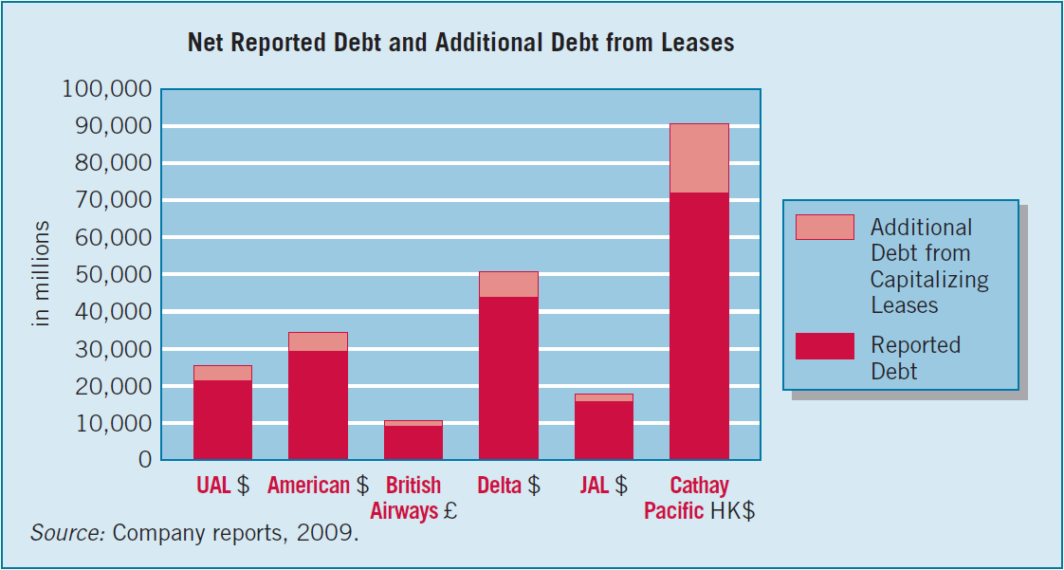
The Leasing Environment
Advantages of Leasing
100% financing at fixed rates.
Protection against obsolescence.
Flexibility.
Less costly financing.
Tax advantages.
Off-balance-sheet financing.
LO 1 Explain the nature, economic substance, and advantages of lease transactions.

Slide 5
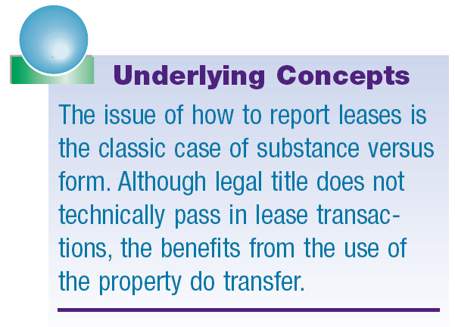
The Leasing Environment
Conceptual Nature of a Lease
Capitalize a lease that transfers substantially all of the benefits and risks of property ownership, provided the lease is noncancelable.
Leases that do not transfer substantially all the benefits and risks of ownership are operating leases.
LO 1 Explain the nature, economic substance, and advantages of lease transactions.

Slide 6
The Leasing Environment
Substance versus Form
Operating Lease
Rent expense xxx
Cash xxx
Although technically legal title may not pass, the benefits from the use of the property do.
Capital Lease
Leased equipment xxx
Lease liability xxx
LO 1 Explain the nature, economic substance, and advantages of lease transactions.

Slide 7
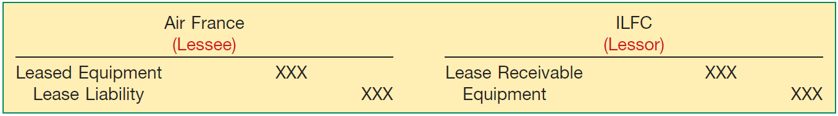
Accounting by the Lessee
If the lessee capitalizes a lease, the lessee records an asset and a liability generally equal to the present value of the rental payments.
  Records depreciation on the leased asset.
  Treats the lease payments as consisting of interest and principal.
Journal Entries for Capitalized Lease
Illustration 21-2
LO 2 Describe the accounting criteria and procedures for capitalizing leases by the lessee.

Slide 8
Accounting by the Lessee
For a capital lease, the FASB has identified four criteria.
  Lease transfers ownership of the property to the lessee.
  Lease contains a bargain-purchase option.
  Lease term is equal to 75 percent or more of the estimated economic life of the leased property.
  The present value of the minimum lease payments (excluding executory costs) equals or exceeds 90 percent of the fair value of the leased property.
One or more must be met for finance lease accounting.
LO 2 Describe the accounting criteria and procedures for capitalizing leases by the lessee.

Slide 9
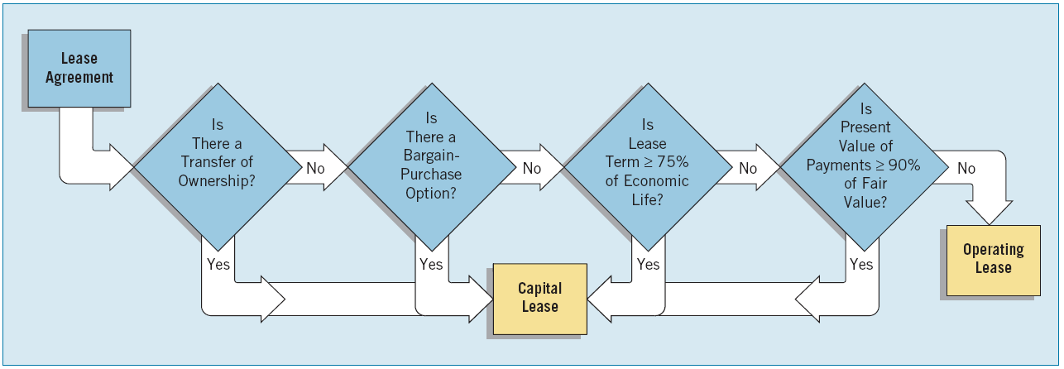
Accounting by the Lessee
Lease Agreement
Leases that DO NOT meet any of the four criteria are accounted for as Operating Leases.
Illustration 21-4
LO 2 Describe the accounting criteria and procedures for capitalizing leases by the lessee.

Slide 10
Accounting by the Lessee
Capitalization Criteria
Transfer of Ownership Test
  Not controversial and easily implemented.
Bargain-Purchase Option Test
  At the inception of the lease, the difference between the option price and the expected fair market value must be large enough to make exercise of the option reasonably assured.
LO 2 Describe the accounting criteria and procedures for capitalizing leases by the lessee.

Slide 11
Accounting by the Lessee
Capitalization Criteria
Economic Life Test (75% Test)
  Lease term is generally considered to be the fixed, noncancelable term of the lease.
  Bargain-renewal option can extend this period.
  At the inception of the lease, the difference between the renewal rental and the expected fair rental must be great enough to make exercise of the option to renew reasonably assured.
LO 2 Describe the accounting criteria and procedures for capitalizing leases by the lessee.

Slide 12
Accounting by the Lessee
Illustration: Home Depot leases Dell PCs for two years at a rental of $100 per month per computer and subsequently can lease them for $10 per month per computer for another two years. The lease clearly offers a bargain-renewal option; the lease term is considered to be four years.
LO 2 Describe the accounting criteria and procedures for capitalizing leases by the lessee.

Slide 13
Accounting by the Lessee
Capitalization Criteria
Recovery of Investment Test (90% Test)
Minimum Lease Payments:
  Minimum rental payment
  Guaranteed residual value
  Penalty for failure to renew or extend the lease
  Bargain-purchase option
Executory Costs:
  Insurance
  Maintenance
  Taxes
Exclude from PV of Minimum Lease Payment Calculation
LO 2

Slide 14
Accounting by the Lessee
Capitalization Criteria
Discount Rate
Lessee computes the present value of the minimum lease payments using its incremental borrowing rate, with one exception.
    If the lessee knows the implicit interest rate computed by the lessor and it is less than the lessee’s incremental borrowing rate, then lessee must use the lessor’s rate.
LO 2 Describe the accounting criteria and procedures for capitalizing leases by the lessee.

Slide 15
Accounting by the Lessee
Asset and Liability Accounted for Differently
Asset and Liability Recorded at the lower of:
  present value of the minimum lease payments (excluding executory costs) or
  fair-market value of the leased asset.
LO 2 Describe the accounting criteria and procedures for capitalizing leases by the lessee.

Slide 16
Accounting by the Lessee
Asset and Liability Accounted for Differently
Depreciation Period
  If lease transfers ownership, depreciate asset over the economic life of the asset.
  If lease does not transfer ownership, depreciate over the term of the lease.
LO 2 Describe the accounting criteria and procedures for capitalizing leases by the lessee.

Slide 17
Accounting by the Lessee
Asset and Liability Accounted for Differently
Effective-Interest Method
  Used to allocate each lease payment between principal and interest.
Depreciation Concept
  Depreciation and the discharge of the obligation are independent accounting processes.
LO 2 Describe the accounting criteria and procedures for capitalizing leases by the lessee.

Slide 18
Accounting by the Lessee
E21-1: On January 1, 2012, Adams Corporation signed a 5-year noncancelable lease for a machine. The terms of the lease called for Adams to make annual payments of $9,968 at the beginning of each year, starting January 1, 2012. The machine has an estimated useful life of 6 years and a $5,000 unguaranteed residual value. Adams uses the straight-line method of depreciation for all of its plant assets. Adams’s incremental borrowing rate is 10%, and the lessor’s implicit rate is unknown.
Instructions
What type of lease is this? Explain.
Compute the present value of the minimum lease payments.
Prepare all necessary journal entries for Adams for this lease through January 1, 2013.
LO 2

Slide 19
Accounting by the Lessee
E21-1: What type of lease is this? Explain.
Capitalization Criteria:
Transfer of ownership
Bargain purchase option
Lease term = 75% of economic life of leased property
Present value of minimum lease payments => 90% of FMV of property
Capital Lease, #3
NO
NO
Lease term 5 yrs.
Economic life 6 yrs.
YES 83.3%
FMV of leased property is unknown.
LO 2 Describe the accounting criteria and procedures for capitalizing leases by the lessee.

Slide 20
Accounting by the Lessee
E21-1: Compute present value of the minimum lease payments.
Payment $ 9,968
Present value factor (i=10%,n=5) 4.16986
PV of minimum lease payments $41,565
1/1/12 Journal Entries:
Leased Machine (under capital leases) 41,565
Lease Liability 41,565
Lease Liability 9,968
Cash 9,968
LO 2 Describe the accounting criteria and procedures for capitalizing leases by the lessee.

Slide 21
Accounting by the Lessee
E21-1: Lease Amortization Schedule
LO 2 Describe the accounting criteria and procedures for capitalizing leases by the lessee.

Slide 22
Accounting by the Lessee
E21-1: Journal entries for Adams through Jan. 1, 2013.
12/31/12
Depreciation Expense 8,313
Accumulated Depreciation 8,313
($41,565 ÷ 5 = $8,313)
Interest Expense 3,160
Interest Payable 3,160
($41,565 – $9,968) X .10]
LO 2 Describe the accounting criteria and procedures for capitalizing leases by the lessee.

Slide 23
Accounting by the Lessee
E21-1: Journal entries for Adams through Jan. 1, 2012.
1/1/13
Lease Liability 6,808
Interest Payable 3,160
Cash 9,968
LO 2 Describe the accounting criteria and procedures for capitalizing leases by the lessee.

Slide 24
Accounting by the Lessee
Operating Method
The lessee assigns rent to the periods benefiting from the use of the asset and ignores, in the accounting, any commitments to make future payments.
Illustration: Assume Adams accounts for it as an operating lease. Adams records this payment on January 1, 2012, as follows.
Rent Expense 9,968
Cash 9,968
LO 3 Contrast the operating and capitalization methods of recording leases.

Slide 25
Accounting by the Lessee
E21-1: Comparison of Capital Lease with Operating Lease
LO 3 Contrast the operating and capitalization methods of recording leases.

Slide 26
Accounting by the Lessor
Benefits to the Lessor
Interest revenue.
Tax incentives.
High residual value.
LO 4 Identify the classifications of leases for the lessor.

Slide 27
Accounting by the Lessor
Economics of Leasing
A lessor determines the amount of the rental, based on the rate of return—the implicit rate—needed to justify leasing the asset.
If a residual value is involved (whether guaranteed or not), the company would not have to recover as much from the lease payments
LO 4 Identify the classifications of leases for the lessor.

Slide 28
Accounting by the Lessor
E21-10 (Computation of Rental): Fieval Leasing Company signs an agreement on January 1, 2012, to lease equipment to Reid Company. The following information relates to this agreement.
The term of the non-cancelable lease is 6 years with no renewal option. The equipment has an estimated economic life of 6 years.
The cost and fair value of the asset at January 1, 2012, is $343,000.
The asset will revert to the lessor at the end of the lease term, at which time the asset is expected to have a residual value of $61,071, none of which is guaranteed.
The agreement requires equal annual rental payments, beginning on January 1, 2012.
Collectability of the lease payments is reasonably predictable. There are no important uncertainties surrounding the amount of costs yet to be incurred by the lessor.
LO 4 Identify the classifications of leases for the lessor.

Slide 29
Accounting by the Lessor
E21-10 (Computation of Rental): Assuming the lessor desires a 10% rate of return on its investment, calculate the amount of the annual rental payment required.
x
-
÷
LO 4 Identify the classifications of leases for the lessor.

Slide 30
Accounting by the Lessor
Classification of Leases by the Lessor
Operating leases.
Direct-financing leases.
Sales-type leases.
LO 4 Identify the classifications of leases for the lessor.

Slide 31
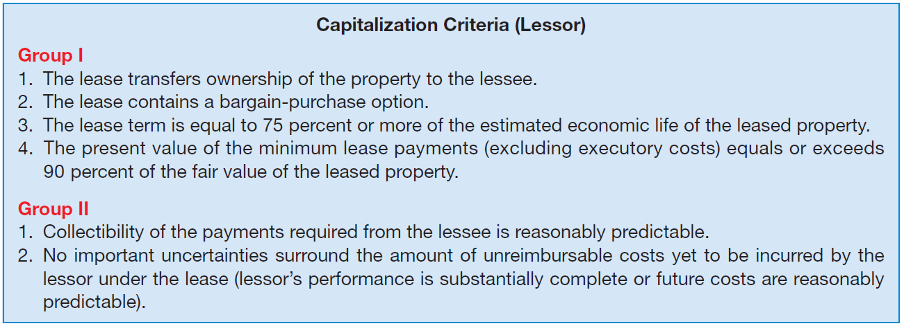
Accounting by the Lessor
Classification of Leases by the Lessor
Illustration 21-10
A sales-type lease involves a manufacturer’s or dealer’s profit, and a direct-financing lease does not.
LO 4 Identify the classifications of leases for the lessor.

Slide 32
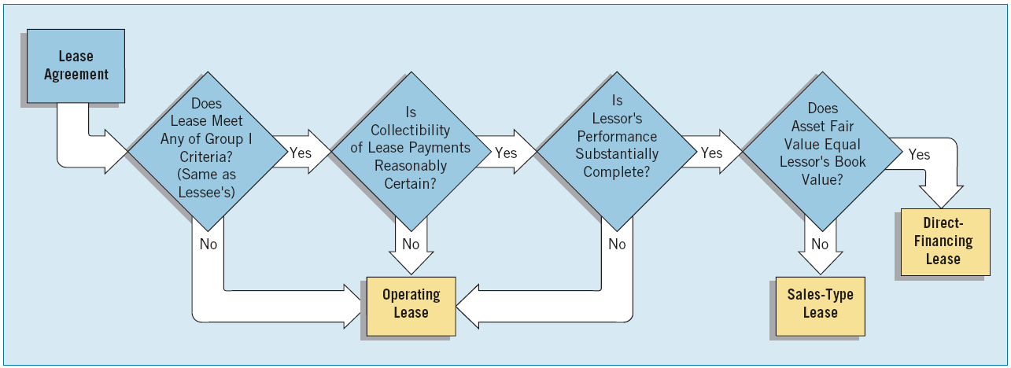
Accounting by the Lessor
Classification of Leases by the Lessor
Illustration 21-11
A lessor may classify a lease as an operating lease but the lessee may classify the same lease as a capital lease.
LO 4

Slide 33
Accounting by the Lessor
Direct-Financing Method (Lessor)
In substance the financing of an asset purchase by the lessee.
Lessor records:
  A lease receivable instead of a leased asset.
  Receivable is the present value of the minimum lease payments.
LO 5 Describe the lessor’s accounting for direct-financing leases.

Slide 34
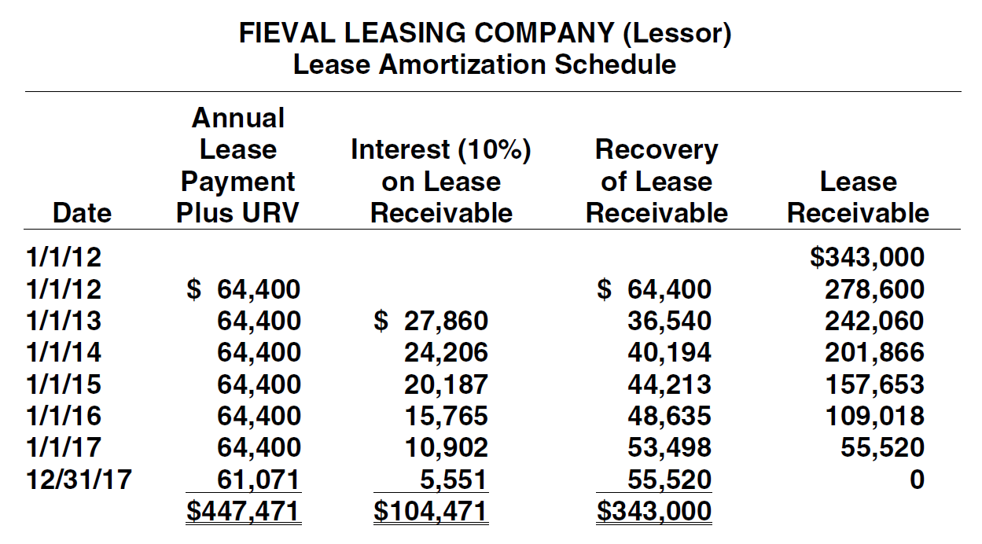
Accounting by the Lessor
E21-10: Amortization schedule for the lessor.
LO 5

Slide 35
Accounting by the Lessor
E21-10: Prepare all of the journal entries for the lessor for 2012 and 2013.
1/1/12 Lease Receivable 343,000
Equipment 343,000
1/1/12 Cash 64,400
Lease Receivable 64,400
12/31/12 Interest Receivable 27,860
Interest Revenue 27,860
LO 5 Describe the lessor’s accounting for direct-financing leases.

Slide 36
Accounting by the Lessor
E21-10: Prepare all of the journal entries for the lessor for 2012 and 2013.
1/1/12 Cash 64,400
Lease Receivable 36,540
Interest Receivable 27,860
12/31/12 Interest Receivable 24,206
Interest Revenue 24,206
LO 5 Describe the lessor’s accounting for direct-financing leases.

Slide 37
Accounting by the Lessor
Operating Method (Lessor)
Records each rental receipt as rental revenue.
Depreciates leased asset in the normal manner.
LO 5 Describe the lessor’s accounting for direct-financing leases.

Slide 38
Accounting by the Lessor
Illustration: Assume Fieval accounts for the lease as an operating lease. It records the cash rental receipt as follows:
Cash 64,400
Rental Revenue 64,400
Depreciation is recorded as follows:
Depreciation Expense 46,989
Accumulated Depreciation 46,989
($343,000 – 61,067) / 6 years = 57,167
LO 5 Describe the lessor’s accounting for direct-financing leases.

Slide 39
Special Accounting Problems
Residual values.
Sales-type leases (lessor).
Bargain-purchase options.
Initial direct costs.
Current versus non-current classification.
Disclosure.
LO 6 Identify special features of lease arrangements that cause unique accounting problems.

Slide 40
Special Accounting Problems
Residual Values
Meaning of Residual Value - Estimated fair value of the leased asset at the end of the lease term.
Guaranteed Residual Value – Lessee agrees to make up any deficiency below a stated amount that the lessor realizes in residual value at the end of the lease term.
LO 6 Identify special features of lease arrangements that cause unique accounting problems.

Slide 41
Special Accounting Problems
Residual Values
Lease Payments - Lessor may adjust lease payments because of the increased certainty of recovery of a guaranteed residual value.
Lessee Accounting for Residual Value - The minimum lease payments, include the guaranteed residual value but excludes the unguaranteed residual value.
LO 6 Identify special features of lease arrangements that cause unique accounting problems.

Slide 42
Special Accounting Problems
Illustration (Guaranteed Residual Value – Lessee Accounting): Caterpillar Financial Services Corp. (a subsidiary of Caterpillar) and Sterling Construction Corp. sign a lease agreement dated January 1, 2012, that calls for Caterpillar to lease a front-end loader to Sterling beginning January 1, 2012. The terms and provisions of the lease agreement, and other pertinent data, are as follows.
  The term of the lease is five years. The lease agreement is noncancelable, requiring equal rental payments at the beginning of each year (annuity-due basis).
  The loader has a fair value at the inception of the lease of $100,000, an estimated economic life of five years, and estimated residual value of $5,000 at the end of the lease.
LO 7 Describe the effect of residual values, guaranteed and unguaranteed, on lease accounting.

Slide 43
Special Accounting Problems
Illustration (Guaranteed Residual Value – Lessee Accounting):
  Sterling pays all of the executory costs directly to third parties except for the property taxes of $2,000 per year, which is included as part of its annual payments to Caterpillar.
  The lease contains no renewal options. The loader reverts to Caterpillar at the termination of the lease.
  Sterling’s incremental borrowing rate is 11 percent per year.
  Sterling depreciates on a straight-line basis.
  Caterpillar sets the annual rental to earn a rate of return on its investment of 10 percent per year; Sterling knows this fact.
LO 7 Describe the effect of residual values, guaranteed and unguaranteed, on lease accounting.

Slide 44
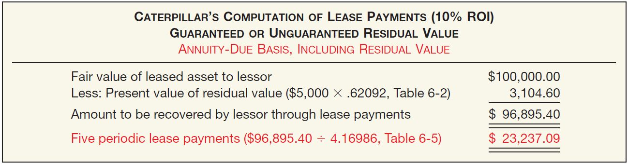
Special Accounting Problems
Illustration (Guaranteed Residual Value – Lessee Accounting):
Caterpillar computation of the lease payments:
Illustration 21-16
LO 7 Describe the effect of residual values, guaranteed and unguaranteed, on lease accounting.

Slide 45
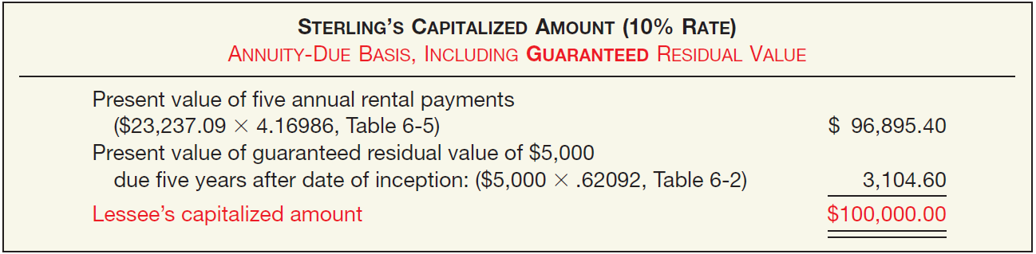
Special Accounting Problems
Illustration (Guaranteed Residual Value – Lessee Accounting):
Computation of Lessee’s capitalized amount
Illustration 21-17
LO 7 Describe the effect of residual values, guaranteed and unguaranteed, on lease accounting.

Slide 46
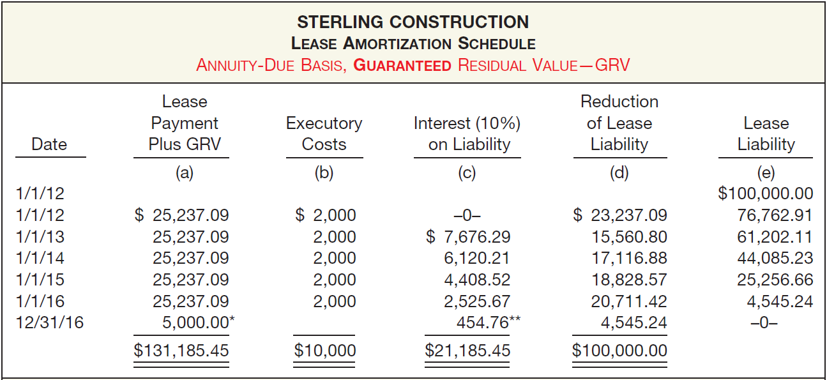
Special Accounting Problems
Illustration (Guaranteed Residual Value – Lessee Accounting):
Illustration 21-18
LO 7

Slide 47
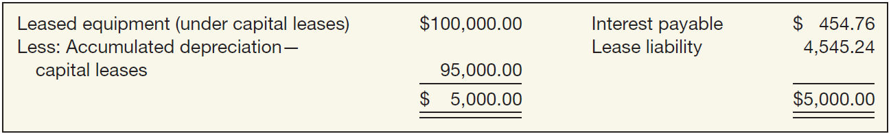
Special Accounting Problems
Illustration (Guaranteed Residual Value – Lessee Accounting):
At the end of the lease term, before the lessee transfers the asset to Caterpillar, the lease asset and liability accounts have the following balances.
Illustration 21-19
LO 7 Describe the effect of residual values, guaranteed and unguaranteed, on lease accounting.

Slide 48
Special Accounting Problems
Illustration (Guaranteed Residual Value – Lessee Accounting):
Assume that Sterling depreciated the leased asset down to its residual value of $5,000 but that the fair market value of the residual value at December 31, 2016, was $3,000. Sterling would make the following journal entry.
Loss on Capital Lease 2,000.00
Interest Expense (or Interest Payable) 454.76
Lease Liability 4,545.24
Accumulated Depreciation 95,000.00
Leased Equipment (under capital leases) 100,000.00
Cash 2,000.00
LO 7 Describe the effect of residual values, guaranteed and unguaranteed, on lease accounting.

Slide 49
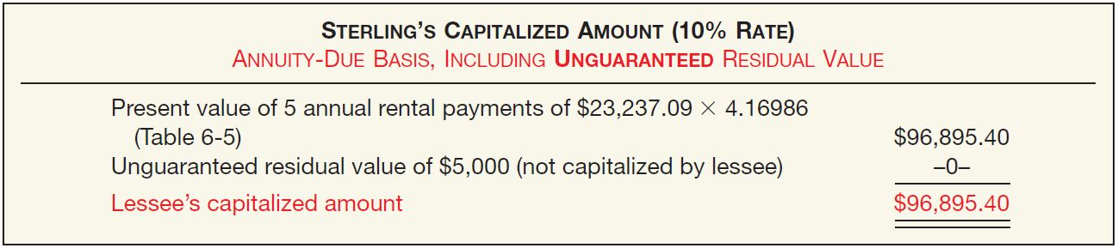
Special Accounting Problems
Illustration (Unguaranteed Residual Value – Lessee Accounting):
Assume the same facts as those above except that the $5,000 residual value is unguaranteed instead of guaranteed. Caterpillar would compute the amount of the lease payments as follows:
Illustration 21-20
LO 7 Describe the effect of residual values, guaranteed and unguaranteed, on lease accounting.

Slide 50
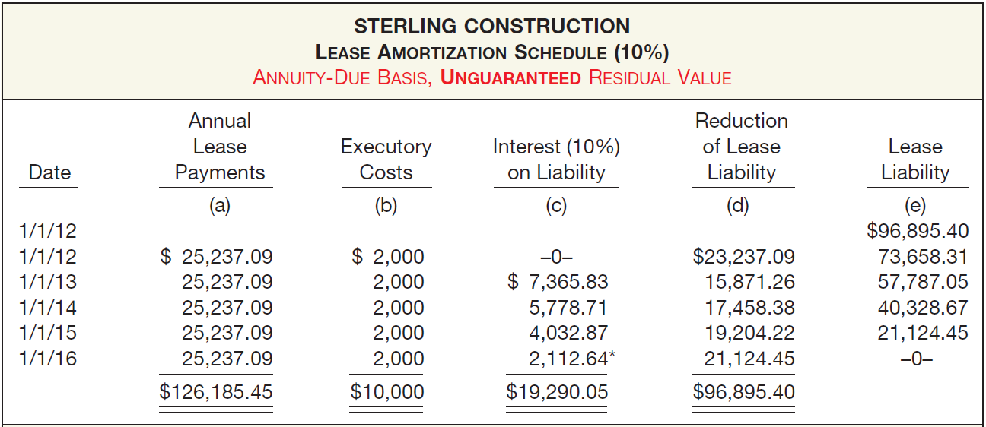
Special Accounting Problems
Illustration (Unguaranteed Residual Value – Lessee Accounting):
Computation of Lease Amortization Schedule
Illustration 21-21
LO 7 Describe the effect of residual values, guaranteed and unguaranteed, on lease accounting.

Slide 51
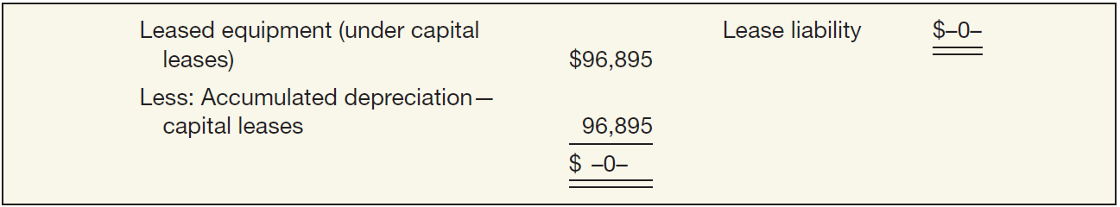
Special Accounting Problems
Illustration (Unguaranteed Residual Value – Lessee Accounting):
At the end of the lease term, before Sterling transfers the asset to Caterpillar, the lease asset and liability accounts have the following balances.
Illustration 21-22
LO 7 Describe the effect of residual values, guaranteed and unguaranteed, on lease accounting.

Slide 52
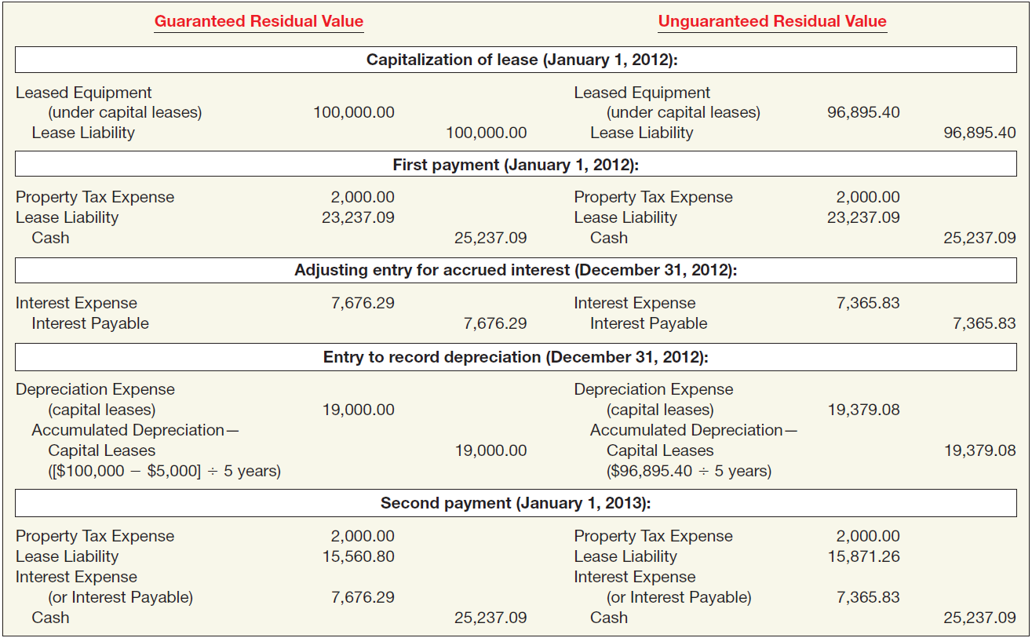
Special Accounting Problems
Comparative Entries, Lessee Company
Illustration 21-23

Slide 53
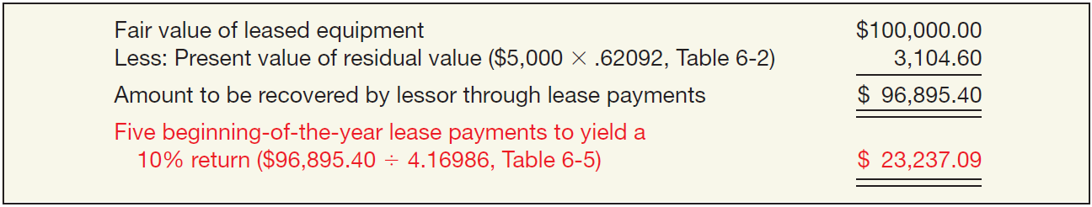
Special Accounting Problems
Lessor Accounting for Residual Value
The lessor works on the assumption that it will realize the residual value at the end of the lease term whether guaranteed or unguaranteed.
Illustration: Assume a direct-financing lease with a residual value (either guaranteed or unguaranteed) of $5,000. Caterpillar determines the payments as follows.
Illustration 21-24
LO 7 Describe the effect of residual values, guaranteed and unguaranteed, on lease accounting.

Slide 54
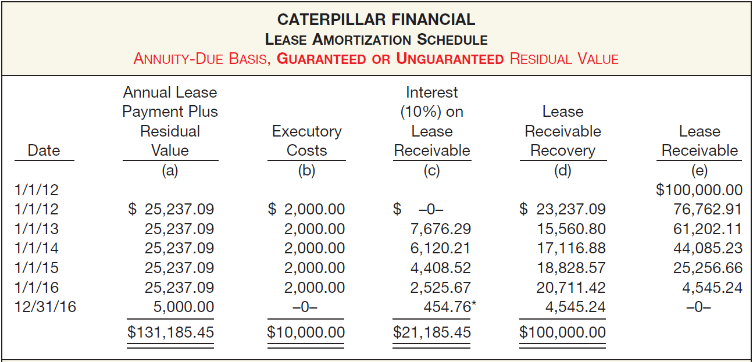
Special Accounting Problems
Lessor Accounting for Residual Value
Illustration: Lease Amortization Schedule, for Lessor.
Illustration 21-25
LO 7

Slide 55
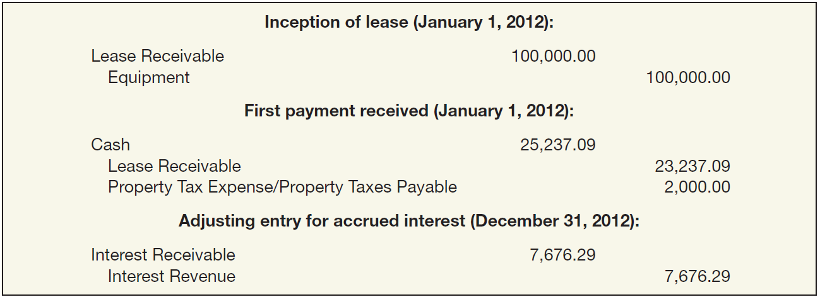
Special Accounting Problems
Lessor Accounting for Residual Value
Illustration: Caterpillar would make the following entries for this direct-financing lease in the first year.
Illustration 21-26
LO 7 Describe the effect of residual values, guaranteed and unguaranteed, on lease accounting.

Slide 56
Special Accounting Problems
Sales-Type Leases (Lessor)
  Primary difference between a direct-financing lease and a sales-type lease is the manufacturer’s or dealer’s gross profit (or loss).
  Lessor records the sale price of the asset, the cost of goods sold and related inventory reduction, and the lease receivable.
  Difference in accounting for guaranteed and unguaranteed residual values.
LO 8 Describe the lessor’s accounting for sales-type leases.

Slide 57
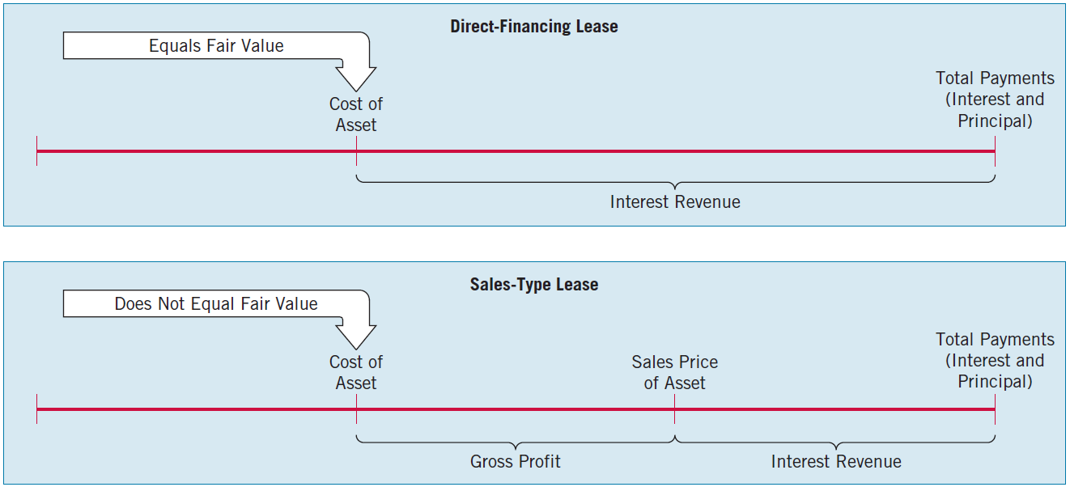
Special Accounting Problems
Sales-Type Leases (Lessor)
Illustration 21-27
LO 8 Describe the lessor’s accounting for sales-type leases.

Slide 58
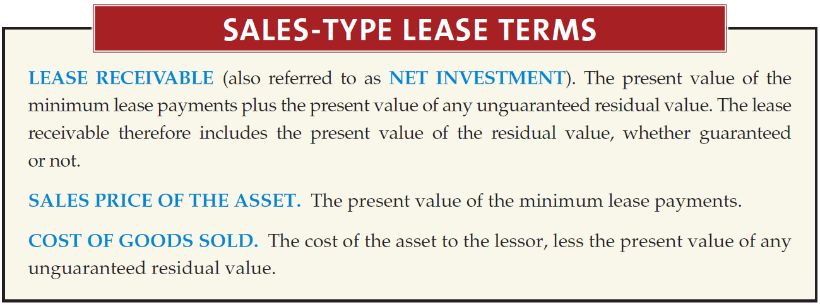
Special Accounting Problems
Sales-Type Leases (Lessor)
LO 8 Describe the lessor’s accounting for sales-type leases.

Slide 59
Special Accounting Problems
Sales-Type Leases (Lessor)
Illustration: To illustrate a sales-type lease with a guaranteed residual value and with an unguaranteed residual value, assume the same facts as in the preceding direct-financing lease situation. The estimated residual value is $5,000 (the present value of which is $3,104.60), and the leased equipment has an $85,000 cost to the dealer, Caterpillar. Assume that the fair market value of the residual value is $3,000 at the end of the lease term.
LO 8 Describe the lessor’s accounting for sales-type leases.

Slide 60
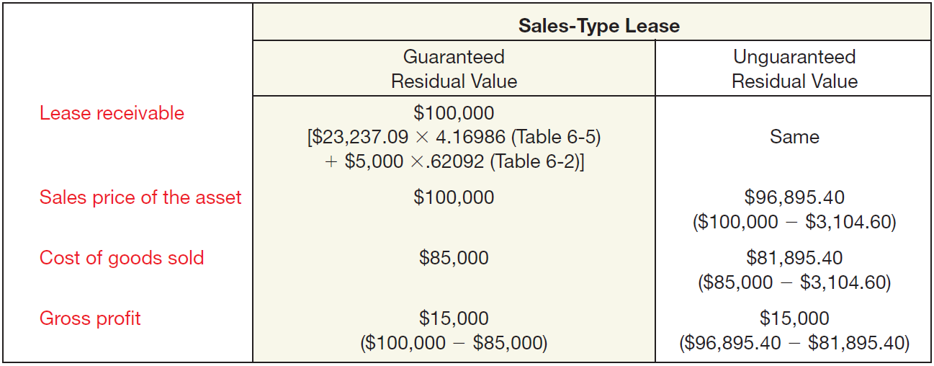
Special Accounting Problems
Sales-Type Leases (Lessor)
Illustration: Computation of Lease Amounts by Caterpillar Financial—Sales-Type Lease
Illustration 21-28
LO 8 Describe the lessor’s accounting for sales-type leases.

Slide 61
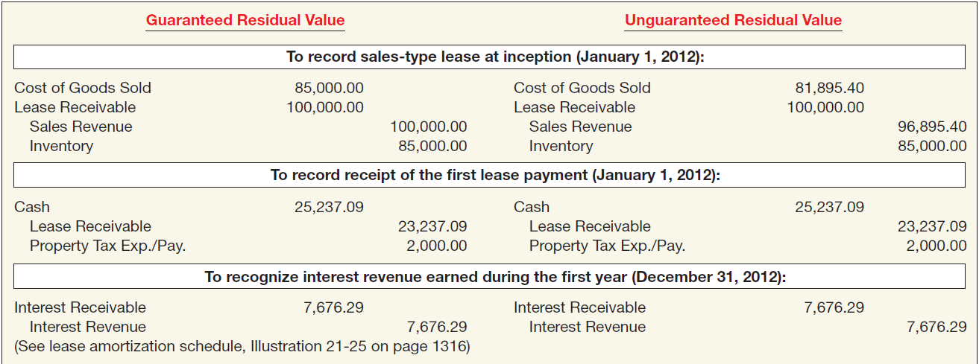
Special Accounting Problems
Sales-Type Leases (Lessor)
Illustration: Caterpillar makes the following entries.
Illustration 21-29
LO 8 Describe the lessor’s accounting for sales-type leases.

Slide 62
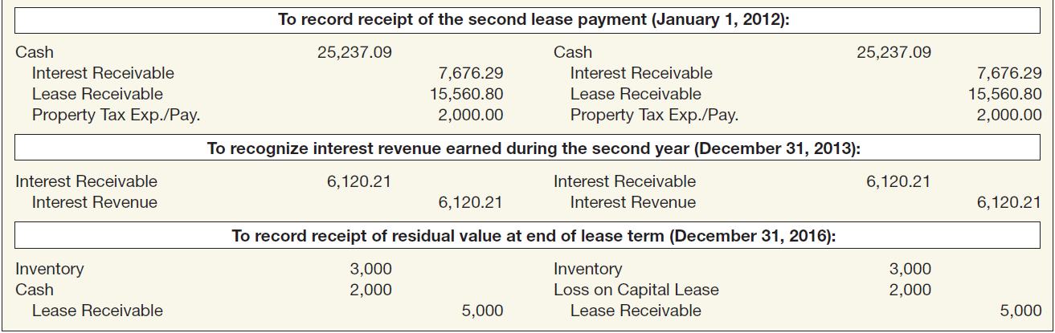
Special Accounting Problems
Sales-Type Leases (Lessor)
Illustration: Caterpillar makes the following entries.
Illustration 21-29
LO 8 Describe the lessor’s accounting for sales-type leases.

Slide 63
Special Accounting Problems
Bargain Purchase Option (Lessee)
  Present value of the minimum lease payments must include the present value of the option.
  Only difference between the accounting treatment for a bargain-purchase option and a guaranteed residual value of identical amounts is in the computation of the annual depreciation.
LO 8 Describe the lessor’s accounting for sales-type leases.

Slide 64
Special Accounting Problems
Initial Direct Costs (Lessor)
Accounting for initial direct costs:
  Operating leases, the lessor should defer initial direct costs.
  Sales-type leases, the lessor expenses the initial direct costs.
  Direct-financing lease, the lessor adds initial direct costs to the net investment.
LO 8 Describe the lessor’s accounting for sales-type leases.

Slide 65
Special Accounting Problems
Current versus Noncurrent
GAAP does not indicate how to measure the current and noncurrent amounts.
For both the annuity-due and the ordinary-annuity situations report the reduction of principal for the next period as a current liability/current asset.
LO 8 Describe the lessor’s accounting for sales-type leases.

Slide 66
Special Accounting Problems
Disclosing Lease Data
For lessees:
  General description of material leasing arrangements.
  Reconciliation between the total of future minimum lease payments at the end of the reporting period and their present value.
  Total of future minimum lease payments at the end of the reporting period, and their present value for periods (1) not later than one year, (2) later than one year and not later than five years, and (3) later than five years.
LO 9 List the disclosure requirements for leases.

Slide 67
Special Accounting Problems
Disclosing Lease Data
  General description of the nature of leasing arrangements.
  The nature, timing, and amount of cash inflows and outflows associated with leases, including payments to be paid or received for each of the five succeeding years.
  The amount of lease revenues and expenses reported in the income statement each period.
  Description and amounts of leased assets by major balance sheet classification and related liabilities.
  Amounts receivable and unearned revenues under lease agreements.
LO 9 List the disclosure requirements for leases.

Slide 68

RELEVANT FACTS
  Both GAAP and IFRS share the same objective of recording leases by lessees and lessors according to their economic substance—that is, according to the definitions of assets and liabilities.
  GAAP for leases uses bright-line criteria to determine if a lease arrangement transfers the risks and rewards of ownership; IFRS is more general in its provisions.
  One difference in IFRS and GAAP is that finance leases are referred to as capital leases in GAAP.
  Under IFRS, lessees and lessors use the same general lease capitalization criteria. GAAP has additional lessor criteria that payments are collectible and there are no additional costs associated with a lease.

Slide 69
RELEVANT FACTS
  IFRS requires that lessees use the implicit rate to record a lease, unless it is impractical to determine the lessor’s implicit rate. GAAP requires use of the incremental rate, unless the implicit rate is known by the lessee and the implicit rate is lower than the incremental rate.
  Under GAAP, extensive disclosure of future noncancelable lease payments is required for each of the next five years and the years thereafter. Although some international companies (e.g., Nokia) provide a year-by-year breakout of payments due in years 1 through 5, IFRS does not require it.

Slide 70
RELEVANT FACTS
  The FASB standard for leases was originally issued in 1976. The standard (SFAS No. 13) has been the subject of more than 30 interpretations since its issuance. The IFRS leasing standard is IAS 17, first issued in 1982. This standard is the subject of only three interpretations. One reason for this small number of interpretations is that IFRS does not specifically address a number of leasing transactions that are covered by GAAP. Examples include lease agreements for natural resources, sale-leasebacks, real estate leases, and leveraged leases.

Slide 71
IFRS SELF-TEST QUESTION
Which of the following is not a criterion for a lease to be recorded as a finance lease?
  There is transfer of ownership.
  The lease is cancelable.
  The lease term is for the major part of the economic life of the asset.
  There is a bargain-purchase option.

Slide 72
IFRS SELF-TEST QUESTION
Under IFRS, in computing the present value of the minimum lease payments, the lessee should:
  use its incremental borrowing rate in all cases.
  use either its incremental borrowing rate or the implicit rate of the lessor, whichever is higher, assuming that the implicit rate is known to the lessee.
  use either its incremental borrowing rate or the implicit rate of the lessor, whichever is lower, assuming that the implicit rate is known to the lessee.
  use the implicit rate of the lessor, unless it is impracticable to determine the implicit rate.

Slide 73
IFRS SELF-TEST QUESTION
A lease that involves a manufacturer’s or dealer’s profit is a (an):
  direct financing lease.
  finance lease.
  operating lease.
  sales-type lease.

