Slide 1
Statement of Cash Flows
23
Intermediate Accounting
Kieso, Weygandt, and Warfield

Slide 2
Section 1 - Preparation of the Statement of Cash Flows
Primary purpose:
To provide information about a company’s cash receipts and cash payments during a period.
Secondary objective:
To provide cash-basis information about the company’s operating, investing, and financing activities.
LO 1 Describe the purpose of the statement of cash flows.

Slide 3
Usefulness of the Statement of Cash Flows
Provides information to help assess:
Entity’s ability to generate future cash flows.
Entity’s ability to pay dividends and meet obligations.
Reasons for difference between net income and net cash flow from operating activities.
Cash and noncash investing and financing transactions.
LO 1 Describe the purpose of the statement of cash flows.

Slide 4
Classification of Cash Flows
Operating Activities
Investing Activities
Financing Activities
Income Statement Transactions
Changes in Investments and Long-Term Asset Items
Changes in Long-Term Liabilities and Stockholders’ Equity
LO 2 Identify the major classifications of cash flows.

Slide 5
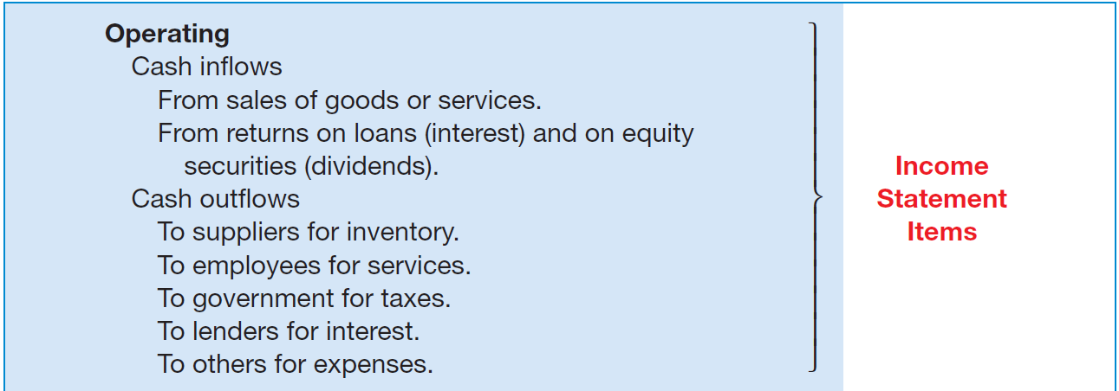
Classification of Cash Flows
Illustration 23-1 Classification of Typical Cash Inflows and Outflows
LO 2 Identify the major classifications of cash flows.

Slide 6
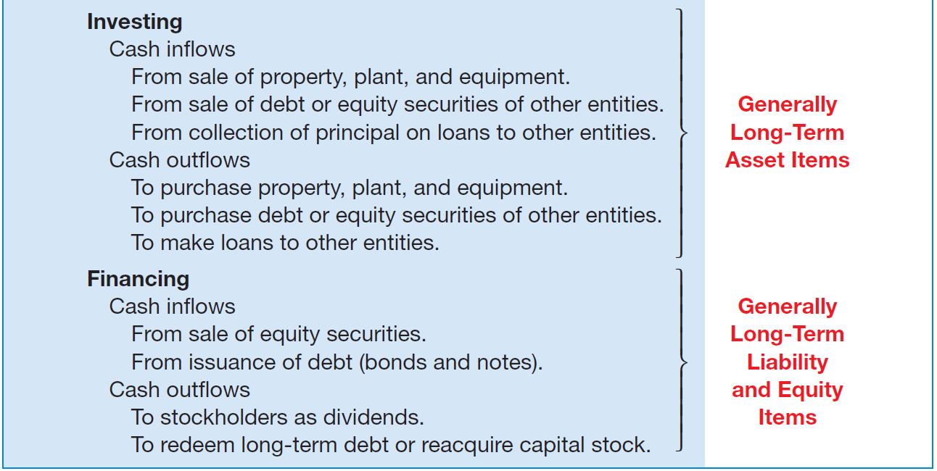
Classification of Cash Flows
Illustration 23-1 Classification of Typical Cash Inflows and Outflows
LO 2 Identify the major classifications of cash flows.

Slide 7
Classification of Cash Flows
The basis recommended by the FASB for the statement of cash flows is actually “cash and cash equivalents.” Cash equivalents are short-term, highly liquid investments that are both:
Readily convertible to known amounts of cash, and
So near their maturity that they present insignificant risk of changes in value (e.g., due to changes in interest rates).
Generally, only investments with original maturities of three months or less qualify under this definition.
LO 2 Identify the major classifications of cash flows.

Slide 8
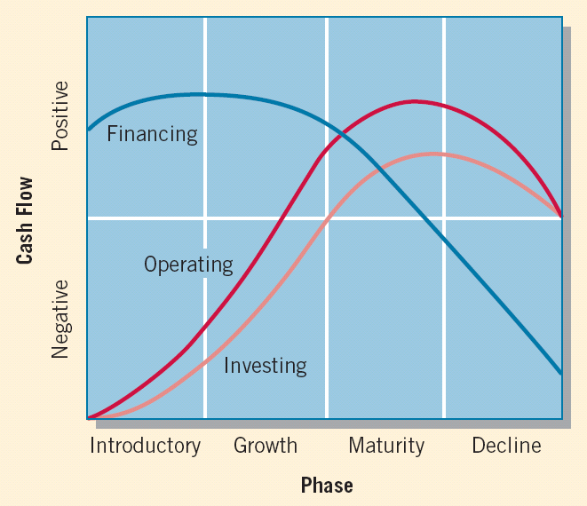
Classification of Cash Flows
Typical Company Product Life Cycle
LO 2 Identify the major classifications of cash flows.

Slide 9
Format of the Statement of Cash Flows
Presentation:
Operating activities.
Investing activities.
Financing activities.
Direct Method
Indirect Method
Report inflows and outflows from investing and financing activities separately.
LO 2 Identify the major classifications of cash flows.

Slide 10
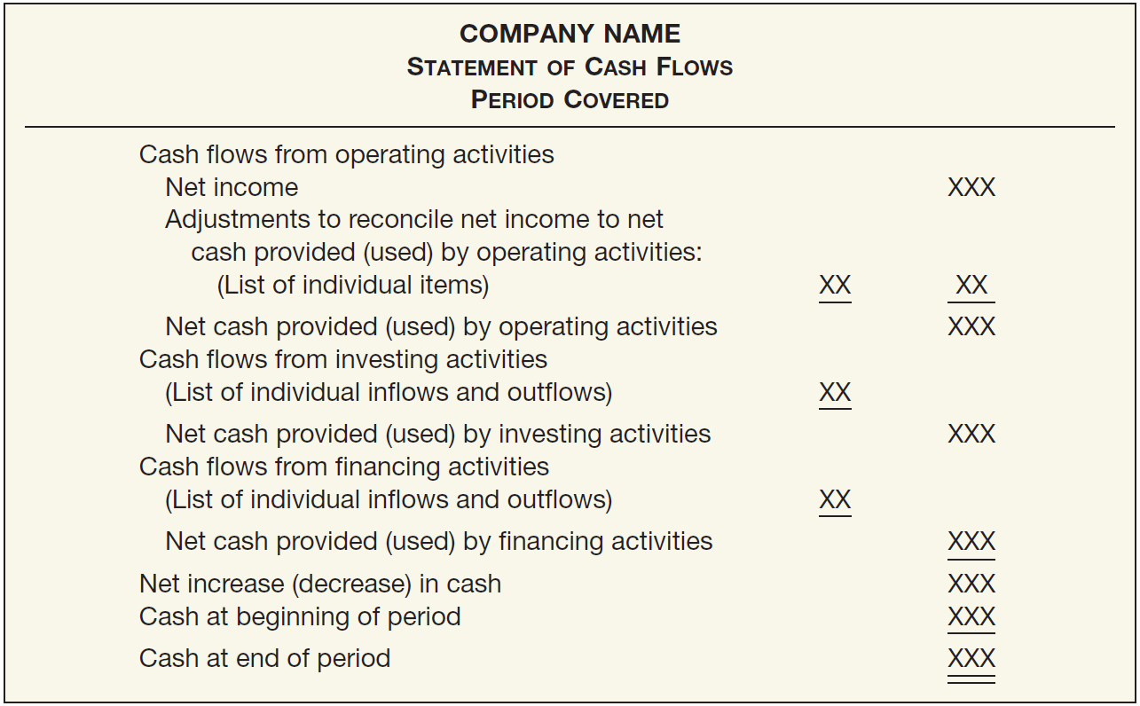
Format of the Statement of Cash Flows
Illustration 23-2
LO 2 Identify the major classifications of cash flows.

Slide 11
Steps in Preparation
Three Sources of Information:
Comparative balance sheets.
Current income statement.
Selected transaction data.
Three Major Steps:
Step 1. Determine change in cash.
Step 2. Determine net cash flow from operating activities.
Step 3. Determine net cash flows from investing and financing activities.
LO 2 Identify the major classifications of cash flows.

Slide 12
First Example - 2011
Illustration: Tax Consultants Inc. started on January 1, 2011, when it issued 60,000 shares of $1 par value common stock for $60,000 cash. The company rented its office space, furniture, and equipment, and performed tax consulting services throughout the first year.
The comparative statements of financial position at the beginning and end of the year 2011 appear in Illustration 23-3. Illustration 23-4 shows the income statement and additional information for Tax Consultants.
LO 2 Identify the major classifications of cash flows.

Slide 13
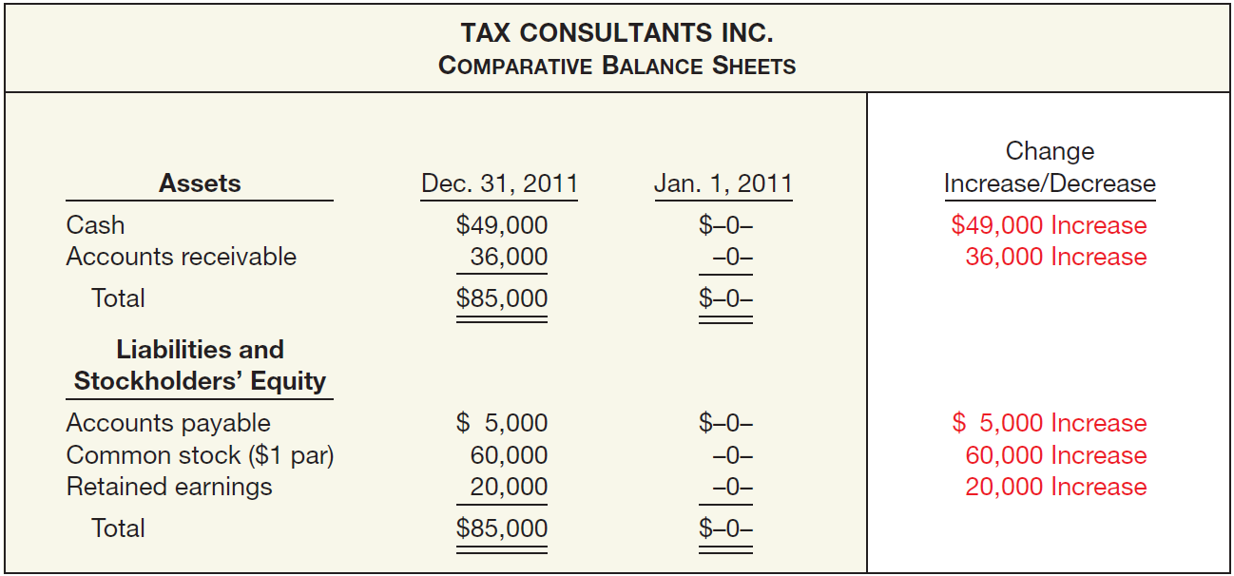
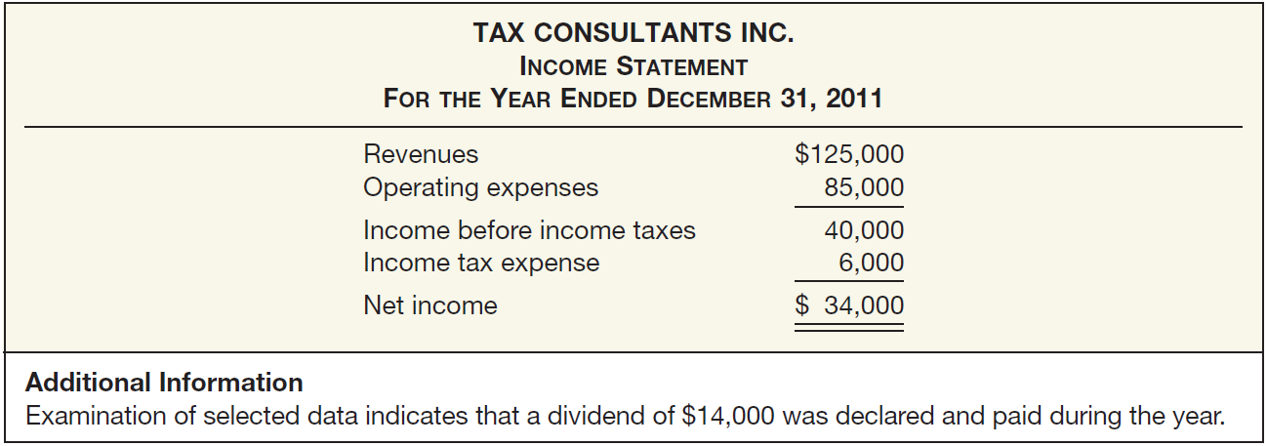
First Example - 2011
Illustration 23-3
Comparative Balance Sheets, Tax Consultants Inc., Year 1
Illustration 23-3
Illustration 23-4
Income Statement, Tax Consultants Inc., Year 1

Slide 14
First Example - 2011
Step 1: Determine the Change in Cash
Illustration 23-3
LO 2 Identify the major classifications of cash flows.

Slide 15
First Example - 2011
Step 2: Determine the Net Cash Flow from Operating Activities
Company must determine revenues and expenses on a cash basis.
Eliminate the effects of income statement transactions that do not result in an increase or decrease in cash.
Convert net income to net cash flow from operating activities through either a direct method or an indirect method.
LO 3 Differentiate between net income and net cash flow from operating activities.

Slide 16
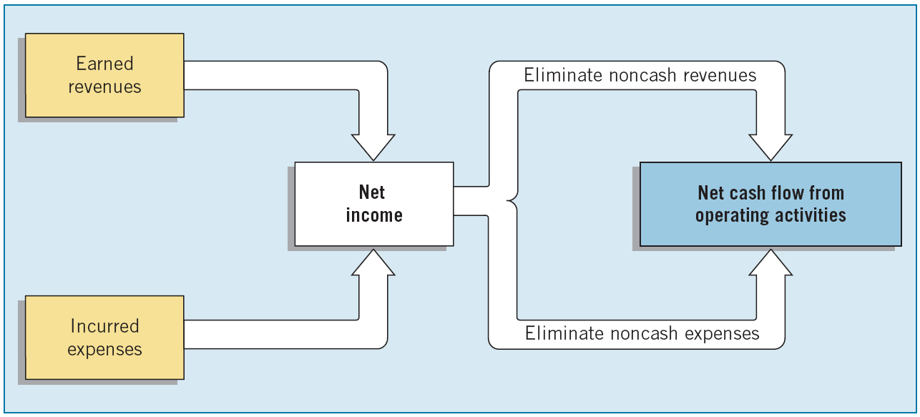
First Example - 2011
Step 2: Determine the Net Cash Flow from Operating Activities
Illustration 23-5
Net Income versus Net Cash Flow from Operating Activities
LO 3 Differentiate between net income and net cash flow from operating activities.

Slide 17
First Example - 2011
Direct Method
Deducts operating cash disbursements from operating cash receipts.
Illustration 23-6
“Net cash provided by operating activities” is the equivalent of cash basis net income.
LO 4 Contrast the direct and indirect methods of calculating net cash flow from operating activities.

Slide 18
First Example - 2011
Direct Method
Illustration 23-6
Accounts Receivable
Illustration 23-7
1/1/11 Balance 0
Receipts from customers 89,000
Revenues 125,000
12/31/11 Balance 36,000
LO 4

Slide 19
First Example - 2011
Direct Method
Illustration 23-6
Accounts Payable
1/1/11 Balance 0
Payments for expenses 80,000
Operating expenses 85,000
12/31/11 Balance 5,000
LO 4

Slide 20
First Example - 2011
Direct Method
Illustration 23-6
Income Tax Payable
1/1/11 Balance 0
Payments for taxes 6,000
Tax expense 6,000
12/31/11 Balance 0
LO 4

Slide 21
First Example - 2011
Indirect Method
Illustration 23-8
Computation of Net Cash
Flow from Operating Activities,
Year 1—Indirect Method
Common adjustments to Net Income (Loss):
Depreciation and amortization expense.
Gain or loss on disposition of long-term assets.
Change in current assets and current liabilities.
LO 4

Slide 22
First Example - 2011
Step 3: Determine Net Cash Flows from Investing and Financing Activities
Illustration 23-3
No long-term assets, thus no investing activities.
LO 5 Determine net cash flows from investing and financing activities.

Slide 23
First Example - 2011
Step 3: Determine Net Cash Flows from Investing and Financing Activities
Illustration 23-3
Purchase of common stock for $60,000 (Financing).
LO 5 Determine net cash flows from investing and financing activities.

Slide 24
First Example - 2011
Step 3: Determine Net Cash Flows from Investing and Financing Activities
Illustration 23-3
Net income of $34,000 (Operating).
Dividends paid of $(14,000) (Financing).
LO 5

Slide 25
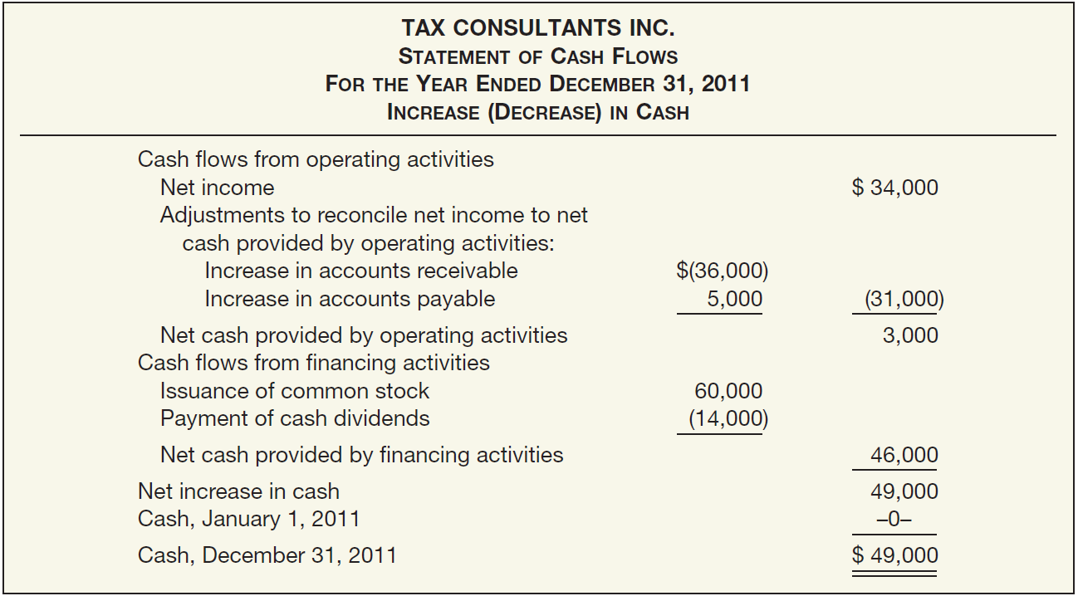
First Example - 2011
Statement of Cash Flows - 2011
Illustration 23-9
LO 6 Prepare a statement of cash flows.

Slide 26
Operating Activities — Indirect Method
E23-6: Norman Company’s financial statements for the year ended December 31, 2012, contained the following condensed information.
LO 4

Slide 27
Operating Activities — Indirect Method
E23-6: Prepare the operating activities section of the statement of cash flows using the indirect method (Step 2).
Advance slide to uncover solution
LO 4

Slide 28
Operating Activities — Direct Method
E23-5: Norman Company’s financial statements for the year ended December 31, 2012, contained the following condensed information.
Assume accounts payable relates to operating expenses.
LO 4

Slide 29
Operating Activities — Direct Method
E23-5: Prepare the operating activities section of the statement of cash flows using the Direct method (Step 2).
Illustration 23-22
Accounts Receivable
1/1/12 Balance 59,000
Receipts from customers 862,000
Revenues 840,000
12/31/12 Balance 37,000
LO 4 Contrast the direct and indirect methods of calculating net cash flow from operating activities.

Slide 30
Operating Activities — Direct Method
E23-5: Prepare the operating activities section of the statement of cash flows using the Direct method (Step 2).
Illustration 23-24
Accounts Payable
1/1/12 Balance 31,000
Payments to suppliers 609,000
Operating expenses 624,000
12/31/12 Balance 46,000
LO 4 Contrast the direct and indirect methods of calculating net cash flow from operating activities.

Slide 31
Operating Activities — Direct Method
E23-5: Prepare the operating activities section of the statement of cash flows using the Direct method (Step 2).
Illustration 23-24
Income Tax Payable
1/1/12 Balance 8,500
Payments for income tax 44,500
Income tax expense 40,000
12/31/12 Balance 4,000
LO 4 Contrast the direct and indirect methods of calculating net cash flow from operating activities.

Slide 32
Operating Activities — Direct Method
E23-5: Prepare the operating activities section of the statement of cash flows using the Direct method (Step 2).
LO 4 Contrast the direct and indirect methods of calculating net cash flow from operating activities.

Slide 33
Step 3: Determine Net Cash Flow from Investing and Financing Activities
E23-2 (a): Plant assets that had cost $25,000 6 years before and were being depreciated on a straight-line basis over 10 years with no estimated scrap value were sold for $5,300.
LO 5 Determine net cash flows from investing and financing activities.

Slide 34
Statement of Cash Flows (a,b,d,h)
O
I
F

Slide 35
E23-2 (b)
E23-2 (b): During the year, 10,000 shares of common stock with a stated value of $10 a share were issued for $33 a share.
LO 5 Determine net cash flows from investing and financing activities.

Slide 36
Statement of Cash Flows (a,b,d,h)
O
I
F

Slide 37
E23-2 (d)
E23-2 (d): The company sustained a net loss for the year of $50,000. Depreciation amounted to $22,000, and a gain of $9,000 was realized on the sale of land for $39,000 cash.
LO 5 Determine net cash flows from investing and financing activities.

Slide 38
Statement of Cash Flows (a,b,d,h)
O
I
F

Slide 39
E23-2 (h)
E23-2 (h): During the year, treasury stock costing $47,000 was purchased.
LO 5 Determine net cash flows from investing and financing activities.

Slide 40
Statement of Cash Flows (a,b,d,h)
O
I
F

Slide 41
Sources of Information for the Statement of Cash Flows
Comparative balance sheets.
An analysis of the Retained Earnings account.
Writedowns, amortization charges, and similar “book” entries, such as depreciation, because they have no effect on cash.
LO 7 Identify sources of information for a statement of cash flows.

Slide 42
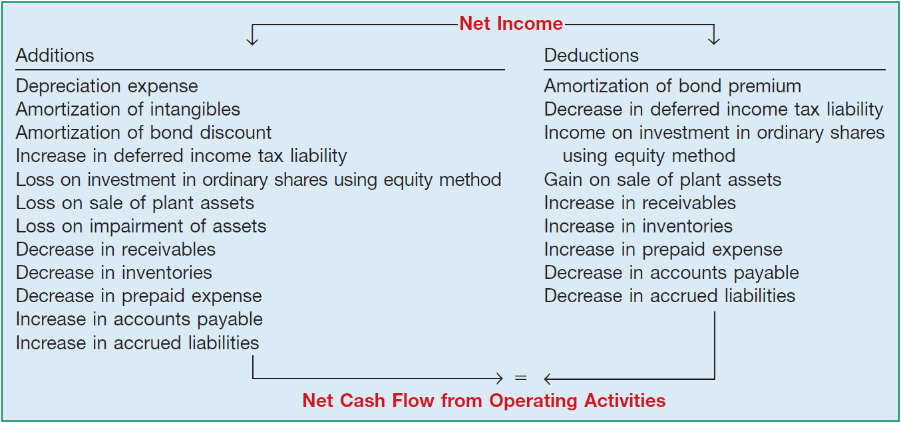
Net Cash Flow from Operating Activities—Indirect Versus Direct Method
Indirect Method
Adjustments Needed to Determine Net Cash Flow from Operating Activities.
Illustration 23-18
LO 7

Slide 43
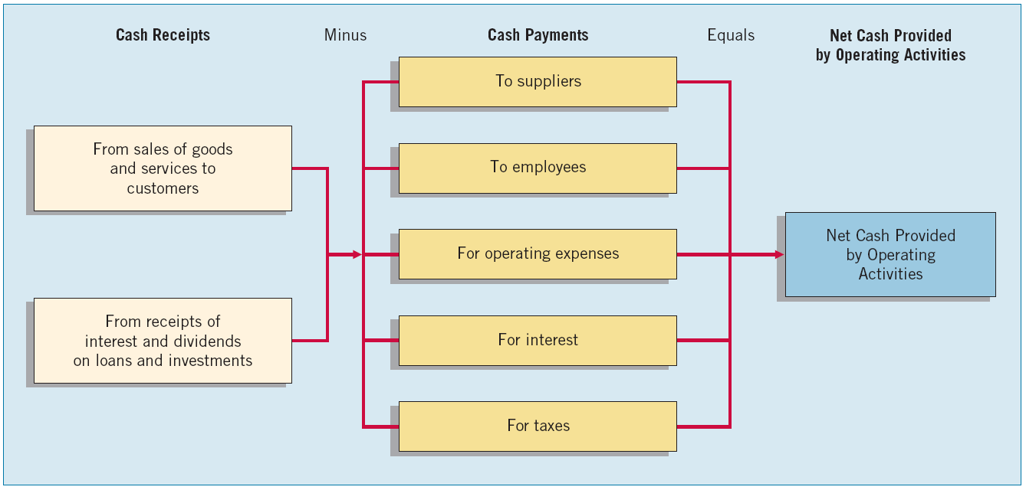
Net Cash Flow from Operating Activities—Indirect Versus Direct Method
Direct Method
Companies adjust each item in the income statement from the accrual basis to the cash basis.
Illustration 23-21
LO 7

Slide 44
Net Cash Flow from Operating Activities—Indirect Versus Direct Method
Direct Versus Indirect Controversy
In Favor of the Direct Method
Shows operating cash receipts and payments.
Information about cash receipts and payments is more revealing of a company’s ability
to generate sufficient cash from operating activities to pay its debts,
to reinvest in its operations, and
to make distributions to its owners.
LO 7 Identify sources of information for a statement of cash flows.

Slide 45
Net Cash Flow from Operating Activities—Indirect Versus Direct Method
Direct Versus Indirect Controversy
In Favor of the Indirect Method
Focuses on the differences between net income and net cash flow from operating activities.
Provides link between the statement of cash flows and the income statement and statement of financial position.
LO 7 Identify sources of information for a statement of cash flows.

Slide 46
Adjustments to Net Income
Depreciation and Amortization
Amortization of limited-life intangible assets.
Amortization of bond discount or premium.
Postretirement Benefit Costs
Company must adjust net income by the difference between cash paid and the expense reported.
LO 8 Discuss special problems in preparing a statement of cash flows.

Slide 47
Adjustments to Net Income
Changes in Deferred Income Taxes
Affect net income but have no effect on cash.
Equity Method of Accounting
Net increase in the investment account does not affect cash flows.
Company must deduct the net increase from net income to arrive at net cash flow from operating activities.
LO 8 Discuss special problems in preparing a statement of cash flows.

Slide 48
Adjustments to Net Income
Loss and Gains
A loss is added to net income to compute net cash flow from operating activities because the loss is a non-cash charge in the income statement.
Company reports a gain in the statement of cash flows as part of the cash proceeds from the sale of equipment under investing activities, thus it deducts the gain from net income to avoid double-counting—once as part of net income and again as part of the cash proceeds from the sale.
LO 8 Discuss special problems in preparing a statement of cash flows.

Slide 49
Adjustments to Net Income
Stock Options
Cash is not affected by recording the expense.
The company must increase net income by the amount of compensation expense from share options in computing net cash flow from operating activities.
LO 8 Discuss special problems in preparing a statement of cash flows.

Slide 50
Adjustments to Net Income
Extraordinary Items
Companies should report either as investing activities or as financing activities cash flows from extraordinary transactions and other events whose effects are included in net income, but which are not related to operations.
LO 8 Discuss special problems in preparing a statement of cash flows.

Slide 51
Accounts Receivable (Net)
Indirect Method
Because an increase in Allowance for Doubtful Accounts results from a charge to bad debt expense, a company should add back an increase in Allowance for Doubtful Accounts to net income to arrive at net cash flow from operating activities.
Illustration 23-28
Accounts Receivable
Balances, Redmark Co.
LO 8 Discuss special problems in preparing a statement of cash flows.

Slide 52
Accounts Receivable (Net)
Indirect Method
One method of presenting this information in the statement of cash flows:
Illustration 23-29
LO 8 Discuss special problems in preparing a statement of cash flows.

Slide 53
Accounts Receivable (Net)
Indirect Method
Alternate method (net approach) of presenting this information in the statement of cash flows:
Illustration 23-30
LO 8 Discuss special problems in preparing a statement of cash flows.

Slide 54
Accounts Receivable (Net)
Direct Method
Company should not net Allowance for Doubtful Accounts against Accounts Receivable.
Illustration 23-31
LO 8 Discuss special problems in preparing a statement of cash flows.

Slide 55
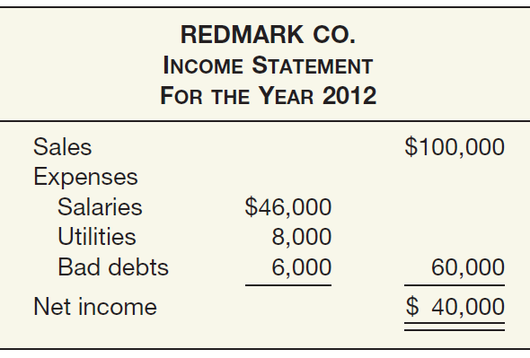
Accounts Receivable (Net)
Illustration 23-31
Direct Method
Company should not net Allowance for Doubtful Accounts against Accounts Receivable.
Illustration 23-32
Cash sales should be reported at $85,000 ($100,000 - 9,000 - 6,000).
Increase in Accounts Receivable
LO 8

Slide 56
Other Working Capital Changes
Some changes in working capital, although they affect cash, do not affect net income.
Purchase of short-term non-trading equity investments.
Issuance of a short-term non-trade note payable for cash.
Cash dividend payable.
LO 8 Discuss special problems in preparing a statement of cash flows.

Slide 57
Net Loss
Illustration: If the net loss is $50,000 and the total amount of charges to add back is $60,000, then net cash provided by operating activities is $10,000.
Illustration 23-33
Computation of Net Cash
Flow from Operating
Activities—Cash Inflow
LO 8 Discuss special problems in preparing a statement of cash flows.

Slide 58
Significant Non-Cash Transactions
Common non-cash transactions that a company should disclose:
Acquisition of assets by assuming liabilities (including finance lease obligations) or by issuing equity securities.
Exchanges of non-monetary assets.
Refinancing of long-term debt.
Conversion of debt or preference shares to ordinary shares.
Issuance of equity securities to retire debt.
LO 8 Discuss special problems in preparing a statement of cash flows.

Slide 59
Use of a Worksheet
A worksheet involves the following steps.
Step 1. Enter the balance sheet accounts and their beginning and ending balances in the balance sheet accounts section.
Step 2. Enter the data that explain the changes in the balance sheet accounts and their effects on the statement of cash flows in the reconciling columns of the worksheet.
Step 3. Enter the increase or decrease in cash on the cash line and at the bottom of the worksheet. This entry should enable the totals of the reconciling columns to be in agreement.
LO 9 Explain the use of a worksheet in preparing a statement of cash flows.

Slide 60
RELEVANT FACTS
Companies preparing financial statements under IFRS must prepare a statement of cash flows as an integral part of the financial statements.
Both IFRS and GAAP require that the statement of cash flows should have three major sections—operating, investing, and financing—along with changes in cash and cash equivalents.
Similar to GAAP, the cash flow statement can be prepared using either the indirect or direct method under IFRS. For both IFRS and GAAP, most companies use the indirect method for reporting net cash flow from operating activities.

Slide 61
RELEVANT FACTS
The definition of cash equivalents used in IFRS is similar to that used in GAAP. A major difference is that in certain situations, bank overdrafts are considered part of cash and cash equivalents under IFRS (which is not the case in GAAP). Under GAAP, bank overdrafts are classified as financing activities.
IFRS requires that non-cash investing and financing activities be excluded from the statement of cash flows. Instead, these non-cash activities should be reported elsewhere. This requirement is interpreted to mean that non-cash investing and financing activities should be disclosed in the notes to the financial statements instead of in the financial statements. Under GAAP, companies may present this information in the cash flow statement.

Slide 62
RELEVANT FACTS
One area where there can be substantive differences between IFRS and GAAP relates to the classification of interest, dividends, and taxes. IFRS provides more alternatives for disclosing these items, while GAAP requires that except for dividends paid (which are classified as a financing activity), these items are all reported as operating activities.

Slide 63
IFRS SELF-TEST QUESTION
Which of the following is true regarding the statement of cash flows under IFRS?
The statement of cash flows has two major sections—operating and nonoperating.
The statement of cash flows has two major sections—financing and investing.
The statement of cash flows has three major sections—operating, investing, and financing.
The statement of cash flows has three major sections—operating, non-operating, and financing.

Slide 64
IFRS SELF-TEST QUESTION
In the case of a bank overdraft:
GAAP typically includes the amount in cash and cash equivalents.
IFRS typically includes the amount in cash equivalents but not in cash.
GAAP typically treats the overdraft as a liability, and reports the amount in the financing section of the statement of cash flows.
IFRS typically treats the overdraft as a liability, and reports the amount in the investing section of the statement of cash flows.

Slide 65
IFRS SELF-TEST QUESTION
For purposes of the statement of cash flows, under IFRS interest paid is treated as:
an operating activity in all cases.
an investing or operating activity, depending on use of the borrowed funds.
either a financing or investing activity.
either an operating or financing activity, but treated consistently from period to period.

